Slide 1
Strategy Pattern
Intent
Motivation
Applicability
Structure
Consequences

Slide 2
Intent
Define a family of algorithms, encapsulate each one, and make them interchangeable to let clients and algorithms vary independently from the clients that use it.
Motivation
Often there are different algorithms that are appropriate at different times for different classes. Hard-wiring such algorithms for such clients can make the code more complex and make it more vulnerable to breaking. Also adding new algorithms or varying them can be a pain if the previous approach is used. These can be avoided by encapsulating the algorithms also known as strategy.

Slide 3
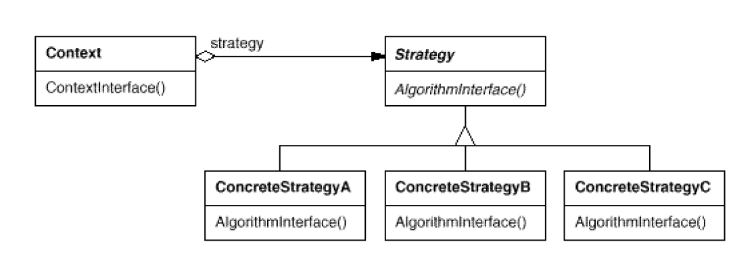
Applicability
When an object should be configurable with one of many algorithms
All algorithms can be encapsulated
One interface covers all encapsulations.
Structure

Slide 4
Consequences
Dynamicity: Algorithms can change dynamically
Flexibility: Support a variety of algorithms
Strategies eliminate conditional statements
Overhead: Communication overhead between strategy and context
Memory: Increased number of objects
Implementation
Exchanging information between a Strategy and its context
Static strategy selection via parameterized types

Slide 5
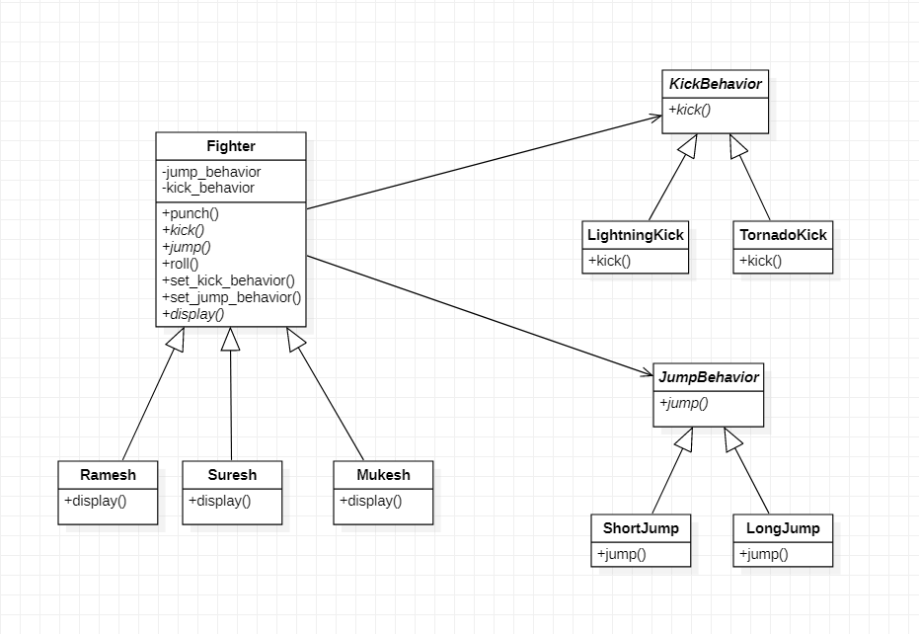
Current Example

