Slide 1
Template Pattern
Intent
Motivation
Applicability
Structure
Consequences

Slide 2
Intent
Provide a skeleton of an algorithm in a method, deferring some steps to subclasses
Motivation
A template method defines an algorithm in terms of abstract operations that subclasses override to provide concrete behavior. It implements the constant parts of an algorithm and leaves it up to the subclasses to implement the behavior that can vary

Slide 3
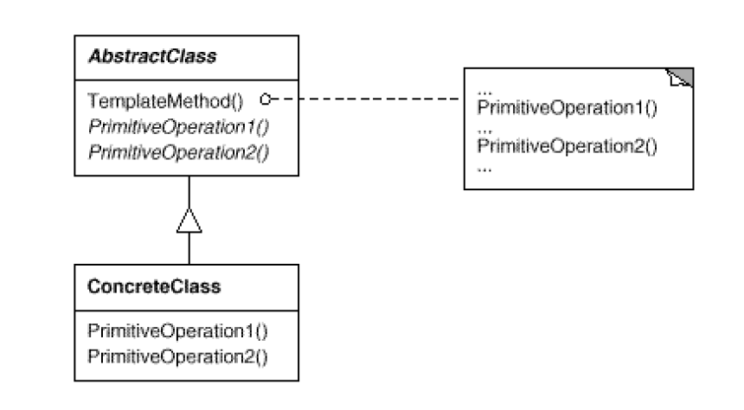
Applicability
Implement invariant aspects of an algorithm once and let subclasses define variant parts
Localize common behavior in a class to increase code reuse Control subclass extensions
Structure

Slide 4
Consequences
Inversion of control: Leads to inversion of control
Reusability: Promotes code reuse
Overriding: Lets you enforce overriding rules
Forced sub classing: Must subclass to specialize behavior
Implementation
Minimizing primitive operations
Naming convention
Virtual vs non-virtual template method

Slide 5
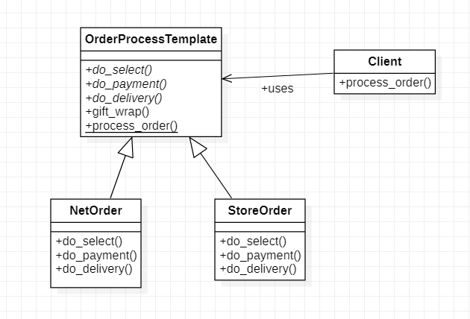
Current Example

