Slide 1
Builder Pattern
Intent
Motivation
Applicability
Structure
Consequences

Slide 2
Intent
Separate the construction of a complex object from its representation so that the same construction process can create different representations.
Motivation
Consider an example where a house is to be built. Each house can be built differently by building different components of the house separately using different build methods. A set of these build methods can be called by a constructor class that would call all those builder methods specific to that type in a particular order and return a built house object.

Slide 3
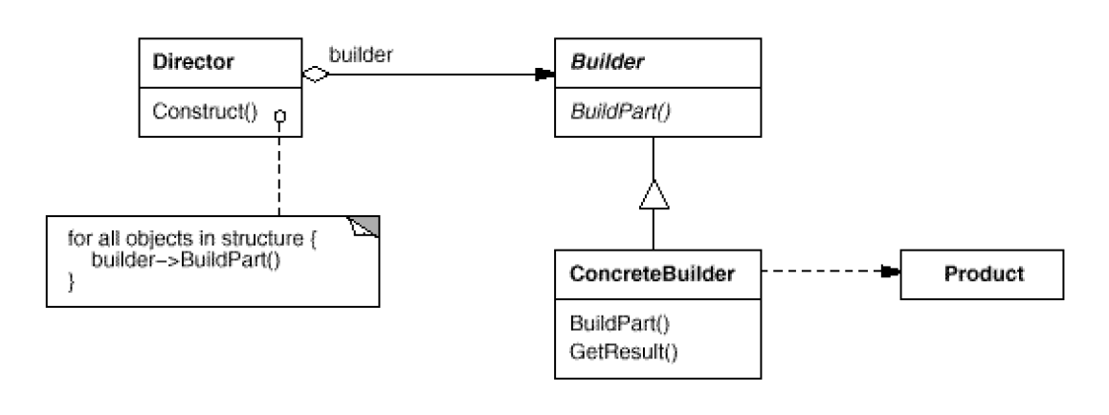
Applicability
Need to isolate knowledge of the creation of a complex object from its parts.
Need to allow different implementations/interfaces of an object’s parts.
Structure

Slide 4
Consequences
Can vary product’s internal representation
Isolates code for construction and representation
Finer control over the construction process
Can involve lots of classes
Implementation
Builder interface should be general enough for all kind of concrete builder
Several implementations are wired together

Slide 5
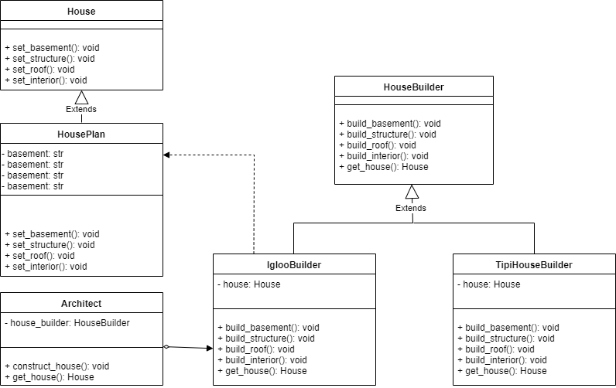
Class diagram of example application

