Slide 1
Interpreter Pattern
Intent
Motivation
Applicability
Structure
Consequences

Slide 2
Intent
Given a language, define a representation for its grammar along with an interpreter that uses the representation to interpret sentences in the language
Motivation
Expressing instances of a problem as sentences in a simple language and interpreting them using an interpreter.

Slide 3
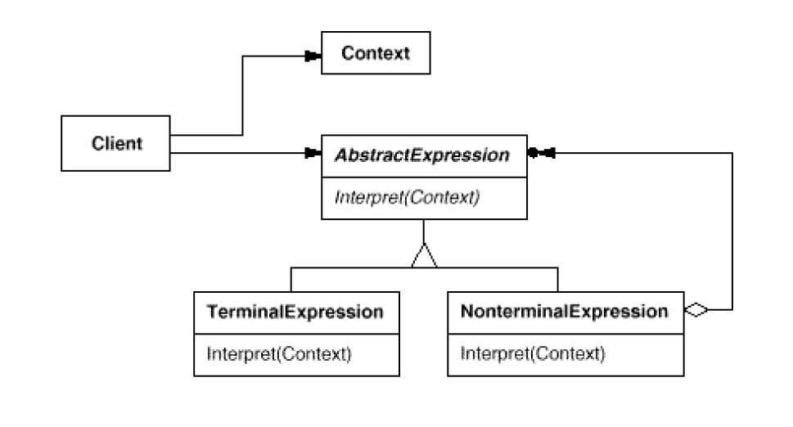
Applicability
When the grammar is simple and relatively stable
Efficiency is not a critical concern.
Structure

Slide 4
Consequences
Extensibility: Easy to change and extend the grammar.
Ease of grammar implementation: Implementing the grammar is easy too.
Complex grammar: Complex grammar are hard to maintain.
Implementation
For each subclass create an interpret operation to match the given context.
Use a class to represent each grammar rule.

Slide 5
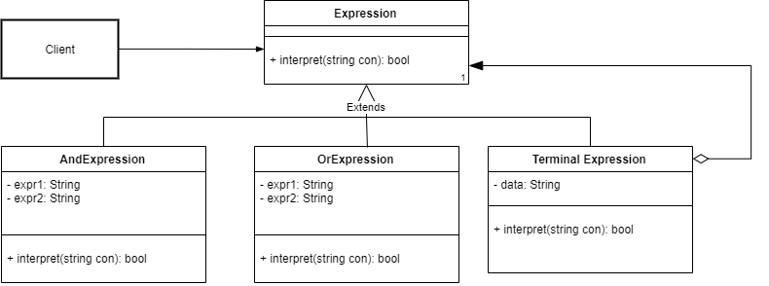
Class diagram of example application

