Slide 1
Facade Pattern
Intent
Motivation
Applicability
Structure
Consequences
Current Example

Slide 2
Intent
Provide a unified interface to a set of interfaces in a subsystem. Facade defines a higher-level interface that makes the subsystem easier to use.
Motivation
Structuring a system into subsystems helps reduce complexity. A common design goal is to minimize the communication and dependencies between subsystems. One way to achieve this goal is to introduce a facade object that provides a single, simplified interface to the more general facilities of a subsystem.

Slide 3
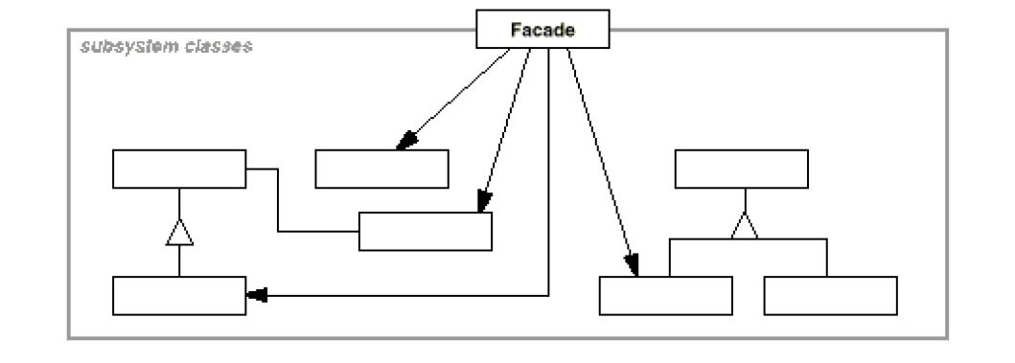
Applicability
When you want to provide a simple interface to a complex subsystem
When there are many dependencies between clients and the implementation classes of an abstraction
When you want to define an entry point to each subsystem level. Dependent subsystems can communicate with each other solely through their facades.
Structure

Slide 4
Consequences
Shielding: Shields clients from subsystem components, thereby reducing the number of objects that clients deal with thus making the subsystem easier to use.
Weak coupling: Promotes weak coupling between the subsystem and its clients
Implementation
Client-subsystem coupling can be reduced even further by making Façade an abstract class with concrete subclasses for different implementations of a subsystem.
Not all languages support private classes and so making subsystem classes private although useful may not be always possible.

Slide 5
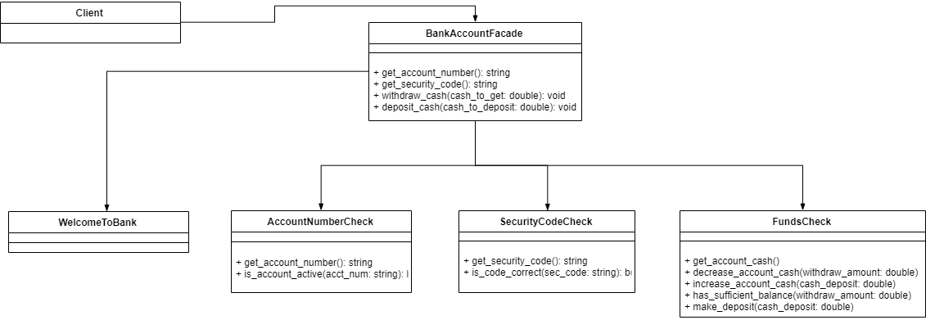
Current Example

