Slide 1
Flyweight Pattern
Intent
Motivation
Applicability
Structure
Consequences

Slide 2
Intent
Use sharing to support large numbers of fine-grained objects efficiently.
Motivation
Let’s say an object-oriented document editor wants to represent characters as objects to provide greater flexibility. However, this will consume a lot of memory if designed in this way. The flyweight pattern describes sharing of objects to allow their use at fine granularities without prohibitive cost.

Slide 3
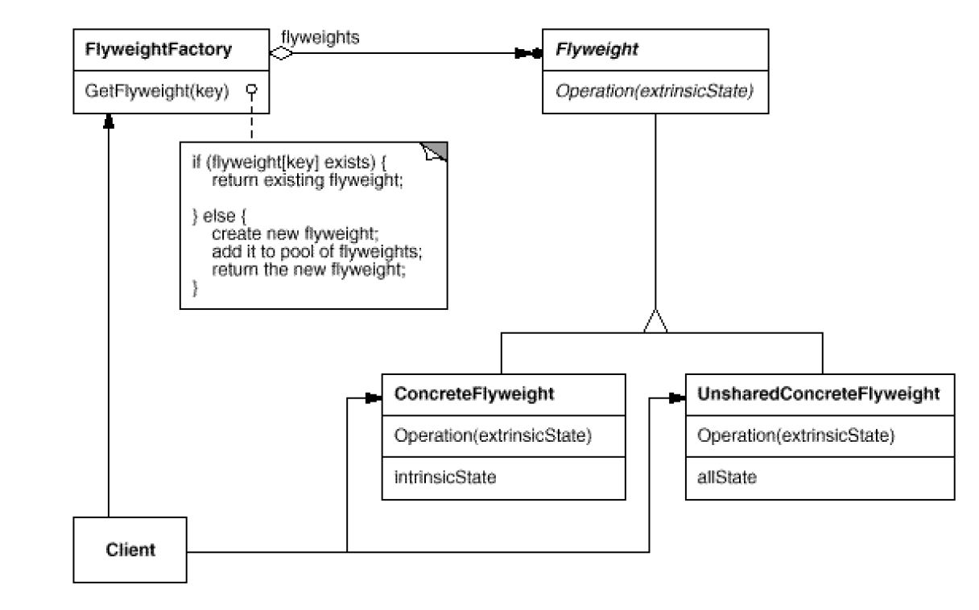
Applicability
When classes define many unrelated operations
Class relationships of objects in the structure rarely change, but the operations on them change often
Algorithms keeps state that is updated during traversal
Structure

Slide 4
Consequences
Space savings: Although flyweights incur run-time costs, a very high number of shared instances can outweigh them.
In a graph with shared leaf nodes, leaf flyweights cannot store a reference to their parent. Rather the parent reference is passed to the flyweight as part of its extrinsic state.
Implementation
Removing extrinsic state: Removing extrinsic state won’t help reduce storage costs if there are as many different kinds of extrinsic state as there are objects before sharing
Since the objects are shared, a client shouldn’t instantiate them directly but rather use a factory that allows the client to look up objects of their interests

Slide 5
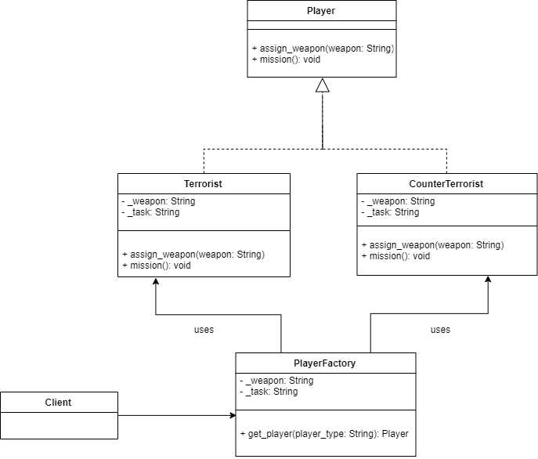
Current Example

