Slide 1
Proxy Pattern
Intent
Motivation
Applicability
Structure
Consequences

Slide 2
Intent
The intent of this pattern is to provide a Placeholder for an object to control references to it.
Motivation
Sometimes we need the ability to control the access to an object. For example if we need to use only a few methods of some costly objects we'll initialize those objects when we need them entirely. Until that point we can use some light objects exposing the same interface as the heavy objects. These light objects are called proxies and they will instantiate those heavy objects when they are really need and by then we'll use some light objects instead.

Slide 3
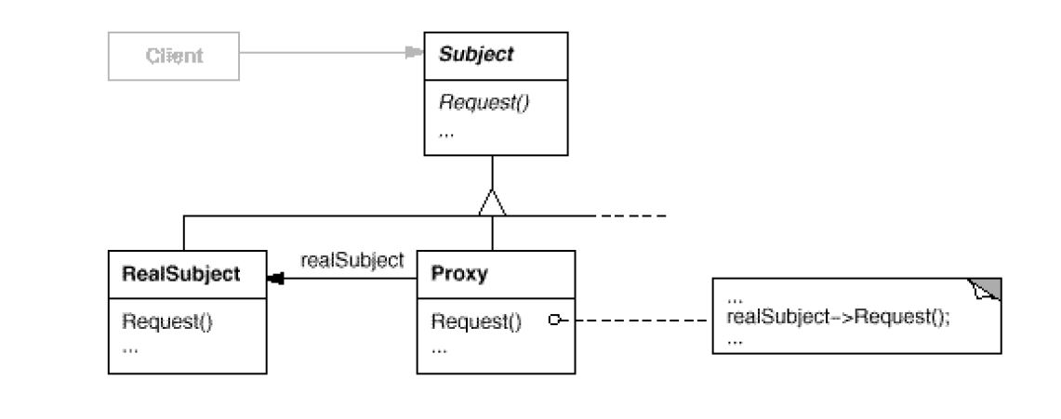
Applicability
Virtual Proxies: delaying the creation and initialization of expensive objects until needed, where the objects are created on demand
Remote Proxies: providing a local representation for an object that is in a different address space.
Protection Proxies: where a proxy controls access to RealSubject methods, by giving access to some objects while denying access to others
Structure

Slide 4
Consequences
Indirection: Pattern involves a level of indirection when accessing an object.
Disparate behavior: If clients are accessing both the RealSubject and the Proxy classes
Implementation
Proxy doesn’t always have to know all the types of RealSubject i.e., if it can deal with the subject through an uniform abstract interface.
Referring to the subject before it’s instantiated. Some form of address space-independent object identifiers must be used

Slide 5
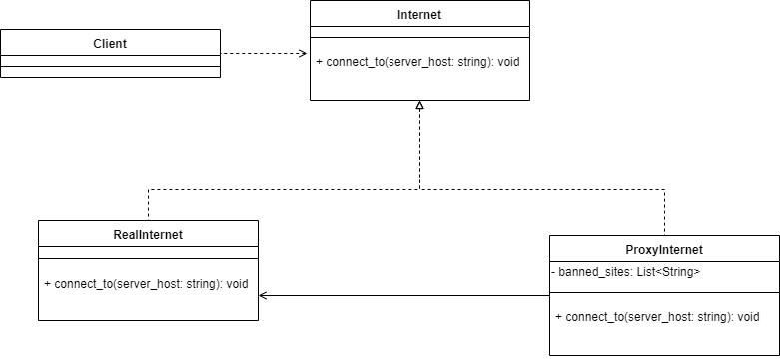
Current Example

