Slide 1
Decorator Pattern
Intent
Motivation
Applicability
Structure
Consequences
Current Example UML diagram

Slide 2
Intent
Attach additional responsibilities to an object dynamically. Decorators provide a flexible alternative to sub-classing for extending functionality
Motivation
Sometimes we want to add behavior to an individual object rather than the entire class. For example, a pizza can be formed with multiple toppings. Not all toppings may be required for every pizza. Also, the price of toppings may vary which should reflect in the pizza. Rather than inheriting such toppings for different kinds of pizza, a topping decorator with a particular behavior can be added to a pizza object.

Slide 3
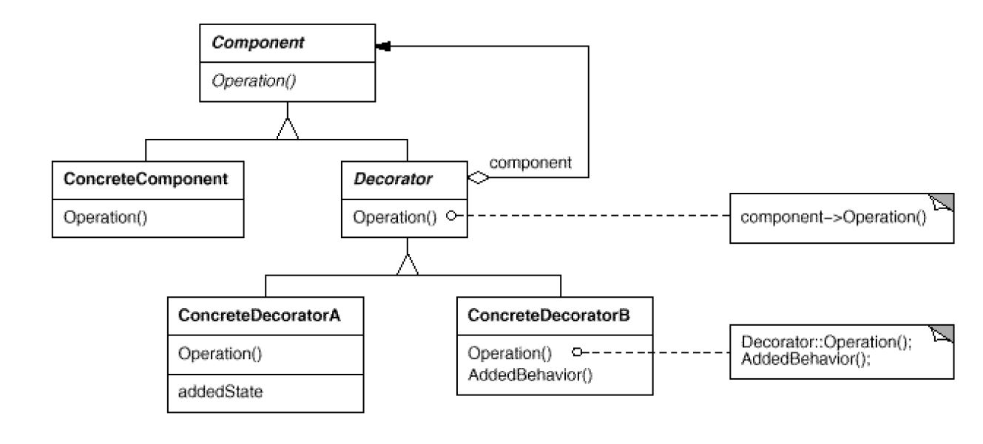
Applicability
To add responsibilities to individual objects dynamically and transparently without affecting other objects.
For responsibilities that can change or be withdrawn.
When extension using sub-classing is impractical.
Structure

Slide 4
Consequences
No unnecessary overhead: Don’t have to add features high up in hierarchy.
Flexibility: More flexibility than static inheritance
Similarity: The decorator is not identical with component hence object identity shouldn’t be relied on while using decorators.
Little objects: A system composed of lots of little objects can be hard to learn and debug
Implementation
Interface conformance: Both the decorator and the component it is decorating should have the same interface.
There’s no need to have an abstract decorator class when only one responsibility needs to be added to the component.
For interface conformance components and decorators must descend from a common Component class

Slide 5
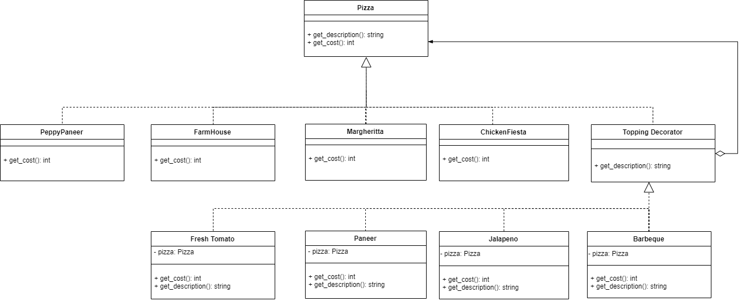
Current Example

