Slide 1
Adapter Pattern
Intent
Motivation
Applicability
Structure
Consequences

Slide 2
Intent
Convert the interface of a class into another interface that the clients expect. The pattern lets otherwise incompatible interfaces to work together.
Motivation
Sometimes, a class that’s designed for reuse isn’t reusable only because its interface doesn’t match the domain-specific interface an application requires.
For example, in a drawing editor which lets user draw and arrange different shapes implementing text can be quite difficult. However, if there is already an implemented class that provides partial functionality but is incompatible with client’s interface then adapter pattern can be used.

Slide 3
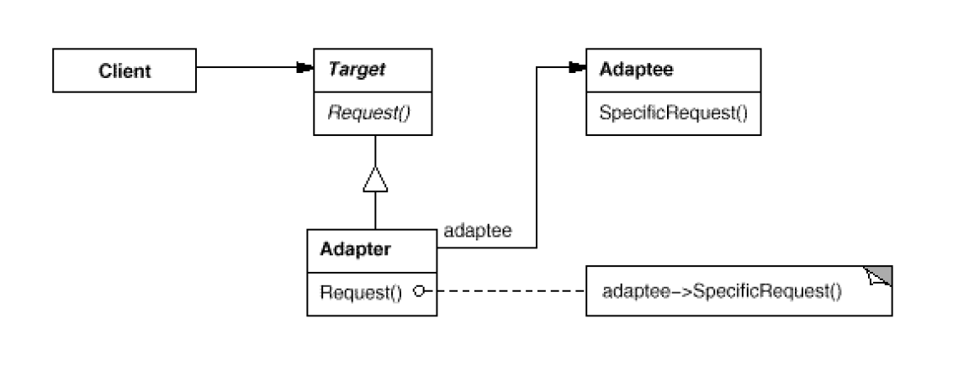
Applicability
When there is a need to use an existing class, but its interface does not match the one needed
When there is need to use several existing subclasses, but it is not practical to adapt their interfaces by subclassing each one.
Structure

Slide 4
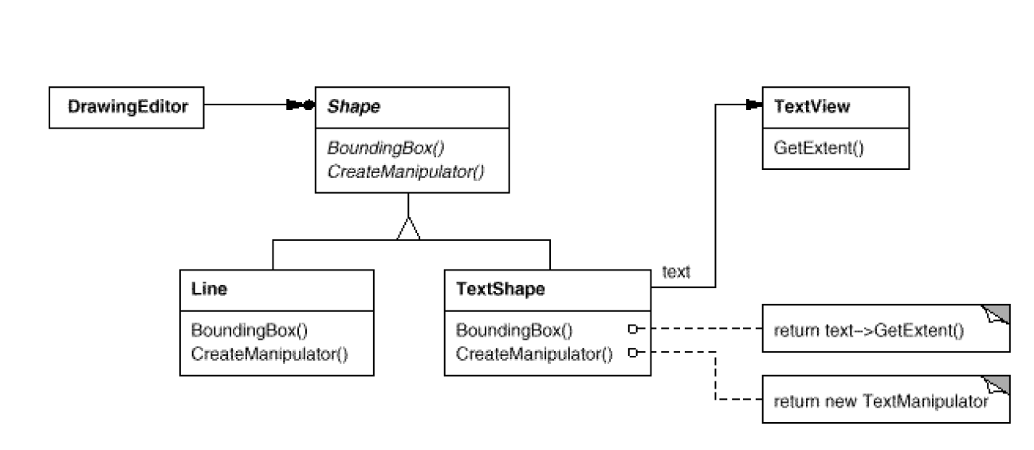
Consequences
+ A single adapter can work with multiple Adaptees
Can make it harder t override Adaptee behavior
Current example

