Slide 1
Singleton Pattern
Intent
Motivation
Applicability
Structure
Consequences

Slide 2
Intent
A class only has one instance, and provide a global point of access to it.
Motivation
For example, there can be multiple celestial bodies in an universe but there should only be one universe object.
As another example, there can be many printers in a system but there should be only one printer spooler.

Slide 3
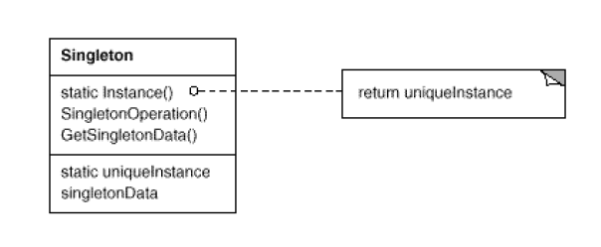
Applicability
When there must be exactly one instance of a class, and it must be accessible to clients from a well known access point.
When the sole instance should be extensible by subclasssing, and clients should be able to use an extended instance without modifying their code.
Structure

Slide 4
Pros
Reduced namespace
Permits a variable number of instances
Subclassing is possible
Cons
Introduces a global state
Cannot run multiple unit tests in parallel

