Slide 1
Review of Design Patterns for IIoT

Slide 2
What is IIoT?
Applications of the IIoT
Challenges of building IIoT applications
What are design patterns and why do we need them?
Identification of design patterns

Slide 3
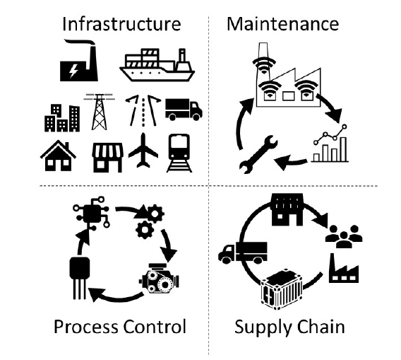
Applications of the Industrial Internet of Things
Infrastructure
Supply chain
Process control
Maintenance

Slide 4
Applications of the Industrial Internet of Things
Infrastructure
Assimilate energy use related data via smart grids for consumption analysis and solutions to reduce cost.
Smart cities
Supply chain
Track products from the production line until point-of-sale.
Improve business intelligence
Process Control
Predict future breakdowns to reduce plant downtime using big data analytics
Real – time networks to communicate between sensors, controllers, and gateways.
Maintenance
Predictive maintenance

Slide 5
Challenges
Interoperability
Open software interfaces
Platform – independence
Embedded platforms, web environments as well as classic desktop OS need to be supported
Scalability
Data processing on different nodes. Nodes can be scaled up and down
System should scale without an impact on performance
Security
Cyberattacks threaten physical as well as financial loss
Design Challenges
Interoperability
Security
Scalability

Slide 6
Design Patterns in IIoT
Solutions to the mentioned challenges address a recurring design problem.
Identification of a set of design patterns found in IIoT applications facilitate improved understanding of the solutions to the challenges as well as the challenges themselves.
The Gang of Four (GoF) patterns are often the basis for other patterns that address specific challenges.
Review of and understanding GoF’s applicability to these issues assist in identifying suitable resource allocation, data analytics frameworks, asset selection and security measures.

Slide 7
IoT for Conveyor Belt
Industries such as mining industries, manufacturing industries and warehouses use a conveyor belt to drive machineries and products often over a long route.
Conveyor system consists of several parts: belt-drive system, head pulley, tail pulley, etc.
Failed component can contribute to a significant downtime and potential losses for an industry
Inspection and monitoring of such components can become very difficult

Slide 8
IoT for Conveyor Belt – Solutions
Remote Monitoring
Components such as idler rolls can be monitored accurately in real time from a remote location
Identification of Failed Parts
This can allow a support team to move quickly, reducing downtime
Predictive Maintenance
Analysis of data collected from different sensors monitoring different parameters can be used to predict possible defects, better manage maintenance and reduce overall downtime.

Slide 9
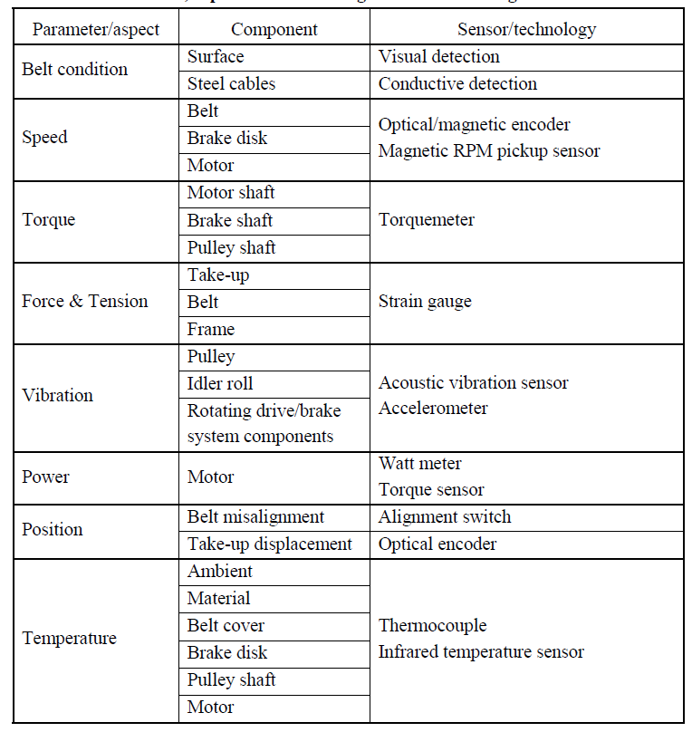
IoT for Conveyor Belt – Remote Monitoring

Slide 10
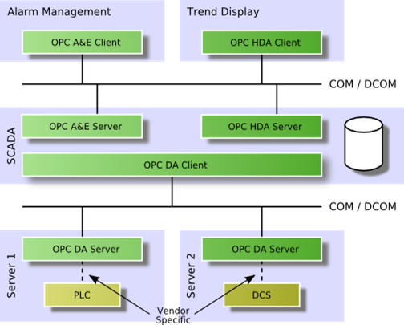
Challenges in Remote Monitoring - Interoperability
Sensors and technologies might come from different vendors.
Heterogeneous software components might need to interact
For example, server could be on a Windows platform while the edge can be on a UNIX based OS.

Slide 11
Useful Patterns
Adapter Pattern – Useful for legacy code
Proxy Pattern – A machine that provides an interface on behalf of another interface
Bridge Pattern – Platform Independence

Slide 12
Challenges in Remote Monitoring - Scalability
Adding newer sensors, increasing sampling time, size of data, can all impact the traffic that is received which ultimately requires scalable solutions.

Slide 13
Useful Patterns
Façade Pattern
Scalable adapter design pattern
Map Reduce (From big data)

Slide 14
Challenges in Remote Monitoring - Security
Tackling security issues such as authentication, access control, encryption, privacy, firewall and accounting.

Slide 15
Secured patterns
Secure design patterns aim to eliminate the accidental insertion of vulnerabilities due to design pattern usage.
Patterns that have been secured or form basis of security design patterns
Abstract Factory Pattern
Strategy Pattern
Mediator Pattern
Singleton Pattern

Slide 16
Design Patterns

Slide 17
Adapter Pattern
Intent
Motivation
Applicability
Structure
Consequences

Slide 18
Intent
Convert the interface of a class into another interface that the clients expect. The pattern lets otherwise incompatible interfaces to work together.
Motivation
Sometimes, a class that’s designed for reuse isn’t reusable only because its interface doesn’t match the domain-specific interface an application requires.
For example, in a drawing editor which lets user draw and arrange different shapes implementing text can be quite difficult. However, if there is already an implemented class that provides partial functionality but is incompatible with client’s interface then adapter pattern can be used.

Slide 19
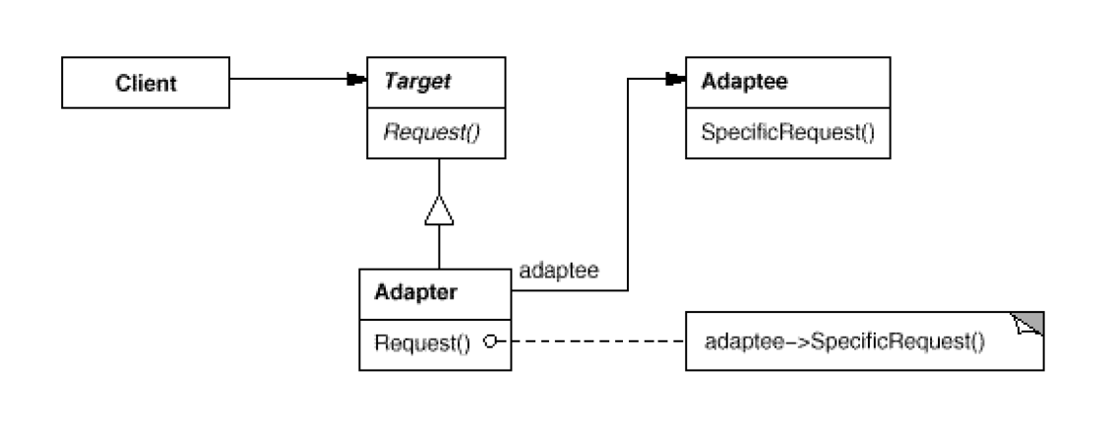
Applicability
When there is a need to use an existing class, but its interface does not match the one needed
When there is need to use several existing subclasses, but it is not practical to adapt their interfaces by subclassing each one.
Structure

Slide 20
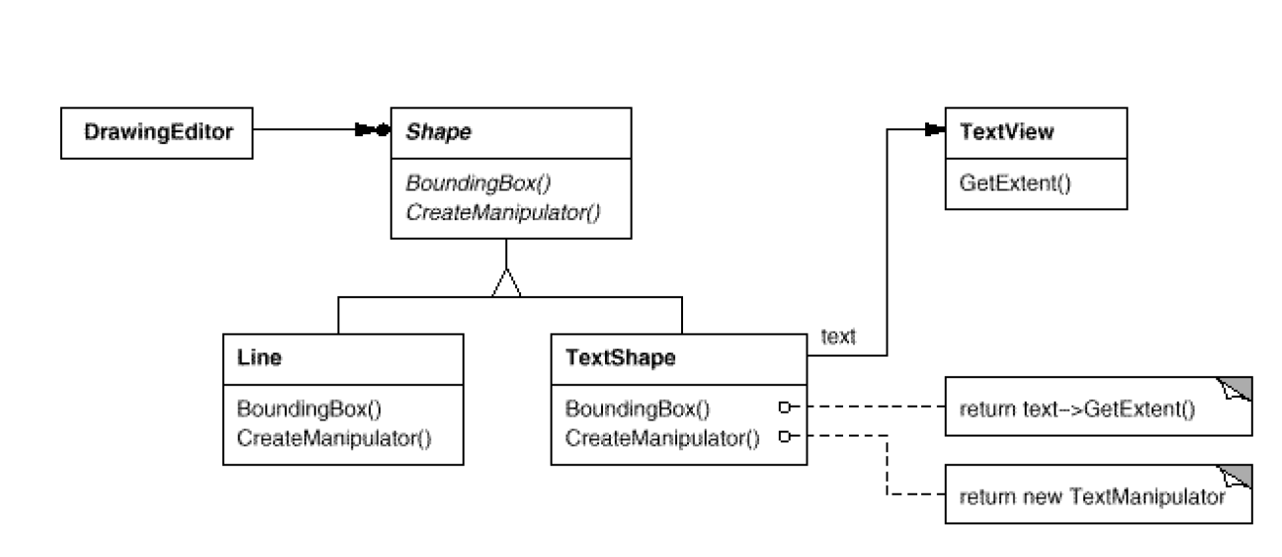
Consequences
+ A single adapter can work with multiple Adaptees
Can make it harder t override Adaptee behavior
Current example

Slide 21
Bridge Pattern
Intent
Motivation
Applicability
Structure
Consequences

Slide 22
Intent
Decouple an abstraction from its implementation so that the two can vary independently.
Motivation
Inheritance binds an implementation to the abstraction permanently, which makes it difficult to modify, extend, and reuse abstractions and implementations independently.
This is important when abstraction and its implementation should vary independently.

Slide 23
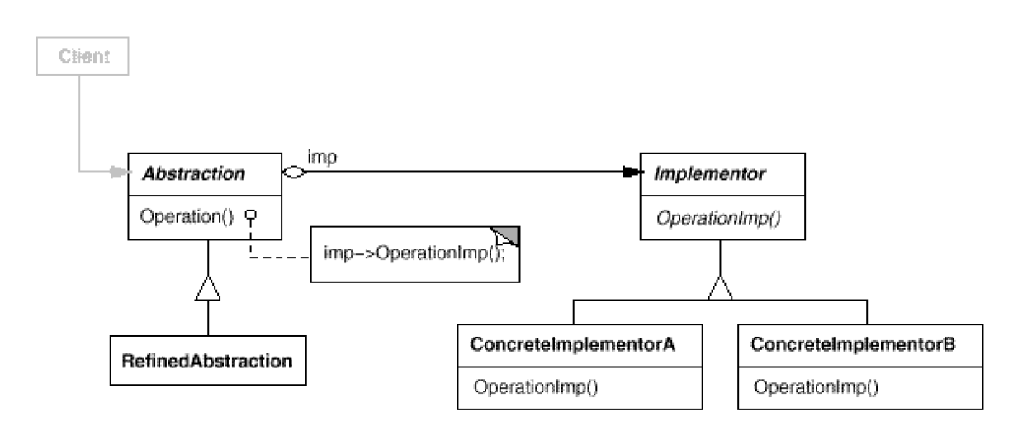
Applicability
When abstraction and implementation should vary independently
When the code base requires a uniform interface to interchangeable class hierarchies.
Structure

Slide 24
Consequences
+ Abstraction and implementation are independent.
+ Implementation can vary dynamically.
- Multiple indirection.

Slide 25
Singleton Pattern
Intent
Motivation
Applicability
Structure
Consequences

Slide 26
Intent
A class only has one instance, and provide a global point of access to it.
Motivation
For example, there can be multiple celestial bodies in an universe but there should only be one universe object.
As another example, there can be many printers in a system but there should be only one printer spooler.

Slide 27
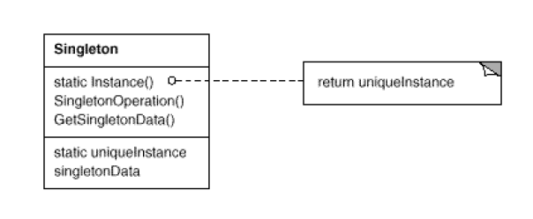
Applicability
When there must be exactly one instance of a class, and it must be accessible to clients from a well known access point.
When the sole instance should be extensible by subclasssing, and clients should be able to use an extended instance without modifying their code.
Structure

Slide 28
Pros
Reduced namespace
Permits a variable number of instances
Subclassing is possible
Cons
Introduces a global state
Cannot run multiple unit tests in parallel

