Slide 1
Bridge Pattern
Intent
Motivation
Applicability
Structure
Consequences

Slide 2
Intent
Decouple an abstraction from its implementation so that the two can vary independently.
Motivation
Inheritance binds an implementation to the abstraction permanently, which makes it difficult to modify, extend, and reuse abstractions and implementations independently.
This is important when abstraction and its implementation should vary independently.

Slide 3
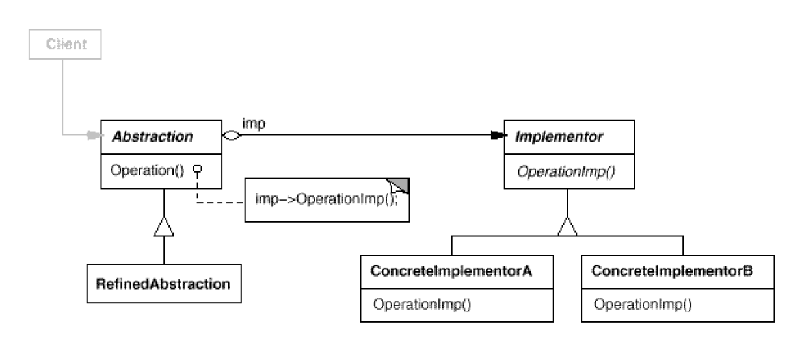
Applicability
When abstraction and implementation should vary independently
When the code base requires a uniform interface to interchangeable class hierarchies.
Structure

Slide 4
Consequences
+ Abstraction and implementation are independent.
+ Implementation can vary dynamically.
- Multiple indirection.

