Slide 1
Factory Pattern
Intent
Motivation
Applicability
Structure
Consequences
Implementation

Slide 2
Intent
Provide an interface for creating an object, but leave the choice of the object’s concrete type to a subclass
Motivation
Often adding new operations and distributing operations can become hard to understand, maintain and change. Visitor pattern allows newer operations to be added separately independent of the nodes on which they operate.

Slide 3
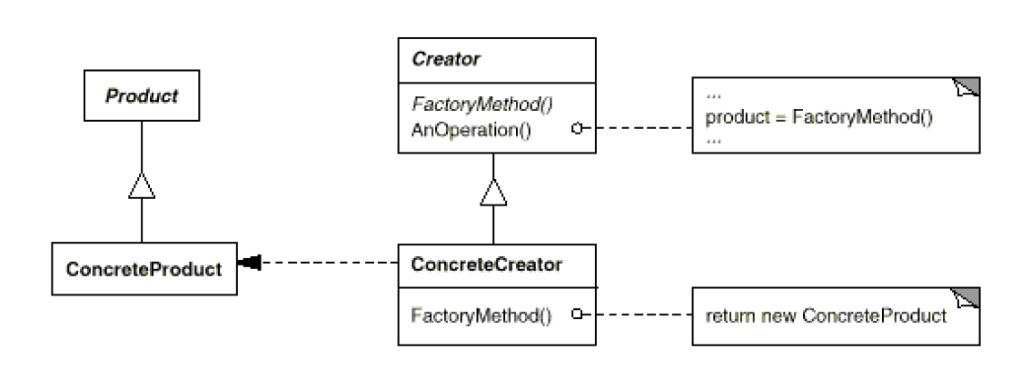
Applicability
When a class cannot anticipate the objects it must create or a class wants its subclasses to specify the objects it creates
Structure

Slide 4
Consequences
Client is only dependent on the interface.
Client doesn’t need to specify the class name or worry about the details of the class’ object which makes it more flexible.
Clients might have to subclass the creator class just to create a particular ConcreteProduct object.
Implementation
Two ways of implementing factory pattern:
Creator class if abstract must be implemented and hence there is no default creation method.
Creator class can be concrete and provides a default implementation, may or may not be sub-classed.
Should a factory method be able to create different variants?

Slide 5
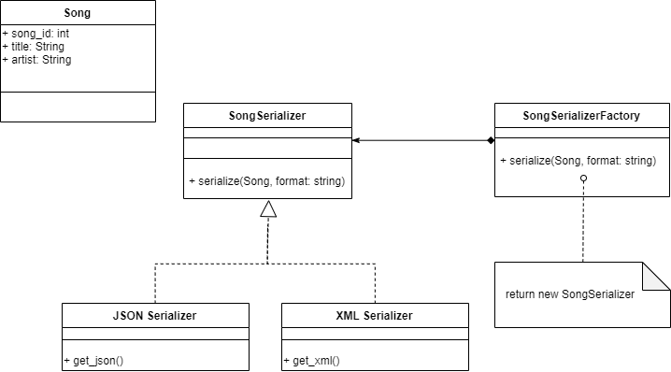
Current Example

