Slide 1
Observer Pattern
Intent
Motivation
Applicability
Structure
Consequences

Slide 2
Intent
Define a one-to-many dependency between objects so that when one object changes state, all dependents are notified and updated
Motivation
Often there are cooperating classes which need to maintain consistency between related objects. However, tightly coupling them reduces their reusability and flexibility. Observer pattern provides a design in which if one object changes state, all its dependents are notified.

Slide 3
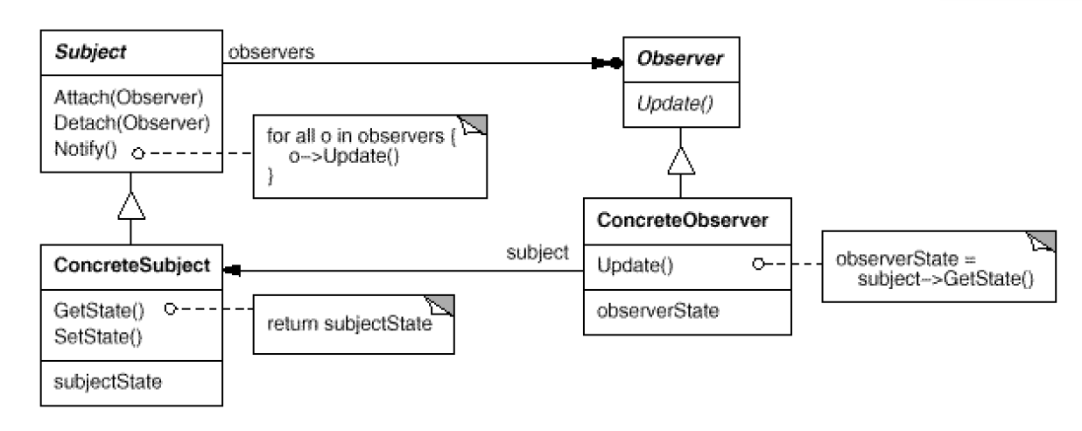
Applicability
An abstraction has two aspects, one dependent on the other
A change to one object requires changing others without knowledge of how many
An object should notify unknown other objects
Structure

Slide 4
Consequences
Modularity: Subject and Observers may vary independently
Extensibility: Can define and add any number of observers
Customizability: Different observers offer different views of subject
Unexpected updates: Observers have no knowledge of each other
Overhead: Might need filtering
Implementation
Subject-Observer mapping
Dangling references
Registering change of interest explicitly
The pull and push models

Slide 5
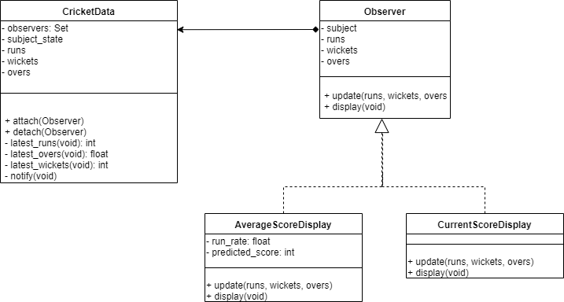
Current Example

