Slide 1
State Pattern
Intent
Motivation
Applicability
Structure
Consequences

Slide 2
Intent
Allow an object to alter its behavior when its internal state changes—the object will appear to change its class
Motivation
An object can have different states and behave differently upon request from other object depending on its current state. Such behavior is realized using State Pattern

Slide 3
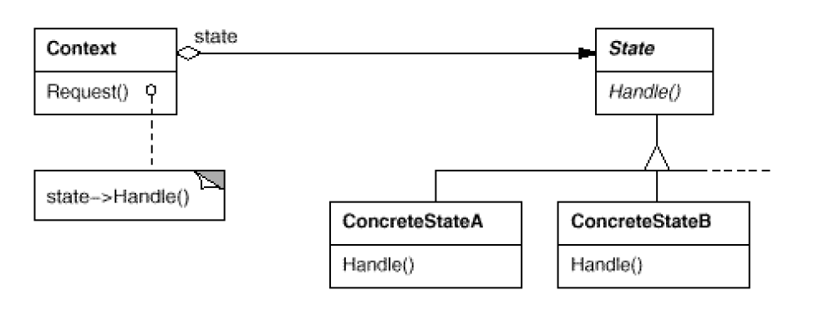
Applicability
When an object must change its behavior at run-time depending on which state it is in
When several operations have the same large multipart conditional structure that depends on the object's state
Structure

Slide 4
Consequences
Localization: It localizes the state-specific behavior and partitions behavior for different states
It makes state transitions explicit
State objects can be shared
Overhead and Complexity: Can result in lots of subclasses that are hard to understand
Implementation
Who defines the state transitions?
Using dynamic inheritance

Slide 5
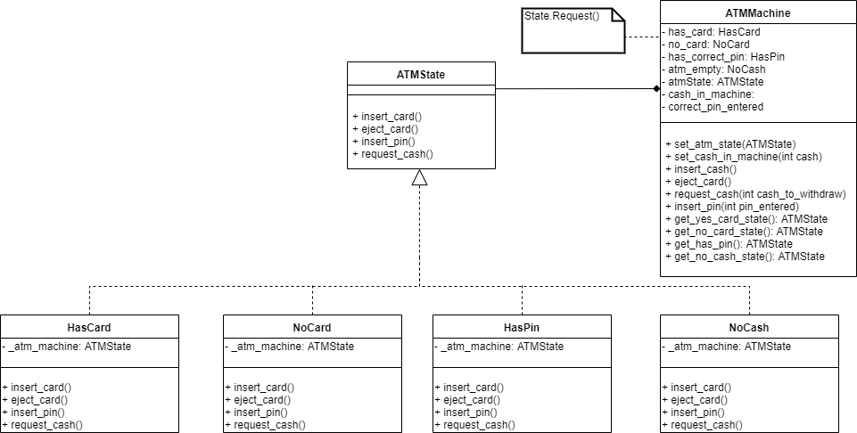
Current Example

