Slide 1
Abstract Factory Pattern
Intent
Motivation
Applicability
Structure
Consequences

Slide 2
Intent
Abstract Factory offers the interface for creating a family of related objects, without explicitly specifying their classes.
Motivation
The Abstract Factory pattern is useful when a client object wants to create an instance of one of a suite of related, dependent classes without having to know which specific concrete class is to be instantiated. Consider a furniture shop that sells both Victorian and Modern Furniture. The furniture includes chair, coffee-table and sofa. An abstract furniture factory’s interface can be used to create chairs, coffee tables and sofas by using one of the two factories – VictorianFurnitureFactory or ModernFurnitureFactory.

Slide 3
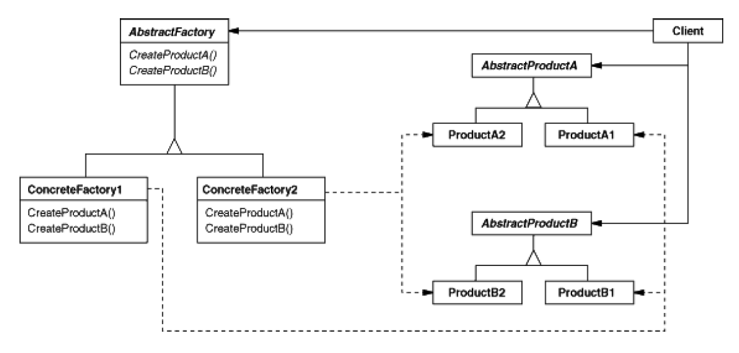
Applicability
When products to be created are to be used together
When the system should have independence between the creation, composition and representation of its products
When implementation of the products needs to be hidden
Structure

Slide 4
Consequences
Isolation: Since the abstract factory separates out the control and creation of products, it isolates the client from the actual implementation
Ease of changing concrete classes: The client can easily change a concrete factory it uses since it only appears once i.e., when instantiated
Consistency: Abstract Factory enforces creation of product objects from one family at a time thus maintaining the consistency between them.
Extension: Extending abstract factories to add new product family can be tedious especially if there are a lot of concrete products.
Implementation
Factories as Singleton: An application usually needs only one instance of the ConcreteFactory class per family product. Thus factories can be implemented as Singleton.
Changing factory to support creation of new products is not easy but can be solved by using a flexible but a less secure approach i.e. by parametrizing the MakeProduct method which identifies the type of the product needed.

Slide 5
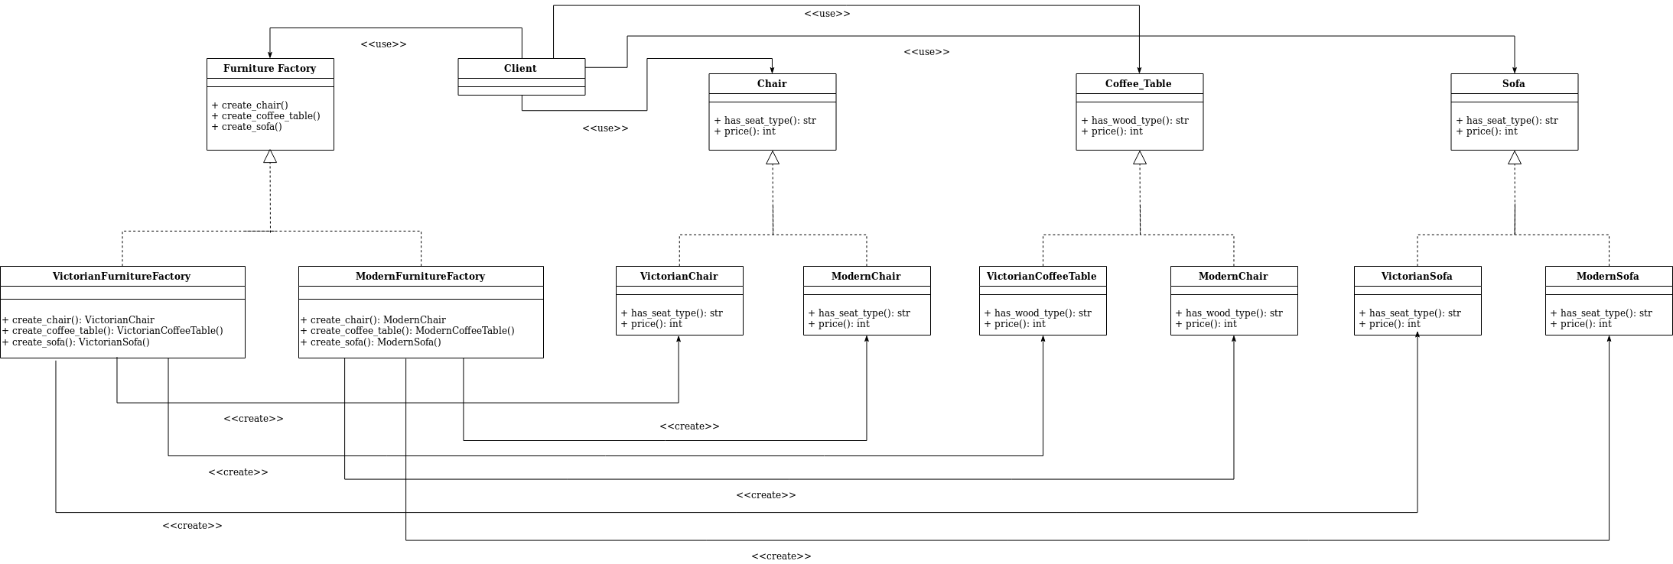
Current Example

Slide 6
Builder Pattern
Intent
Motivation
Applicability
Structure
Consequences

Slide 7
Intent
Separate the construction of a complex object from its representation so that the same construction process can create different representations.
Motivation
Consider an example where a house is to be built. Each house can be built differently by building different components of the house separately using different build methods. A set of these build methods can be called by a constructor class that would call all those builder methods specific to that type in a particular order and return a built house object.

Slide 8
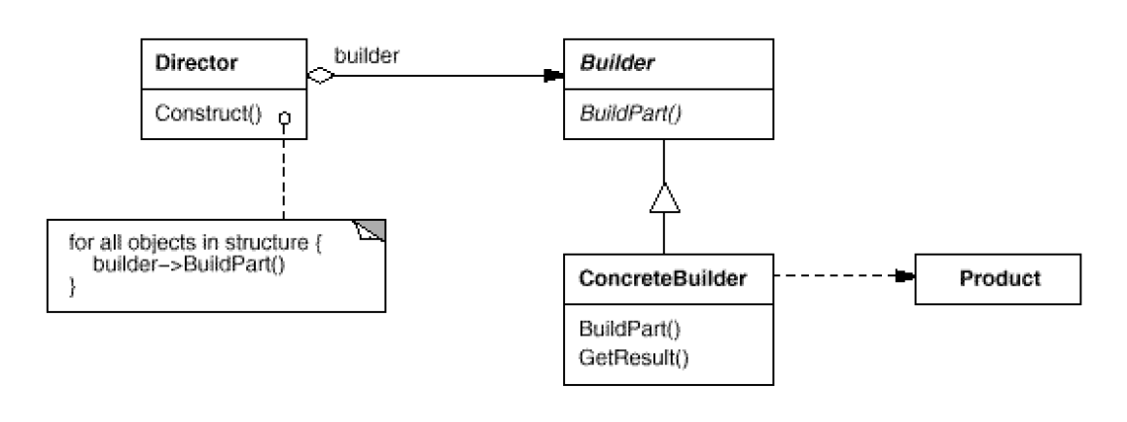
Applicability
Need to isolate knowledge of the creation of a complex object from its parts.
Need to allow different implementations/interfaces of an object’s parts.
Structure

Slide 9
Consequences
Controlled access to a sole instance
Reduced namespace pollution
Finer control over the construction process
Can involve lots of classes
Implementation
Builder interface should be general enough for all kinds of concrete builder
Several implementations are wired together

Slide 10
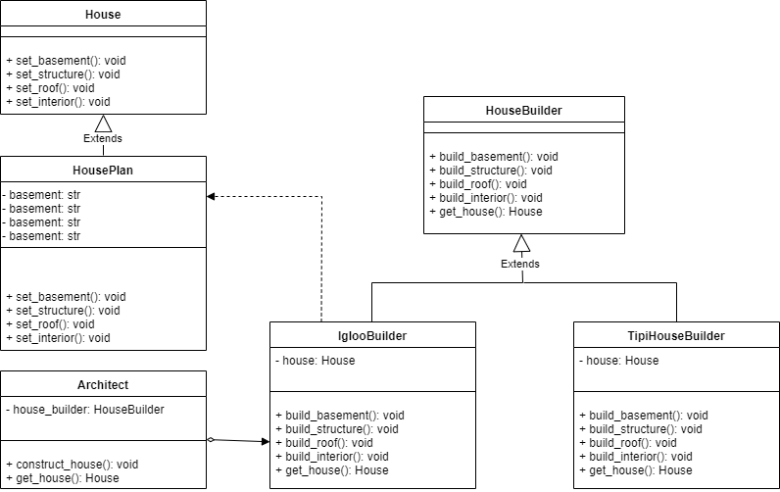
Class diagram of example application

Slide 11
Factory Pattern
Intent
Motivation
Applicability
Structure
Consequences
Implementation

Slide 12
Intent
Provide an interface for creating an object, but leave the choice of the object’s concrete type to a subclass
Motivation
Often an application or a client isn’t aware of which subclass object to instantiate from a set of inherited subclasses and so it uses the parent class’ interface to demand an object. Based on the context of the application, expansion of requirements or enhancements or some configuration settings, the factory method instantiates the required object and returns it as an instance of the parent class type.

Slide 13
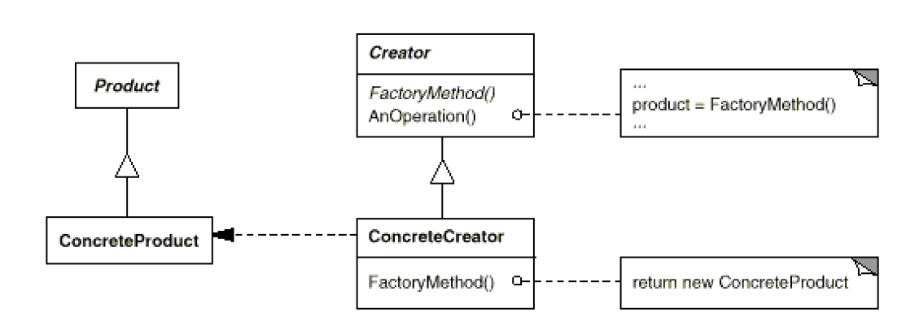
Applicability
When a class cannot anticipate the objects it must create or a class wants its subclasses to specify the objects it creates
Structure

Slide 14
Consequences
Client is only dependent on the interface.
Client doesn’t need to specify the class name or worry about the details of the class’ object which makes it more flexible.
Clients might have to subclass the creator class just to create a particular ConcreteProduct object.
Implementation
Two ways of implementing factory pattern:
Creator class if abstract must be implemented and hence there is no default creation method.
Creator class can be concrete and provides a default implementation, may or may not be sub-classed.
Should a factory method be able to create different variants?

Slide 15
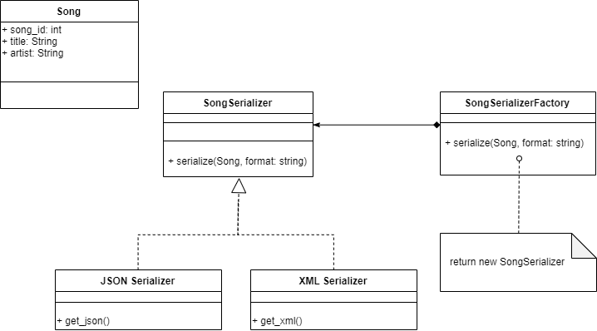
Current Example

Slide 16
Prototype Pattern
Intent
Motivation
Applicability
Structure
Consequences

Slide 17
Intent
Specify the kinds of objects to create using a prototypical instance, and create new objects by copying this prototype
Motivation
Prototype allows us to hide the complexity of making new instances from the client. The concept is to copy an existing object rather than creating a new instance which may include costly operations.

Slide 18
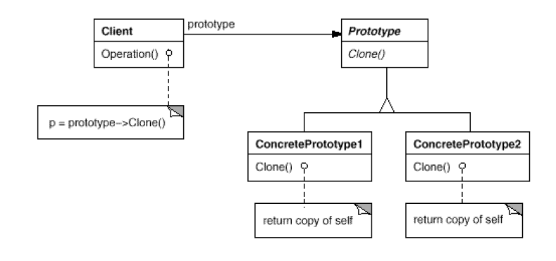
Applicability
When object creation is costly
When dynamic loading is used i.e. the classes to instantiate are specified at run-time
When instances of a class can have one of only a few different combinations of state. It may be more convenient to install a corresponding number of prototypes and clone them rather than instantiating the class manually, each time with the appropriate state.
Structure

Slide 19
Consequences
Dynamic behavior: A client can exhibit dynamic behavior by delegating responsibility to the prototype
Flexibility: Adding and removing products at run-time simply by registering or de-registering a prototypical instance with the client
Overhead: Each subclass must implement the ‘Clone’ operation.
Implementation
Consider circular references while using clone operation
Consider implementing a prototype manager that will keep track of the available prototypes

Slide 20
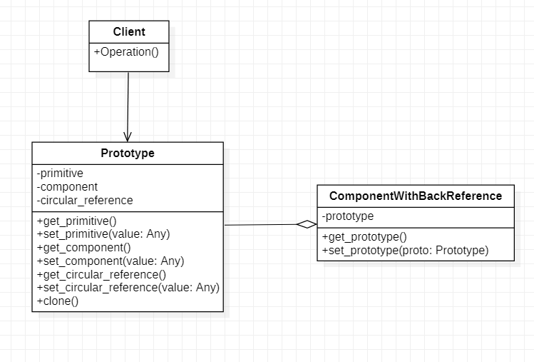
Current Example

Slide 21
Singleton Pattern
Intent
Motivation
Applicability
Structure
Consequences

Slide 22
Intent
A class only has one instance, and provide a global point of access to it.
Motivation
For example, there can be multiple celestial bodies in an universe but there should only be one universe object.
As another example, there can be many printers in a system but there should be only one printer spooler.

Slide 23
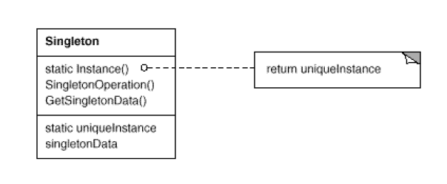
Applicability
When there must be exactly one instance of a class, and it must be accessible to clients from a well known access point.
When the sole instance should be extensible by sub-classsing, and clients should be able to use an extended instance without modifying their code.
Structure

Slide 24
Pros
Reduced namespace
Permits a variable number of instances
Sub-classing is possible
Cons
Introduces a global state
Cannot run multiple unit tests in parallel

Slide 25
Singleton Pattern
Intent
Motivation
Applicability
Structure
Consequences

Slide 26
Intent
A class only has one instance, and provide a global point of access to it.
Motivation
For example, there can be multiple celestial bodies in an universe but there should only be one universe object.
As another example, there can be many printers in a system but there should be only one printer spooler.

Slide 27
Applicability
When there must be exactly one instance of a class, and it must be accessible to clients from a well known access point.
When the sole instance should be extensible by sub-classsing, and clients should be able to use an extended instance without modifying their code.
Structure

Slide 28
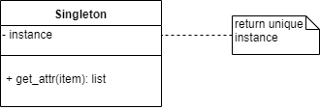
Current Example

Slide 29
Pros
Reduced namespace
Permits a variable number of instances
Sub-classing is possible
Cons
Introduces a global state
Cannot run multiple unit tests in parallel

Slide 30
Adapter Pattern
Intent
Motivation
Applicability
Structure
Consequences

Slide 31
Intent
Convert the interface of a class into another interface that the clients expect. The pattern lets otherwise incompatible interfaces to work together.
Motivation
Sometimes, a class that’s designed for reuse isn’t reusable only because its interface doesn’t match the domain-specific interface an application requires.
For example, in a drawing editor which lets user draw and arrange different shapes implementing text can be quite difficult. However, if there is already an implemented class that provides partial functionality but is incompatible with client’s interface then adapter pattern can be used.

Slide 32
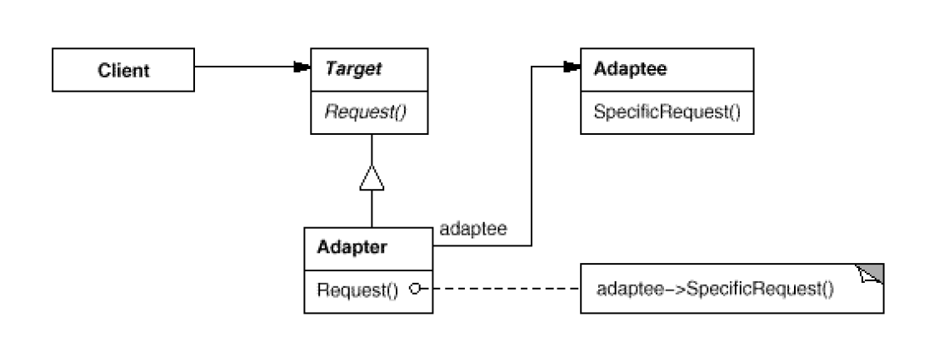
Applicability
When there is a need to use an existing class, but its interface does not match the one needed
When there is need to use several existing subclasses, but it is not practical to adapt their interfaces by subclassing each one.
Structure

Slide 33
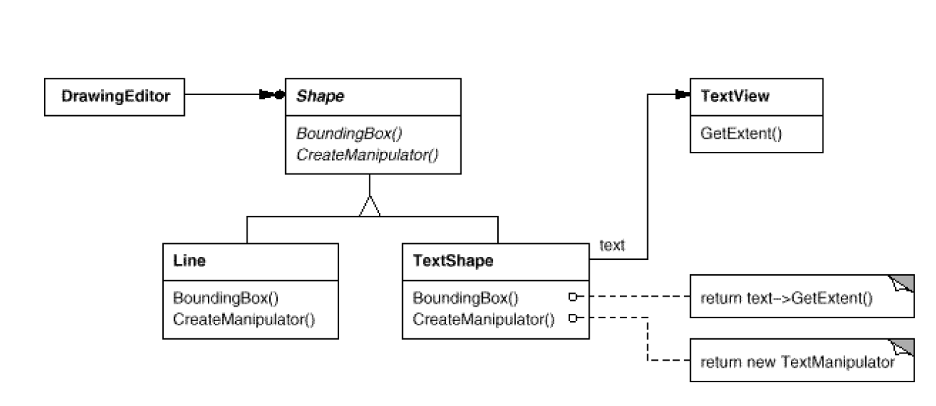
Consequences
+ A single adapter can work with multiple Adaptees
Can make it harder to override Adaptee behavior
Current example

Slide 34
Bridge Pattern
Intent
Motivation
Applicability
Structure
Consequences

Slide 35
Intent
Decouple an abstraction from its implementation so that the two can vary independently.
Motivation
Inheritance binds an implementation to the abstraction permanently, which makes it difficult to modify, extend, and reuse abstractions and implementations independently.
This is important when abstraction and its implementation should vary independently.

Slide 36
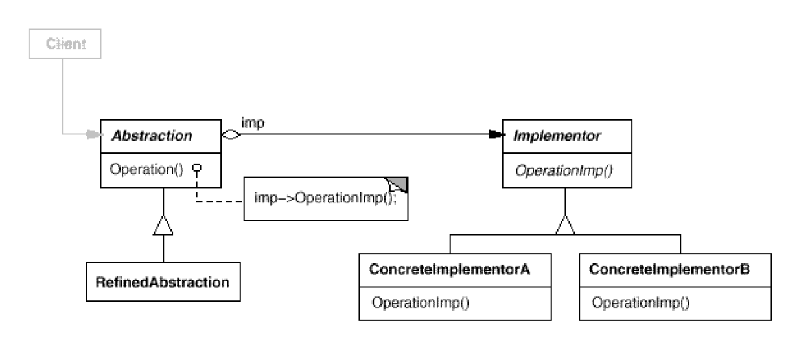
Applicability
When abstraction and implementation should vary independently
When the code base requires a uniform interface to interchangeable class hierarchies.
Structure

Slide 37
Consequences
+ Abstraction and implementation are independent.
+ Implementation can vary dynamically.
- Multiple indirection.

Slide 38
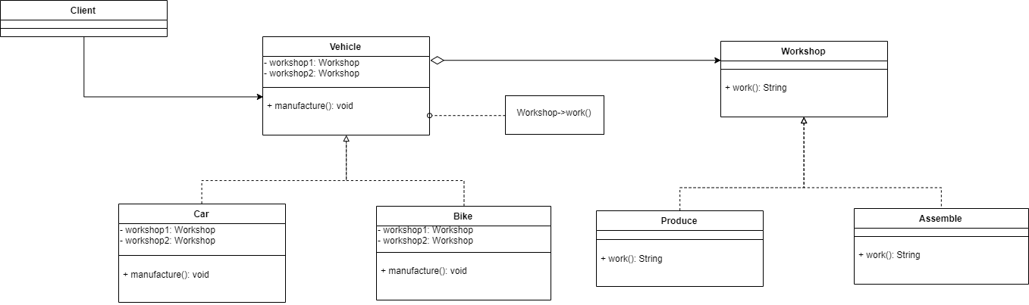
Current Example

Slide 39
Composite Pattern
Intent
Motivation
Applicability
Structure
Consequences

Slide 40
Intent
Compose objects into tree structure to represent part-whole hierarchies. Composite lets client treat individual objects and compositions of object uniformly.
Motivation
Often primitive objects and container objects have to be treated differently, even if most of the time the user treats them identically. This makes the application complex. Composite pattern removes that necessity for the client code.

Slide 41
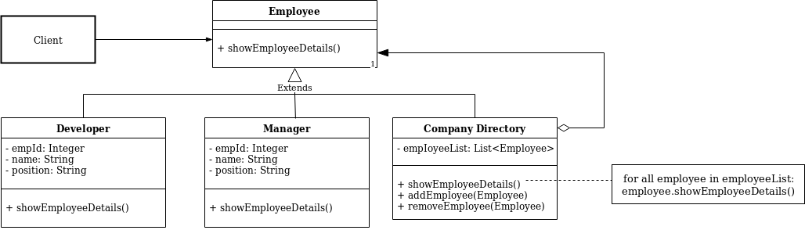
Applicability
Objects must be composed recursively
No distinction between individual and composed elements i.e. objects in structure can be treated uniformly.
Structure

Slide 42
Consequences
Consistency: Components are treated the same irrespective of the composition
Flexibility: New subclasses can work wherever the old ones do
Sharing components: Sharing component is difficult when a component has more than one parent
Overhead: Restrictive as the number of objects increase.
Implementation
Components knowledge of parents
Uniform interface for both composites and leaves?
Maximizing the component interface

Slide 43
Decorator Pattern
Intent
Motivation
Applicability
Structure
Consequences
Current Example UML diagram

Slide 44
Intent
Attach additional responsibilities to an object dynamically. Decorators provide a flexible alternative to sub-classing for extending functionality
Motivation
Sometimes we want to add behavior to an individual object rather than the entire class. For example, a pizza can be formed with multiple toppings. Not all toppings may be required for every pizza. Also, the price of toppings may vary which should reflect in the pizza. Rather than inheriting such toppings for different kinds of pizza, a topping decorator with a particular behavior can be added to a pizza object.

Slide 45
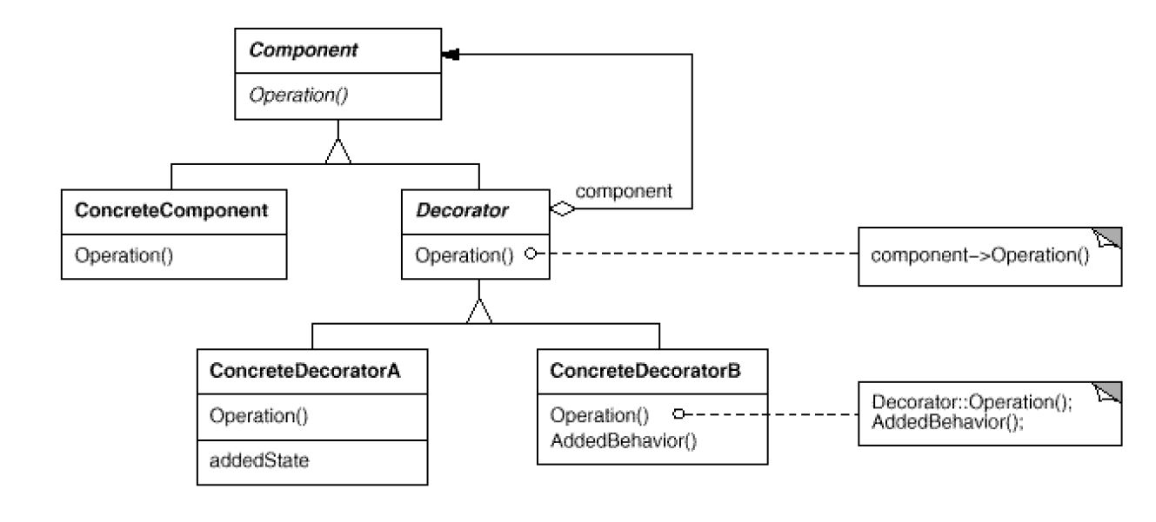
Applicability
To add responsibilities to individual objects dynamically and transparently without affecting other objects.
For responsibilities that can change or be withdrawn.
When extension using sub-classing is impractical.
Structure

Slide 46
Consequences
No unnecessary overhead: Don’t have to add features high up in hierarchy.
Flexibility: More flexibility than static inheritance
Similarity: The decorator is not identical with component hence object identity shouldn’t be relied on while using decorators.
Little objects: A system composed of lots of little objects can be hard to learn and debug
Implementation
Interface conformance: Both the decorator and the component it is decorating should have the same interface.
There’s no need to have an abstract decorator class when only one responsibility needs to be added to the component.
For interface conformance components and decorators must descend from a common Component class

Slide 47
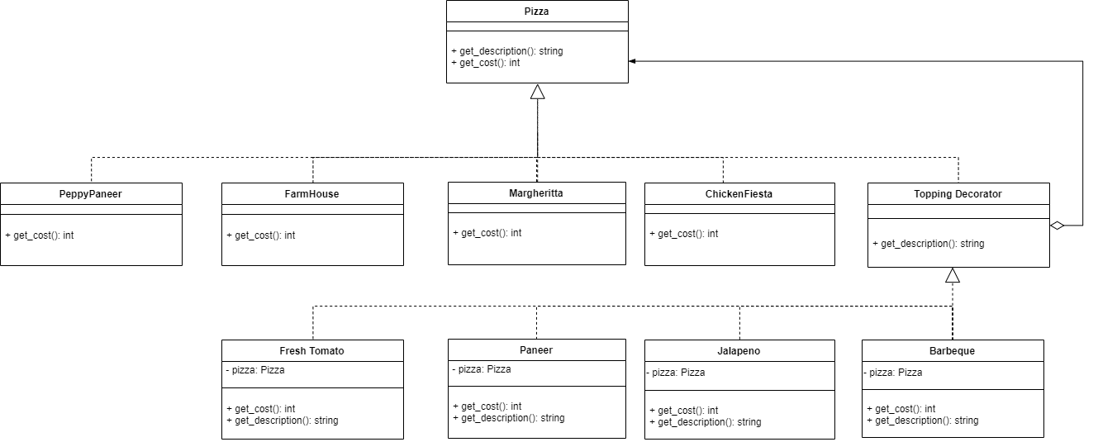
Current Example

Slide 48
Facade Pattern
Intent
Motivation
Applicability
Structure
Consequences
Current Example

Slide 49
Intent
Provide a unified interface to a set of interfaces in a subsystem. Facade defines a higher-level interface that makes the subsystem easier to use.
Motivation
Structuring a system into subsystems helps reduce complexity. A common design goal is to minimize the communication and dependencies between subsystems. One way to achieve this goal is to introduce a facade object that provides a single, simplified interface to the more general facilities of a subsystem.

Slide 50
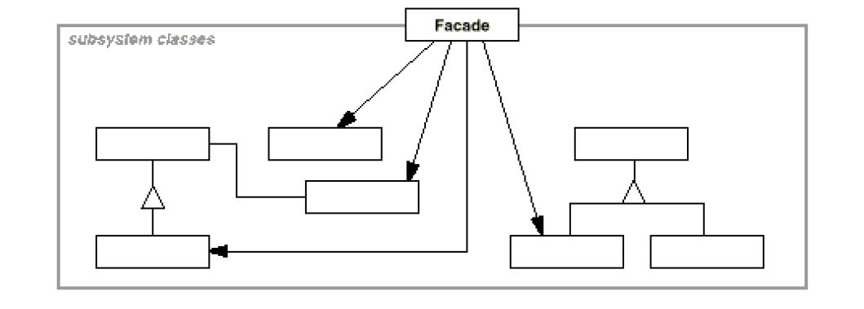
Applicability
When you want to provide a simple interface to a complex subsystem
When there are many dependencies between clients and the implementation classes of an abstraction
When you want to define an entry point to each subsystem level. Dependent subsystems can communicate with each other solely through their facades.
Structure

Slide 51
Consequences
Shielding: Shields clients from subsystem components, thereby reducing the number of objects that clients deal with thus making the subsystem easier to use.
Weak coupling: Promotes weak coupling between the subsystem and its clients
Implementation
Client-subsystem coupling can be reduced even further by making Façade an abstract class with concrete subclasses for different implementations of a subsystem.
Not all languages support private classes and so making subsystem classes private although useful may not be always possible.

Slide 52
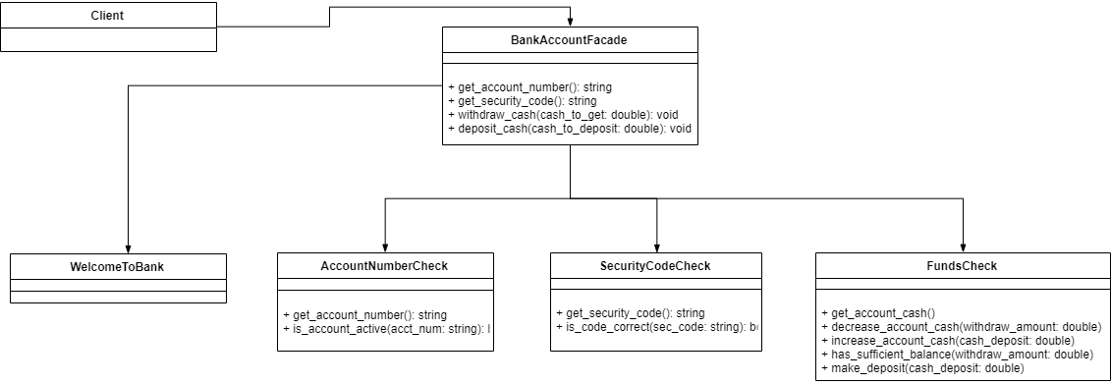
Current Example

Slide 53
Facade Pattern
Intent
Motivation
Applicability
Structure
Consequences
Current Example

Slide 54
Intent
Provide a unified interface to a set of interfaces in a subsystem. Facade defines a higher-level interface that makes the subsystem easier to use.
Motivation
Structuring a system into subsystems helps reduce complexity. A common design goal is to minimize the communication and dependencies between subsystems. One way to achieve this goal is to introduce a facade object that provides a single, simplified interface to the more general facilities of a subsystem.

Slide 55
Applicability
When you want to provide a simple interface to a complex subsystem
When there are many dependencies between clients and the implementation classes of an abstraction
When you want to define an entry point to each subsystem level. Dependent subsystems can communicate with each other solely through their facades.
Structure

Slide 56
Consequences
Shielding: Shields clients from subsystem components, thereby reducing the number of objects that clients deal with thus making the subsystem easier to use.
Weak coupling: Promotes weak coupling between the subsystem and its clients
Implementation
Client-subsystem coupling can be reduced even further by making Façade an abstract class with concrete subclasses for different implementations of a subsystem.
Not all languages support private classes and so making subsystem classes private although useful may not be always possible.

Slide 57
Current Example

Slide 58
Flyweight Pattern
Intent
Motivation
Applicability
Structure
Consequences

Slide 59
Intent
Use sharing to support large numbers of fine-grained objects efficiently.
Motivation
Let’s say an object-oriented document editor wants to represent characters as objects to provide greater flexibility. However, this will consume a lot of memory if designed in this way. The flyweight pattern describes sharing of objects to allow their use at fine granularities without prohibitive cost.

Slide 60
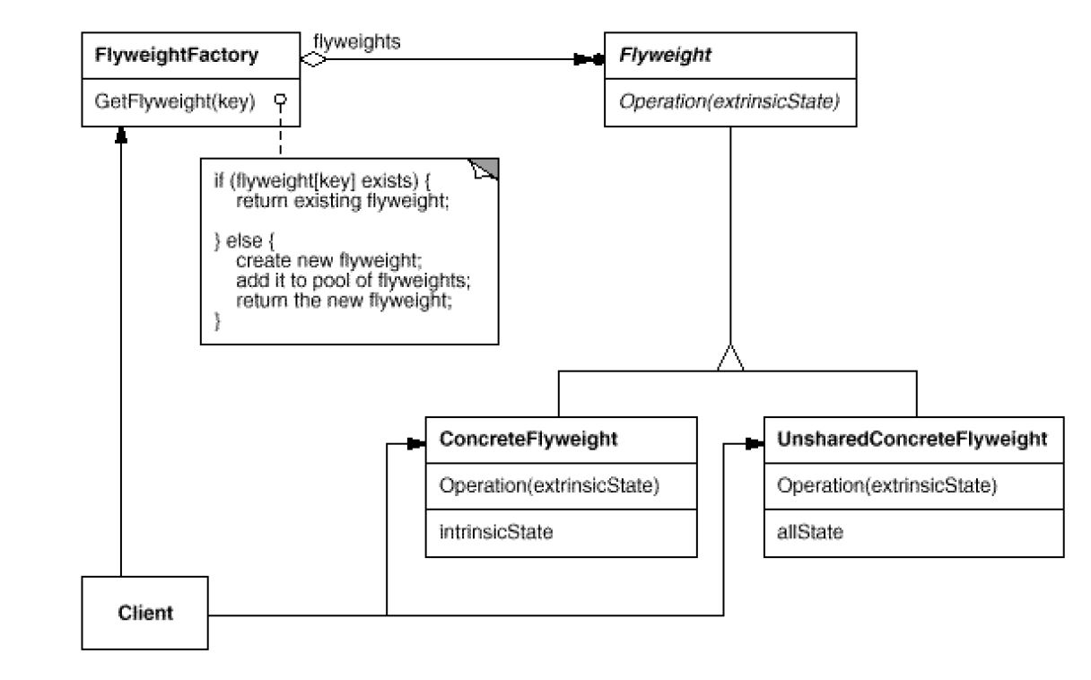
Applicability
When classes define many unrelated operations
Class relationships of objects in the structure rarely change, but the operations on them change often
Algorithms keeps state that is updated during traversal
Structure

Slide 61
Consequences
Space savings: Although flyweights incur run-time costs, a very high number of shared instances can outweigh them.
In a graph with shared leaf nodes, leaf flyweights cannot store a reference to their parent. Rather the parent reference is passed to the flyweight as part of its extrinsic state.
Implementation
Removing extrinsic state: Removing extrinsic state won’t help reduce storage costs if there are as many different kinds of extrinsic state as there are objects before sharing
Since the objects are shared, a client shouldn’t instantiate them directly but rather use a factory that allows the client to look up objects of their interests

Slide 62
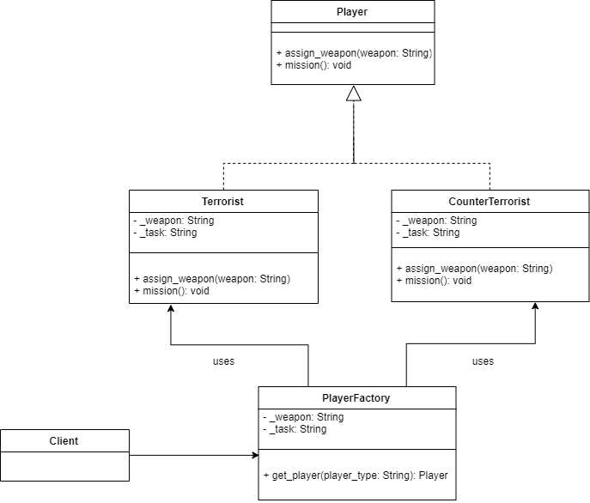
Current Example

Slide 63
Proxy Pattern
Intent
Motivation
Applicability
Structure
Consequences

Slide 64
Intent
The intent of this pattern is to provide a Placeholder for an object to control references to it.
Motivation
Sometimes we need the ability to control the access to an object. For example if we need to use only a few methods of some costly objects we'll initialize those objects when we need them entirely. Until that point we can use some light objects exposing the same interface as the heavy objects. These light objects are called proxies and they will instantiate those heavy objects when they are really need and by then we'll use some light objects instead.

Slide 65
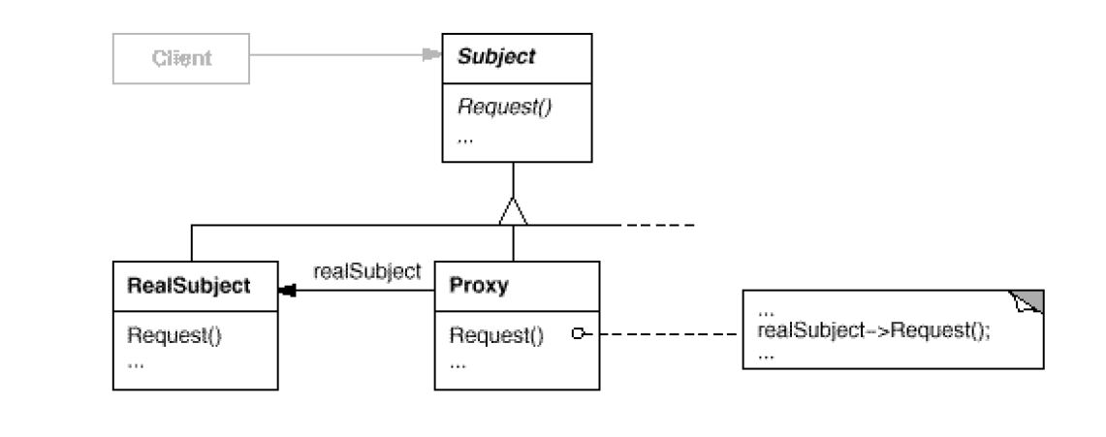
Applicability
Virtual Proxies: delaying the creation and initialization of expensive objects until needed, where the objects are created on demand
Remote Proxies: providing a local representation for an object that is in a different address space.
Protection Proxies: where a proxy controls access to RealSubject methods, by giving access to some objects while denying access to others
Structure

Slide 66
Consequences
Indirection: Pattern involves a level of indirection when accessing an object.
Disparate behavior: If clients are accessing both the RealSubject and the Proxy classes
Implementation
Proxy doesn’t always have to know all the types of RealSubject i.e., if it can deal with the subject through an uniform abstract interface.
Referring to the subject before it’s instantiated. Some form of address space-independent object identifiers must be used

Slide 67
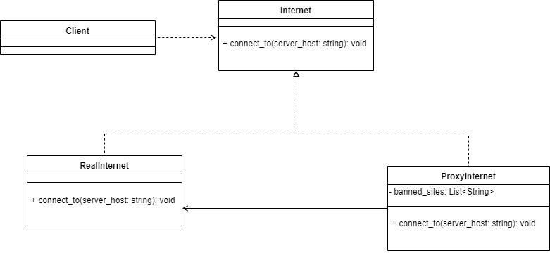
Current Example

Slide 68
Chain of Responsibility Pattern
Intent
Motivation
Applicability
Structure
Consequences

Slide 69
Intent
Avoid coupling the sender of a request to its receiver by giving more than one object a chance to handle the request.
Motivation
Often the requestor isn’t aware of the object that handles that request. A way to decouple the object that initiates the request from the object that serves it, is the motivation behind using a pattern like chain of responsibility. As the name suggests, the request gets passed along a chain of objects until one of them handles it.

Slide 70
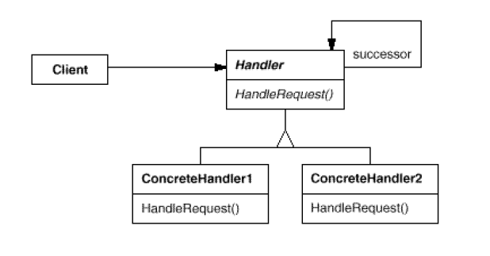
Applicability
When more than one object may handle a request, and the handler isn’t known a priori
When multiple objects can receive the request without either of them being specified explicitly
The set of objects that can handle a request should be specified dynamically
Structure

Slide 71
Consequences
Reduced coupling: The requestor doesn’t have to know which object will handle the request
Flexibility: Add or change responsibilities for handling a request by adding to or changing the chain at run-time
Guarantee: The request may fall off the chain without ever being handled. There’s no guarantee
Implementation
Implementing the successor chain – either using new links or existing links
Connecting successors – should there be a default implementation of handler request

Slide 72
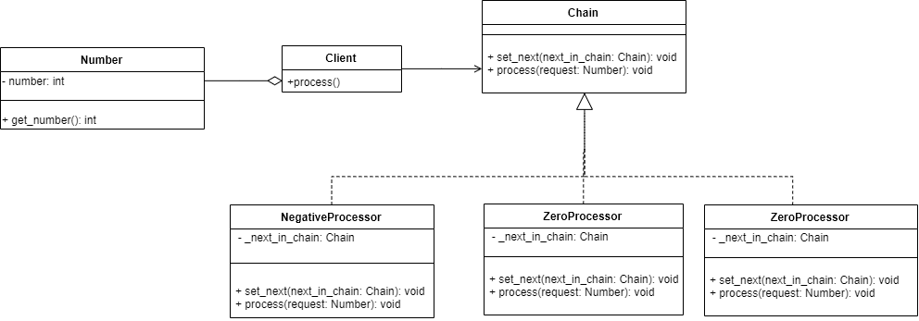
Current Example

Slide 73
Command Pattern
Intent
Motivation
Applicability
Structure
Consequences

Slide 74
Intent
Centralize operations on an object structure so that they can vary independently but still behave polymorphically
Motivation
Often adding new operations and distributing operations can become hard to understand, maintain and change. Visitor pattern allows newer operations to be added separately independent of the nodes on which they operate.

Slide 75
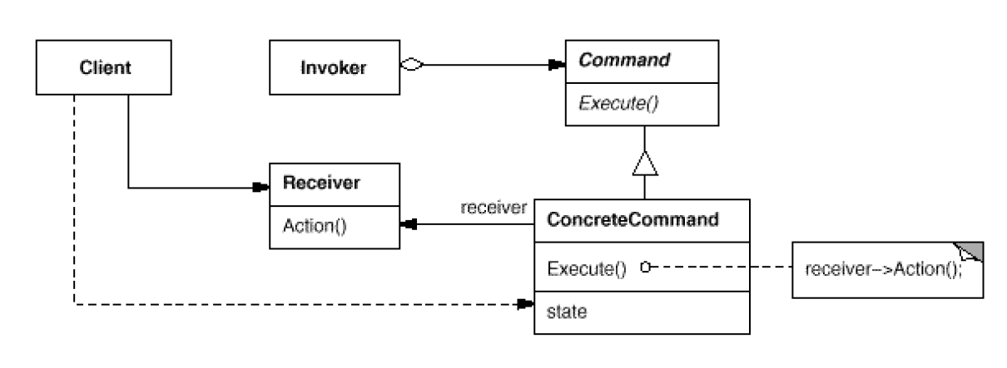
Applicability
When classes define many unrelated operations
Class relationships of objects in the structure rarely change, but the operations on them change often
Algorithms keeps state that is updated during traversal
Structure

Slide 76
Consequences
Consistency: Components are treated the same irrespective of the composition
Flexibility: Visitor algorithms and object structure are independent
Extension: Adding new concrete element subclasses is hard
Dependency: Circular dependency between visitor and element interfaces
Implementation
Double dispatch
General interface to elements of object structure

Slide 77
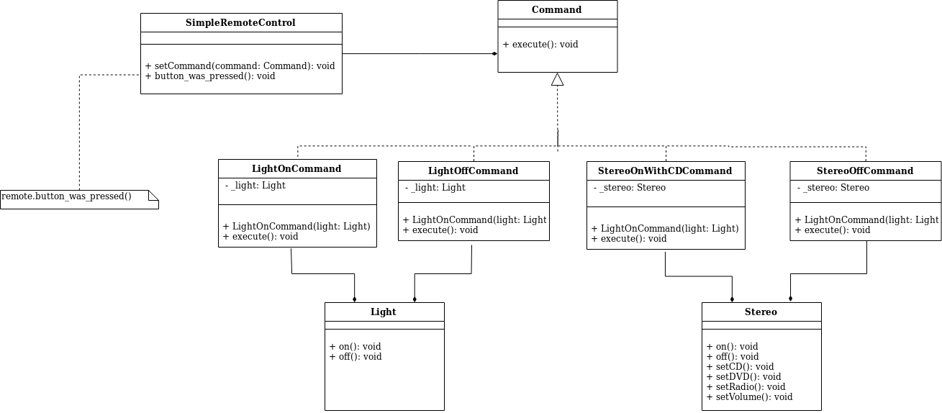
Current Example

Slide 78
Interpreter Pattern
Intent
Motivation
Applicability
Structure
Consequences

Slide 79
Intent
Given a language, define a representation for its grammar along with an interpreter that uses the representation to interpret sentences in the language
Motivation
Expressing instances of a problem as sentences in a simple language and interpreting them using an interpreter.

Slide 80
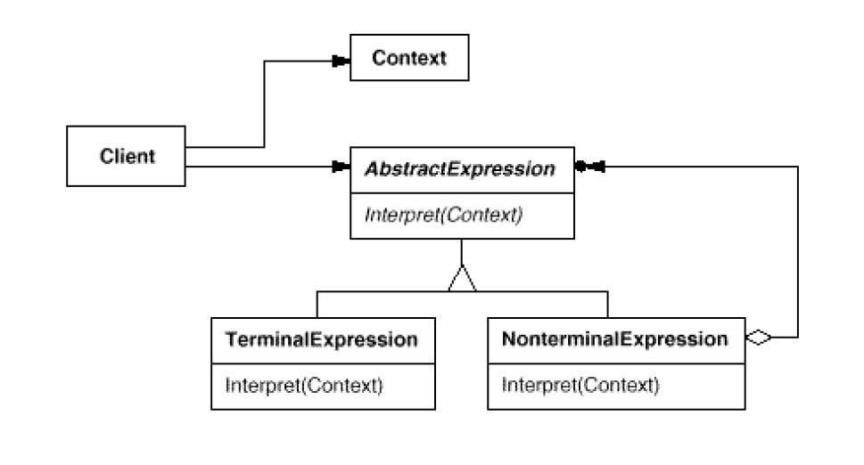
Applicability
When the grammar is simple and relatively stable
Efficiency is not a critical concern.
Structure

Slide 81
Consequences
Extensibility: Easy to change and extend the grammar.
Ease of grammar implementation: Implementing the grammar is easy too.
Complex grammar: Complex grammar are hard to maintain.
Implementation
For each subclass create an interpret operation to match the given context.
Use a class to represent each grammar rule.

Slide 82
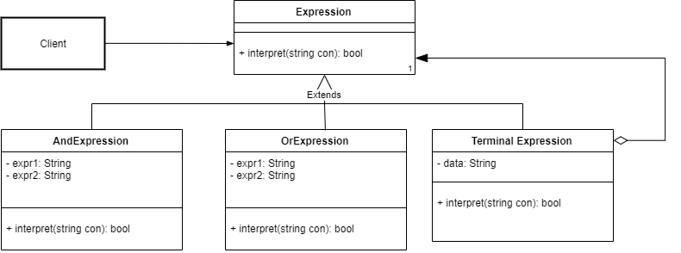
Class diagram of example application

Slide 83
Iterator Pattern
Intent
Motivation
Applicability
Structure
Consequences

Slide 84
Intent
access elements of a aggregate (container) without exposing its representation
Motivation
Aggregate objects should give a way to access its elements without exposing its internal structure.

Slide 85
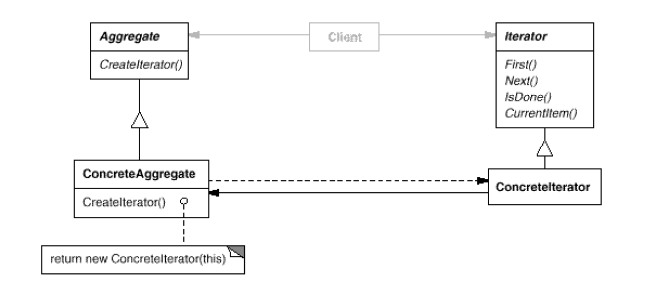
Applicability
When aggregate can use multiple traversal algorithms.
When an uniform traversal interface over different aggregates is required.
When aggregate classes and traversal algorithm must vary independently.
Structure

Slide 86
Consequences
Traversal variation: It supports variations in the traversal of an aggregate
Flexibility: Aggregate and Traversal are independent
Overhead: Communication overhead between iterator and aggregate
Implementation
Violation of object structure’s encapsulation
Synchronization overhead in multithreaded programs
Internal versus external iterators

Slide 87
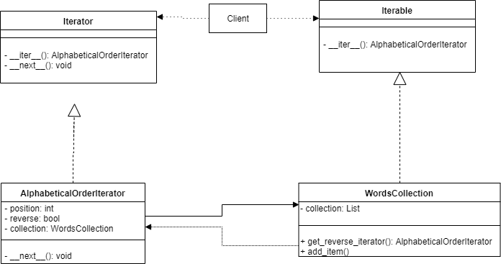
Current Example

Slide 88
Mediator Pattern
Intent
Motivation
Applicability
Structure
Consequences

Slide 89
Intent
To allow loose coupling by encapsulating the way disparate sets of objects interact and communicate with each other. This allows for the actions of each object set to vary independently of one another.
Motivation
An object-oriented design with different classes interacting with each other requires independence. Such frameworks need a mechanism to facilitate the interaction between objects in a manner that they are not aware of each other’s existence. A mediator object realized using mediator pattern can address this issue.

Slide 90
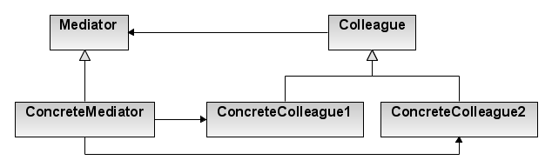
Applicability
When a set of objects communicate in well-defined but complex ways. The resulting interdependencies are unstructured and difficult to understand
When reusing an object is difficult because it refers to and communicates with many other objects
When a behavior that’s distributed between several classes should be customizable without a lot of sub-classing
Structure

Slide 91
Consequences
Behavior localization: It limits sub-classing
Decoupling: A mediator promotes loose coupling between colleagues
Simplification: It simplifies object protocols, replacing many-to-many interactions with one-to-many interactions
Complexity: Mediator itself can become more complex than any other colleague thus trading complexity of interaction for complexity in itself
Implementation
Abstract mediator class isn’t required
One approach for colleague-mediator communication can be realized using observer pattern.

Slide 92
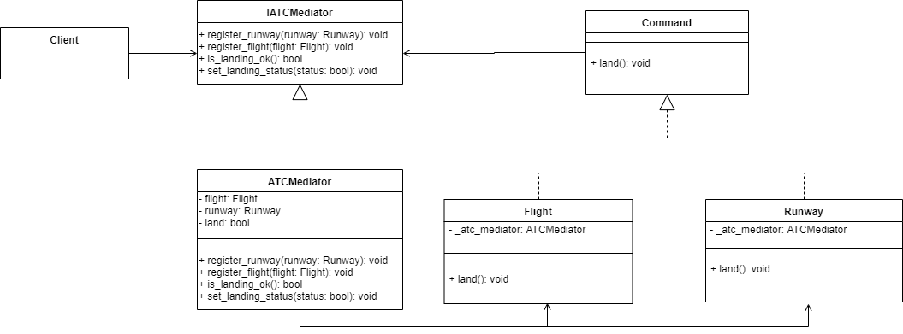
Current Example

Slide 93
Memento Pattern
Intent
Motivation
Applicability
Structure
Consequences

Slide 94
Intent
Capture an object’s internal state so that the object can be restored to this state later.
Motivation
Sometimes it’s necessary to record the internal state of an object. Implementing checkpoints and undo mechanisms lets users back out of a tentative operations and/or recover from errors. Saving the state information enable the restoration of objects to their previous states.

Slide 95
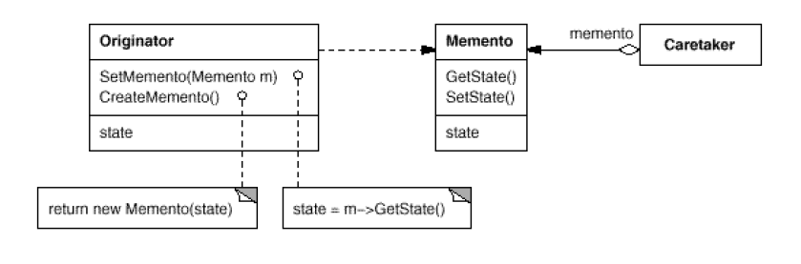
Applicability
When an object’s state must be saved so that it can be restored later, and
A direct interface to obtaining the state would expose implementation details and break the object’s encapsulation.
Structure

Slide 96
Consequences
Encapsulation: Memento pattern preserves encapsulation boundaries
Originator simplification: Clients instead of originator manage the state they ask for, removing the burden of storage management from the originator.
State privacy: Ensuring only originator can access the memento’s state can be challenging
Expensive: If mementos are large in size or frequency of their creation is high, the pattern can become expensive
Implementation
Language support
Storing incremental changes

Slide 97
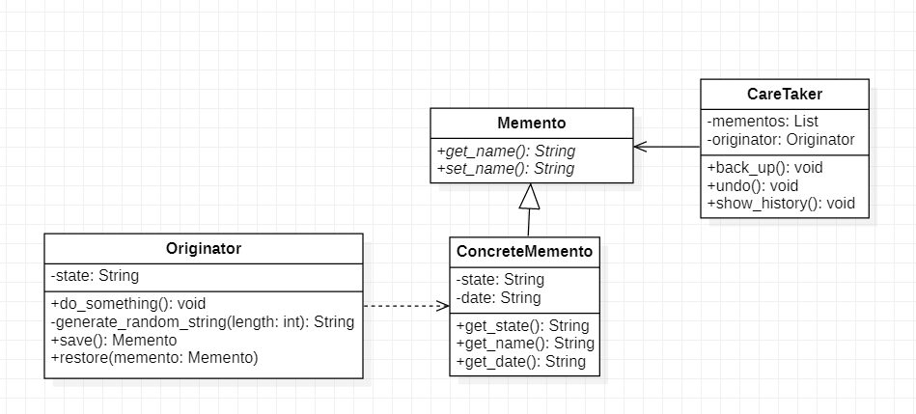
Current Example

Slide 98
Observer Pattern
Intent
Motivation
Applicability
Structure
Consequences

Slide 99
Intent
Define a one-to-many dependency between objects so that when one object changes state, all dependents are notified and updated
Motivation
Often there are cooperating classes which need to maintain consistency between related objects. However, tightly coupling them reduces their reusability and flexibility. Observer pattern provides a design in which if one object changes state, all its dependents are notified.

Slide 100
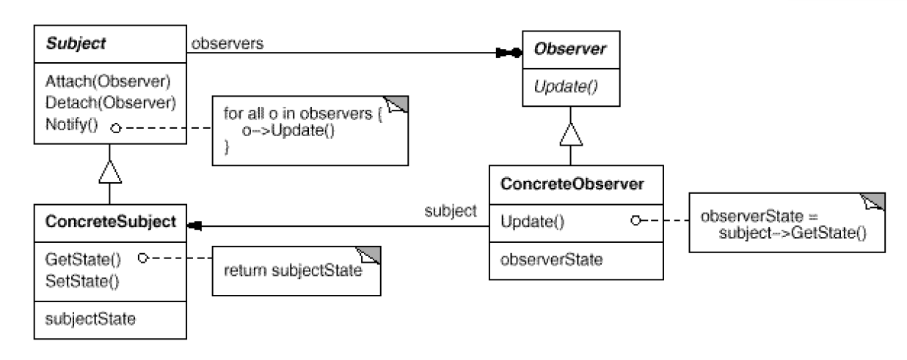
Applicability
An abstraction has two aspects, one dependent on the other
A change to one object requires changing others without knowledge of how many
An object should notify unknown other objects
Structure

Slide 101
Consequences
Modularity: Subject and Observers may vary independently
Extensibility: Can define and add any number of observers
Customizability: Different observers offer different views of subject
Unexpected updates: Observers have no knowledge of each other
Overhead: Might need filtering
Implementation
Subject-Observer mapping
Dangling references
Registering change of interest explicitly
The pull and push models

Slide 102
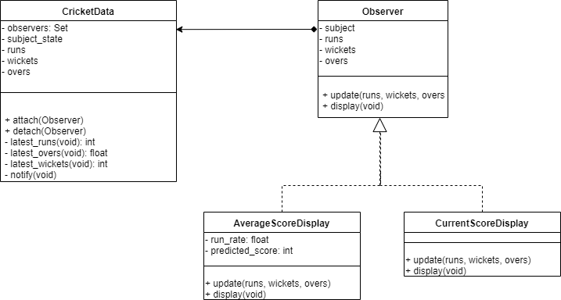
Current Example

Slide 103
State Pattern
Intent
Motivation
Applicability
Structure
Consequences

Slide 104
Intent
Allow an object to alter its behavior when its internal state changes—the object will appear to change its class
Motivation
An object can have different states and behave differently upon request from other object depending on its current state. Such behavior is realized using State Pattern

Slide 105
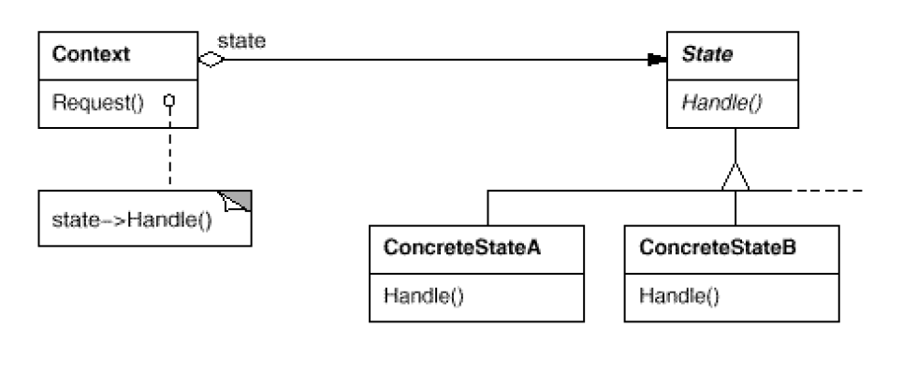
Applicability
When an object must change its behavior at run-time depending on which state it is in
When several operations have the same large multipart conditional structure that depends on the object's state
Structure

Slide 106
Consequences
Localization: It localizes the state-specific behavior and partitions behavior for different states
It makes state transitions explicit
State objects can be shared
Overhead and Complexity: Can result in lots of subclasses that are hard to understand
Implementation
Who defines the state transitions?
Using dynamic inheritance

Slide 107
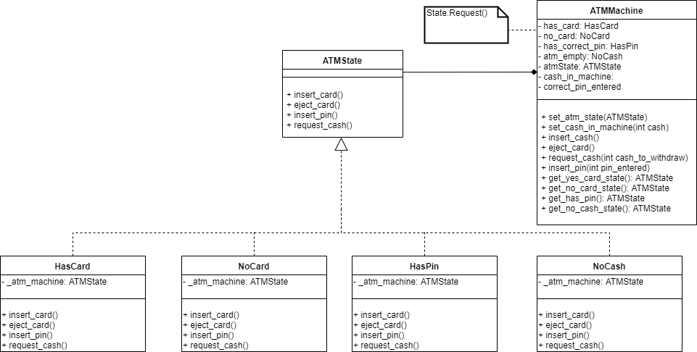
Current Example

Slide 108
Strategy Pattern
Intent
Motivation
Applicability
Structure
Consequences

Slide 109
Intent
Define a family of algorithms, encapsulate each one, and make them interchangeable to let clients and algorithms vary independently from the clients that use it.
Motivation
Often there are different algorithms that are appropriate at different times for different classes. Hard-wiring such algorithms for such clients can make the code more complex and make it more vulnerable to breaking. Also adding new algorithms or varying them can be a pain if the previous approach is used. These can be avoided by encapsulating the algorithms also known as strategy.

Slide 110
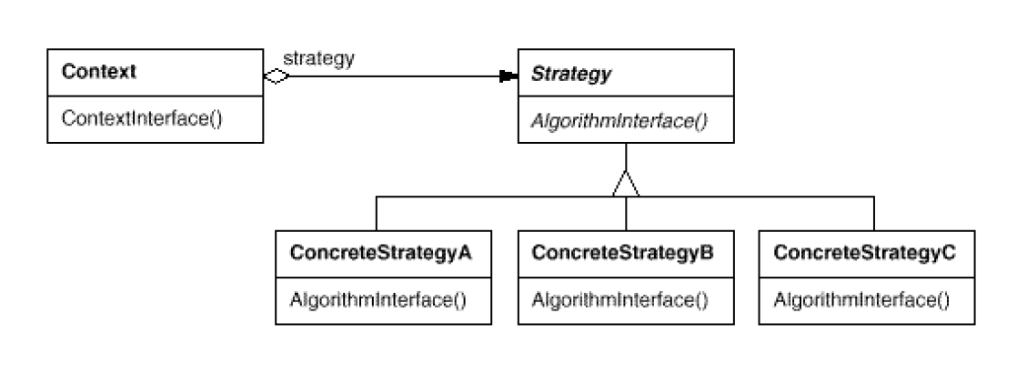
Applicability
When an object should be configurable with one of many algorithms
All algorithms can be encapsulated
One interface covers all encapsulations.
Structure

Slide 111
Consequences
Dynamicity: Algorithms can change dynamically
Flexibility: Support a variety of algorithms
Strategies eliminate conditional statements
Overhead: Communication overhead between strategy and context
Memory: Increased number of objects
Implementation
Exchanging information between a Strategy and its context
Static strategy selection via parameterized types

Slide 112
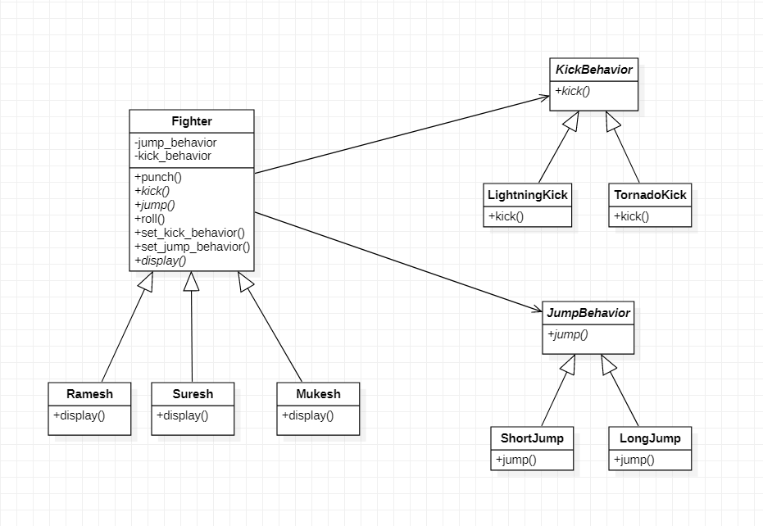
Current Example

Slide 113
Template Pattern
Intent
Motivation
Applicability
Structure
Consequences

Slide 114
Intent
Provide a skeleton of an algorithm in a method, deferring some steps to subclasses
Motivation
A template method defines an algorithm in terms of abstract operations that subclasses override to provide concrete behavior. It implements the constant parts of an algorithm and leaves it up to the subclasses to implement the behavior that can vary

Slide 115
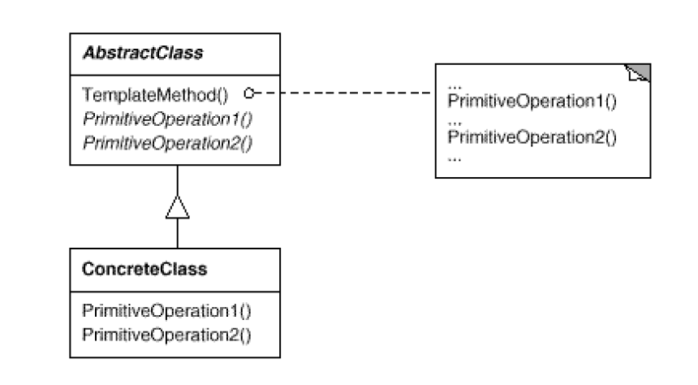
Applicability
Implement invariant aspects of an algorithm once and let subclasses define variant parts
Localize common behavior in a class to increase code reuse Control subclass extensions
Structure

Slide 116
Consequences
Inversion of control: Leads to inversion of control
Reusability: Promotes code reuse
Overriding: Lets you enforce overriding rules
Forced sub classing: Must subclass to specialize behavior
Implementation
Minimizing primitive operations
Naming convention
Virtual vs non-virtual template method

Slide 117
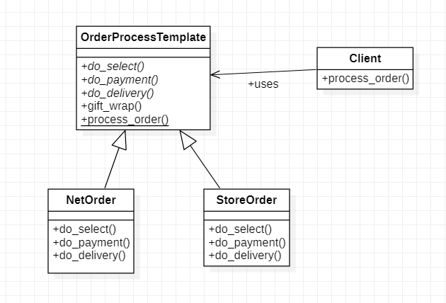
Current Example

Slide 118
Visitor Pattern
Intent
Motivation
Applicability
Structure
Consequences

Slide 119
Intent
Centralize operations on an object structure so that they can vary independently but still behave polymorphically
Motivation
Often adding new operations and distributing operations can become hard to understand, maintain and change. Visitor pattern allows newer operations to be added separately independent of the nodes on which they operate.

Slide 120
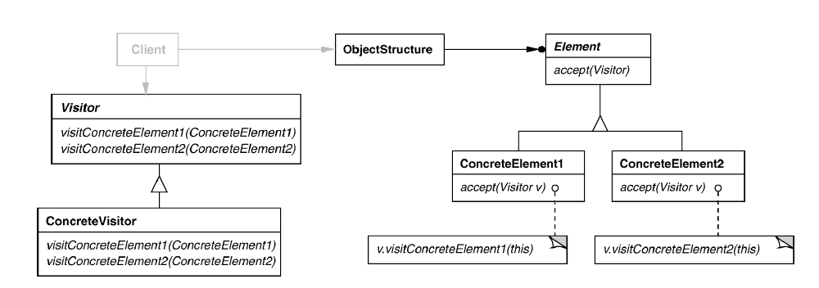
Applicability
When classes define many unrelated operations
Class relationships of objects in the structure rarely change, but the operations on them change often
Algorithms keeps state that is updated during traversal
Structure

Slide 121
Consequences
Consistency: Components are treated the same irrespective of the composition
Flexibility: Visitor algorithms and object structure are independent
Extension: Adding new concrete element subclasses is hard
Dependency: Circular dependency between visitor and element interfaces
Implementation
Double dispatch
General interface to elements of object structure

Slide 122
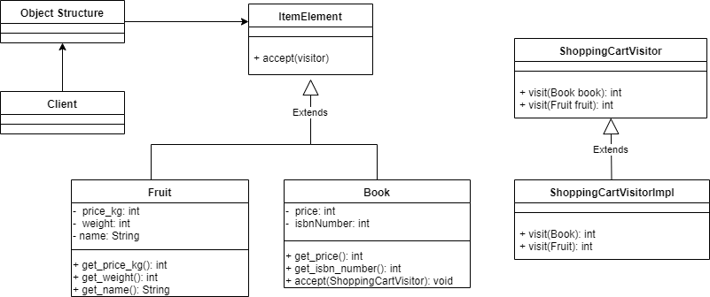
Current Example

