Slide 1
Mediator Pattern
Intent
Motivation
Applicability
Structure
Consequences

Slide 2
Intent
To allow loose coupling by encapsulating the way disparate sets of objects interact and communicate with each other. This allows for the actions of each object set to vary independently of one another.
Motivation
An object oriented design with different classes interacting with each other requires independence. Such frameworks need a mechanism to facilitate the interaction between objects in a manner that they are not aware of each other’s existence. A mediator object realized using mediator pattern can address this issue.

Slide 3
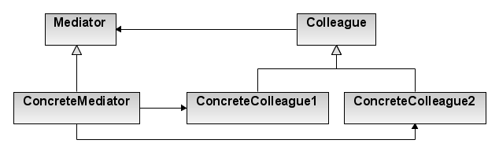
Applicability
When a set of objects communicate in well-defined but complex ways. The resulting interdependencies are unstructured and difficult to understand
When reusing an object is difficult because it refers to and communicates with many other objects
When a behavior that’s distributed between several classes should be customizable without a lot of sub-classing
Structure

Slide 4
Consequences
Behavior localization: It limits sub-classing
Decoupling: A mediator promotes loose coupling between colleagues
Simplification: It simplifies object protocols, replacing many-to-many interactions with one-to-many interactions
Complexity: Mediator itself can become more complex than any other colleague thus trading complexity of interaction for complexity in itself
Implementation
Abstract mediator class isn’t required
One approach for colleague-mediator communication can be realized using observer pattern.

Slide 5
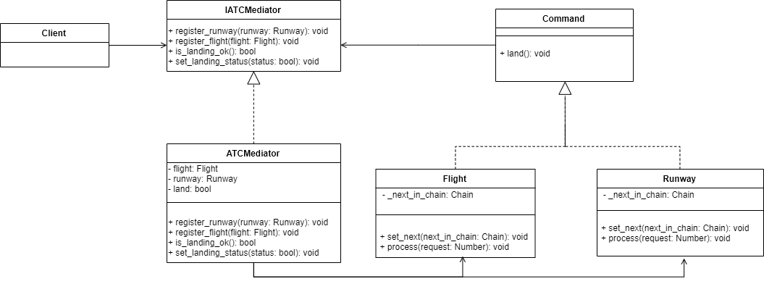
Current Example

