Slide 1
Memento Pattern
Intent
Motivation
Applicability
Structure
Consequences

Slide 2
Intent
Capture an object’s internal state so that the object can be restored to this state later.
Motivation
Sometimes it’s necessary to record the internal state of an object. Implementing checkpoints and undo mechanisms lets users back out of a tentative operations and/or recover from errors. Saving the state information enable the restoration of objects to their previous states.

Slide 3
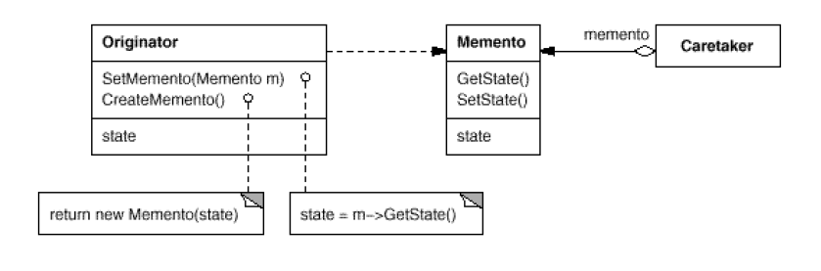
Applicability
When an object’s state must be saved so that it can be restored later, and
A direct interface to obtaining the state would expose implementation details and break the object’s encapsulation.
Structure

Slide 4
Consequences
Encapsulation: Memento pattern preserves encapsulation boundaries
Originator simplification: Clients instead of originator manage the state they ask for, removing the burden of storage management from the originator.
State privacy: Ensuring only originator can access the memento’s state can be challenging
Expensive: If mementos are large in size or frequency of their creation is high, the pattern can become expensive
Implementation
Language support
Storing incremental changes

Slide 5
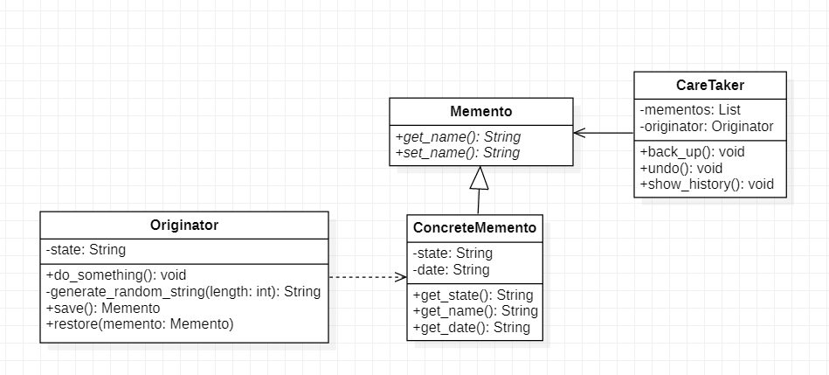
Current Example

