Slide 1
Prototype Pattern
Intent
Motivation
Applicability
Structure
Consequences

Slide 2
Intent
Specify the kinds of objects to create using a prototypical instance, and create new objects by copying this prototype
Motivation
Prototype allows us to hide the complexity of making new instances from the client. The concept is to copy an existing object rather than creating a new instance which may include costly operations.

Slide 3
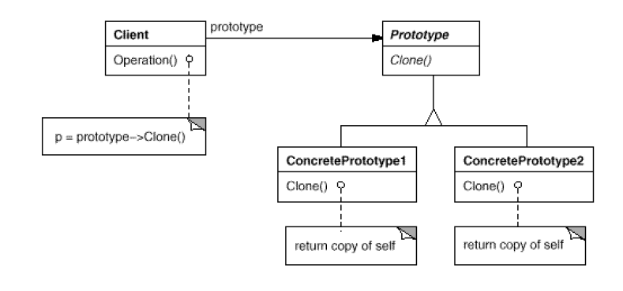
Applicability
When object creation is costly
When dynamic loading is used i.e. the classes to instantiate are specified at run-time
When instances of a class can have one of only a few different combinations of state. It may be more convenient to install a corresponding number of prototypes and clone them rather than instantiating the class manually, each time with the appropriate state.
Structure

Slide 4
Consequences
Dynamic behavior: A client can exhibit dynamic behavior by delegating responsibility to the prototype
Flexibility: Adding and removing products at run-time simply by registering or de-registering a prototypical instance with the client
Overhead: Each subclass must implement the ‘Clone’ operation.
Implementation
Clone operation considering circular references
Consider implementing a prototype manager that will keep track of the available prototypes

Slide 5
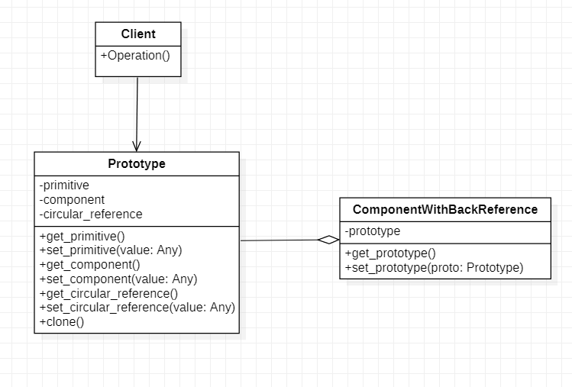
Current Example

