Slide 1

INTEGRATED APPROACH TO ASSESS THE QUALITY OF WATER
by
S.K SUHANA ANJUM
Roll No. 224G1A05A7
P. MAHAMMED THANVEER
Roll No. 224G1A0546
C. PALLAVI
Roll No. 224G1A0564
Under the guidance of
Mr. C. Sudheer Kumar, M.Tech., (Ph. D)
Assistant Professor
Department of Computer Science and Engineering
Srinivasa Ramanujan Institute of Technology
Autonomous
Rotarypuram Village, B K Samudram Mandal, Ananthapuramu – 515701.
2025-2026
B18
DEPT. OF COMPUTER SCIENCE AND ENGINEERING
SRINIVASA RAMANUJAN INSTITUTE OF TECHNOLOGY
01

Slide 2
INTEGRATED APPROACH TO ASSESS THE QUALITY OF WATER
Queries From Review 0
What are the models you are using?
How do you detect the object?
How do you classify the object?
What is the expected output of the project?
B18
DEPT. OF COMPUTER SCIENCE AND ENGINEERING
SRINIVASA RAMANUJAN INSTITUTE OF TECHNOLOGY
02

Slide 3
INTEGRATED APPROACH TO ASSESS THE QUALITY OF WATER
Title Explanation
The title “Integrated Approach to Assess the Quality of Water” represents a web-based system that evaluates river water quality using automated detection techniques.
Integrated Approach refers to the combination of image preprocessing, object detection, and a web-based platform working together as a unified system.
Assess means analyzing river water images to identify and classify different pollutants.
Quality of Water indicates the overall water condition based on detected pollutants such as acid pollution, plastic waste, dead animals, eutrophication, and fish oil.
B18
DEPT. OF COMPUTER SCIENCE AND ENGINEERING
03
SRINIVASA RAMANUJAN INSTITUTE OF TECHNOLOGY

Slide 4
INTEGRATED APPROACH TO ASSESS THE QUALITY OF WATER
Contents
Abstract
Introduction
Software Requirements
Datasets/Modules
Implementation
Outputs
Conclusion
References
B18
DEPT. OF COMPUTER SCIENCE AND ENGINEERING
04
SRINIVASA RAMANUJAN INSTITUTE OF TECHNOLOGY

Slide 5
INTEGRATED APPROACH TO ASSESS THE QUALITY OF WATER
Abstract
The River Water Quality Assessment System is designed to address the challenges of manually monitoring water pollution in rivers. Traditional inspection methods are time-consuming and may fail to detect multiple pollutants accurately.
To overcome this, the project provides a web-based platform that uses image processing and object detection to identify pollutants in river water. The main objective is to make water quality monitoring faster, accurate, and systematic.
The system is developed using YOLOv10 with a Flask-based web interface that allows users to upload images and view detection results. Testing shows that the system reduces manual effort and improves the efficiency of pollution assessment and reporting.
B18
DEPT. OF COMPUTER SCIENCE AND ENGINEERING
05
SRINIVASA RAMANUJAN INSTITUTE OF TECHNOLOGY

Slide 6
INTEGRATED APPROACH TO ASSESS THE QUALITY OF WATER
Introduction
Water pollution is a serious environmental issue affecting river ecosystems, aquatic life, and human health. Rivers carry pollutants such as plastic waste, oil residues, chemicals, and organic matter. Traditional monitoring methods are time-consuming and often fail to provide accurate results.
To address these challenges, this project proposes an Integrated River Water Quality Assessment System. It uses image-based object detection with the YOLOv10 algorithm to identify river pollutants. The system analyzes uploaded river images to classify different types of contamination.
A Flask-based web application provides an easy interface for users to upload images and view results. The automated detection process reduces manual effort and improves monitoring efficiency. This approach supports systematic assessment and reporting of river water quality.
B18
DEPT. OF COMPUTER SCIENCE AND ENGINEERING
06
SRINIVASA RAMANUJAN INSTITUTE OF TECHNOLOGY

Slide 7
INTEGRATED APPROACH TO ASSESS THE QUALITY OF WATER
Software Requirements
Frontend
HTML, CSS, JavaScript
Bootstrap
Backend Python
Flask Framework
Database SQLite
AI / Logic YOLOv10 (Deep Learning Object Detection) Image Processing & Classification (Python)
Libraries / Tools Pandas, TensorFlow, Keras VS Code Python 3.8+ Python Virtual Environment (venv)
B18
DEPT. OF COMPUTER SCIENCE AND ENGINEERING
07
SRINIVASA RAMANUJAN INSTITUTE OF TECHNOLOGY

Slide 8
INTEGRATED APPROACH TO ASSESS THE QUALITY OF WATER
Datasets/Modules
River Pollution Dataset
Fields: Image ID, Image Path, Pollution Type, Object Type, Bounding Box Coordinates, Confidence Score
Purpose: Stores labeled river images used for training and testing the YOLOv10 model to detect different pollutants.
Object Dataset
Fields: Object ID, Object Name, Category (Plastic/Organic/Metal), Image ID
Purpose: Maintains details of objects such as bottles, glass, metal, paper, and trash detected in river water.
User Dataset
Fields: User ID, Name, Email, Password, Login Time, Uploaded Image History
Purpose: Manages user authentication, image uploads, and user activity tracking.
B18
DEPT. OF COMPUTER SCIENCE AND ENGINEERING
08
SRINIVASA RAMANUJAN INSTITUTE OF TECHNOLOGY

Slide 9
INTEGRATED APPROACH TO ASSESS THE QUALITY OF WATER
Datasets/Modules
Detection Results Dataset
Fields: Detection ID,Image ID,Detected Class,Confidence Level,Detection Time.
Purpose: Stores detection outcomes for monitoring, reporting, and future analysis.
Admin Dataset
Fields: Admin ID, Username, Password, Role/Access Level, Notification Status
Purpose: Handles system monitoring, pollution alerts, and administrative controls.
B18
DEPT. OF COMPUTER SCIENCE AND ENGINEERING
09
SRINIVASA RAMANUJAN INSTITUTE OF TECHNOLOGY

Slide 10
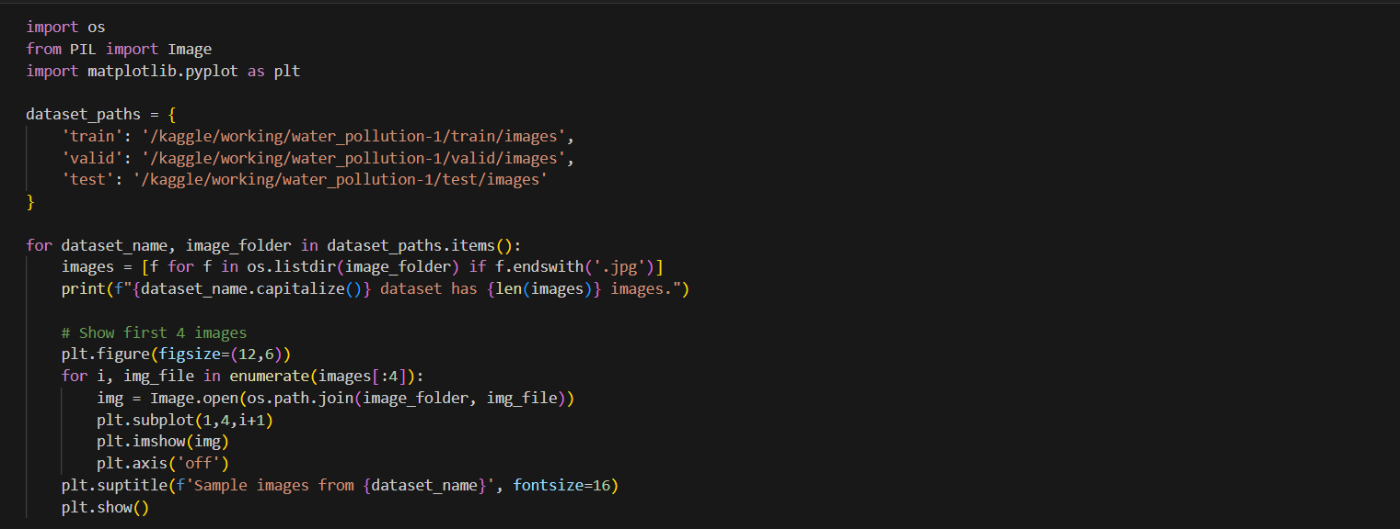
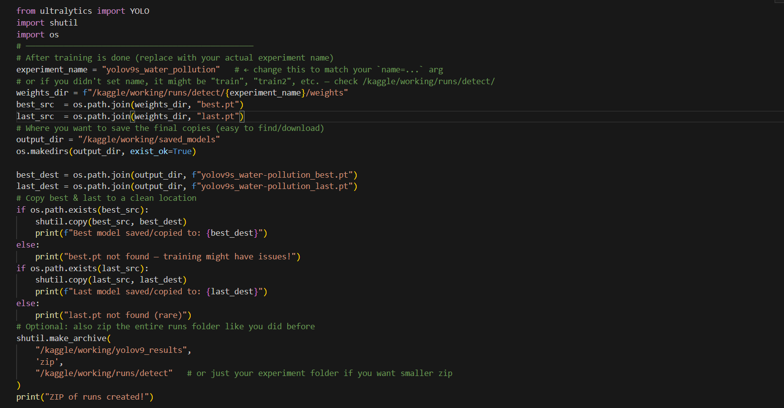
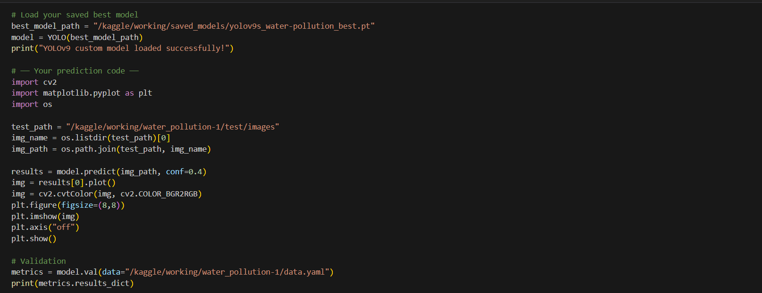
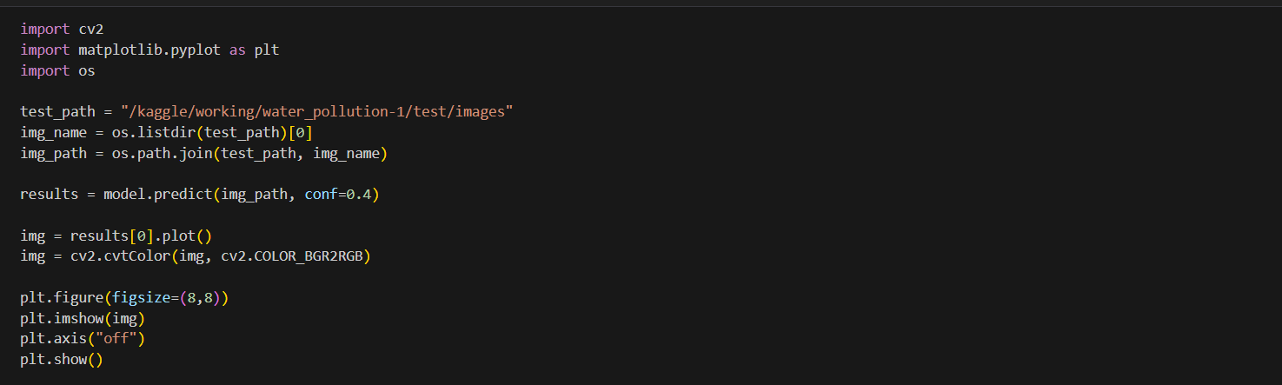
INTEGRATED APPROACH TO ASSESS THE QUALITY OF WATER
Implementation
B18
DEPT. OF COMPUTER SCIENCE AND ENGINEERING
10
SRINIVASA RAMANUJAN INSTITUTE OF TECHNOLOGY

Slide 11
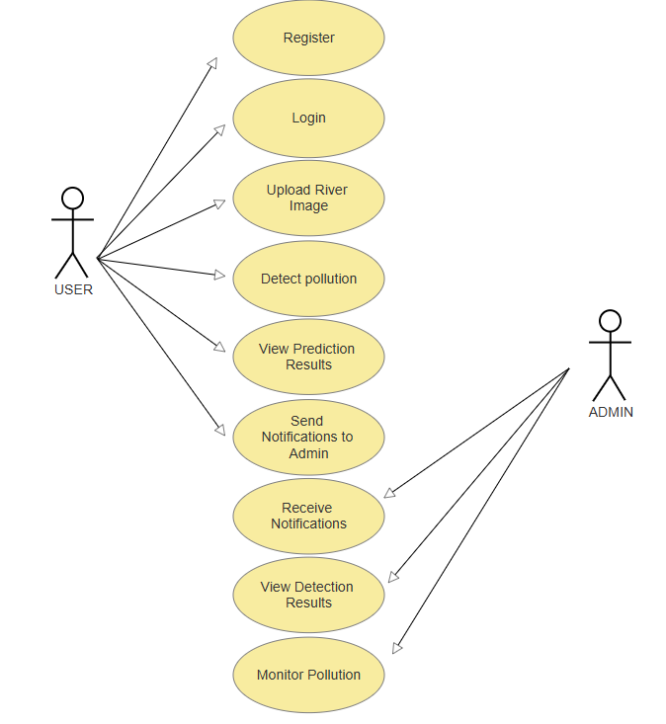
INTEGRATED APPROACH TO ASSESS THE QUALITY OF WATER
UML diagram of Use Case
Purpose
To provide a centralized platform for assessing river water quality by detecting pollutants using image-based object detection and enabling effective monitoring and reporting.
Admin Role
Monitor pollution detection results through the admin dashboard
Receive automated notifications when pollutants are detected
Manage system data and oversee monitoring activities
User Role
Register and log in to the system
Upload river water images for pollution detection
View prediction results and detected pollutants
Send notifications to the admin if pollution is identified
Log out securely from the system
B18
DEPT. OF COMPUTER SCIENCE AND ENGINEERING
11
SRINIVASA RAMANUJAN INSTITUTE OF TECHNOLOGY

Slide 12
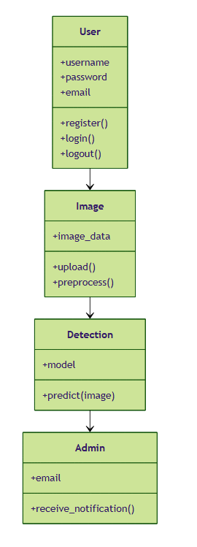
INTEGRATED APPROACH TO ASSESS THE QUALITY OF WATER
UML diagram of Class
User
Attributes: user_id, username, password, email
Functions: register(), login(), logout()
Purpose: Allows users to access the system, upload river images, and view pollution detection results.
Image
Attributes: image_id, image_data, upload_time, user_id
Functions: upload(), preprocess()
Purpose: Handles image upload and preprocessing before pollution detection.
B18
DEPT. OF COMPUTER SCIENCE AND ENGINEERING
12
SRINIVASA RAMANUJAN INSTITUTE OF TECHNOLOGY

Slide 13
INTEGRATED APPROACH TO ASSESS THE QUALITY OF WATER
UML diagram of Class
Detection
Attributes: model, detected_class, confidence_score
Functions: predict(image)
Purpose: Uses the YOLOv10 model to detect and classify pollutants and objects in river images.
Admin
Attributes: admin_id, email
Functions: receive_notification()
Purpose: Receives alerts when pollution is detected and monitors system activity.
B18
DEPT. OF COMPUTER SCIENCE AND ENGINEERING
13
SRINIVASA RAMANUJAN INSTITUTE OF TECHNOLOGY

Slide 14
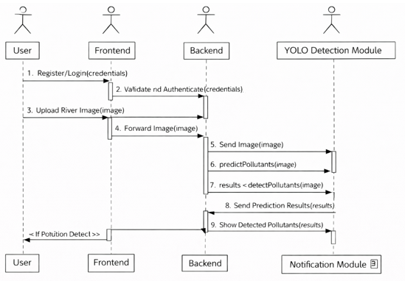
INTEGRATED APPROACH TO ASSESS THE QUALITY OF WATER
UML diagram of Sequence
User Authentication & Image Upload
The user registers or logs in through the frontend interface.
The frontend sends the login details to the backend for validation.
Once authenticated, the user uploads a river water image through the system.
Image Processing & Detection
The frontend forwards the uploaded image to the backend server.
The backend sends the image to the YOLOv10 detection module for analysis.
The detection module predicts pollutants and objects present in the image.
Result Display
After detection, the results are returned to the backend.
The backend sends the prediction results to the frontend.
The frontend displays the detected pollutants and confidence levels to the user.
Notification & Monitoring
If pollution is detected, the detection module triggers a notification.
The backend sends an alert to the admin with detection details.
The admin monitors pollution status through the system dashboard.
B18
DEPT. OF COMPUTER SCIENCE AND ENGINEERING
14
SRINIVASA RAMANUJAN INSTITUTE OF TECHNOLOGY

Slide 15
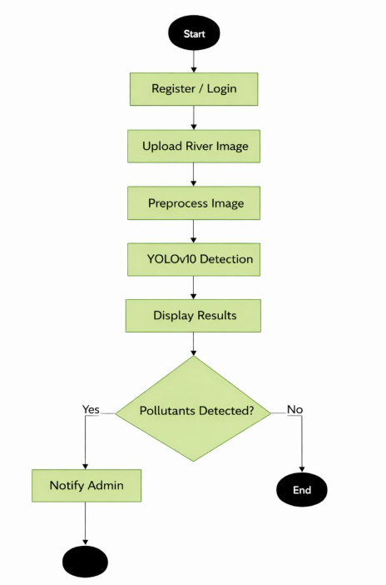
INTEGRATED APPROACH TO ASSESS THE QUALITY OF WATER
UML diagram of Activity
Activity Diagram
The user starts the process by registering or logging into the system.
After successful login, the user uploads a river water image for analysis.
The system preprocesses the uploaded image to improve detection accuracy.
The YOLOv10 detection model is executed to identify pollutants and objects.
Detection results are displayed to the user on the interface.
If pollutants are detected, the system sends a notification to the admin.
The process ends after notifying the admin or displaying clean results.
B18
DEPT. OF COMPUTER SCIENCE AND ENGINEERING
15
SRINIVASA RAMANUJAN INSTITUTE OF TECHNOLOGY

Slide 16
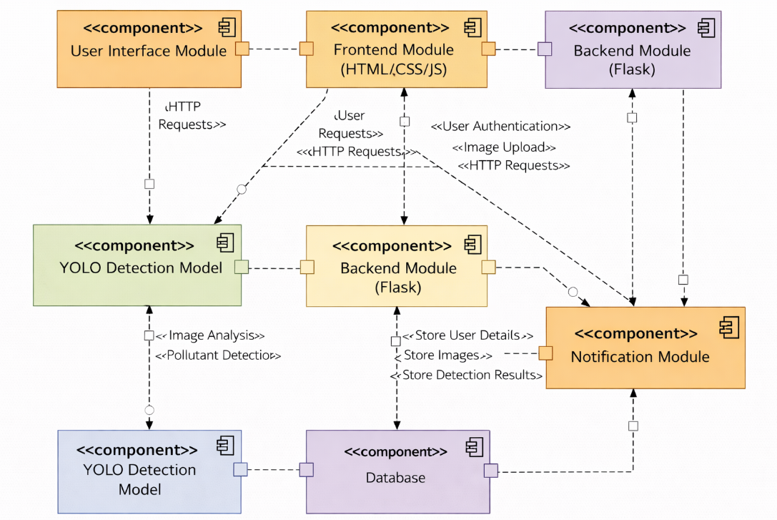
INTEGRATED APPROACH TO ASSESS THE QUALITY OF WATER
UML diagram of Component
Component Diagram
The user interacts with the system through the User Interface Module.
The Frontend (HTML, CSS, JavaScript) sends HTTP requests to the backend server.
The Backend (Flask) handles user authentication, image processing, and request management.
The YOLO Detection Model analyzes images and detects pollutants.
The Database stores user details, uploaded images, and detection results.
The Notification Module alerts the admin when pollution is detected.
B18
DEPT. OF COMPUTER SCIENCE AND ENGINEERING
15
SRINIVASA RAMANUJAN INSTITUTE OF TECHNOLOGY

Slide 17
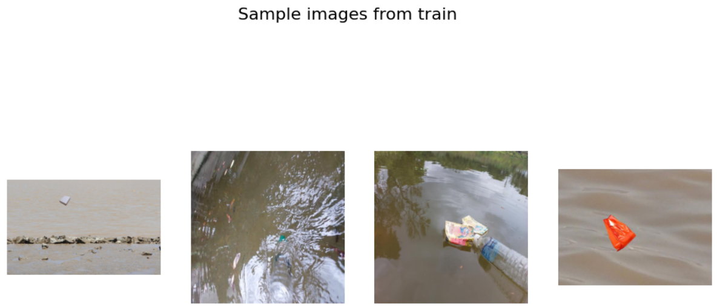
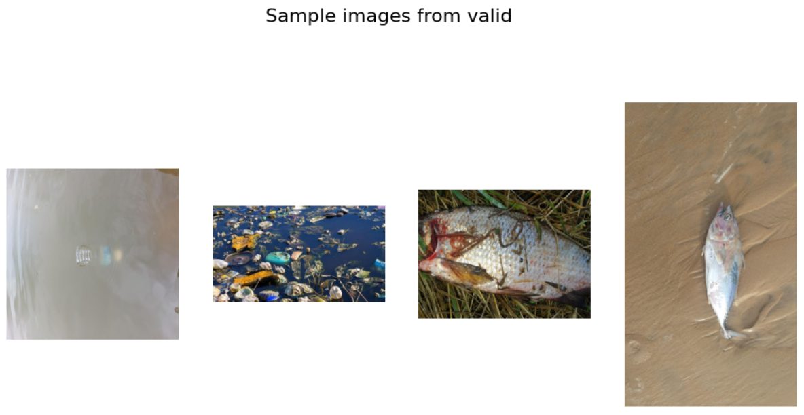
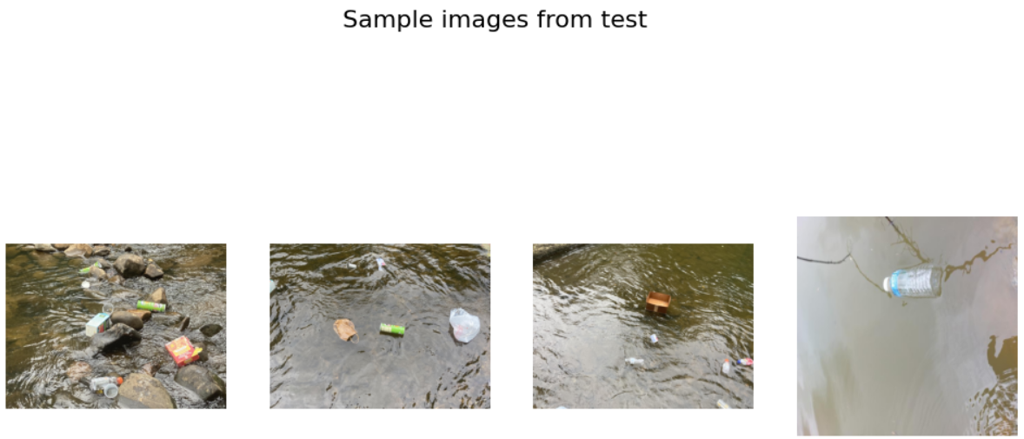
INTEGRATED APPROACH TO ASSESS THE QUALITY OF WATER
Output
B18
DEPT. OF COMPUTER SCIENCE AND ENGINEERING
16
SRINIVASA RAMANUJAN INSTITUTE OF TECHNOLOGY

Slide 18
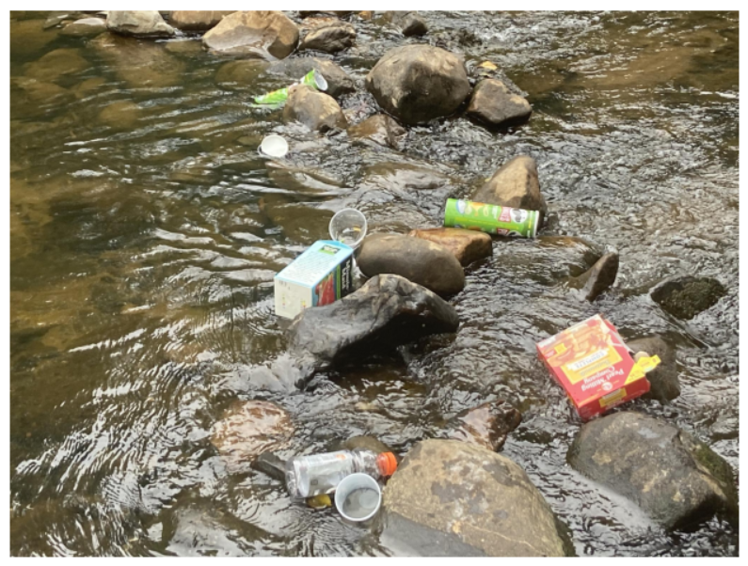
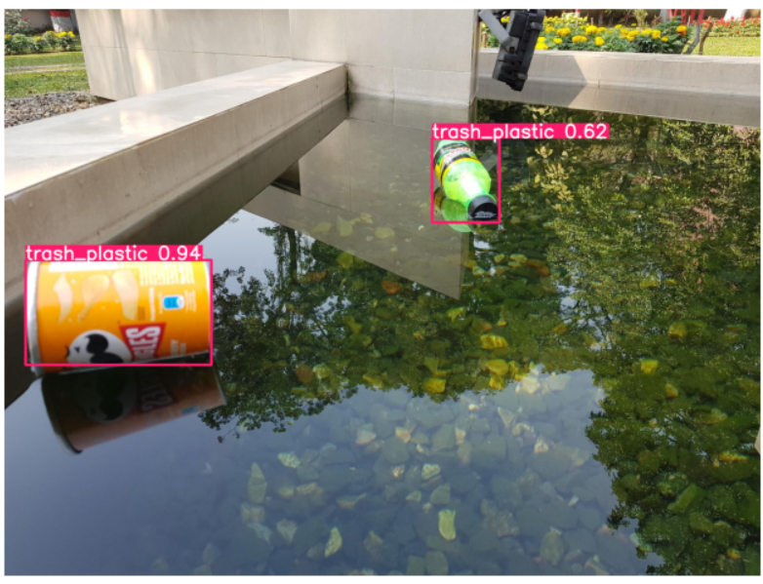
INTEGRATED APPROACH TO ASSESS THE QUALITY OF WATER
Output
B18
DEPT. OF COMPUTER SCIENCE AND ENGINEERING
16
SRINIVASA RAMANUJAN INSTITUTE OF TECHNOLOGY

Slide 19
INTEGRATED APPROACH TO ASSESS THE QUALITY OF WATER
Conclusion
The project presents an integrated system for assessing river water quality using automated object detection.
YOLOv10 effectively detects and classifies multiple pollutants such as plastic waste, oil, acid contamination, eutrophication, and dead organisms.
Image preprocessing and proper dataset preparation improve detection accuracy and reliability.
The Flask-based web application enables easy user interaction, image upload, and result visualization.
Automated admin notifications support efficient monitoring and documentation.
Overall, the system reduces manual effort and provides a scalable solution for water quality assessment.
B18
DEPT. OF COMPUTER SCIENCE AND ENGINEERING
17
SRINIVASA RAMANUJAN INSTITUTE OF TECHNOLOGY

Slide 20
INTEGRATED APPROACH TO ASSESS THE QUALITY OF WATER
References
Books
[1] S. Russell and P. Norvig, Artificial Intelligence: A Modern Approach, Pearson Education, New Jersey, 2021.
Journal Article
[2] Improved YOLOv7 Algorithm for Floating Waste Detection Based on GFPN and Long-Range Attention Mechanism, Wuhan University Journal of Natural Sciences, 2024.
Newspaper article
[3] A. Verma and N. Sharma, Design and Implementation of an AI-Based River Water Quality Monitoring System, Department of Computer Science, National Institute of Technology, Technical Report, 2024. Report
Technical
[4] “AI Helps Monitor River Pollution More Efficiently,” The Hindu, India, 2024.
B18
DEPT. OF COMPUTER SCIENCE AND ENGINEERING
18
SRINIVASA RAMANUJAN INSTITUTE OF TECHNOLOGY

Slide 21
INTEGRATED APPROACH TO ASSESS THE QUALITY OF WATER
THANK YOU
B18
DEPT. OF COMPUTER SCIENCE AND ENGINEERING
19
SRINIVASA RAMANUJAN INSTITUTE OF TECHNOLOGY

Slide 22
INTEGRATED APPROACH TO ASSESS THE QUALITY OF WATER
ANY QUERIES?
B18
DEPT. OF COMPUTER SCIENCE AND ENGINEERING
20
SRINIVASA RAMANUJAN INSTITUTE OF TECHNOLOGY

