Slide 1

MARINE GUARD
by
S.K SUHANA ANJUM
Roll No. 224G1A05A7
P. MAHAMMED THANVEER
Roll No. 224G1A0546
C. PALLAVI
Roll No. 224G1A0564
Under the guidance of
Mr. C. Sudheer Kumar, M.Tech., (Ph. D)
Assistant Professor
Department of Computer Science and Engineering
Srinivasa Ramanujan Institute of Technology
Autonomous
Rotarypuram Village, B K Samudram Mandal, Ananthapuramu – 515701.
2025-2026
B - 18

Slide 2
Contents
Marine Guard
Title Justification
Abstract
Problem statement
Objectives of Project
Literature survey for objectives
Proposed Work -(Methods to be followed for proposed system)
References
GitHub Link
Queries
Srinivasa Ramanujan Institute of Technology

Slide 3
Title Justification
Marine Guard
The title “MarineGuard – River Pollution Awareness & Reporting System” is appropriate because it clearly represents the project’s purpose of protecting river ecosystems by raising awareness and enabling public reporting. “MarineGuard” suggests safeguarding water bodies, “River Pollution Awareness”. “Reporting System” shows that users can submit real-time reports with images and locations. Overall, the title reflects the system’s goal of combining awareness, monitoring, and citizen participation in line with Life Below Water.
Srinivasa Ramanujan Institute of Technology

Slide 4
Abstract
Marine Guard
River pollution is rising due to plastic waste, industrial dumping making it difficult for authorities to track affected river stretches in real time. To address this challenge, the project introduces a web-based River Pollution Awareness and Reporting System under Life Below Water.
The system displays the output through an interactive dashboard. Each report includes details such as river name, pollution type, location, uploaded image, and timestamp. This dashboard visualization helps authorities quickly identify pollution hotspots, improves public awareness, and supports environmental response actions, contributing to the protection and conservation of aquatic ecosystems.
Srinivasa Ramanujan Institute of Technology

Slide 5
Problem Statement
Marine Guard
River pollution is increasing due to plastic waste, chemical dumping, and industrial effluents.
Traditional monitoring methods are slow, manual, and limited, causing delays in identifying pollution-prone river areas.
Authorities do not receive real-time information, making it difficult to respond quickly to pollution incidents.
Citizens lack a centralized digital platform to report polluted river locations with photo evidence and location details.
Existing systems fail to combine reporting, dashboard visualization, and admin verification, leading to incomplete or unreliable data.
Public awareness about the impact of river pollution on aquatic ecosystems and community health is insufficient.
Srinivasa Ramanujan Institute of Technology

Slide 6
Objectives of Project
Marine Guard
Research Objective
To analyze how a web-based citizen reporting system improves the identification, visualization, and tracking of pollution incidents in river environments.
System Development Objective
To design and develop a full-stack web platform that supports real-time reporting, mapping, and verification of river pollution incidents using user-submitted data and admin monitoring.
Srinivasa Ramanujan Institute of Technology

Slide 7
Marine Guard
Literature Survey for Objectives
d
No | Title | Authors | Journal Name & Year | Methodology Adapted | Key Findings
1. | Microplastics in Freshwater Ecosystems of India: Current Trends and Future Perspectives | K. Neelavannan, I. S. Sen | ACS Omega, Vol. 8, 2023 | Reviews 18 studies on microplastics in Indian rivers and lakes using sampling, separation, and polymer identification techniques. | Microplastics are widespread in Indian freshwater systems with significant regional data gaps and inconsistent study methods.
2. | Using Citizen Science to Understand River Water Quality: The Catchment Science Approach | S. Hegarty et al. | Science of the Total Environment, Vol. 790, 2021 | Uses citizen science, where volunteers collect water samples and report water-quality information using standardized scientific procedures | Citizen participation improves water-quality data collection, increases monitoring coverage, and helps identify river pollution patterns more efficiently.
Srinivasa Ramanujan Institute of Technology

Slide 8
Proposed System
Marine Guard
The proposed system, MarineGuard – River Pollution Awareness & Reporting System, is a full-stack web platform designed to support public participation in monitoring river pollution.
Key Features: Users can login/register and submit pollution reports with:
Image evidence
Description
Pollution type
Location details captured through device GPS (without using Google Maps)
All reports are stored in a centralized MySQL/MongoDB database.
The system displays pollution incidents on the website through an interactive dashboard, using:
Tables
Category-wise lists (instead of pins on a Google Map)
Admin can:
Verify or reject reports
Update status (Pending, Verified, Resolved)
Forward verified reports to authorities
Srinivasa Ramanujan Institute of Technology

Slide 9
References
Marine Guard
K. Neelavannan and I. S. Sen, “Microplastics in Freshwater Ecosystems of India: Current Trends and Future Perspectives,” ACS Omega, vol. 8, pp. 34235–34248, 2023.
Citizen Science for River Water Quality (Very Closely Related to Your Concept)
S. Hegarty et al., “Using citizen science to understand river water quality: The catchment science approach,” Science of the Total Environment, vol. 790, 2021.
Srinivasa Ramanujan Institute of Technology

Slide 10
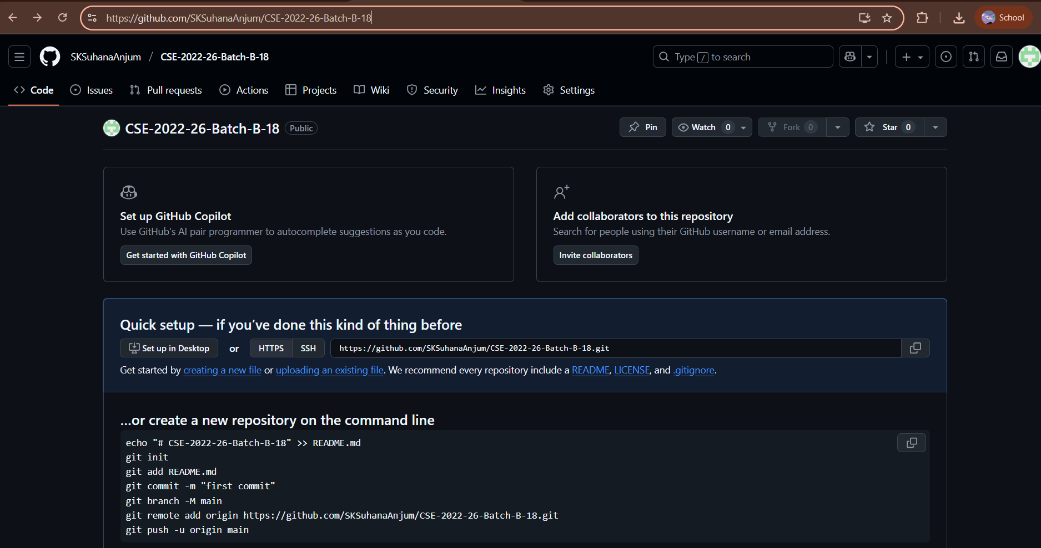
Git Hub Dashboards of each student
Marine Guard
Github link: https://github.com/SKSuhanaAnjum/CSE-2022-26-Batch-B-18
Srinivasa Ramanujan Institute of Technology

Slide 11
Any Queries?
Marine Guard
Srinivasa Ramanujan Institute of Technology

