Slide 1
Medical Symptom Advisor
High-Risk AI System for Healthcare Decision Support
Satish Swarnkar
University of Texas at Austin
Notes:
Hello I'm Satish Swarnkar
Today, I’ll present my project — Medical Symptom Advisor, a high-risk AI system designed for healthcare decision support.

Slide 2
Introduction
Problem:
Traditional symptom checkers fail on free-form input
Importance:
Mistrust and wrong triage decisions
Healthcare AI is high-risk but critical
Notes:
The motivation for this project was the serious gap in how traditional symptom checkers work. They fail when users describe symptoms in a natural language. Sometimes they show wrong diagnosis.
Also this where innovation is needed so that patients can trust AI.

Slide 3
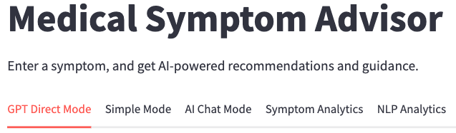
Methodology Overview
Approach:
Semantic Search (FAISS embeddings)
Chain-of-Thought Reasoning
LangChain for dialogue management
Real-time validation via OpenFDA and PubMed
Frontend: Streamlit
Notes:
There are three options here
First, semantic search
Chain-of-Thought reasoning
Agentic AI with LangChain
Then I connect using OpenFDA and PubMed APIs to get real-time validation.
The frontend is built in Streamlit

Slide 4
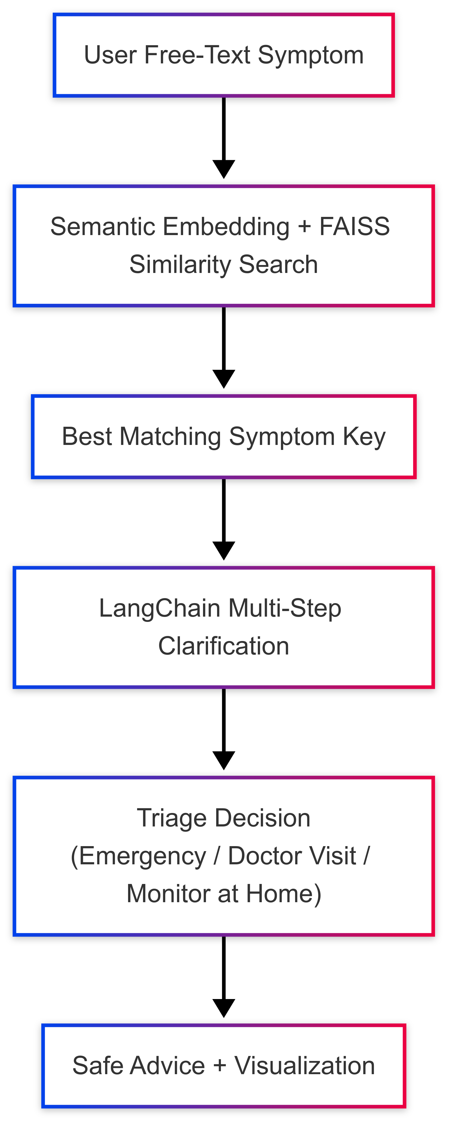
System Architecture
Workflow:
Input ➔ Semantic Matching ➔ Clarification ➔ Triage ➔ Validation ➔ Visualization
Notes:
I will demonstrate the workflow shortly – but it starts with patients input and…
provides triage decision – such as go to doctor or emergency room or monitor at home and then shows additional information and research articles from the internet,

Slide 5

Chain-of-Thought Reasoning
Multi-turn clarifications
Dynamically generated questions
Improves reasoning transparency
Notes:
Chain-of-Thought Reasoning - Once a symptom match is found, the system asks smart follow-up questions.

Slide 6
Semantic Symptom Matching
FAISS-based vector embeddings
Flexible matching to symptom database
Handles variability in patient language
Notes:
In case of Semantic Matching – my app uses Facebook’s FAISS - Facebook AI Similarity Search embeddings.
The natural query - feels very flexible and natural to a patient and I will show you that in my demo.

Slide 7
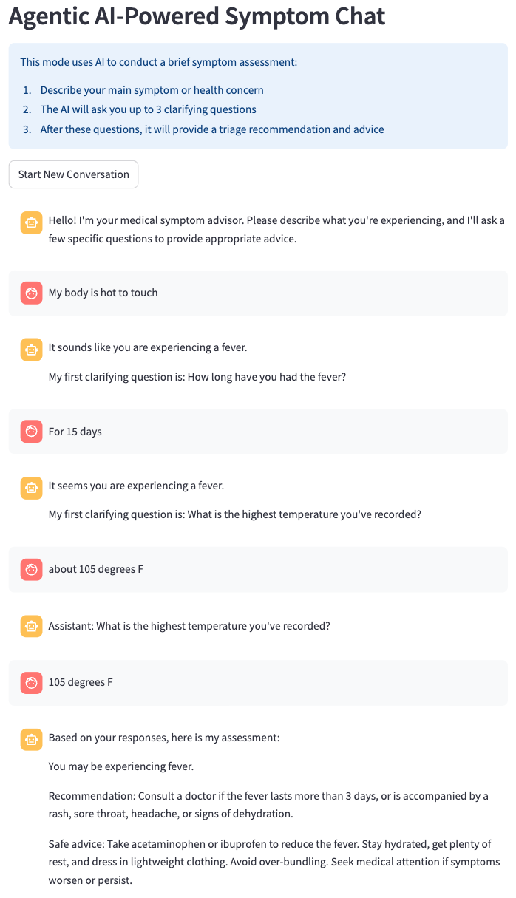

Agentic AI with LangChain
Conversational Retrieval Chain
Manages multi-turn conversations
Prevents context loss and repetition
Notes:
Agentic AI with LangChain powers the conversation. It feels natural as if you are conversing with a human.

Slide 8
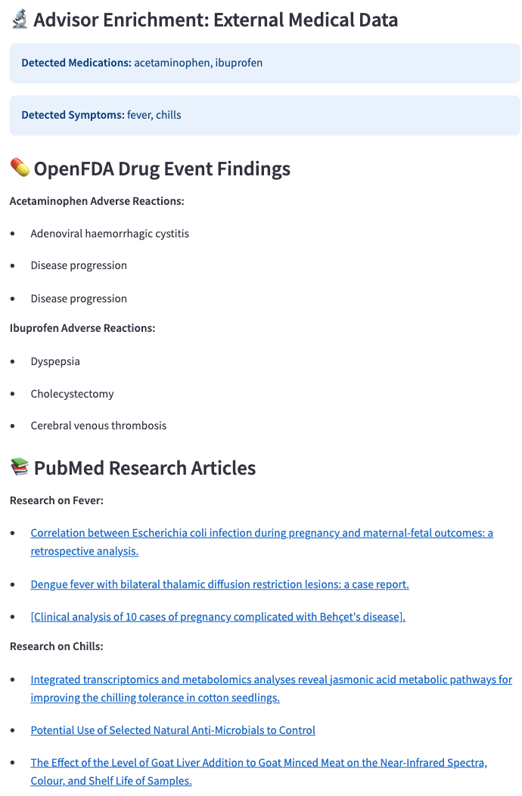


External Medical Data Integration
OpenFDA for adverse event reports
PubMed for medical literature
Strengthens evidence grounding
Notes:
I have integrated APIs from OpenFDA for medication risks and PubMed for the latest research.

Slide 9
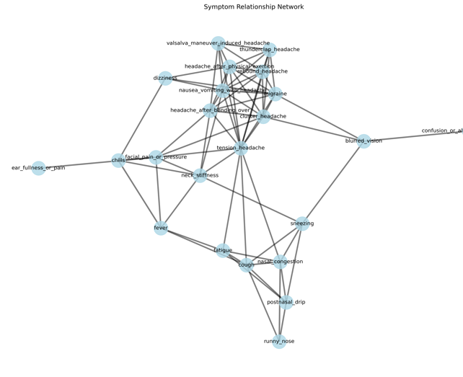
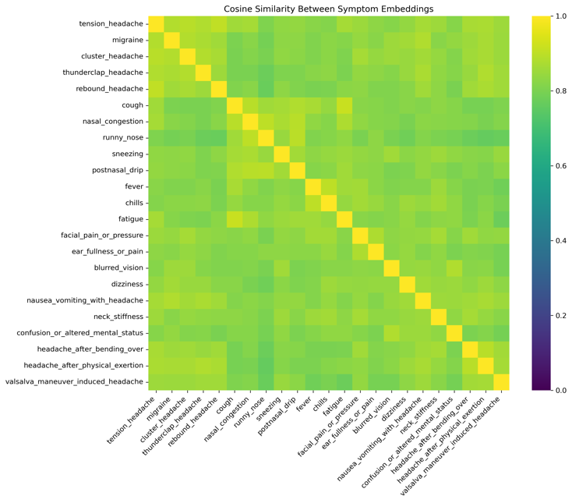
Visualization Capabilities
Cosine Similarity Heatmaps
t-SNE Projections
Symptom Network Graphs
PCA Dimension Analysis
Notes:
To improve transparency, I implemented several visualization that I will show you shortly:

Slide 10

Risk Mitigation Strategies
Tiered Triage Recommendations
External Validation
'Conditions to Flag' Warnings
Clear Medical Disclaimers
Notes:
Given the risks, I added safeguards:
Every recommendation is tiered into Emergency, Doctor Visit, or Home Monitoring.
Conditions to flag are highlighted.

Slide 11
Results
92% Semantic Matching Accuracy
Successful External Data Enrichment
Robust Symptom Clustering
Notes:
Testing showed over 90% matching accuracy for paraphrased symptoms
I was successful in identifying medication risks and getting pertinent articles on the internet.

Slide 12
Future Directions
Expand symptom and rare disease coverage
Integrate WHO, CDC real-time feeds
Mobile-first and multilingual expansion
Clinical validation studies
Notes:
Four items in my roadmap:
-

Slide 13
Thank You
Questions?
Swarnkar.Satish@Gmail.com
Notes:
”Here is my email and feel free to ask any questions. Now the DEMO time.

Slide 14

Live Demo
Notes:
Let me now show a quick demo.

