Slide 1
Hw 2 - Part 1

Slide 2
Your classes will be:
Insertion
Merge
Quick
Main
Route
StdRandom
StdOut

Slide 3
Use the codes from book
Insertion sort (use the algorithm on Page 251 of the textbook)
Merge sort (use the algorithm on Page 273 and 271 of the textbook)
Quick sort (use the algorithm on Page 289 and 291 of the textbook)
Take less() and exch() methods from page 245

Slide 4
Quick sort will need:
StdRandom.java, you can download it here:
https://introcs.cs.princeton.edu/java/stdlib/StdRandom.java.html
And for, StdRandom.java you need StdOut.java, download it here:
https://introcs.cs.princeton.edu/java/stdlib/StdOut.java.html

Slide 5
Step 1
You will read integers.txt (the txt file will be given to you)
See ReadingFile.java for reading a txt file and filling the array
Output should look like:
Integers are reading from the integers.txt file, the array is:
20 7 8 1 6 4 5 9 5 8 1 2 5 8 154 25 32 12 18 19 58
The array has been sorted in increasing order by using the insertion sort algorithm:
1 1 2 4 5 5 5 6 7 8 8 8 9 12 18 19 20 25 32 58 154
Step 1 has been completed.

Slide 6
Step 2
This is how you use sorting algoritms from Main:
ClassName.methodName(arrayName);
Ex: Insertion.sort(arr);
Output should look like:
The array of integers that has been sorted in decreasing order by using the insertion sort algorithm:
154 58 32 25 20 19 18 12 9 8 8 8 7 6 5 5 5 4 2 1 1
Step 2 has been completed.

Slide 7
Step 3
You will read doubles.txt
You can convert the ReadingFile code to double type
Output should look like:
Doubles are reading from the doubles.txt file, the array is:
13.0 7.3 8.66 1.4 6.0 4.9 5.7 9.3 5.2 8.4 1.5 2.0 -5.0 -8.2
The array of double values has been sorted in increasing order by using the insertion sort algorithm:
-8.2 -5.0 1.4 1.5 2.0 4.9 5.2 5.7 6.0 7.3 8.4 8.66 9.3 13.0
Step 3 has been completed.

Slide 8
Step 4
Modify Merge.java for descending ordering
Output should look like:
The original array is:
20 7 8 1 6 4 5 9 5 8 1 2 5 8 154 25 32 12 18 19 58
The array of integer values has been sorted in descending order by using the merge sort algorithm is:
154 58 32 25 20 19 18 12 9 8 8 8 7 6 5 5 5 4 2 1 1
Step 4 has been completed.

Slide 9
Step 5
This step is preparation for step 6 so there will be no output for step 5
Create the Route class

Slide 10
Step 6
Your objects should be like this:
Ankara, Antalya
Ankara, Istanbul
Istanbul, Antalya
Antalya, Izmir
Izmir, Antalya
Izmir, Ankara
Antalya, Ankara
Ankara, Izmir
Istanbul, Izmir
Istanbul, Ankara

Slide 11
Step 6 (cont.)
Output should look like:
Ankara Antalya
Ankara Istanbul
Ankara Izmir
Antalya Ankara
Antalya Izmir
Istanbul Ankara
Istanbul Antalya
Istanbul Izmir
Izmir Ankara
Izmir Antalya
Step 6 has been completed.

Slide 12
Step7
This step is preparation for step 8 so there will be no output for step 7
Modify Quick.java for descending ordering

Slide 13
Step 8
Think this like a bonus +5 points

Slide 14
You will upload your code to the VPL
You need to upload these classess to the VPL and test your code:
Insertion
Merge
Quick
Main
Route

Slide 15
What to hand in
You will not write a report for this part of the assignment
Write detailed comment lines in your code
Submit your codes to the VPL
Zip your codes and submit under hw (zip file name should be your name)

Slide 16
Grading
Test case 15 + Approach 15 = 30 points
A simple test case is used to be sure your code will give the expected output, your comment lines are important

Slide 17
Hw 2 - Part 2

Slide 18
Open separate classes for sorting algorithms
Your classes will be:
Selection
Insertion
Merge
Quick
SortingAlgorithmTester
Method
StdRandom
StdOut

Slide 19
Use the codes from book and do not change anything
Selection sort (use the algorithm on Page 249 of the textbook)
Insertion sort (use the algorithm on Page 251 of the textbook)
Merge sort (use the algorithm on Page 273 and 271 of the textbook)
Quick sort (use the algorithm on Page 289 and 291 of the textbook)
Take less() and exch() methods from page 245

Slide 20
Quick sort will need:
StdRandom.java, you can download it here:
https://introcs.cs.princeton.edu/java/stdlib/StdRandom.java.html
And for, StdRandom.java you need StdOut.java, download it here:
https://introcs.cs.princeton.edu/java/stdlib/StdOut.java.html
You will only upload to VPL your method and tester classes

Slide 21
Method.java
Your method will inlude:
Method()
pairwiseDifference()
main()

Slide 22
Expected Output
input: 113, 23, 1, 109, 4, 102, 7, 105, 100, 107
Enter the sort you want to use:
Selection
2 [100 102]
Enter the sort you want to use:
insertion
2 [100 102]
Enter the sort you want to use:
MERGE
2 [100 102]

Slide 23
Expected Output(cont.)
Enter the sort you want to use:
qUiCk
2 [100 102]
Enter the sort you want to use:
bubble
Enter a valid sorting algorithm

Slide 24
Hints
Use Math.abs finding the pairwise difference
Do not forget about running time complexity (has to be O(n))

Slide 25
SortingAlgorithmTester.java
You need to create randomly generated arrays
You will take a seed input from user and will use it while creating your array like this:
Random random = new Random(seed);
You need to try at least 5 input sizes for all sorting algorithms

Slide 26
SortingAlgorithmTester.java(cont.)
To measure the run time you can use the code below:
Long [] times = new Long [3];
for(int j=0; j<3; j++)
{
Long t1 = System.currentTimeMillis();
Method.Method(a, sortOptions[k]);
Long t2 = System.currentTimeMillis();
times[j] = t2-t1;
}
Insertion.sort(times);
System.out.println("Time: " + times[1]);

Slide 27
Expected Output
Enter a seed to create random generated values :
11
Seed : 11
Input size: 1000
Sort option: Selection
Random
6970 [-1446235204 -1446228234]
6970 [-1446235204 -1446228234]
6970 [-1446235204 -1446228234]
Time: 1
Ascending
6970 [-1446235204 -1446228234]
6970 [-1446235204 -1446228234]
6970 [-1446235204 -1446228234]
Time: 1
Descending
6970 [-1446235204 -1446228234]
6970 [-1446235204 -1446228234]
6970 [-1446235204 -1446228234]
Time: 1

Slide 28
Expected Output(cont.)
Input size: 256000
Sort option: Selection
random
0 [-2052864163 -2052864163]
0 [-2052864163 -2052864163]
0 [-2052864163 -2052864163]
Time: 115445
Ascending
0 [-2052864163 -2052864163]
0 [-2052864163 -2052864163]
0 [-2052864163 -2052864163]
Time: 121974
Descending
0 [-2052864163 -2052864163]
0 [-2052864163 -2052864163]
0 [-2052864163 -2052864163]
Time: 126575

Slide 29
Hints
You can use any algorithm to sort that random array to get an ascending array
You can write a reverse method to create a descending array

Slide 30
Report
You need to add 3 plots for each input size that includes all sorting algorithms, time and 3 different array types as random, ascending, descending
You need to make comparisons and discuss the results

Slide 31
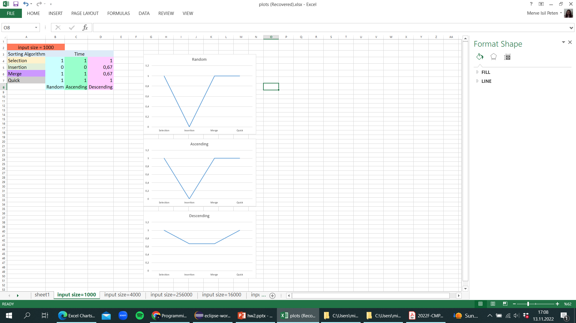
Example of plotting

Slide 32
What to hand in
Write detailed comment lines in your code
Submit your codes to the VPL
Zip your codes and report together and submit under hw2 (zip file name should be your name)

Slide 33
Grading
Code 20 points + report 50 points = 70 points
Main.Java 10 points
SortingAlgorithmTester.java 10 points

