Slide 1

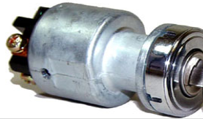





Transponder key coil
Ignition key
Key Cylinder
Transponder chip(ID code)
Transponder key Amplifier
Security indicator light
Engine ECU
Spark plug
Transponder key ECU
Injector
Security Alarm
Driver door courtesy switch
Injector pump

