Slide 1
Microprocessor
22BCM033
22BCE151

Slide 2
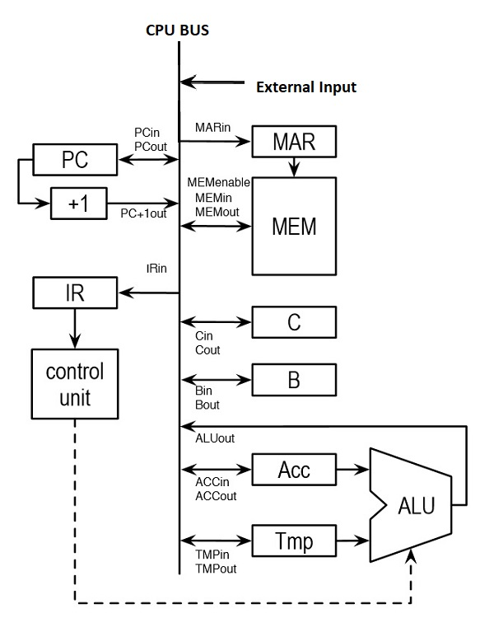
Box diagram

Slide 3
Components
Register
ALU
Memory address register(MAR)
Memory buffer register(MBR)
Bus
Ram

Slide 4
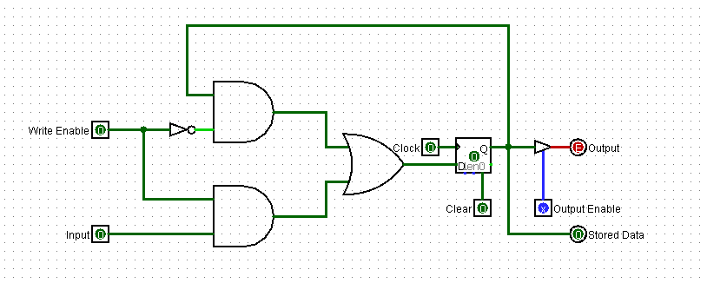
1 BIT MEMORY
Using D flip flop we have created
1-bit memory which can store 1 bit.

Slide 5
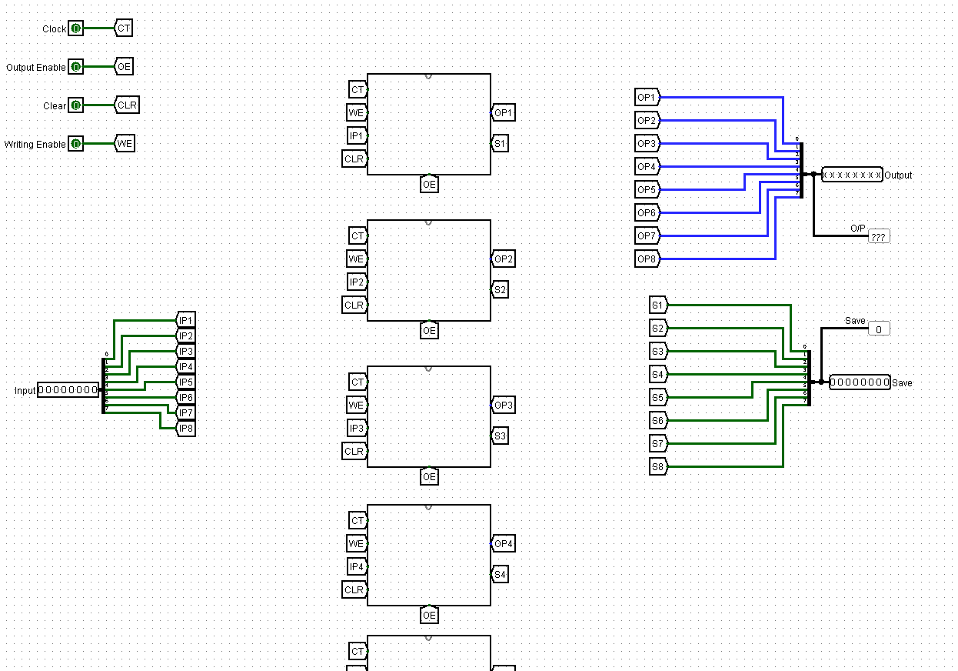
8 bit memory
8 bit Memory made using 8 1-bit of memory

Slide 6
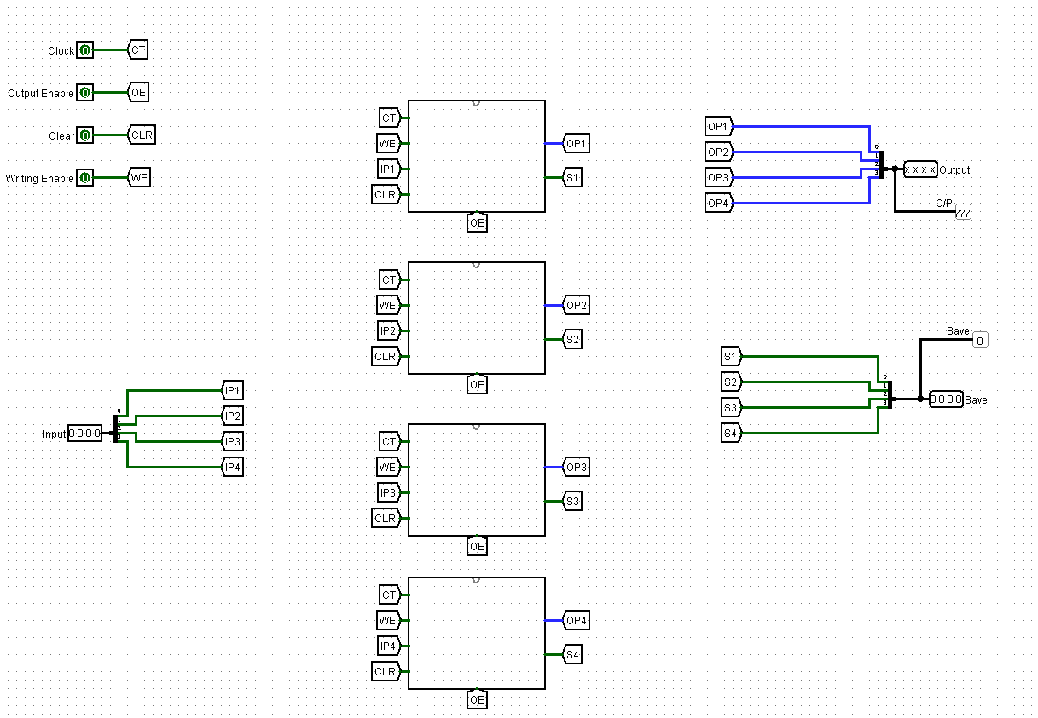
Register

Slide 7
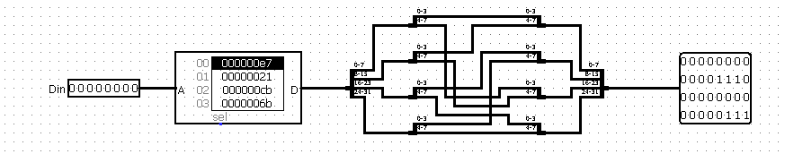
7 segment decode

Slide 8
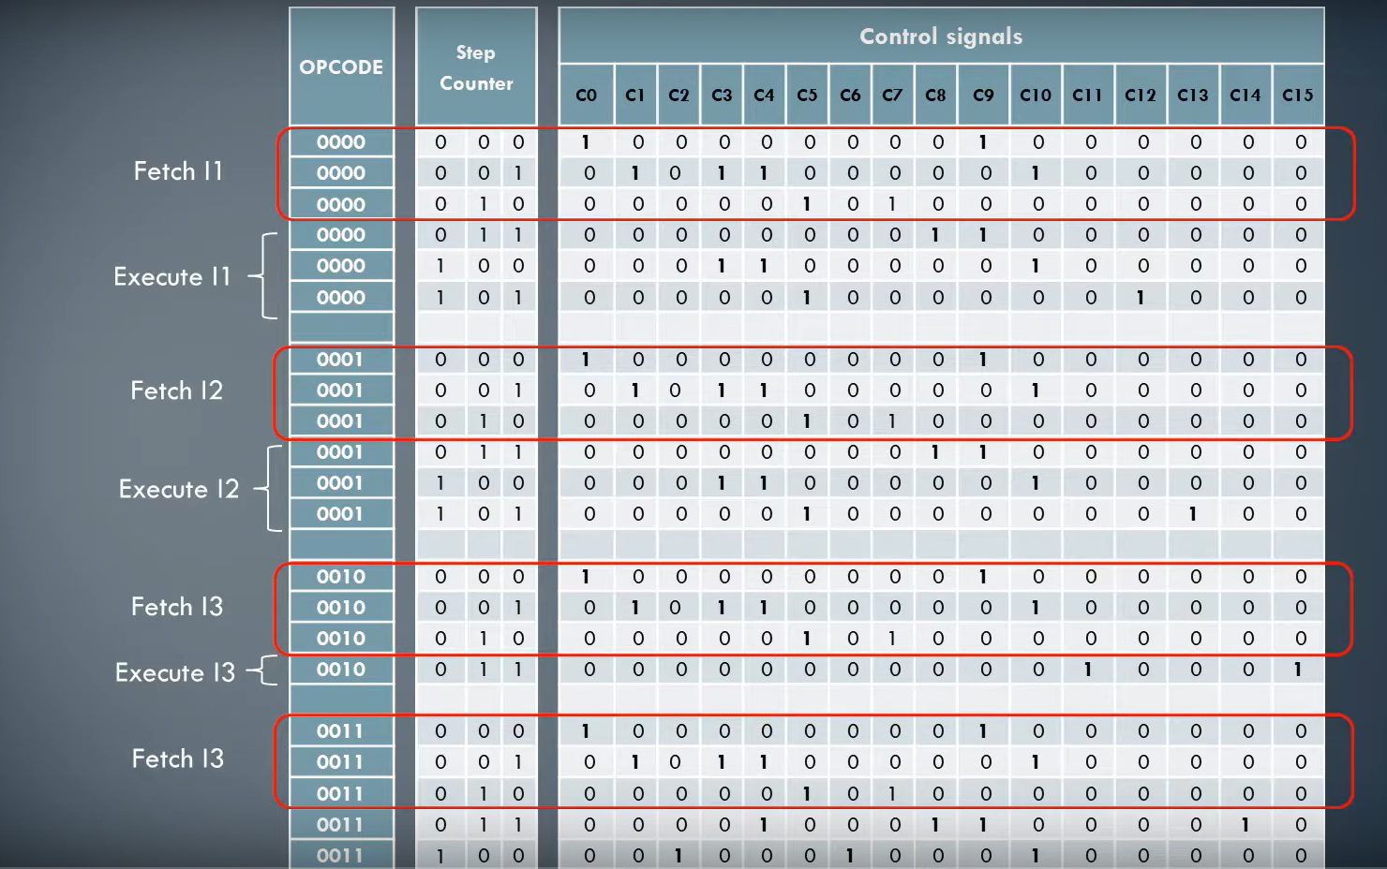
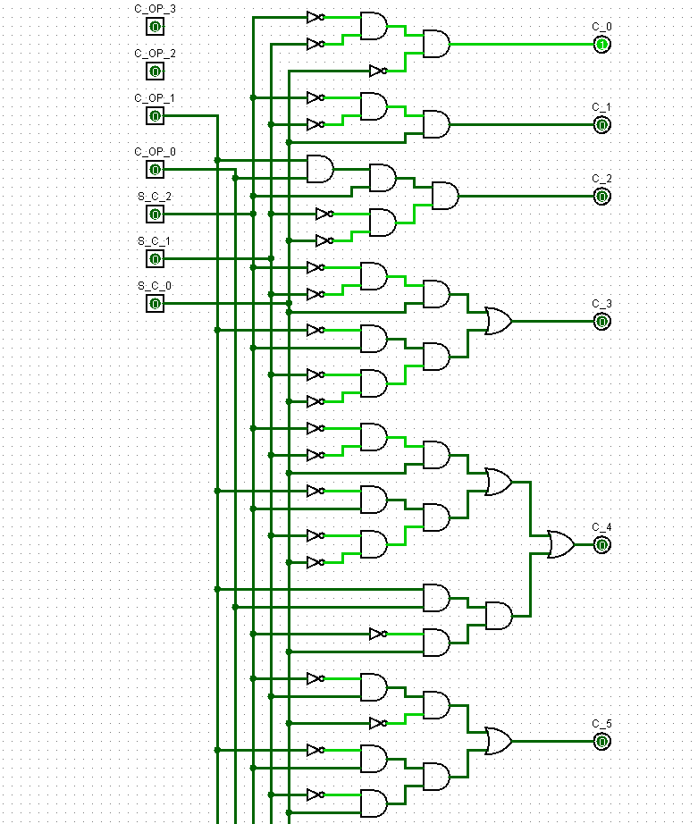
Control Unit

Slide 9
