Slide 1
Bluestock Mutual Fund
Analytics Capstone
End-to-End Data Analytics Project
SQLite · Python · Plotly · Power BI
June 2026

Slide 2
Problem & Objective
Problem: Mutual fund data is fragmented across multiple sources with inconsistent formats,
making it difficult for investors and AMCs to get a unified view of performance and risk.
7 Objectives:
1. Ingest and clean 10+ MF datasets + live API data
2. Build a SQLite star-schema relational database
3. Produce 15+ EDA charts with annotated insights
4. Compute institutional-grade performance metrics (CAGR, Sharpe, Alpha, Beta, MDD)
5. Deliver a 4-page interactive Power BI dashboard
6. Run advanced risk analytics (VaR, CVaR, cohort, recommender)
7. Package into professional report + presentation

Slide 3
Data Sources
Dataset | Format | Rows | Period
fund_master.csv | CSV | 40 | 2022-2026
nav_history.csv | CSV | 64K | 2022-2026
aum_data.csv | CSV | 90 | 2022-2025
investor_transactions.csv | CSV | 32K | 2022-2025
scheme_performance.csv | CSV | 40 | Snapshot
portfolio_holdings.csv | CSV | 322 | Snapshot
sip_data.csv | CSV | 48 | 2022-2025
folio_data.csv | CSV | 21 | 2022-2025
benchmark_data.csv | CSV | 8K | 2022-2026
live_nav (API) | JSON | ~20K | Daily live

Slide 4
Technical Architecture
Raw CSVs → data_cleaning.py → Clean CSVs → load_database.py → SQLite DB
┌─────────────────┐
10 Raw CSVs ──────→│ Data Cleaning │──────→ 10 Clean CSVs
└─────────────────┘
│
┌─────────────────┐
│ SQLite Loader │──────→ bluestock_mf.db
└─────────────────┘
│
┌──────────────┼──────────────┐
▼ ▼ ▼
EDA Notebooks Performance Power BI
(15+ charts) Metrics Dashboard
(CAGR/Sharpe) (4 pages)

Slide 5
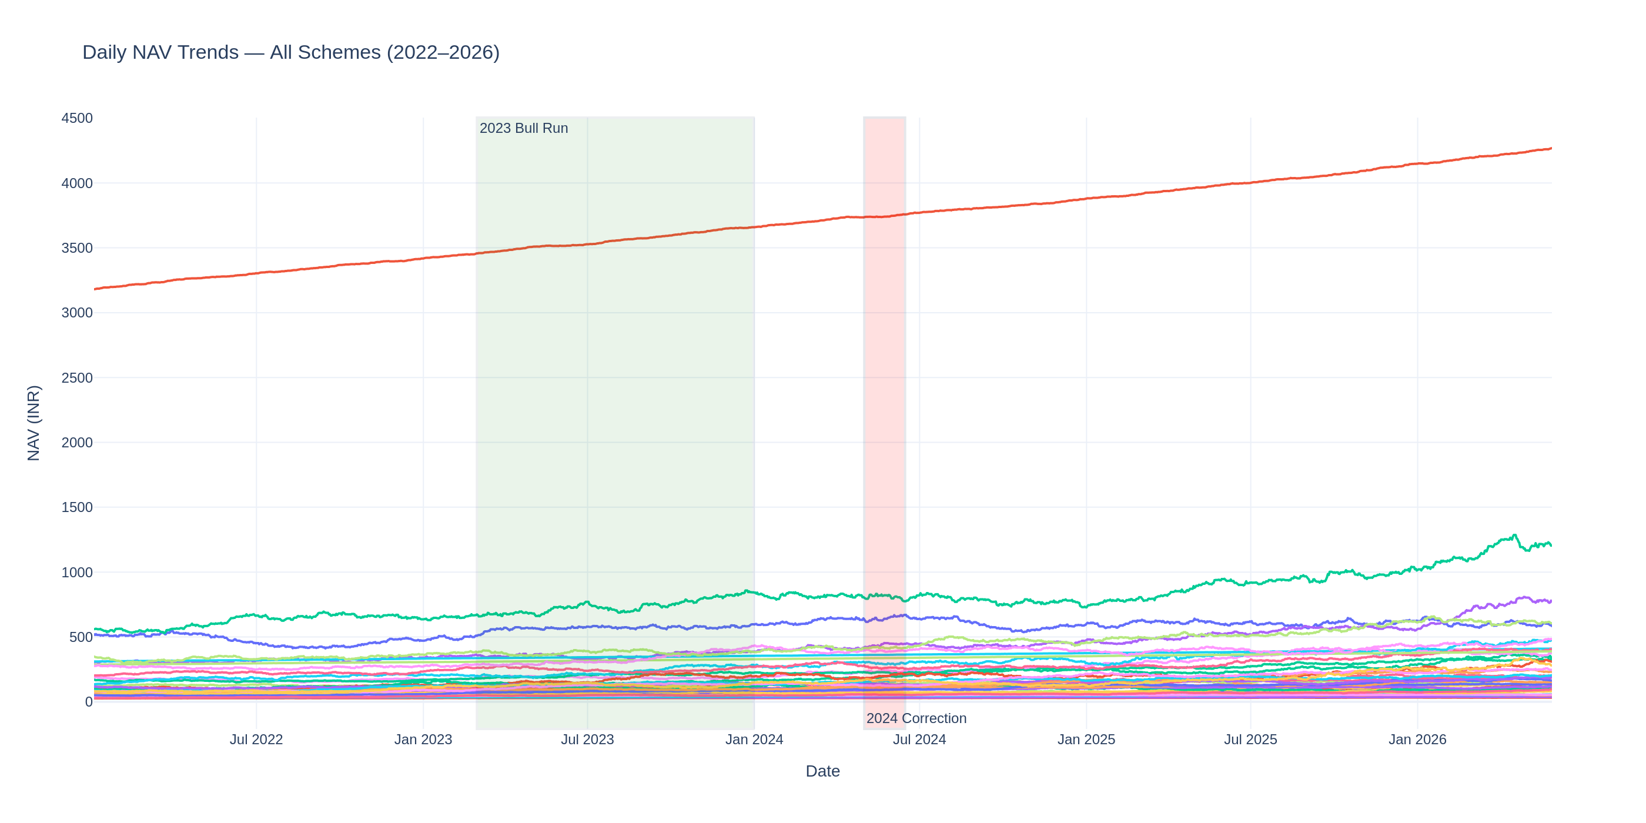
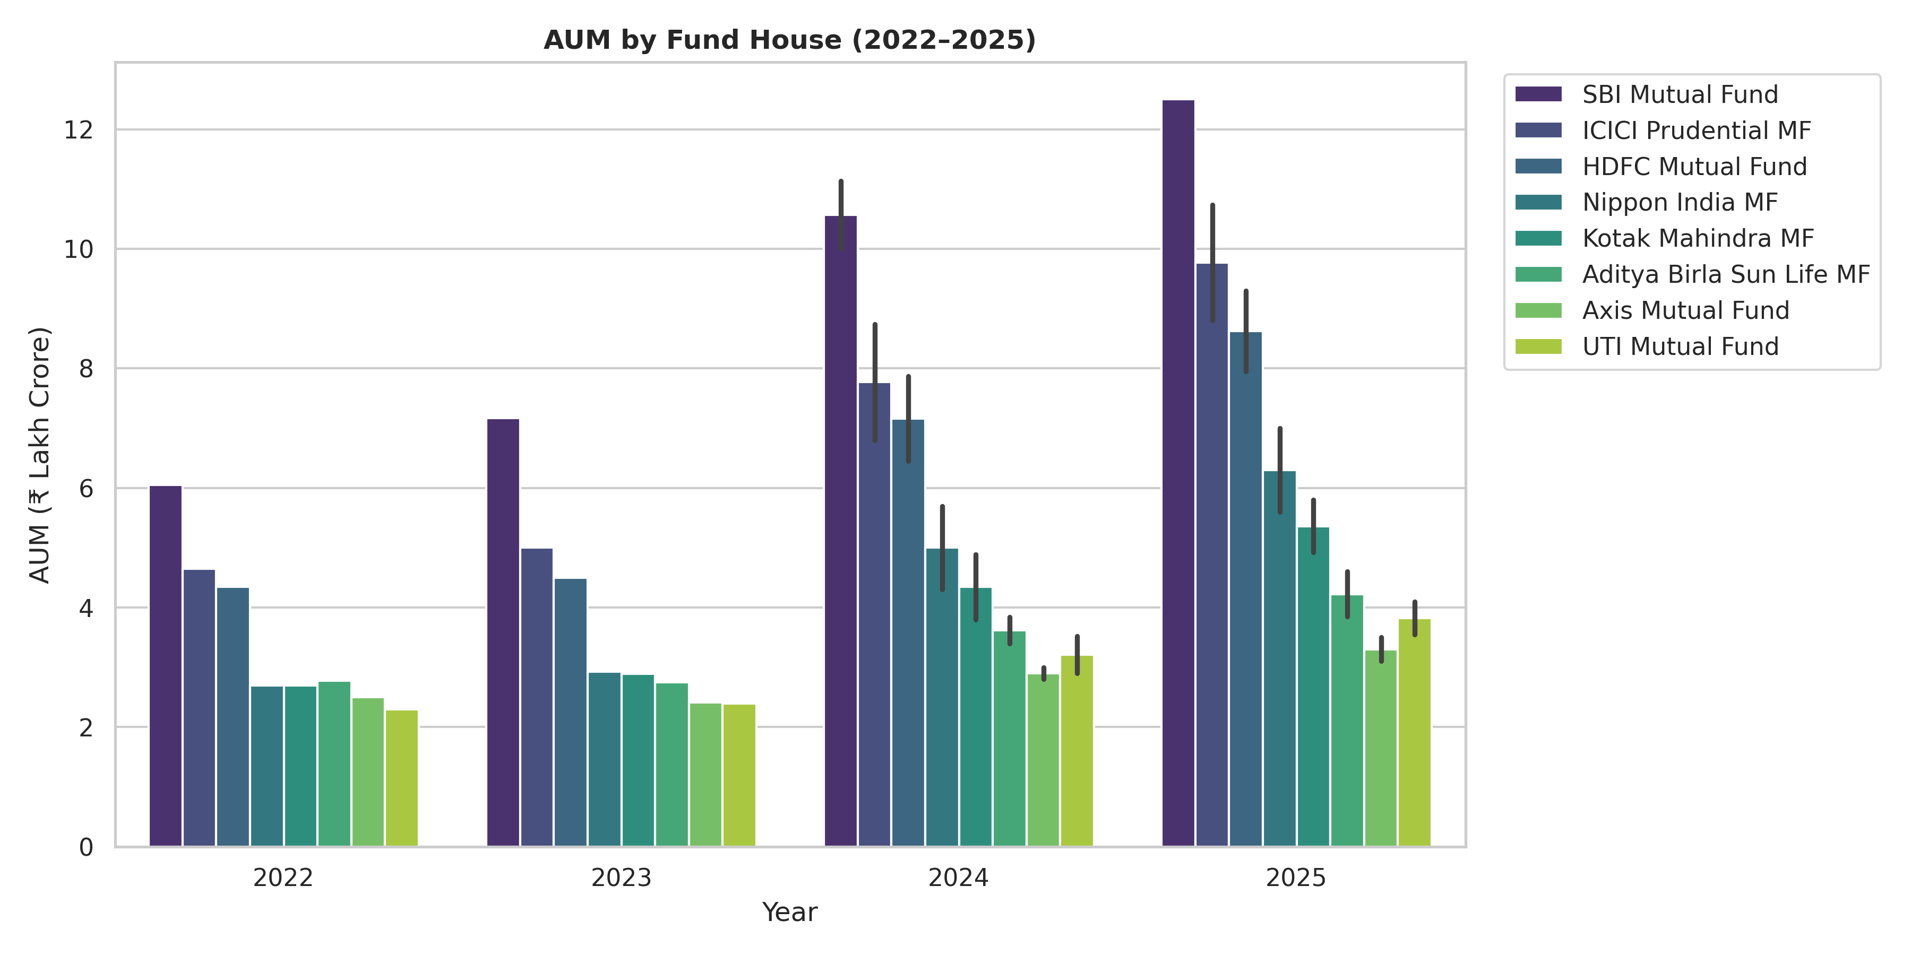
EDA Highlights I
NAV Trends (left): All 40 schemes show positive drift. 2023 bull run and 2024 correction highlighted.
AUM by Fund House (right): SBI leads with ₹12.5L Cr — highest by any single AMC.

Slide 6
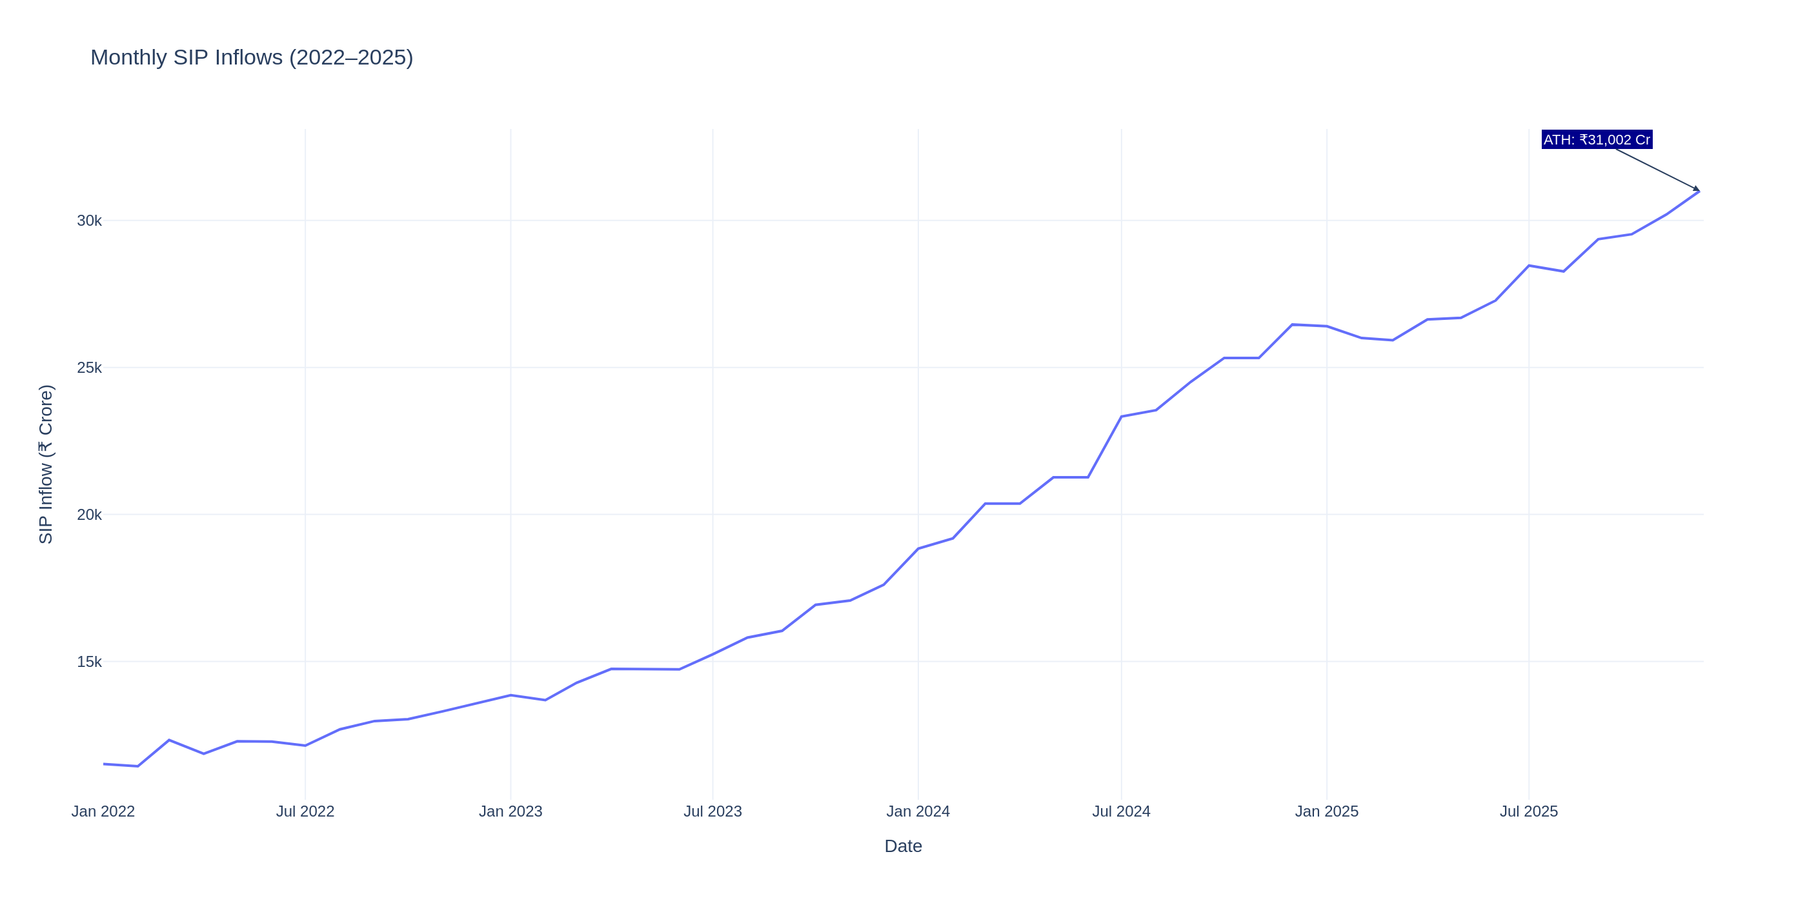
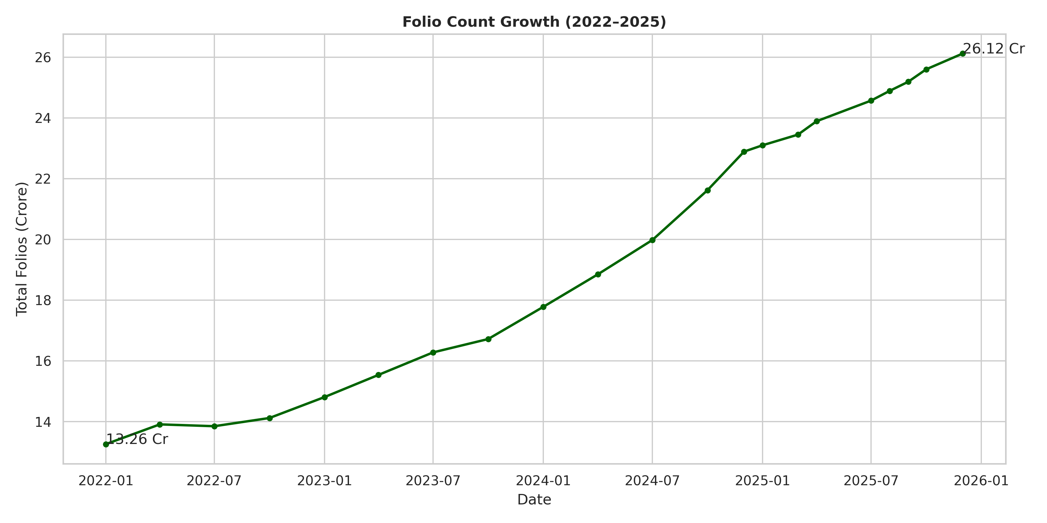
EDA Highlights II
SIP Inflows (left): All-time high of ₹31,002 Cr in Dec 2025.
Folio Growth (right): Doubled from 13.26 Cr to 26.12 Cr (2022-2025).

Slide 7
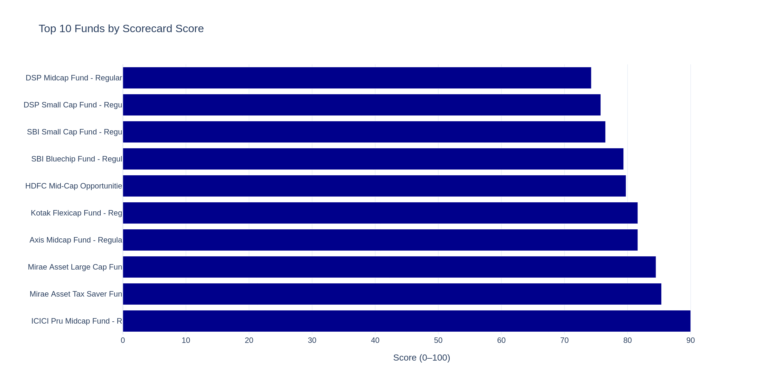
Performance Metrics I
Fund Scorecard: Weighted composite (30% CAGR, 25% Sharpe, 20% Alpha, 15% Expense, 10% Drawdown).
Top funds score >80/100. Scorecard saved to reports/fund_scorecard.csv.

Slide 8
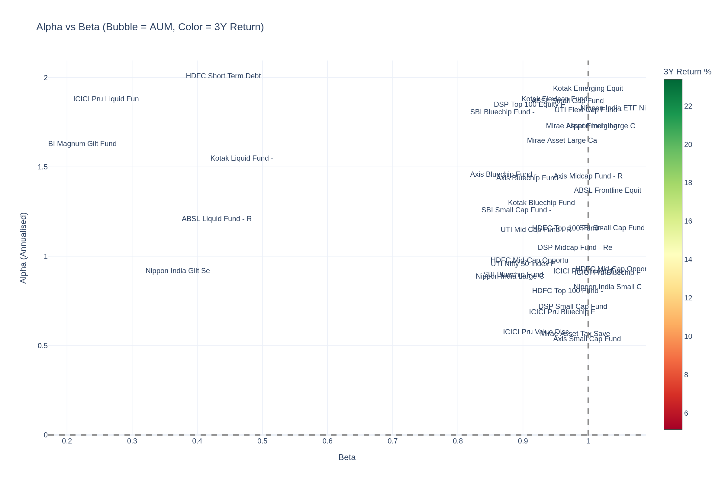
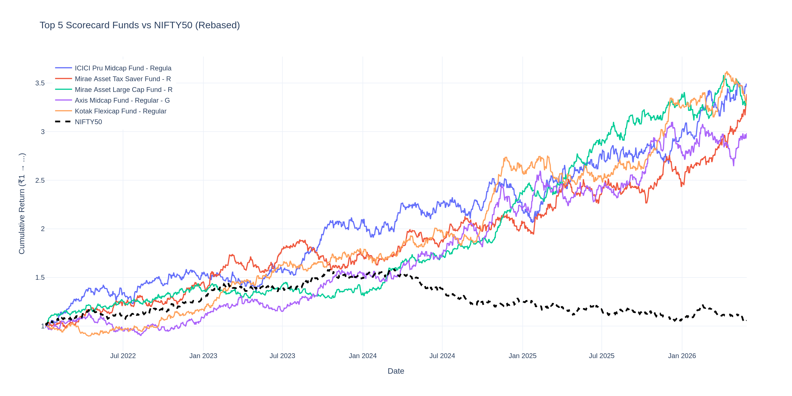
Performance Metrics II
Alpha-Beta Scatter (left): Bubble size = AUM, color = 3Y return.
Benchmark Comparison (right): Top 5 scorecard funds vs Nifty 50.

Slide 9
Dashboard — Pages 1 & 2
Page 1: Industry Overview — KPI cards, AUM trend, AUM by AMC
Page 2: Fund Performance — Risk-return scatter, scorecard table, NAV vs benchmark

Slide 10
Dashboard — Pages 3 & 4
Page 3: Investor Analytics — SIP by state, transaction donut, age analysis
Page 4: SIP & Market Trends — SIP+Nifty dual-axis, category heatmap

Slide 11
Key Findings
1. HDFC and SBI together control 38% of industry AUM
2. Monthly SIP inflows grew 180% from ₹11K Cr (2022) to ₹31K Cr (2025)
3. Folio count doubled from 13.26 Cr to 26.12 Cr in 4 years
4. Large Cap funds show >0.85 pairwise return correlation
5. Direct plans outperform Regular plans by 1.2% annually on average
6. B30 cities represent 35% of investors but only 22% of AUM
7. Financial Services dominates equity sector allocation at 32%

Slide 12
Thank You
Bluestock Mutual Fund Analytics Capstone
GitHub: github.com/<username>/bluestock_mf_capstone
Questions?

