Slide 1

MAHENDRA ENGINEERING COLLEGE (Autonomous)
CATCH ‘25 – Hackathon
Name of the College : Mahendra Engineering College
Name of the Team : Solution Makers
Name of the Team Leader : Karthikeyan S
Name of the Department : B.E-CSE
Problem Statement : Virtual Health Assistant: Create a chat bot for diagnosing common illnesses and suggesting remedies
Date : 21/02/2025

Slide 2
CREW DETAILS
NAME OF THE STUDENT | YEAR | DEPARTMENT | DESIGNATION | E MAIL ID
Karthikeyan S | III | CSE | Team leader (Project Manager,Coder) | karthikeyancse62@gmail.com
Abishek N | III | CSE | Team member 1 (Coder,NLP Trainer) | abisheknesamony@gmail.com
Karthikeyan I | III | CSE | Team member 2 (Frontend Developer) | Karthikeyanimec@gmail.com
Bharath Kumar C | III | CSE | Team member 3 (Frontend Developer) | bharath0534@gmail.com
Ebinesh K | III | CSE | Team member 4 (Coder) | ebinesh705@gmail.com

Slide 3
MODULE LIST
ABSTRACT
IDEA/APPROACH DETAILS
FLOW CHART
TECH STACK AND DEPENDENCIES
METHODOLIGIES OR ALGORITHMS FOCUSED
ANALYSIS PART OF THEIR PROJECT
EXPECTED OUTCOME
SOCIAL RELEVANCE
CONCLUSION AND FUTURE WORK

Slide 4
ABSTRACT
The Virtual Health Assistant is an AI powered RASA chatbot designed to help users diagnose common illnesses and suggest remedies.
Built using the Rasa framework, the chatbot uses Natural Language Processing (NLP) to understand user symptoms and provide appropriate recommendations.
The system aims to provide quick, accessible, and reliable health advice for minor ailments, reducing the need for unnecessary doctor visits.
Key features include symptom analysis, remedy suggestions, and a user-friendly conversational interface.

Slide 5
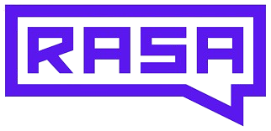

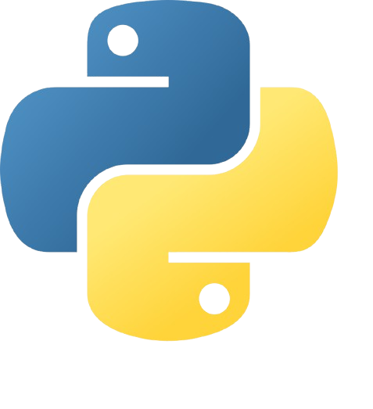
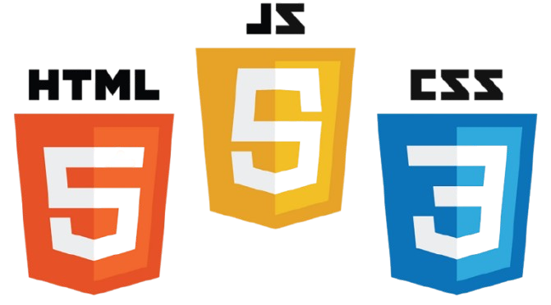
IDEA/APPROACH DETAILS
Technology and Tools Used:
Rasa Framework: NLP and dialogue management.
Python: Custom actions and backend logic.
SQLite/PostgreSQL: Store symptoms and remedies.
HTML, CSS, and JavaScript: To create the website.
Flask Framework: To integrate the chatbot into a web application.
Workflow
User describes symptoms.
Chatbot extracts symptoms using NLP.
Custom action fetches remedies from the database.
Chatbot suggests remedies and provides advice.

Slide 6
FLOW CHAT
Start
User input
Rasa NLU
Exract Intent And Entities
​
Query Database
Custom Action
Rasa Core
Generate Response
Bot Responds
End

Slide 7
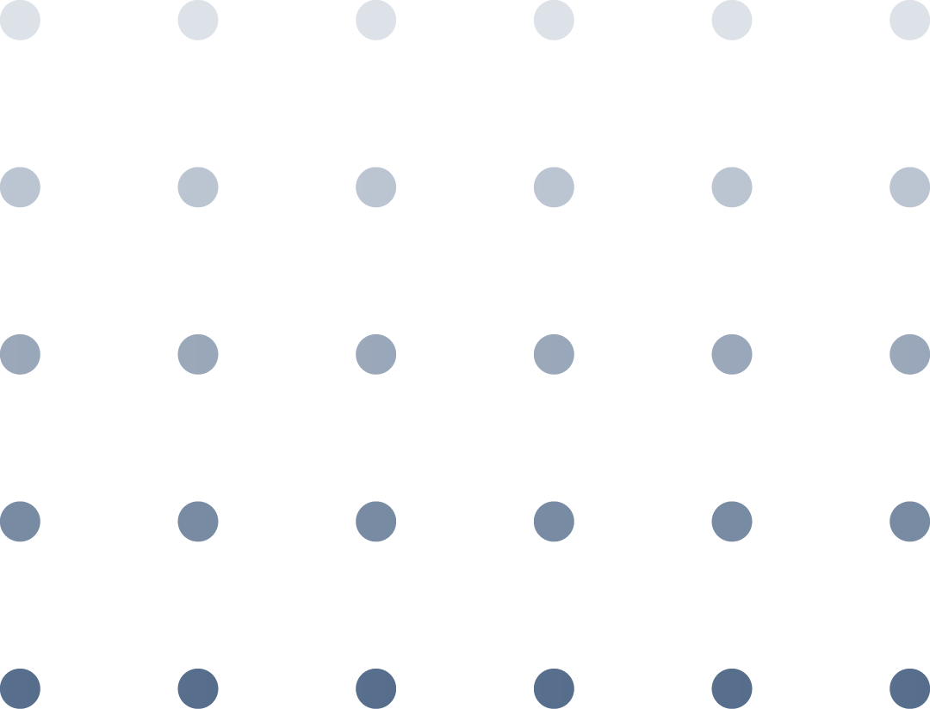
METHODOLIGIES OR ALGORITHMS FOCUSED
Natural Language Processing (NLP):
Intent Classification: To identify user intents (e.g., "inform_symptoms").
Entity Recognition: To extract symptoms (e.g., "headache").
Dialogue Management:
Rule-based and story-based approaches to handle conversation flow.
Machine Learning:
Supervised learning for intent and entity recognition.
Reinforcement learning for improving dialogue management over time.

Slide 8
ANALYSIS OF THE PROJECT
Data Analysis:
Analyze user inputs to identify common symptoms and intents.
Evaluate the accuracy of the NLU model using metrics like precision, recall, and F1-score.
Performance Analysis:
Measure response time and user satisfaction.
Test the chatbot with diverse user inputs to ensure robustness.
Error Analysis:
Continuously improve the model with more training data.

Slide 9
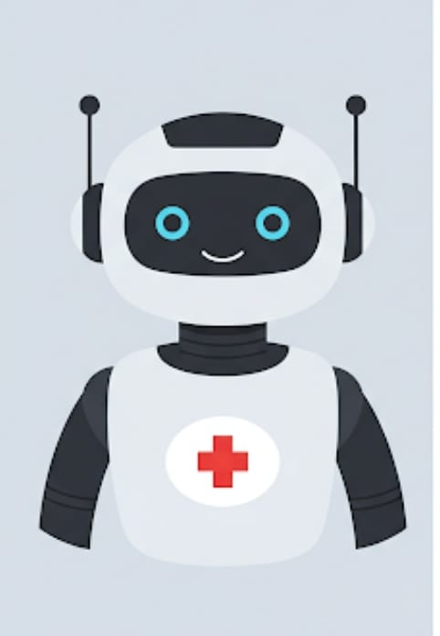
EXPECTED OUTCOME
A fully functional chatbot that:
Accurately recognizes user symptoms.
Provides reliable and effective remedies for common illnesses.
Offers a seamless and intuitive user experience.
Supports Voice Assistant
Metrics for Success:
High accuracy in symptom recognition.
Positive user feedback and satisfaction.
Reduction in unnecessary doctor visits for minor ailments.

Slide 10
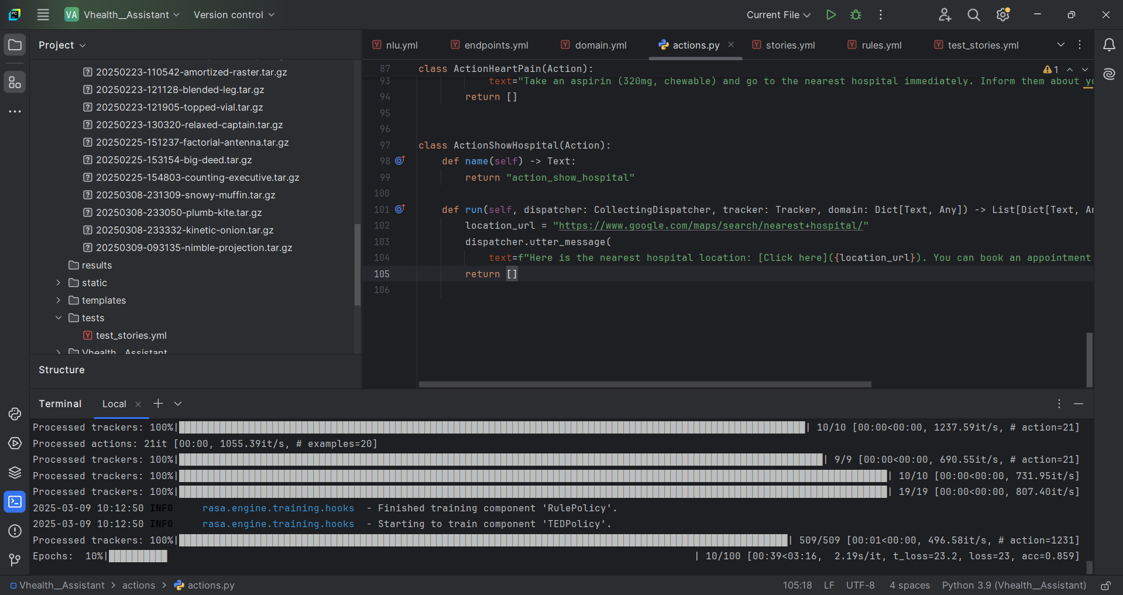

Slide 11
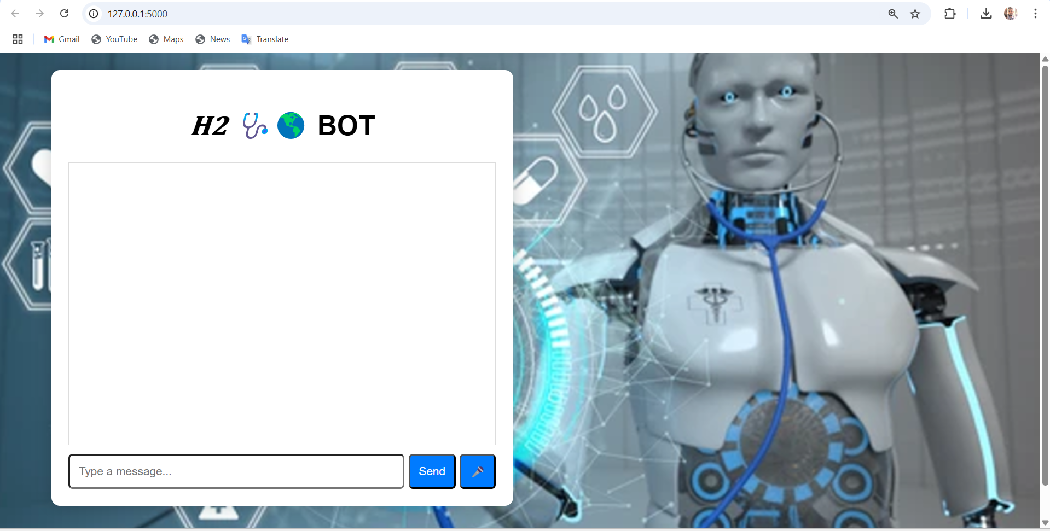
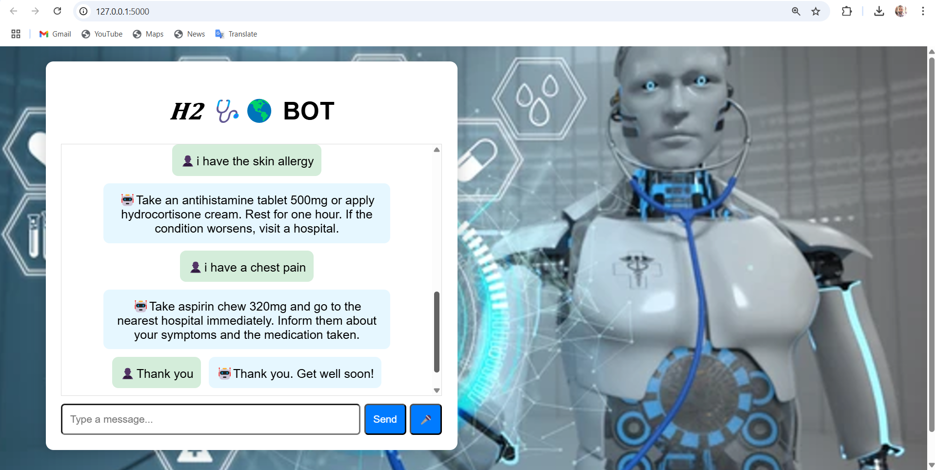

Slide 12
SOCIAL RELEVANCE
Accessibility:
Provides immediate health advice to users, especially in remote or underserved areas.
Cost-Effective:
Reduces healthcare costs by offering free, preliminary advice for minor illnesses.
Awareness:
Educates users about common illnesses and their remedies.
Scalability:
Can be scaled to support multiple languages and regions, making it globally relevant.

Slide 13
CONCLUSION AND FUTURE WORK
The Virtual Health Assistant is a socially relevant and technically advanced solution for providing health advice.
It leverages the power of AI and NLP to deliver accurate and accessible healthcare support.
Future enhancements will focus on improving accuracy, adding new diseases and remedies with the help of doctor and integrating with other healthcare systems.
Deploy the H2 bot(Health Helper BOT) by using AWS/Google Cloud/Azure/Render.

Slide 14
THANK YOU !

