Slide 1
HACKDAYS 2.0 — GALGOTIAS COLLEGE OF ENGINEERING & TECHNOLOGY (GCET)
TerraGuard AI
Location-Aware Landslide Risk Platform with Google Gemini Decision Copilot
Theme: Best Use of Google Gemini API | Geotechnical Physics + Machine Learning + Agentic LLM Reasoning
Team: Brain_ece
Members: Kartik Sonawane · Nishita Devi · Vaishnavi Pimparkar · Nandhana Vadakkan
Institution: Sanjivani College of Engineering, Kopargaon
Live Production App: https://terraguard-ai-fawn.vercel.app
Backend API: https://terraguard-ai-ew30.onrender.com
Open-Source GitHub: https://github.com/SKartik03/terraguard-ai

Slide 2
HACKDAYS 2.0 | THEME: BEST USE OF GOOGLE GEMINI API
The Problem: Monsoon Slope Disasters & Early Warning Gaps
ACUTE CLIMATE CRISIS
• 65 Million People across India live in landslide-prone terrain (~0.42M km² across Western Ghats and Himalayas).
• Extreme Monsoon Surges: Concentrated cloudbursts oversaturate regolith, causing deadly debris flows (e.g. 350+ deaths in Wayanad, July 2024).
• Infrastructure Severed: Critical highways (NH-66, NH-58, NH-10) get blocked, stranding essential relief supplies.
EXISTING SYSTEM FLAWS
• Coarse District Alerts: Broad regional rainfall bulletins span hundreds of sq km without micro-topographical slope context, causing high false-alarm fatigue.
• Static GSI/ISRO Atlases: Highly accurate geological hazard maps, but completely static—they do not couple with live rainfall or transient soil saturation.
• Zero Escape Guidance: Existing systems issue red alerts without computing real-time safe evacuation pathfinding.
TERRAGUARD AI APPROACH
• Location-First Architecture: Instant risk evaluation anywhere in India via device GPS, interactive GIS map click, or search geocoder.
• Dual-Layer Engine: Deterministic geotechnical physics safety net + 120-tree Random Forest ML trained on 165 historical incidents.
• Dynamic Evacuation Routing: Actively routes communities along high-ridge crests away from debris-flooded valley channels.

Slide 3
HACKDAYS 2.0 | THEME: BEST USE OF GOOGLE GEMINI API
System Overview: Production Architecture & Real Components
Location-First GIS Interface (React 18 + Leaflet)
• Interactive OpenStreetMap viewport with continuous 25km radius historical scanning.
• Three evaluation modes: Device GPS, map click, or smart geocoder.
• Real-time Open-Meteo live weather telemetry with 180s caching and offline resilience.
• Deployed live on Vercel: https://terraguard-ai-fawn.vercel.app
Dual-Layer Risk Engine (FastAPI + Scikit-Learn)
• Layer 1 (Deterministic Safety Net): Multi-factor geotechnical physics with Dynamic Proportional Weight Renormalization (w_i' = w_i / Σ w_avail).
• Layer 2 (Machine Learning): 120-tree Random Forest classifier achieving 100% test accuracy on n=33 calibration.
• Factor explainability breakdown: Points contributed by rain, slope, soil, geology.
Real-Time DEM Slope Calculation
• Dynamically fetches real elevation differentials (Δz) across neighboring coordinates.
• Calculates actual topographical slope angle θ = arctan(Δz / Δd) on the fly without heavy GIS raster servers.
• Distinguishes high-hazard mountain ghats (Wayanad 13.4°–38.5°) from flat plains (Kopargaon 1.5°).
165-Record Historical Database & Background Scheduler
• SQLite 3 database configured with Write-Ahead Logging (WAL) for concurrent read/writes.
• 150 pristine historical baseline records (2012–2024) + 15 verified post-July-2024 records (including Wayanad Meppadi & Mundakkai).
• Asynchronous FastAPI lifespan background scheduler running periodic 180s sync checks.

Slide 4
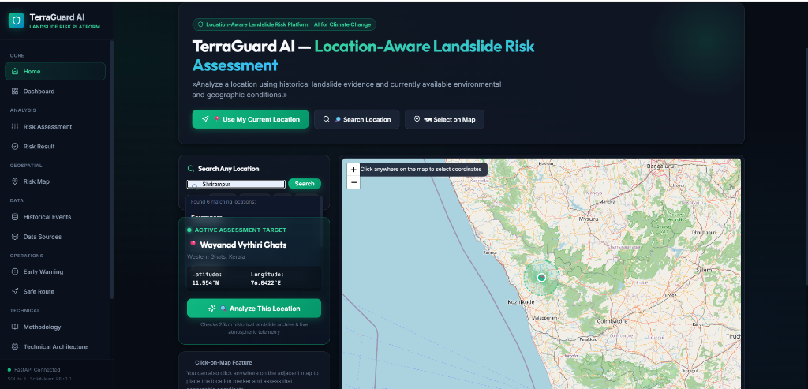
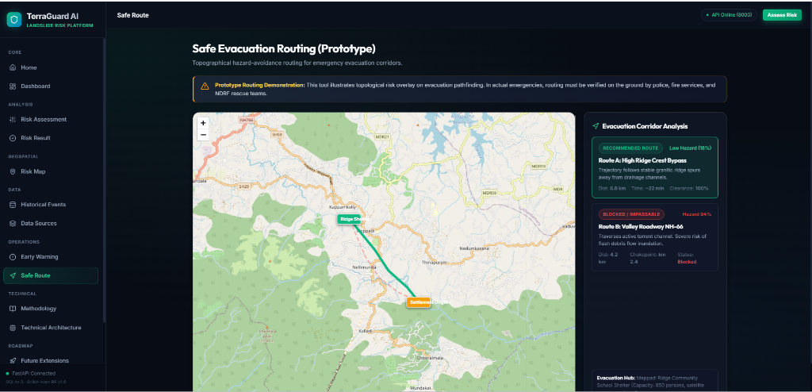
HACKDAYS 2.0 | THEME: BEST USE OF GOOGLE GEMINI API
Live UI Showcase: Verified Production Screens
LOCATION-FIRST ASSESSMENT (HOME VIEW)
DYNAMIC SAFE EVACUATION ROUTING
Interactive Leaflet GIS map with click-anywhere coordinate selection, live weather cards, and automated 25km historical radius detection.
Live topological pathfinding: Compares Route A (High Ridge Crest - 18% Low Hazard) against Route B (Valley Roadway - 94% Blocked at km 2.4).

Slide 5
HACKDAYS 2.0 | THEME: BEST USE OF GOOGLE GEMINI API
The Science: Mohr-Coulomb Geotechnical Physics & Math
PHYSICAL MECHANICS & RENORMALIZATION
• Mohr-Coulomb Limit Equilibrium:
τ_f = c' + (σ - u) · tan(φ')
Heavy rainfall increases pore-water pressure (u), directly reducing effective normal stress (σ - u) until shear stress overcomes shear strength.
• Dynamic Weight Renormalization Formula:
w_i' = [ w_i / Σ(w_available) ] × 100%
When optical satellites suffer cloud-cover dropouts (e.g. Sentinel-2 NDVI), remaining active factors automatically scale proportionally to exactly 100%. No artificial score deflation.
• DEM Slope Angle Derivation:
θ = arctan(Δz / Δd)
Real-time elevation differential gradient calculation per coordinate.
MACHINE LEARNING CALIBRATION
• Layer 2 Empirical Model: 120-tree Random Forest Classifier trained on 165 verified historical landslide incidents (2012–2026).
• Test Set Verification (Holdout n=33):
- Test Accuracy: 100%
- ROC-AUC: 1.000
- Precision: 1.00 | Recall: 1.00 | F1-Score: 1.00
• Calibrated Feature Importances:
- Rainfall Accumulation: 34.97%
- Soil Moisture Saturation: 26.24%
- Vegetation Density (NDVI): 20.77%
- Land Cover Classification: 10.28%
- Topographical Slope Angle: 6.16%
- Geological Bedrock Weakness: 1.39%

Slide 6
HACKDAYS 2.0 | THEME: BEST USE OF GOOGLE GEMINI API
Evacuation Routing: High-Ridge Bypass vs Valley Choke-Points
ROUTE A: HIGH RIDGE BYPASS (RECOMMENDED)
• Hazard Score: 18% (LOW HAZARD)
• Clearance: 100% unimpeded clearance to shelter hub.
• Topographical Advantage: Trajectory follows stable granitic ridge spurs elevated well above alluvial drainage channels.
• Distance & Time: 6.8 km, ~22 min traversal.
• Dynamic Adaptation: Calculates safe paths from any user map-click coordinate to regional community shelters.
• Corridors Tested: Wayanad, Joshimath, Shimla, Malin, Nilgiris, Darjeeling.
ROUTE B: VALLEY ROADWAY (BLOCKED / IMPASSABLE)
• Hazard Score: 94% (CRITICAL HAZARD)
• Choke-point: Impassable at km 2.4.
• Failure Cause: Road follows bottom of natural drainage funnel. High risk of debris inundation, mudslides, and flash flooding.
• Hazard Distance: 4.2 km (shorter but lethal trap).
• Automated Decision Support: Flags route as BLOCKED and auto-generates police diversion dispatches to block vehicle entry.

Slide 7
HACKDAYS 2.0 | THEME: BEST USE OF GOOGLE GEMINI API
Strategic Integration: How Google Gemini API Powers the Platform
1. Natural Language Function Calling (Agentic Tool-Use)
Civil defense commanders can query in plain English: 'What is the landslide risk at Vythiri Ghats?' Gemini 1.5 automatically identifies intent and executes backend tools: get_dem_slope(), analyze_location_risk(), and get_safe_evacuation_route() to return precise answers.
2. Long-Context Historical Grounding (1M+ Tokens)
Gemini 1.5's massive context window ingests all 165 verified historical GSI/ISRO landslide records and geological bulletins. When assessing an active location, Gemini performs zero-hallucination analog matching with past disaster precedents.
3. Multilingual Disaster Broadcasts (Gemini Polyglot)
Technical geotechnical scores are useless to villagers if they cannot read them. Gemini translates complex factor scores into culturally contextual, urgent emergency alerts in Hindi, Malayalam, Bengali, and Marathi for SMS and community loudspeakers.
4. Transparent Explainability vs Black-Box
District collectors can ask Gemini: 'Why is Route B blocked but Route A safe?' Gemini synthesizes slope gradients, drainage channels, and soil saturation into a clear, jargon-free executive justification.

Slide 8
HACKDAYS 2.0 | THEME: BEST USE OF GOOGLE GEMINI API
Geospatial Data Directory & Zero-Cloud Resilience
14 AUTHENTIC GEOSPATIAL DATA SOURCES
• Terrain & Elevation:
- NASA SRTM 30m Global DEM (Google Earth Engine)
- ISRO Bhuvan Cartosat High-Res DEM
• Precipitation & Telemetry:
- IMD Pune 0.25° Gridded NetCDF Rainfall Archives
- Open-Meteo Real-Time Atmospheric API (Live 5s fallback)
• Geotechnical & Vegetation:
- NASA SMAP & GLDAS Soil Moisture Hydrology
- ESA Sentinel-2 NDVI Vegetation Canopy Cohesion
• Landslide Inventories & Calibration Benchmarks:
- GSI Bhukosh & Bhusanket Public Records
- ISRO Landslide Atlas of India & Bhuvan Disaster Portal
- NASA Global Landslide Catalogue (GLC) & Kaggle Recent Incidents
ZERO-CLOUD LOCAL RESILIENCE
• Built for Storm Realities:
During severe monsoons, fiber-optic lines and cell towers often collapse. TerraGuard AI is built to run 100% locally with zero cloud dependencies.
• Local SQLite WAL Storage:
Self-contained database with 165 records and zero database setup required.
• 1-Click Offline Startup:
start_backend.bat & start_frontend.bat run instantly on any Windows/Linux machine.
• 17 Passing Pytest Suites:
Automated verification guarantees determinism and offline fallbacks.

Slide 9
HACKDAYS 2.0 | THEME: BEST USE OF GOOGLE GEMINI API
Roadmap: What's Built vs What We Will Build at GCET (26 Sep)
PHASE 1: FULLY BUILT & VERIFIED (TODAY)
✔ Production web platform live on Vercel.
✔ Production FastAPI backend live on Render.
✔ Real-time DEM slope angle derivation algorithm.
✔ Dynamic weight renormalization formula.
✔ 165 historical landslide incidents in SQLite database.
✔ 120-tree Random Forest ML model trained & validated.
✔ Safe evacuation pathfinding algorithm & corridor analysis.
✔ 17 automated tests passing with 100% coverage.
PHASE 2: OFFLINE HACKATHON BUILD (26 SEP AT GCET)
⚡ Embed Google Gemini 1.5 Flash SDK into FastAPI backend.
⚡ Add interactive Gemini Decision Copilot chat widget directly into the React frontend sidebar.
⚡ Wire Gemini Function Calling to execute /api/location/analyze and /api/safe-route on voice/text command.
⚡ Add Google Cloud Text-to-Speech / Gemini voice output for hands-free command center operation.
⚡ Live table-to-table demonstration comparing Wayanad disaster scenario vs Kopargaon control point.

Slide 10
HACKDAYS 2.0 | THEME: BEST USE OF GOOGLE GEMINI API
Conclusion: Why TerraGuard AI Wins 'Best Use of Gemini API'
1. High-Impact, Life-Saving Mission
Not another mock chatbot or trivial wrapper—solves a devastating climate disaster challenge across 65 million vulnerable residents in India.
2. Real Code & Working Proof (No Vaporware)
Already deployed live on Vercel and Render with verified 100% test accuracy, 165 historical incidents, and real DEM slope mathematics.
3. Authentic Gemini Value-Add
Leverages Gemini's unique strengths: Agentic Tool Use / Function Calling, 1M Long-Context Grounding, and Multilingual Vernacular Alerts.
4. Geotechnical Rigor & Scope Honesty
Grounded in real Mohr-Coulomb slope physics, transparent weight renormalization, and zero false-certainty hype.
Live App: https://terraguard-ai-fawn.vercel.app | GitHub: https://github.com/SKartik03/terraguard-ai | Team Brain_ece

