Slide 1

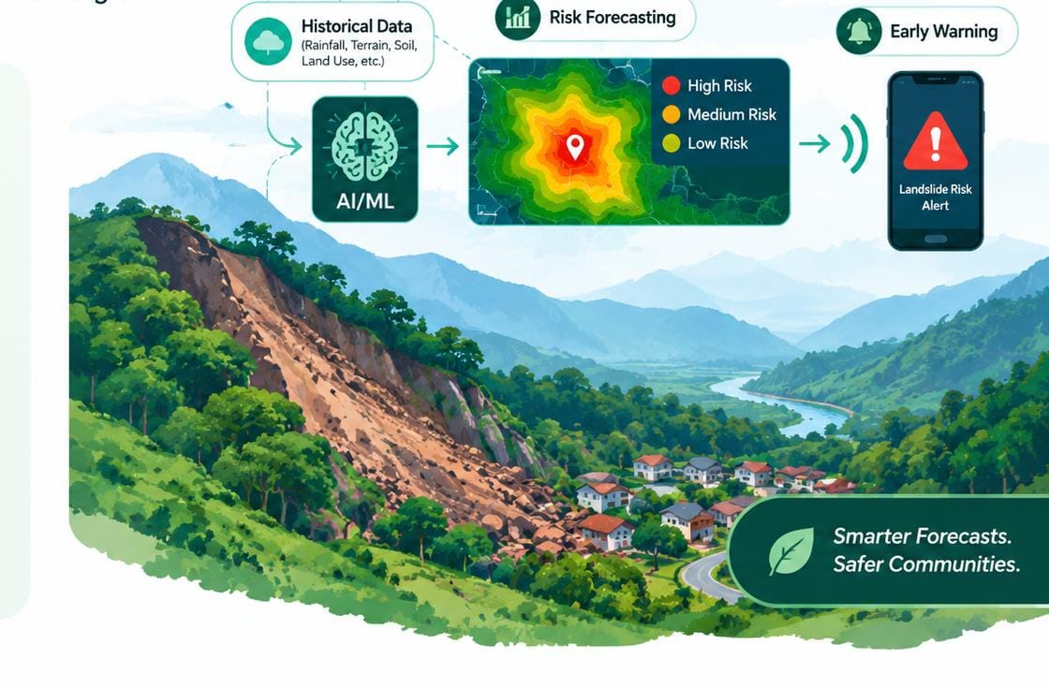
TEAM SANJIVANI
Team
Theme: AI for Climate Change
Historical-Data-Based Landslide Risk Prediction Platform
Team Name : Terraguard
Team Members (UG) :
Kartik Sonawane (Team Leader)
Nandhana Vadakkan
Vaishnavi Pimparkar
Nishita Devi
Institute Name : Sanjivani College of Engineering, Kopargaon

Slide 2
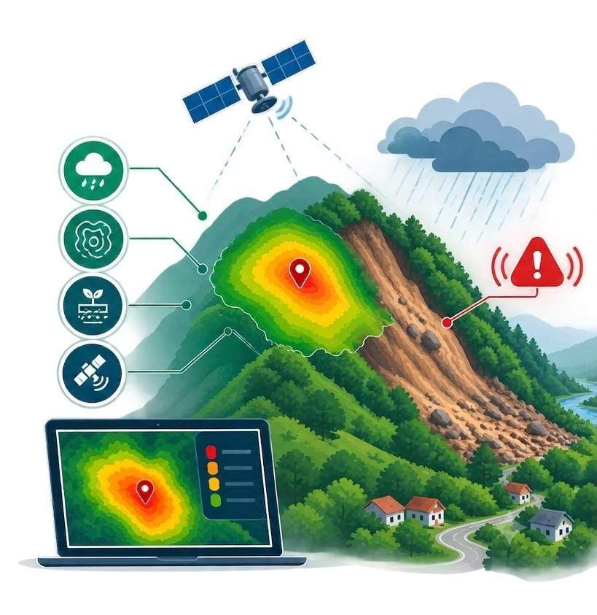
TEAM SANJIVANI
Team
Outline
01
Problem
Problem Statement / Idea
02
Objectives
Goals and Targets
03
Solution
Proposed Solution / Architecture
04
Innovation
Unique Features / Innovation
05
Outcomes
Expected Outcomes
06
Conclusion / Reference
AI • Risk Forecasting • Early Warning
Key Takeaways

Slide 3
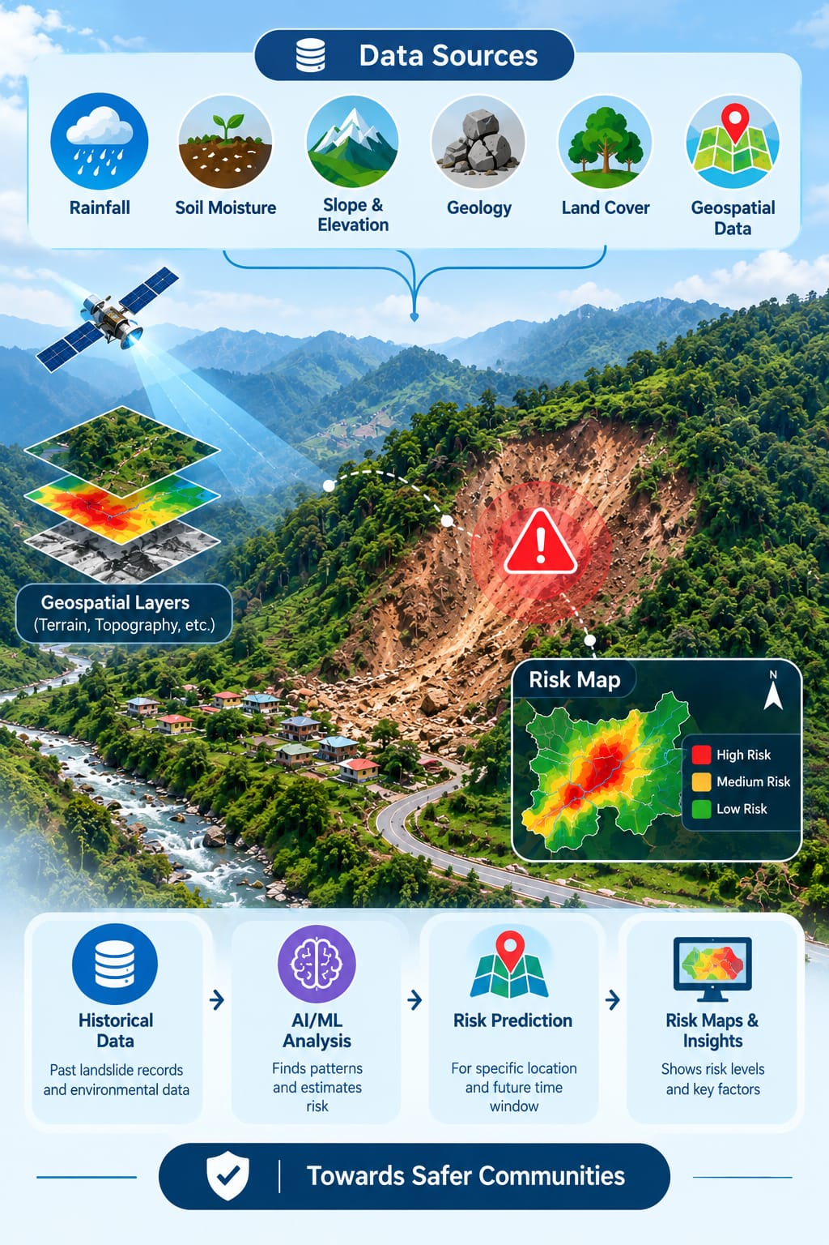
TEAM SANJIVANI
Problem Statement
Team
Landslides are a major natural hazard in hilly and mountainous regions, where factors such as heavy rainfall, soil moisture, slope, elevation, geology, and land cover can contribute to slope instability. Existing methods often rely on static susceptibility maps or individual environmental factors, which may not adequately show how landslide risk changes over time.
Rising Climate Risk — Erratic rainfall from climate change is triggering more frequent landslides in hilly terrain.
Unused Historical Data — Rainfall, terrain, and soil data already exist across agencies but are never combined for prediction.
Slow, Generic Warnings — Current alerts are broad and delayed, leaving little time for at-risk communities to act.
High Exposure, No Tools — Remote hill regions face the highest risk with the least access to predictive monitoring.
No Software-Only Solution — Most proposed systems rely on costly sensor hardware instead of existing open data.

Slide 4
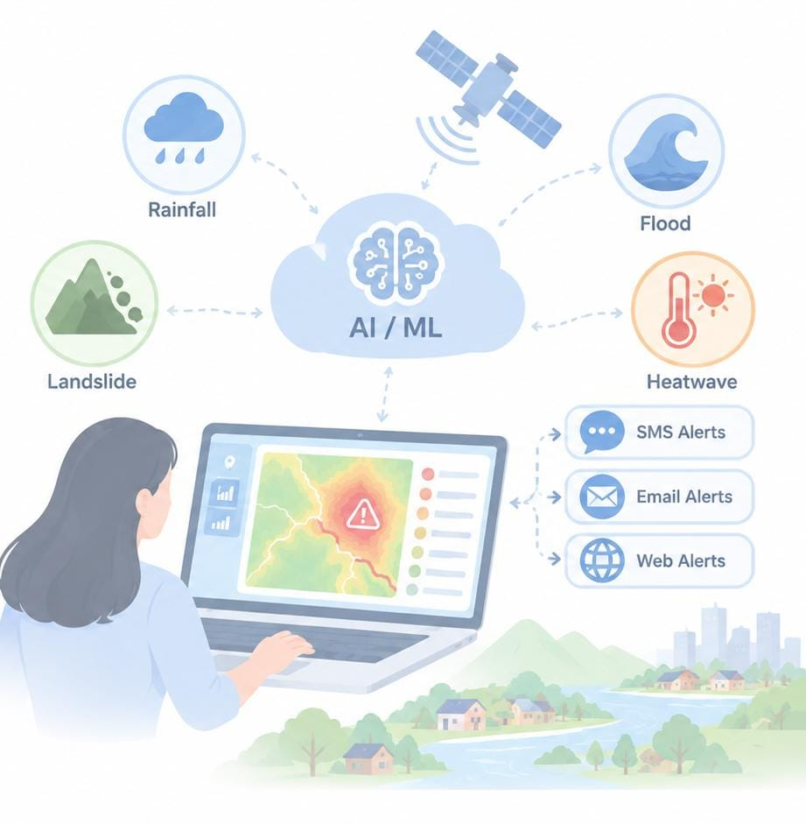
TEAM SANJIVANI
Objectives
Team
📊 Bring Data Together: Combine rainfall, soil, terrain, and past landslide data in one place.
🤖 Predict Risk Early: Use AI to identify areas that may become dangerous before a landslide occurs.
🚨 Send Timely Warnings: Alert people through SMS, email, or web notifications so they can act early.
🗺️ Make Risk Easy to Understand: Show danger zones and safer routes on a simple map.
☁️ No Hardware Needed: Work entirely with existing data, without installing sensors or equipment.
🌍 Ready for the Future: Easily expand the system to floods, cloudbursts, and other regions.

Slide 5
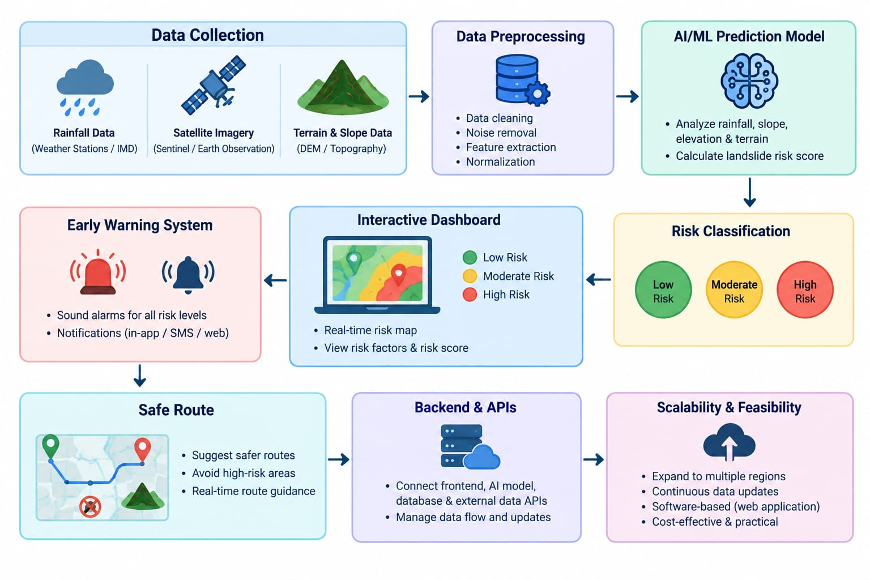





TEAM SANJIVANI
Solution / Architecture
Team
OUR SOLUTION
OUR PROBLEM
Historical Data Aggregation
Consolidates years of rainfall, soil moisture, terrain (DEM/slope) and past landslide records from open archives.
AI/ML Risk Modelling
Models trained on this historical data classify each region's risk as Low, Moderate, High or Critical.
Automated Early Warnings
Instant SMS, email and web alerts to authorities and communities the moment risk crosses a threshold.
Interactive Risk Dashboard
Web-based GIS map of risk zones, trends and safe routes — accessible anywhere, no hardware required.
Our Goal: Build a reliable, scalable, software-first landslide forecasting system that saves lives using data already available today.

Slide 6












TEAM SANJIVANI
TECHNICAL APPROACH
Team
TECHNOLOGY STACK
HOW IT WORKS — PROCESS FLOW
Frontend
Backend
Historical Data Collection
React.js, HTML5, CSS3, JavaScript
Python — FastAPI / Flask, REST APIs
Rainfall, soil moisture, terrain and past landslide records from open archives
Preprocessing & Feature Engineering
Cleaning, alignment and derivation of rainfall, slope and saturation features
AI / ML
Database
Python, Pandas, NumPy, Scikit-learn, XGBoost
PostgreSQL + PostGIS (spatial queries)
AI/ML Model Training
Supervised learning on historical patterns (Random Forest / XGBoost)
GIS & Mapping
Alerts & Notifications
Risk Classification
Leaflet.js / Mapbox interactive risk maps
Twilio SMS API, SMTP Email, Web Push
Each zone scored Low / Moderate / High / Critical
GIS Risk Mapping
Risk levels visualised on an interactive web map
Historical Data Sources
Cloud Deployment
IMD rainfall, NASA SMAP, ISRO Bhuvan, GSI, Sentinel-2
Fully hosted on cloud (AWS / Render) — zero hardware
Early Warning & Alerts
Automated SMS, email and dashboard notifications
Entirely cloud/web-based for this phase — no on-ground hardware or live sensors required.

Slide 7
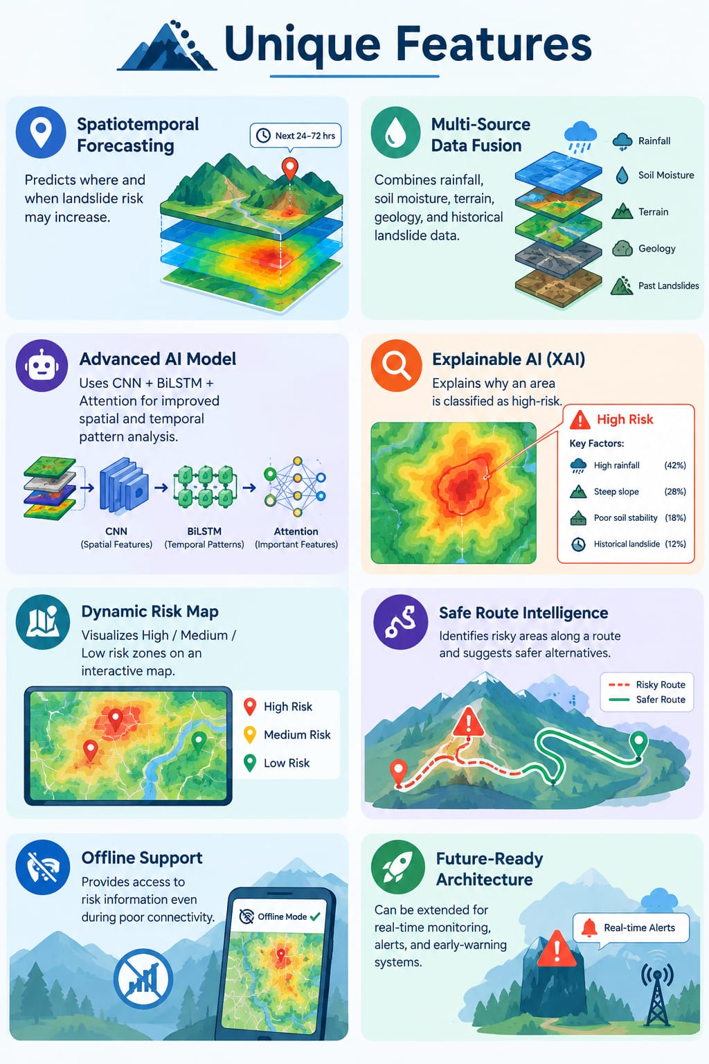
TEAM SANJIVANI
Features/Innovation
Team
📍 Spatiotemporal Forecasting – Predicts where and when risk may increase.
🌧️ Multi-Source Data – Combines rainfall, soil moisture, terrain, geology, and past landslides.
🤖 Advanced AI – Uses CNN + BiLSTM + Attention for better pattern analysis.
🔍 Explainable AI – Shows why an area is risky.
🗺️ Dynamic Risk Map – Displays High / Medium / Low risk zones.
🛣️ Safe Route Intelligence – Finds risky areas on a route and suggests safer alternatives.
📡 Offline Support – Provides access to risk information during poor connectivity.
🚀 Future Ready – Can support real-time monitoring and alerts in the future.

Slide 8
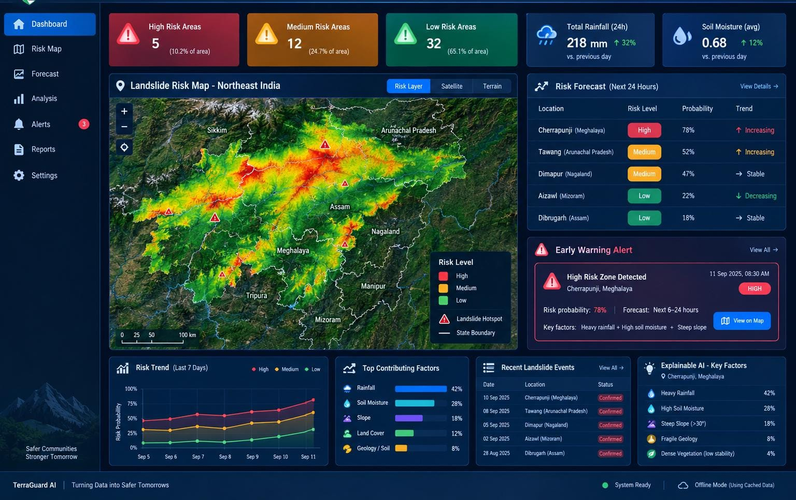
TEAM SANJIVANI
Expected Outcomes
Team
🔮 Early Prediction: Predicts where and when landslide risk may increase.
🤖 Smart AI Analysis: Uses AI to analyse complex environmental data accurately.
🗺️ Risk Identification: Classifies areas into 🔴 High, 🟡 Medium, and 🟢 Low-risk zones.
🛣️ Safer Travel: Suggests safer routes by identifying risky locations.
🚨 Early Warning Support: Can help provide alerts before dangerous situations occur.
📡 Offline Access: Risk information can be available even with poor connectivity.

Slide 9



TEAM SANJIVANI
RESEARCH & REFERENCES
Team
Historical Rainfall Data
India Meteorological Department (IMD) — Open climate data archives
mausam.imd.gov.in
Historical Soil Moisture
NASA SMAP L4 (Soil Moisture Active Passive), via Google Earth Engine catalog
earthengine.google.com
Terrain & Slope Data
ISRO Bhuvan — DEM and disaster-thematic geospatial layers
bhuvan.nrsc.gov.in
Past Landslide Inventory
Geological Survey of India — Bhukosh geoscience data portal
bhukosh.gsi.gov.in
Satellite Imagery
Copernicus Sentinel-2 (European Space Agency)
dataspace.copernicus.eu
Machine Learning
Scikit-learn & XGBoost documentation
scikit-learn.org
Geospatial Analysis
PostGIS spatial database documentation
postgis.net
“Predict Risk. Warn Early. Protect Communities.”

