Slide 1
3
AP ML RD
3
40
COP
MDIST
1
100
3
Subject #1
100
60
Subject #1
Subject #2-10
30
Authentication
Model
30*9=270 right footsteps
1 footstep
3
3
1
Subject #2-10
30 right footsteps
270

Slide 2
3
Subject #1
p
Euclidean distance = sqrt((p1-q1)^2+(p2-q2)^2+(p3-q3)^2+)
3
Subject #2-10
30
270
0
0.2
0.1
Max(score)
training
threshold
30
Th=0.1
30
30
1st
0
1.2
270
1st at least one in that row < 0.1 => correct user
0
TN, FP
0
TP
1st at least one in that row > 0.1 => imposter
testing
30 outputs => TP, FN

Slide 3
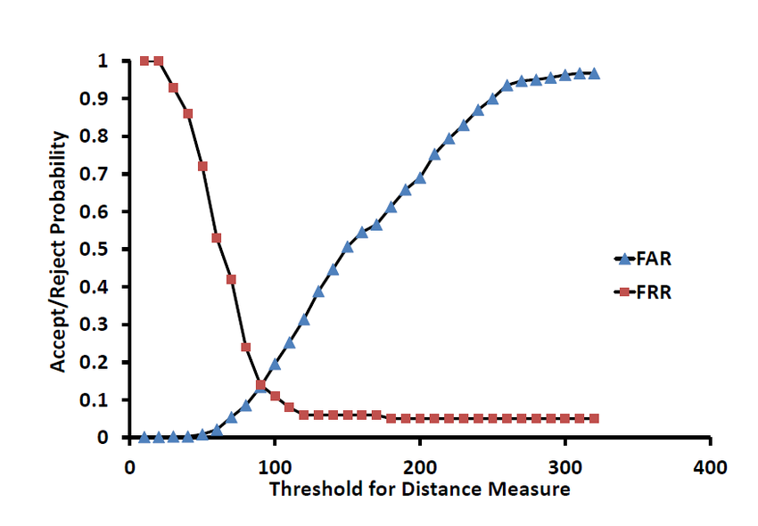
Euclidean distance vs. Correlation coefficient
Zero-FAR is the FRR when FAR=0.

Slide 4
Data (.mat) for Topic 1
COPTimeSeries.m
All the features (.m)
% Col 1: Subject ID
% Col 2: Foot classification : Left(0)/Right(1) (2 for footwear type 1 or 3 for footwear type 2)
% Col 3: Foot index in the trial
% Col 4: Footstep : Complete(0)/Incomplete(1)
% Col 5: y center-offset : (allows determining distance between consecutive footsteps)
% Col 6: x center-offset : (allows determining distance between consecutive footsteps)
% Col 7: Time center-offset
% Col 8: x (in pixels) offsets used for alignment
% Col 9: y (in pixels) offsets used for alignment
% Col 10: Rotational (in degrees) offsets used for alignment
% Col 11: Relative scale of the foot to the template (1.0 being same size)
% Col 12: Fitness score (1.0 being a perfect match)
% The pressure values are between 0 and 255.
% The aligned data is stretched in time to fit the full 100 time steps (also using nearest neighbour interpolation).

