Slide 1
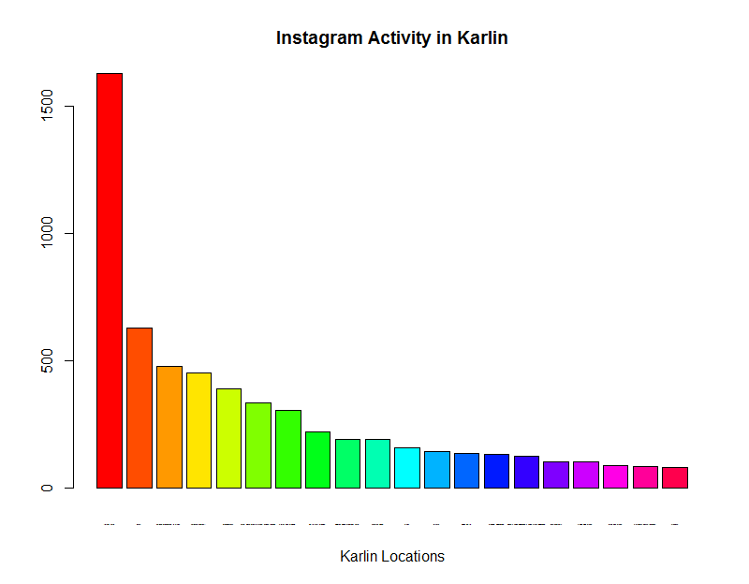
TOP_20
forum karlin 1629
eska 631
national monument in vitkov 479
karlinske namesti 454
Mujsalekkavy 389
karlin, hlavni mesto praha, czech republic 334
storm club prague 304
bistro proti proudu 220
holmes place premium karlin 192
kavarna kocici 191
Vitkov 157
jatka78 144
nejen bistro 135
prague, holesovice 134
beauty salon elegance - salon krasy elegance 125
lokal hamburk 102
studio wella Praha 102
drive club praha 89
starbucks ceska republika 84
krizikova 81
Štefan Kosztolányi
KPMG, R Meetup

Slide 2
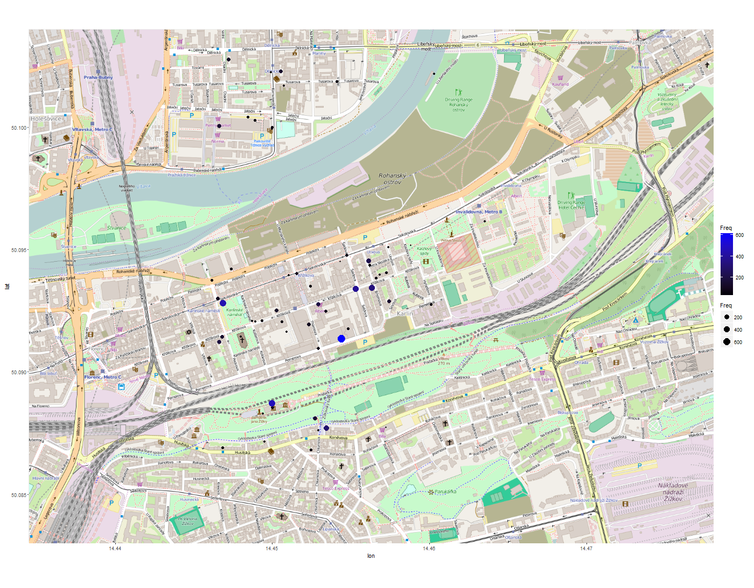

Slide 3
