Slide 1

Hardware-Software Co-Design
Flexible Per-Row Sparsity Patterns
Sozos Koulas – Undergraduate Student
Ilias Papalambrou
Dimosthenis Masouros
Dιmιtrios Soundris
School of Electrical and Electronics Engineering at NTUA

Slide 2
Introduction
The Evolution of Structured Sparsity in Deep Learning

Slide 3
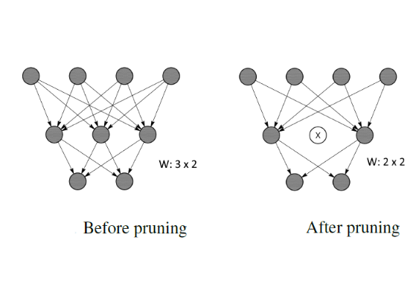
The Challenge of Modern AI
Exponential growth in model parameters
Increasing demand for real-time inference
Memory Bandwidth and Energy Constraints
Necessity for Advanced Compression Techniques

Slide 4



Defining Matrix Sparsity
Unstructured
Structured
Semi-Structured
Maximum flexibility with zero weights anywhere
High Accuracy but extremely difficult to accelerate in Hardware
Entire Rows/Channels Removed
Easy for Hardware but often leads to significant accuracy degradation
Fine-grained patterns like 2:4
Bridges the gap between Accuracy and Hardware Efficiency

Slide 5
Motivation
Why move beyond the static 2:4 Pattern?

Slide 6
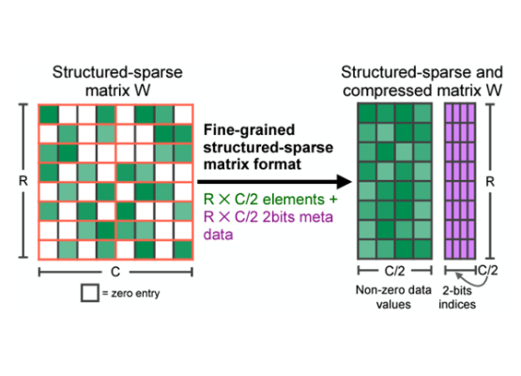
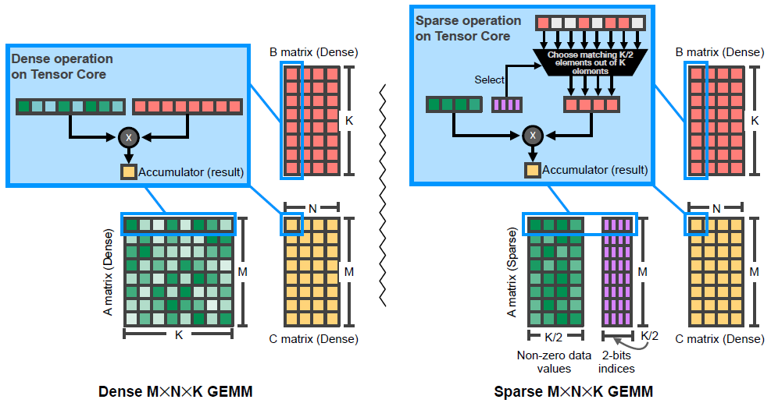
Current State: NVIDIA 2:4
50% Fixed Sparsity Ratio
High Hardware Throughput (2x Speedup)
Uniformity is a Limitation
Cannot Adapt to “Important” Rows

Slide 7
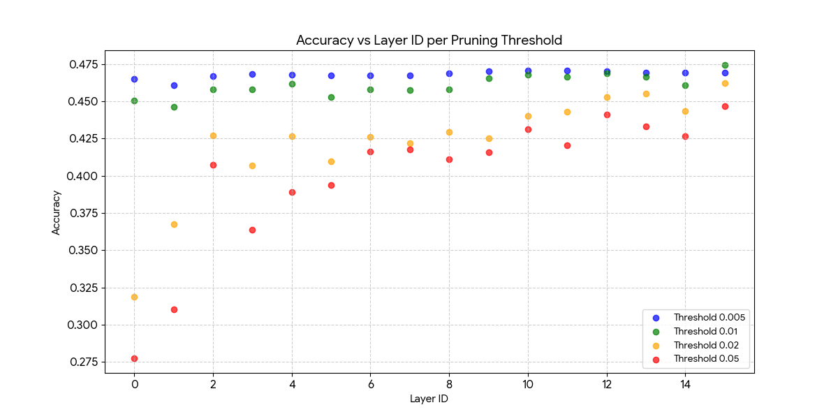
Pruning Layers of Llama-3.2-1B
Notes:
Από το διάγραμμα αυτό παρατηρούμε ότι με ελαφρύ pruning σε όλα τα layers η ακρίβεια του μοντέλου παραμένει υψηλή και κοντά στο Baseline. Με αύξηση του threshold παρατηρείται αισθητή πτώση της απόδοσης του μοντέλου.
Σημασία έχει να δούμε την ευαισθησία των Layers, όπου τα πρώτα layers με pruning έχουν καταστροφικά αποτελέσματα σε αντίθεση με τα τελευταία layers, τα οποία και με aggressive pruning παραμένουν με ψηλό accuracy.
Αυτό είναι λογικό καθώς τα πρώτα layers είναι πιο κοντά στην είσοδο με αποτέλεσμα να επικρατεί το φαινόμενο σπασμένου τηλεφώνου, ενώ τα layers που είναι κοντά στην έξοδο είναι πιο ανθεκτικά καθώς η πληροφορία έχει ήδη επεξεργαστεί αρκετά από τα προηγούμενα layers.

Slide 8
The Need for Adaptation
Theoretical Thesis
One Size
Different parts of a Neural Network possess different sensitivity to pruning
A static 50% ratio across all rows ignores the intrinsic hierarchical importance of weights
Our goal is to allow the hardware to handle variable sparsity while maintaining the acceleration benefits of the 2:4 structure
Does Not Fit All

Slide 9
Proposed Solution
Heterogenous Per-Row Sparsity

Slide 10
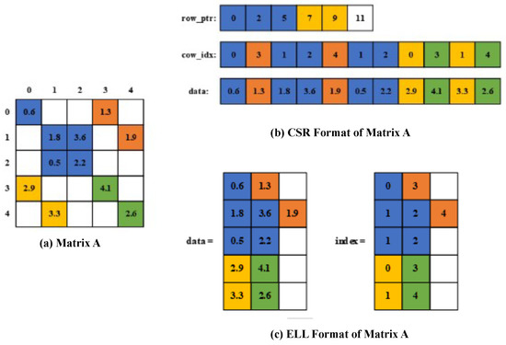
Flexible Sparsity
Our architecture expands the 2:4 window concept to support multiple ratios (e.g. 2:4, 2:8, 2:16 and 2:32) dynamically per row or batch of input.
This allows “dense” row to keep more weights and “sparse” rows to keep less weights optimizing the accuracy-efficiency target

Slide 11
Core Architectural Changes
Dynamic Multiplexing: Adaptive logic to route non-zero elements based on row/batch level metadata
Metadata Encoding: Extending the 2-bit index per 2:4 block to include row/batch level density flags
Run-time Sparsity Changes: Ability to change sparsity patterns on run-time per row-batch

Slide 12
Baseline Architecture
Dense GEMV Module

Slide 13
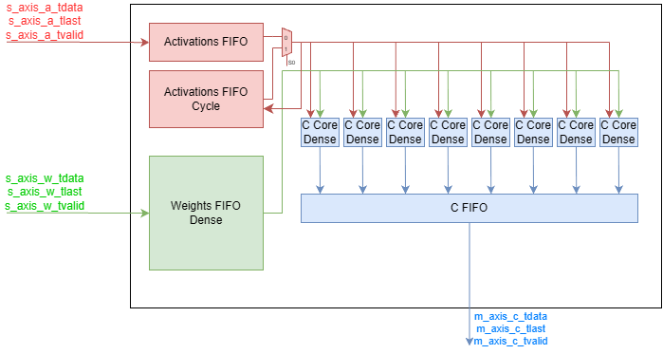
Top Dense Module

Slide 14
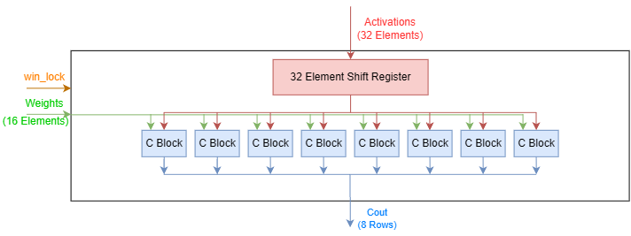
C Core Dense Module

Slide 15
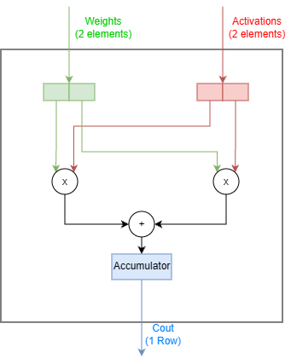
C Block Dense Module

Slide 16
Sparse Architecture
Sparse 2:N GEMV Module

Slide 17
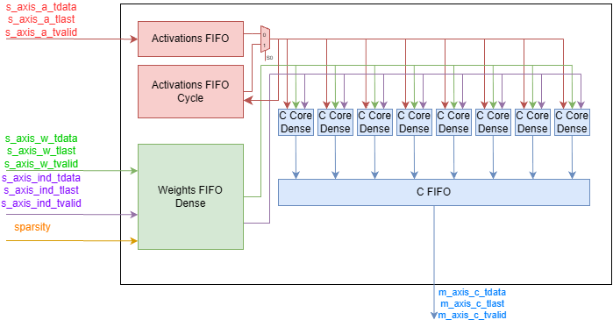
Top Sparse Module

Slide 18
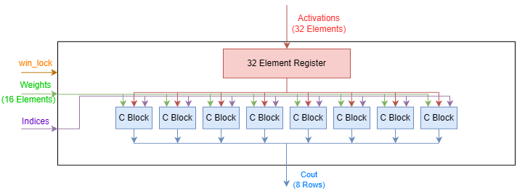
C Core Sparse Module

Slide 19
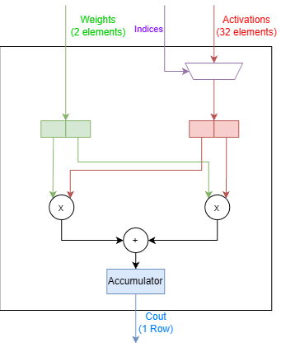
C Block Sparse Module

Slide 20
Results
Sparse 2:N GEMV vs Dense GEMV Module

Slide 28
Innovations
Sparse 2:N GEMV vs Dense GEMV Module

Slide 29
Main Implementation Innovatios

