Slide 1
Stock market Price prediction
CAPSTONE PROJECT
Presented By:
Sanjay Ashok Rout – IMED, Bharati Vidyapeeth Deemed to be University – Dept : Dept of Computer Application
Degree: Bachelor of Computer Application
Project Details:
Github Link: https://github.com/SKrout05/Stock-Price-Prediction
Google Drive Link: https://drive.google.com/drive/folders/14NEoIeDHDTkD-qEAWXP16xJuXzxmnECf?usp=sharing
Contact Details:
Mobile No. : 8010795039
Email Id: iamsanjay04032002@gmail.com
LinkedIn: https://www.linkedin.com/in/sr05/

Slide 2
OUTLINE
Problem Statement
Proposed System/Solution
System Development Approach
Algorithm & Deployment
Result
Conclusion
Future Scope
References

Slide 3
Problem Statement
To predict and forecast stock market prices using machine learning techniques, specifically leveraging Long Short-Term Memory (LSTM) neural networks. The goal is to create a model that can accurately predict future stock prices based on historical data.

Slide 4
Proposed Solution
To develop a predictive model for forecasting stock market prices using historical data and Long Short-Term Memory (LSTM) neural networks.
Data Collection
Source: Obtain historical stock price data from financial institution.
Libraries: Use libraries like pandas, to handle the data.
Data Preprocessing:
Normalization: Scale the data to a range of 0 to 1 using MinMaxScaler.
Dataset Creation: Create training and test datasets with a specific timestep window
Machine Learning Algorithm:
Model Definition: Build a stacked LSTM model using Keras.
Training: Compile and train the model using training data.
Deployment:
Frameworks: Utilize a framework like Flask or Django to create a web service for the model.
Integration: Deploy the model to a cloud service (e.g., AWS, Google Cloud) and integrate with a front-end for user interaction.
Evaluation:
Metrics: Use Root Mean Squared Error (RMSE) to evaluate the model’s performance.
Visualization: Plot the actual vs. predicted prices to visualize model accuracy.

Slide 5
System Approach
System requirements
Processor: Multi-core CPU (Intel i5/i7 or AMD equivalent)
RAM: Minimum 8 GB (16 GB recommended for large datasets).
Storage: SSD with at least 50 GB free space.
Internet Connection: Required for data collection via APIs and deploying the model.
Operating System: Windows 10 or 11 / macOS Catalina
Software: Python: Version 3.7 or later
Google Colab: For interactive coding and model development
Library required to build the model
Data Collection and Processing: pandas - Data manipulation and analysis
numpy - Numerical computing
sscikit-learn - Preprocessing and scaling data
Machine Learning and Deep Learning: tensorflow - Building and training the LSTM model
keras - High-level neural networks API (integrated with TensorFlow)
Visualization: matplotlib - Plotting and visualization of data

Slide 6
Algorithm & Deployment
Algorithm Selection:
We selected a Stacked Long Short-Term Memory (LSTM) neural network for this project. LSTMs are a type of recurrent neural network (RNN) specifically designed to handle sequential data and time series predictions by capturing long-term dependencies. The stacked version, which uses multiple LSTM layers, enhances the model's ability to learn complex patterns in the data.
Data Input:
The input data consists of historical stock prices collected from the AAPL.csv file. The data includes various features such as opening price, closing price, high, low, volume, and date. For the prediction task, we primarily focus on the closing price as the target variable. The data is pre-processed by normalizing the values to a specific range, typically between 0 and 1, to improve the performance and convergence of the LSTM model.
Training Process:
The training process involves splitting the preprocessed data into training and testing sets. The LSTM model is then trained on the training set, where it learns to recognize patterns and trends in the historical stock prices. The model's parameters are optimized using backpropagation through time (BPTT) and an optimizer such as Adam. During training, the model’s performance is monitored using metrics like mean squared error (MSE) to ensure it is learning effectively and not overfitting the data.

Slide 7
Prediction Process:
Once the model is trained, it is used to make predictions on the test set. The input sequence of historical stock prices is fed into the model, which then outputs the predicted future stock prices. The predictions are denormalized to convert them back to the original scale. The model's accuracy is evaluated by comparing the predicted stock prices to the actual prices using evaluation metrics such as root mean squared error (RMSE). The predictions can be visualized to provide insights into future stock market trends.

Slide 8
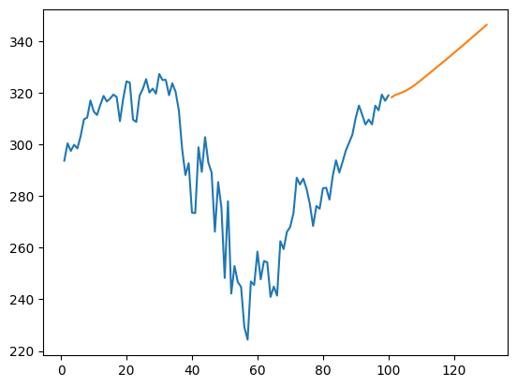
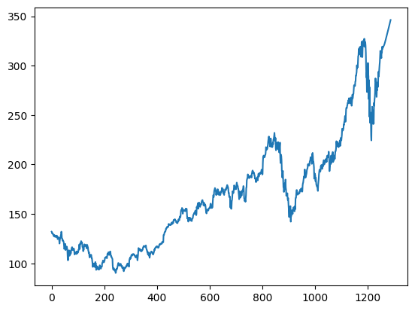
Result
Orange Line shows the prediction of price for coming 30 Days
Final visualization in broad time Range

Slide 9
Conclusion
This project demonstrates the efficacy of using a Stacked Long Short-Term Memory (LSTM) neural network for stock market price forecasting. By leveraging the sequential nature of historical stock price data, the LSTM model captures complex temporal patterns and dependencies, providing accurate predictions for future stock prices. The successful implementation of this model highlights the potential of advanced machine learning techniques in financial forecasting, offering valuable insights and aiding investors in making informed decisions. The end-to-end workflow, from data collection and preprocessing to model training and evaluation, showcases the comprehensive approach required for building robust predictive models in the financial domain.

Slide 10
Future scope
Incorporating Additional Data Sources: Integrate more diverse datasets such as financial news, macroeconomic indicators, and social media sentiment to enhance the model's predictive power and robustness.
Model Optimization: Experiment with different neural network architectures, hyperparameter tuning, and advanced optimization techniques to improve the accuracy and efficiency of the model.
Real-Time Prediction: Develop capabilities for real-time data streaming and prediction, enabling dynamic and up-to-date stock price forecasting for immediate decision-making.
Risk Management: Integrate risk assessment and management techniques to provide not only predictions but also insights into potential risks and uncertainties in the stock market.
User-Friendly Interface: Develop a user-friendly web or mobile application that allows users to interact with the model, visualize predictions, and customize forecasting parameters based on their requirements.

Slide 11
References
https://chatgpt.com/
https://www.youtube.com/watch?v=OXwZtlcTiuk
https://www.analyticsvidhya.com/blog/2021/10/machine-learning-for-stock-market-prediction-with-step-by-step-implementation/
https://www.sciencedirect.com/science/article/pii/S1877050922021937

Slide 12
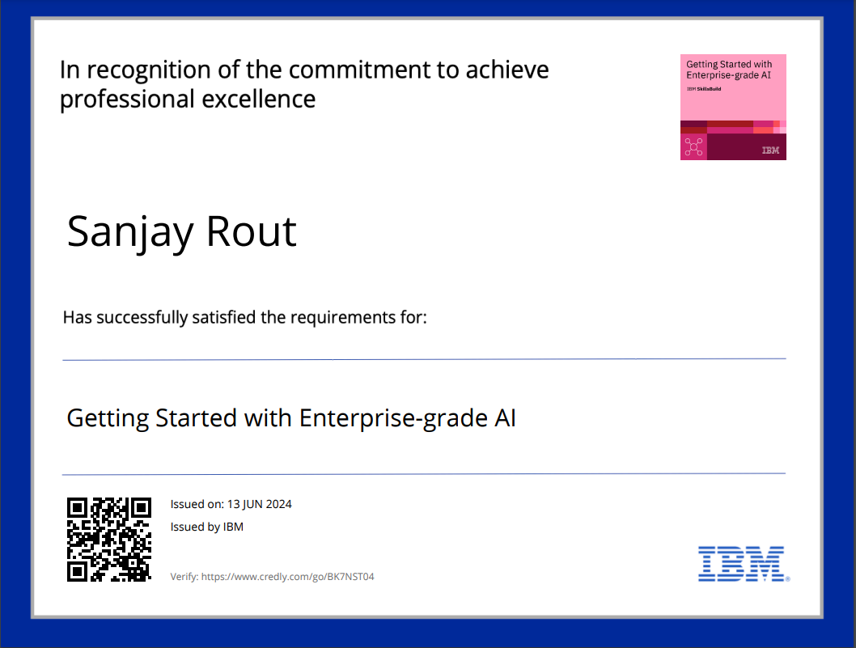
course certificate 1
https://www.credly.com/badges/1545129b-71b8-49bb-b881-8596bc8dd34d/public_url

Slide 13
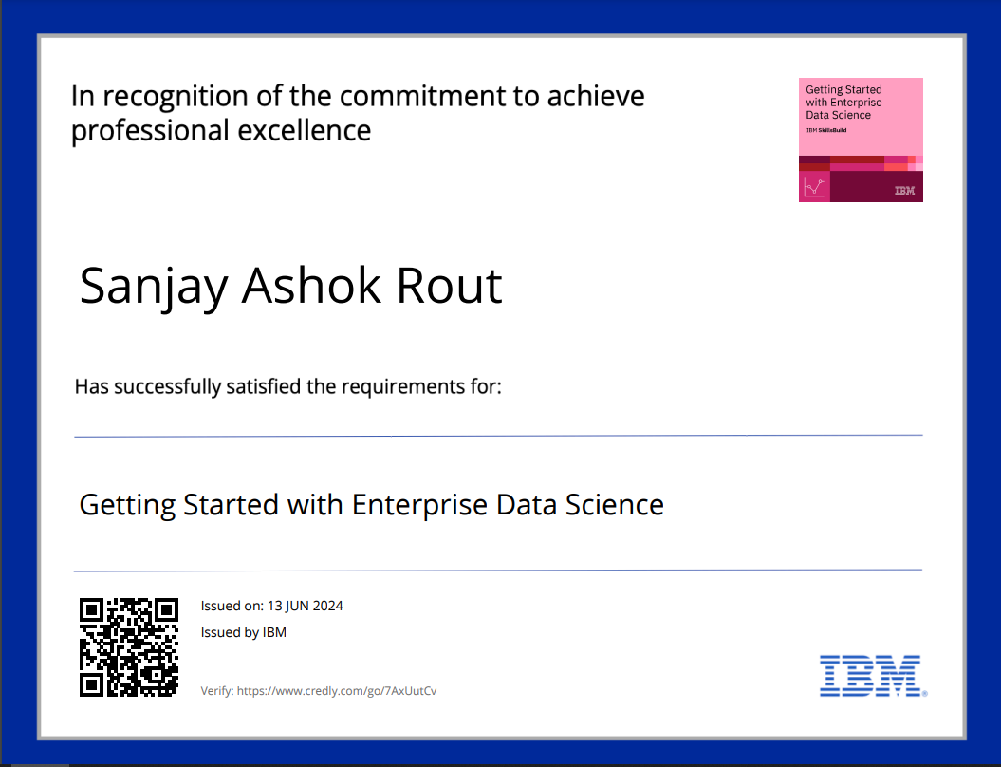
course certificate 2
https://www.credly.com/badges/33e0ee25-473a-4164-aeca-f49b38ab9451/public_url

Slide 14
THANK YOU

