Slide 1
BEACON
MPCA PROJECT
4TH SEM-G
sk saqlain mustaq : 01FB16ECS388
SKANDA C.S : 01FB16ECS389
SUMAIR AHMED SHARIFF : 01FB16ECS399
SUROLIA HARSHVARDHAN: 01FB16ECS408

Slide 2
PARKING PROBLEMS!!!
PARKING NIGHTMARE: You won't believe the amount of time drivers spend looking for a space
DRIVERS spend an average of 44 hours a year searching for a parking space, according to new research in India and Us.
This costs the typical motorist £733 in wasted time, fuel and emissions, the study by traffic information supplier Inrix found.
Businesses and high streets bear the brunt of parking pain as 40 per cent of drivers say they avoid driving to shops due to problems finding a space.

Slide 3
SOLUTION
Increase parking supply.
Establish minimum parking requirements. ...
Increase on-street/curbside parking provision. ...
Increasing on-street parking. ...
Subsidizing off-street parking. ...
The above mentioned points requires additional space thus we have devised a solution to the problem which does not require extra space but find available spaces near by where the user wants to park his/hers car.
AUTOMATED PARKING SPACE FINDER.

Slide 4
MICRO-CONTROLLER
A microcontroller (or MCU for microcontroller unit) is a small computer on a single integrated circuit.
Which is used to perform a specific task.
ARDUINO.
Arduino Uno is a microcontroller board
Arduino consists of both a physical programmable circuit board (often referred to as a microcontroller) and a piece of software, or IDE (Integrated Development Environment) that runs an users computer, used to write and upload computer code to the physical board.

Slide 5
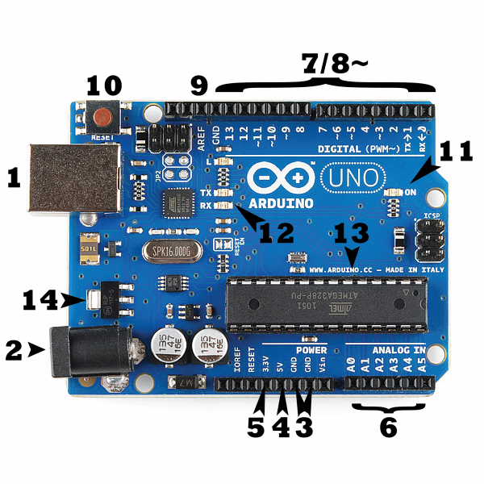
ARDUINO
In the picture the USB connection is labeled (1) and the barrel jack is labeled (2)
GND (3): Short for ‘Ground’. There are several GND pins on the Arduino, any of which can be used to ground your circuit.
5V (4) & 3.3V (5): The 5V pin supplies 5 volts of power, and the 3.3V pin supplies 3.3 volts of power
Analog (6): The area of pins A0 through A5 on the UNO are Analog In pins. These pins can read the signal from an analog sensor and convert it into a digital value that we can read
Digital (7): Across from the analog pins are the digital pins (0 through 13 on the UNO). These pins can be used for both digital input (like telling if a button is pushed) and digital output (like powering an LED).
.
.
PWM (8): The digital pins 3, 5, 6, 9, 10, and 11 on the UNO. These pins act as normal digital pins, but can also be used for something called Pulse-Width Modulation (PWM).
AREF (9): Stands for Analog Reference. Most of the time this pin is left alone. It is sometimes used to set an external reference voltage (between 0 and 5 Volts) as the upper limit for the analog input pins.
Reset Button(10)
Power LED Indicator(11)
the TX and RX indicator LEDs (12)
Integrated Circuit (13)
The voltage regulator (14)

Slide 6
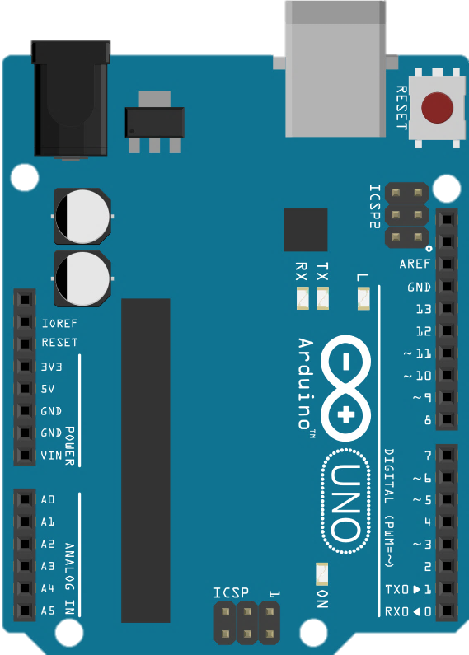
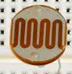

HARDWARE USED
INITIAL APPROACH (USEING LDR):
Use LDR to detect car that is placing the ldr below the car if
car is not present then resistance value is low in the ldr thus
indicating that the parking space is empty. If not then the parking space is occupied.
LIMITATIONS:
The ldr analog output is not consistent thus resulting in wrong output.

Slide 7
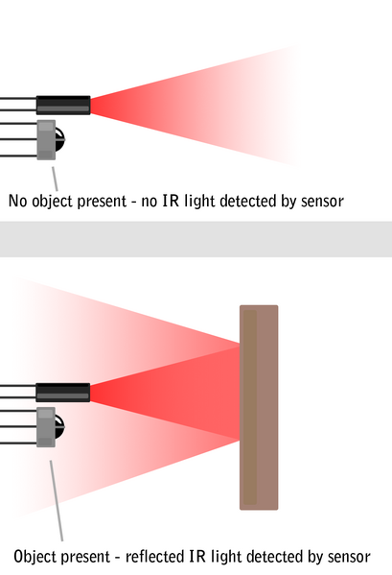
HARDWARE USED:
SECOND APPROACH( USING IR SENSOR):
IR Sensors work by using a specific light sensor to detect a select light wavelength
in the Infra-Red (IR) spectrum. By using an LED which produces light at the same
wavelength as what the sensor is looking for, you can look at the intensity of the
received light. When an object is close to the sensor, the light from the LED bounces
off the object and into the light sensor. This results in a large jump in the intensity,
which we already know can be detected using a threshold.

Slide 8
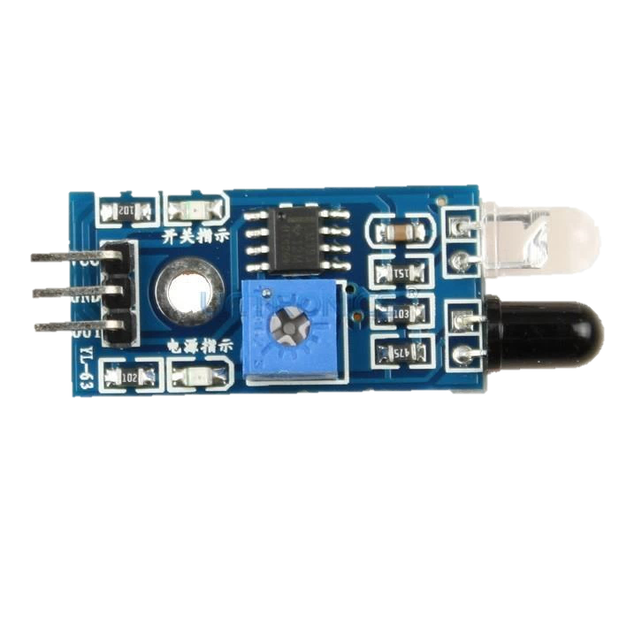
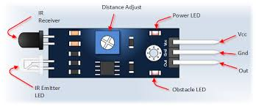
By using the principle of IR we have made a model .
Placing IR in front of each parking slot .
If the slot is empty then the ir light does not get reflected thus no car is detected.
When there is a car parked then the ir light gets reflected by the cars bonnet thus the ir sensor detects reflected ir light indicating that a parking slot is full.
This concept can be used in order to detect parking spaces in the nearby arear.

Slide 9

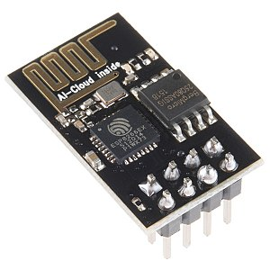
INTERFACE/COMMUNICATION
INITIAL APPROACH (MAKING AN ANDROID APP):
Interface:
using android studio to make an app
making a grid of 3*2 indicating parking slots green slot indicates empty parking slot
yellow indicates occupied.
communication:
in order to communicate we used esp8266 module.
limitation:
setting up esp866 is difficult
faced problem during connection between esp866 and android app.

Slide 10


INTERFACE/COMMUNICATION
SECOND APPROACH
Communication :
Print the values in the serial monitor of the Arduino IDE.
Read the serial monitor value using python script (pySerial library)
INTERFACE:
Then upload that values into a mysql database using MySQLdb library of python
Reading back those values from the database using php and making an interface using HTML and JAVASCRIPT.

Slide 11
USING DATABASE INSTEAD OF A FILE.
DRAWBACKS OF FILE SYSTEM:
Data Isolation: Because data are scattered in various files, and files may be in different formats, writing new application programs to retrieve the appropriate data is difficult.
Duplication of data – Redundant data
Dependency on application programs – Changing files would lead to change in application programs.
ADVANTAGES OF DBMS
No redundant data – Redundancy removed by data normalization
Data Consistency and Integrity – data normalization takes care of it too
Secure – Each user has a different set of access
Privacy – Limited access
Easy access to data by application programs
Easy recovery
Flexible

Slide 12
CONCLUSION
India is facing a new problem nowadays – lack of sufficient parking space.
It is not the lack of sufficient parking space but unable to locate a right parking lot at the right time.
Thus resulting in traffic and waste of time of a user.
Thus the method proposed above not only reduces the effort of finding a parking slot but also in turn reduces traffic problems.
The above method proposed does not only solve the parking problem but also is cost effective and easy to implement.

