Slide 1
Market Basket Analysis Using ML.
DATA TRIUMPH.
SK SAQLAIN MUSTAQ 01FB16ECS388
SUMAIR AHMED SHARIFF 01FB16ECS399

Slide 2
PROBLEM STATEMENT.
Market basket analysis is based upon the identiﬁcation and analysis of purchasing patterns of the customers.
In recent years, analyzing shopping baskets has turned out to be very helpful for the retailers. Revolutionary technologies made it possible to collect information of customers and what they purchase.
The process involves an analysis of historic data and based on that analysis to predict the future occurrences.
Analyzing such information is exceedingly valuable for understanding purchasing behavior. Mining purchasing patterns allows retailers to adjust promotions, store settings and serve consumers better.
The tradition method of analysis includes the usage of ‘Associative rules mining’ and ‘Apriori’ based methods in which majority of the time is consumed in generating the rules.
Our goal was to use an ML model that will recommend items to the user based on the previous purchase and the current set of items in the basket. On using an ML model the overhead of rule generation is eliminated and the only overhead is the amount of time it takes for the model to learn the pattern.

Slide 3
DATASET.
Dataset1 :- Instacart Market Basket
Source:-Kaggle.
The dataset consists of separate information/files on aisles, departments, order_products_prior, order_products_train, orders, products.
The dataset consists of 3 million grocery orders from more than 200,000 Instacart users, with each user ordering multiple times.
Dataset2:-Transactions from a Bakery
Source:-Kaggle.
The dataset consists of about 10,000 transaction with 95 unique items.

Slide 4
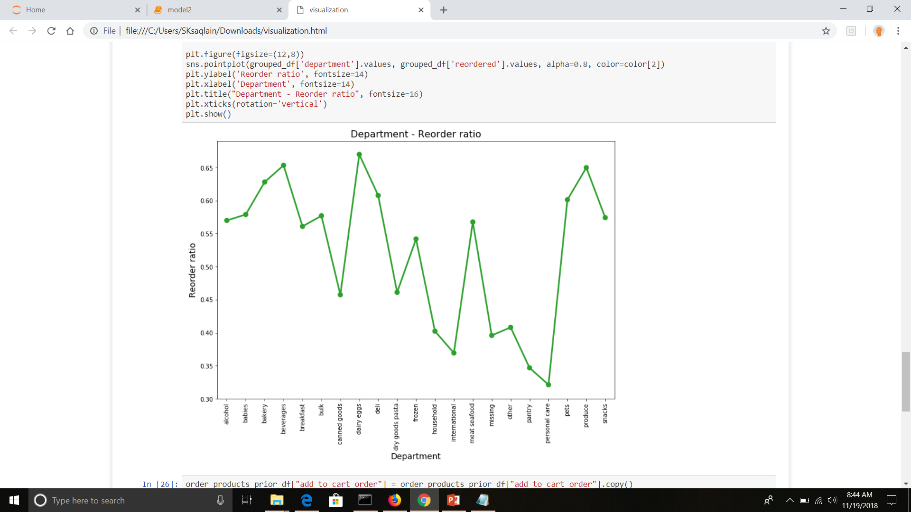
Reorder Ratio
Visualizations
It is evident from the plot that the reorder ratio’s are high for the products belonging to department such as beverages, dairy eggs, frozen foods, meat and sea food, pet supplies and organic produce.
It gives an idea as to what kind of products have a high probability or chance of being bought, and items with higher chance of being bought also would have a higher chance of being bought together.
For example, if somebody’s bought eggs there’s a high chance they’ll buy organic produce a well.

Slide 5
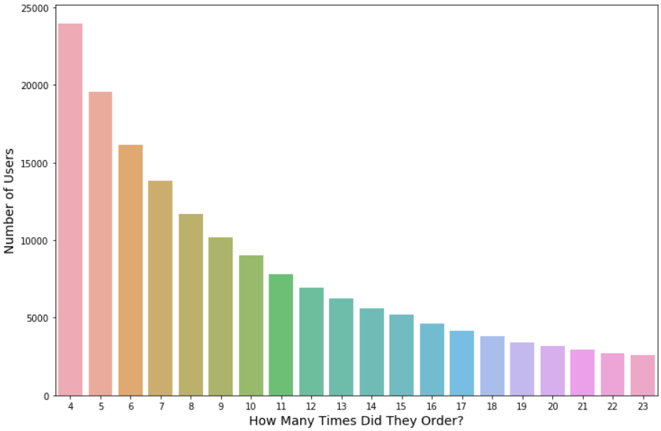
How many times did they order?
As it can be seen from the above graph that around 24000 users have ordered at 4 times which likely indicates that they buy groceries that last for longer duration. As the number of orders increases so does the number of users. It becomes constant at around 14 and then continues to stay so in the range of 5000.
Hence it is deduced that a lot of users prefer to buy maybe quarterly and to last for a long duration. Also there’s a huge number of people who buy regularly.

Slide 6
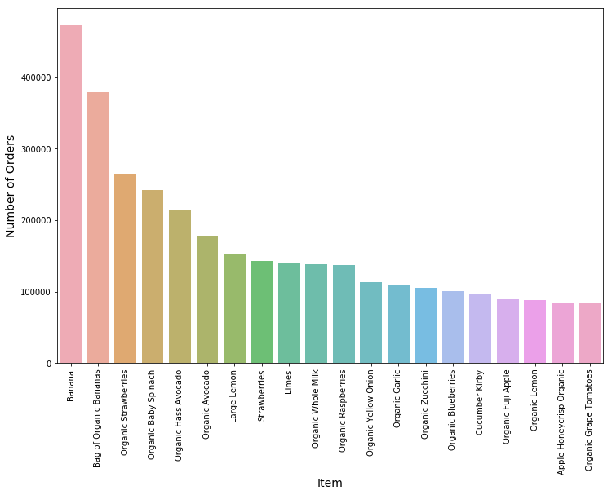
Most Bought Items
We see that Banana tops the list with most orders. But on scrutinizing the graph you find that all the items belong to the Organic Produce Department concretely proving the former result we got from the previous graph.
There are other visualizations as well in the iPython Notebook

Slide 7
APPROACH.
As the dataset had information about whether the product will be re-ordered or not this information was used to predict how likely a product will be re-order .
1
2
3
Train-Test split:-
Model training:-
Model testing:-
The information such as the user_id, product_id, department_id, aisle_id was used with a train-test split of 70-30%.
The training data was used to train a logistic regression model
With training data size to be 969231
The training data was also used to train a Multi-Layer Perceptron model with activation function being ‘relu’ and learning rate being 0.0001 to check which model performed better.
The testing data was used to test a logistic regression model
With testing data size to be 415386.
The model predicted with an accuracy of ~60%
The F1-score of the model was around ~75%
The testing data was also used to test against the MLP model the model predicted with accuracy of
~ 62%.
Even though the accuracy of the MLP model performed slightly better than the regression model but the amount of time required to train the model was more and hardware requirements were more for the case of the MLP model.

Slide 8
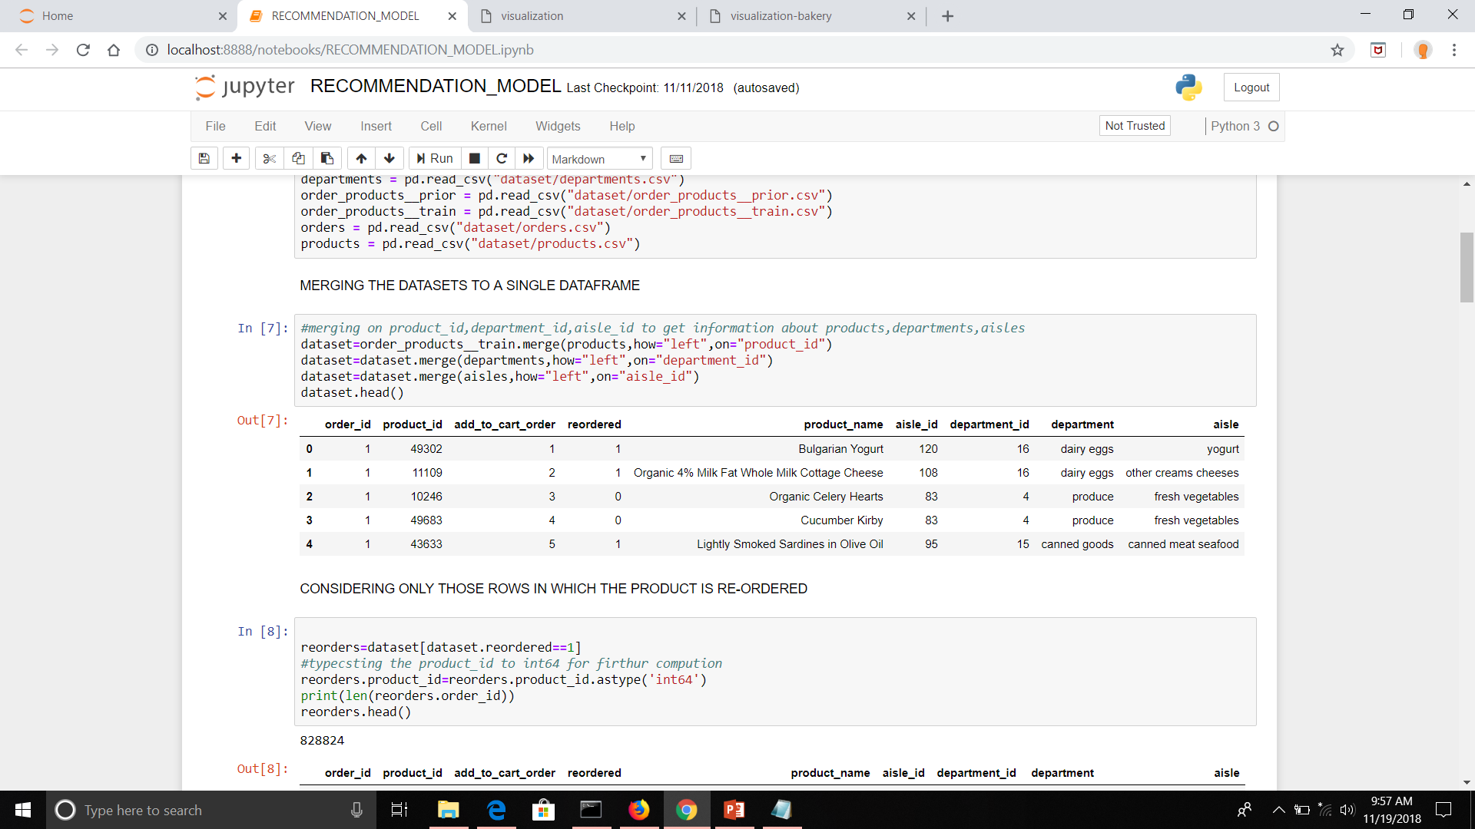
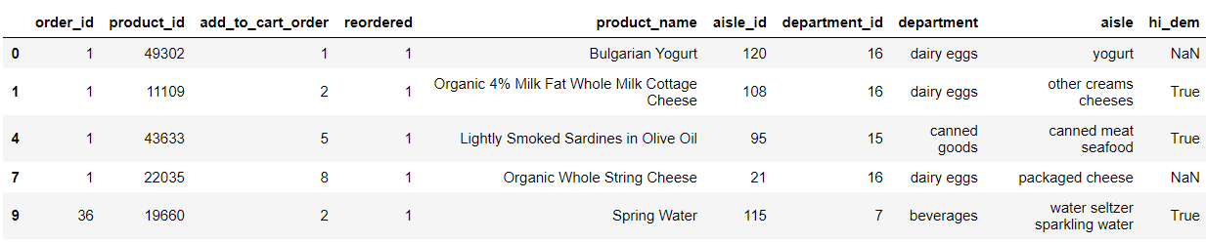
RECOMMENDATION SYSTEM.
As the dataset had information of a product being likely to be re-ordered. That is if a product is likely to be reordered this in turn indicates that, that the product is likely to be picked up by multiple users thus this information along with collaborative filtering is used to recommend products to the users.
1)DATA-PROCESSSING:-
a)The dataset was merged to get the information such as product name, the department that it belongs to and the aisle information.
b)Considering only those rows in which the product was re-ordered and ordered more than once high demand.

Slide 9
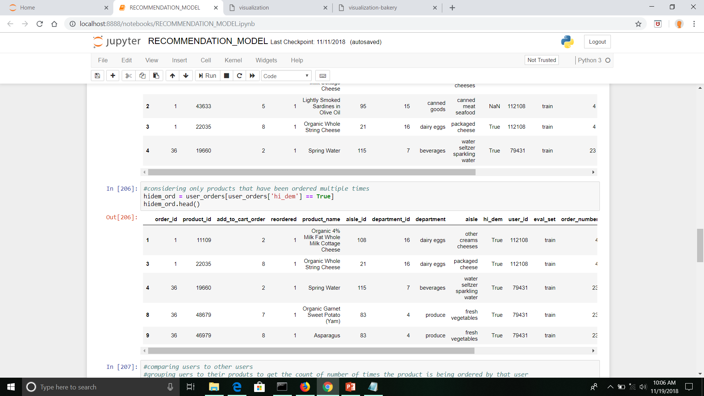
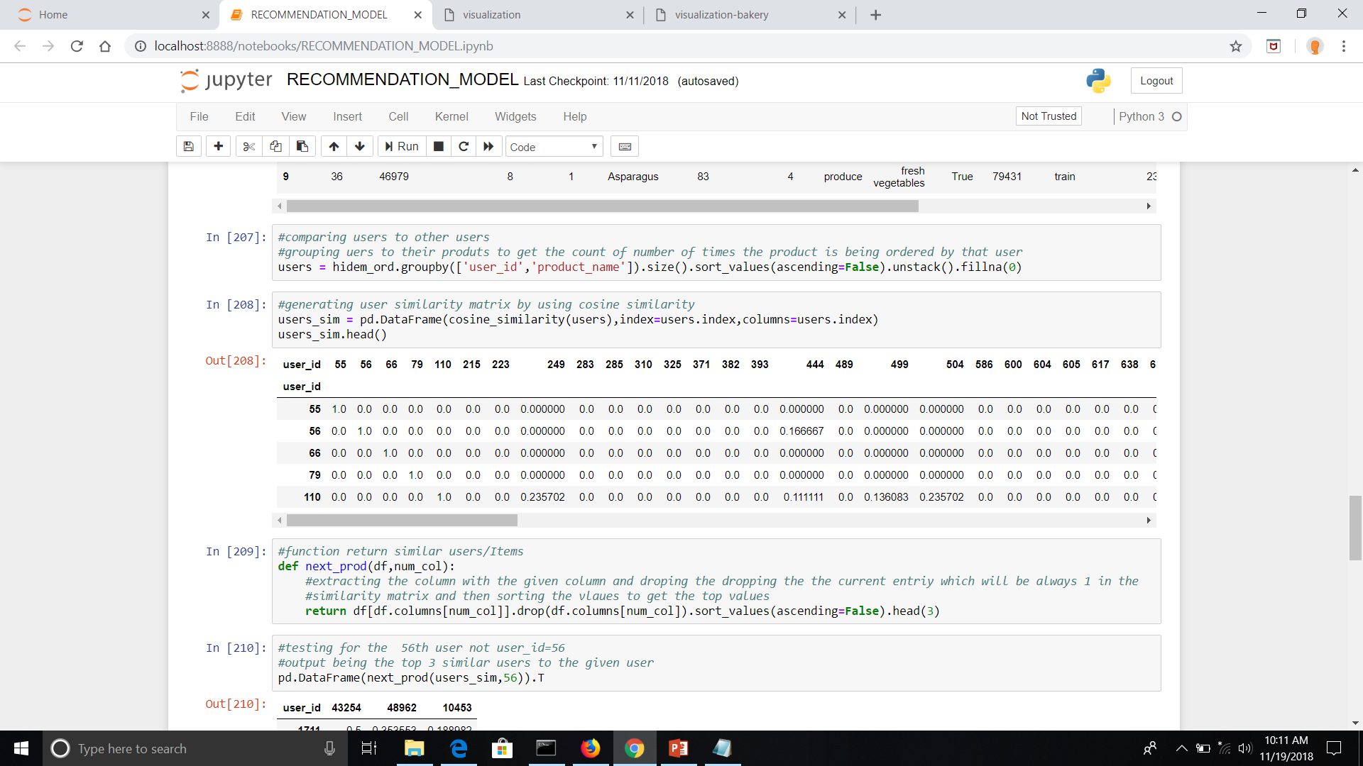
RECOMMENDATION SYSTEM.
2) RECOMMENDATION SYSTEM:-
a)Once the information about the products being re-ordered was obtained now the user information was extracted by merging the order dataset to get the user_id information.
b)Once the dataset was merged the number of times a specific product was ordered were extracted by grouping on user_id, product_id and converted to a single row which also in-turn indicates that the product was bough by that user.
c)A user-user similarity matrix was generated using cosine similarity measure from the user product matrix.
d)A product user matrix was also generated to get the list of user’s that ordered the specific product.
e)Thus the product user matrix and user-user similarity matrix is used to recommend top 5 products to a specific user by performing a dot product between the item-user matrix and the list of users similar to that user.

Slide 10
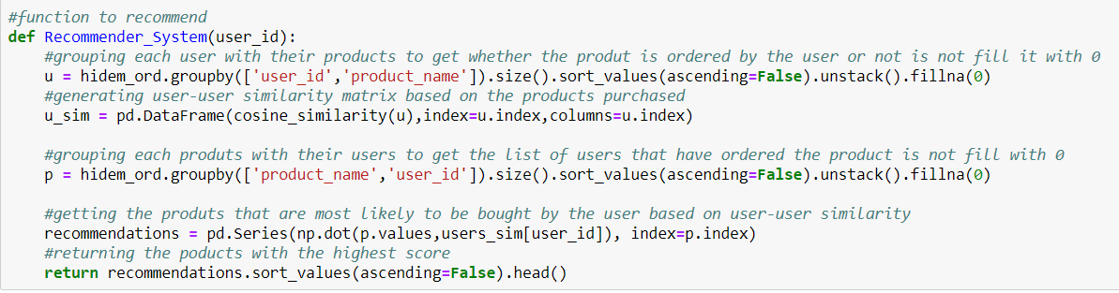
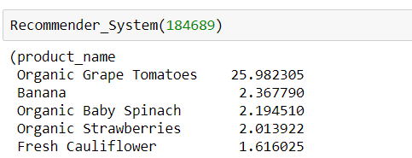
RECOMMENDATION SYSTEM.
Performing a dot product between the user-user similarity vector and product-user matrix will generate scores for each products thus the product with the max score will be the one which is bought by all the users that are similar to that specific user for which recommendation is being done.
Consider an example a recommendation for a specific user number 184689 thus the top product recommended to the user are as shown in the figure below.

Slide 11

THANK YOU!

