Slide 1
Project Work :
ESA 2020
Project Title : Flavour Enhanced Food Recommendation
Project Guide : Dr. Dinkar Sitaram
Project ID : PW20DS106
Project Team : Sk Saqlain Mustaq 01FB16ECS388
Sumair Ahmed Shariff 01FB16ECS399
Harshvardhan Surolia 01FB16ECS408

Slide 2
Problem Statement
Health Applications like MyFitnessPal ,Apple Health Kit ,Google Fit etc. provide users a way to monitor one’s food consumption and activity and recommend food, however these recommendations do not consider the user’s flavor preference.
The main objective of the project is to prove the hypothesis that a user prefer similar dishes because there are specific set of flavonoids that are common among the dishes as the user prefers those specific set of flavonoid molecules. We try to determine to what extent will the recommendation model improve when it incorporates just the flavonoids compared to the recommendation model which just incorporates the ingredients and the flavour
Including the flavor factors directly into the recommendation system will not only help in recommending healthy food but also will recommend food that is appealing to the users taste.

Slide 3
User Profile
In the present world everyone are health conscious and are serious about what they eat as healthy diet decreases the probability of acquiring any chronic disease.
To help in making a healthy diet ,algorithms can compute health scores based on the users physical and medical conditions.
However most of the food that falls under healthy domain lacks tastes . Thus the user prefers to eat healthy food by sacrificing the pleasures of taste, and this is what most of the recommendation systems that is being used in food related sites have incorporated.
We have proposed a mechanism where we have implemented a recommendation system which incorporates flavonoid(chemical compounds) present in the food as features thereby not only just recommending food but also taking into consideration the taste preference of the user.

Slide 4
Literature Survey
Taste–nutrient relationships in commonly consumed foods
van Dongen, Mirre Viskaal, Marjolijn C. van den Berg, Nicole Vink, Frans J. Kok, and Cees de Graaf. "Taste–nutrient relationships in commonly consumed foods." British Journal of Nutrition 108, no. 1 (2012): 140-147.
The paper proposes a study to determine if there is any association between the nutrients in the food and the taste.
Mainly focused on five basic tastes that is sweetness, saltiness, sourness, savouriness and bitterness.
Worked with only fifty food items that were commonly consumed food items within Netherlands
The author worked around with limited set of nutrients to find association with taste, such as sucrose for sweetness, NaCl for saltiness, monosodium glutamate(MSG) for savouriness, citric acid for sourness and caffeine for bitterness
The author concludes that sweetness in the food is due to the presence of mono and disaccharide content in addition to this both saltiness and savouriness were associated with sodium(Na) and protein content.
But the author fails to asserts any evidence for the relationship of the nutrients with bitterness.
The paper doesn’t propose a formula to assign a score to each of these tastes based on the nutrient content.

Slide 5
Joint Deep Modeling of Users and Items Using Reviews for Recommendation
Zheng, Lei, Vahid Noroozi, and Philip S. Yu. "Joint deep modeling of users and items using reviews for recommendation." In Proceedings of the Tenth ACM International Conference on Web Search and Data Mining, pp. 425-434. ACM, 2017.
The paper proposes a model named DeepCoNN(Deep cooperative Neural Networks) which takes in both the user review and item review in order to recommend items
The model consists of two parallel neural network coupled in the last layer.
One of the network focuses on learning user behaviors by exploiting reviews written by the user and the other learns item properties from the review written for the item.
The shared layer enables latent factors learned for users and items to interact with each other in a manner similar to matrix factorization techniques.
The model was tested on multiple datasets such as Yelp, amazon and Beer(ratebeer.com)
Matrix factorization was used as a baseline and it was proved that the DeepCoNN performs better in recommendation that the MF technique
The Model seems to solve problems such as matrix sparsity (few reviews) as the model is trying to extract semantic information form the reviews and cold start problems.
The same model can be used for recommending food item but a different embedding has to be used such as TFIDF for both the reviews and item(properties)

Slide 6
Automated Healthy Dish Recommendation
Nag, Nitish, Vaibhav Pandey, Abhisaar Sharma, Jonathan Lam, Runyi Wang, and Ramesh Jain. "Pocket dietitian: Automated healthy dish
recommendations by location." In International Conference on Image Analysis and Processing, pp. 444-452. Springer, Cham, 2017.
Recommendation via expert knowledge are the key to unlock healthy diets
The system architecture includes 2 parts Data filter that is filtering food based on calories ,carbohydrates and an Expert Knowledge which performs personalized health score calculation
Proposed an algorithm called ELIXIR which incorporates expert knowledge of the dietitians
In simple terms the Algorithm places healthy components of the nutrients in the numerator and unhealthy section in the denominator ,then the ratio of the two components is then scaled from 1-100.
Used USDA food composition database , compared the model with existing nutritional ranking algorithms such as (FSA,SAIN,NRF)

Slide 7
Flavour Enhanced Food Recommendation
Nag, Nitish, Aditya Narendra Rao, Akash Kulhalli, Kushal Samir Mehta, Nishant Bhattacharya, Pratul Ramkumar, Aditya Bharadwaj, Dinkar Sitaram, and Ramesh Jain. "Flavour Enhanced Food Recommendation." In Proceedings of the 5th International Workshop on Multimedia Assisted Dietary Management, pp. 60-66. 2019
.
The paper proposes a technique of recommending food items by incorporating flavour features.
The author has proposed techniques to calculate a score associated to flavours such as salt, sweet, bitter, Umami and Richness
These scores are incorporated as additional features with each item
The author has used collaborative and content based filtering for recommendation.
The author has evaluated the performance of the recommendation system by comparing it with a recommendation system without incorporating the additional feature, and it is observed that the former performed better at recommending items.
Our goal is to expand upon the work presented in this paper by incorporating new features such as the flavonoids present in the food (chemical compounds) and also try to build a deep learning based model for recommendation system.

Slide 8
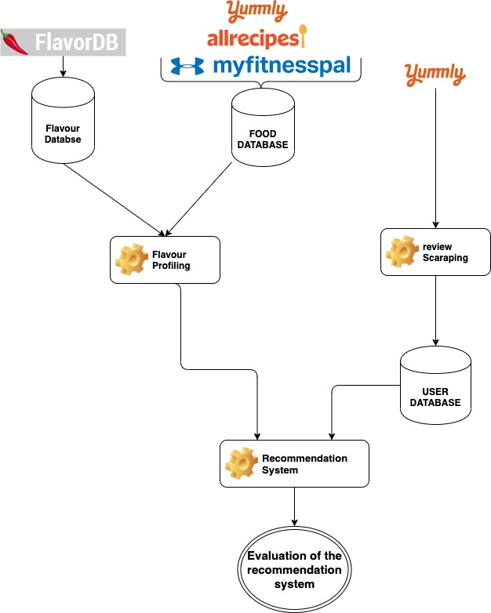
Proposed Solution

Slide 9

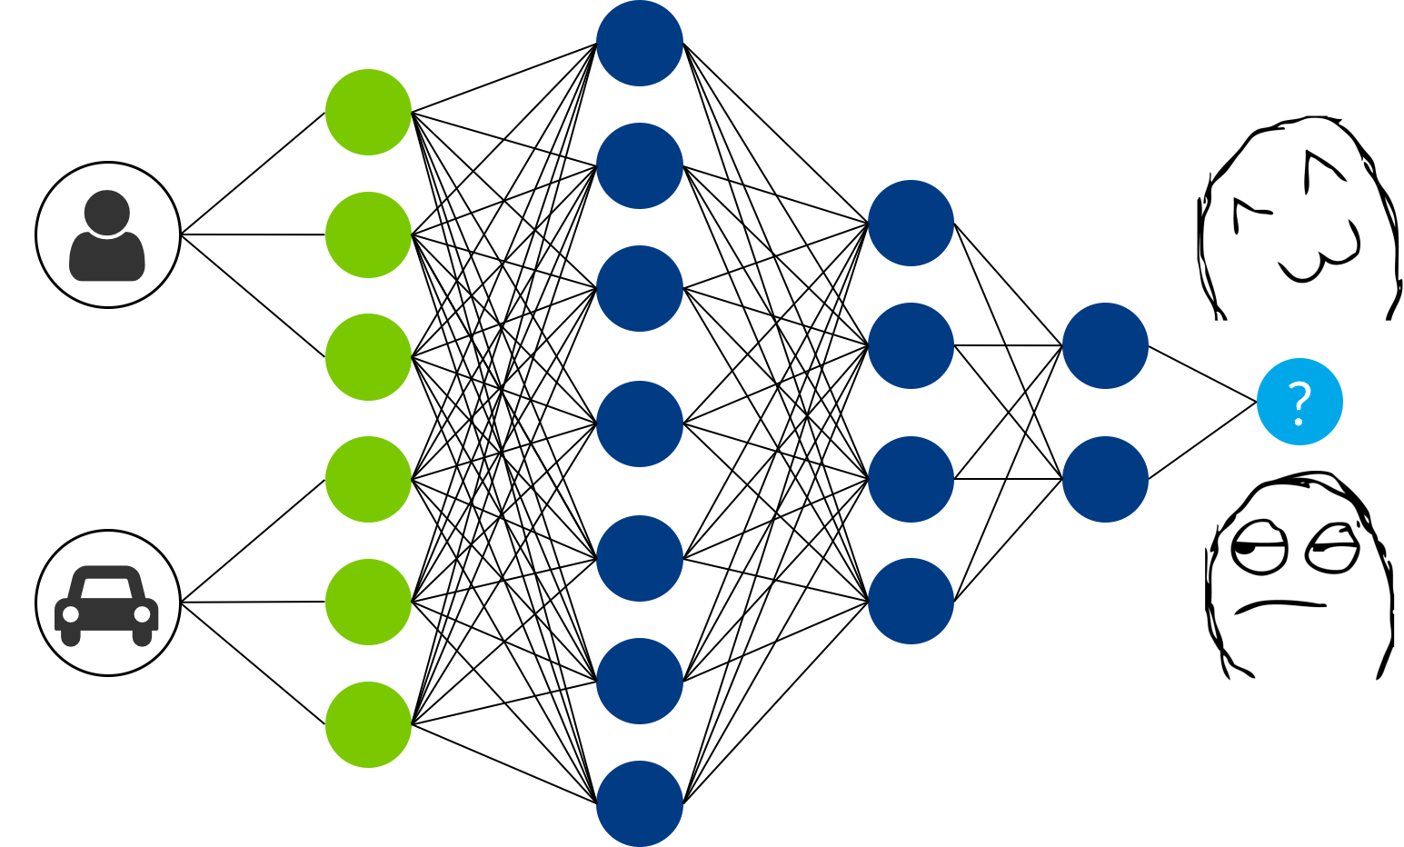


Data Collection
Food Data
In order to build the recommendation system we needed user data and food data.
The data related to the dishes such as the nutrient contents, ingredients were collected by scraping it from Yummly, MyFitnessPal and allrecipes.
But we needed reviews related to each dish also as we had planned to a train deep learning based model that needed user reviews and food reviews for training.
Initially the user review data was collected from twitter using twitter Api’s

Slide 10
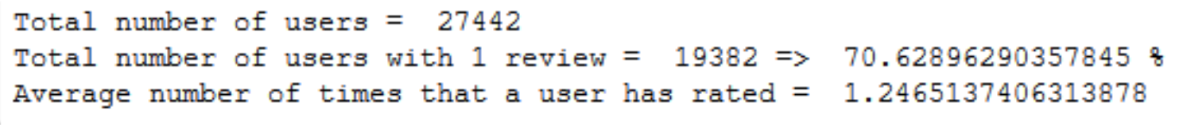
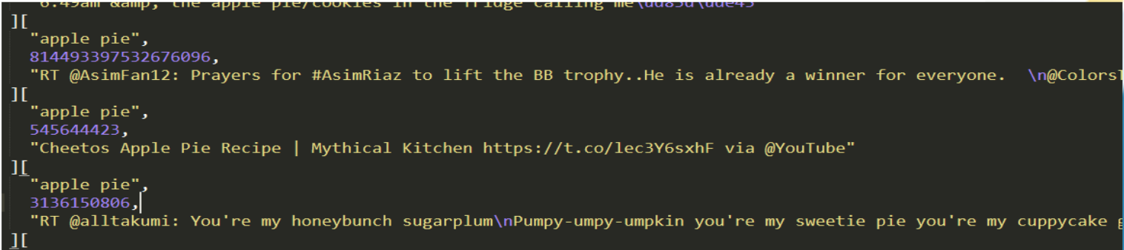
Data Collection
Review Data
But the twitter data did not have any ratings associated to it so we used NLTK Vader library, which analysed the sentiment of each review and produces a rating in the range of 1-5.
The reason we used Vader library is because it proved to work really well on social media data. It does a rule based analysis on the input text and throws out a score.
There were some inherent problems with the above approach of data collection ,firstly there was no way of validating the method that we used to assign rating to each review.
Second the data that we had collected was not proper about 70% of the users had given reviews only once , and the reviews that were given by most of the users were not related to food at all , the below figure summarises the problem that existed in our data

Slide 11
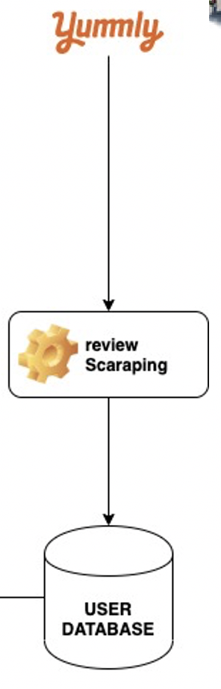


Data Collection
Review Data
In order to overcome the drawbacks of the previously mentioned dataset, we managed to scrape legitimate food review data from Yummly by making use of beautiful soup and mechanize library as Yummly developer API’s were no longer available.

Slide 12

Data Collection
Since we are aiming to incorporate flavour features into recommendation, we are using the chemical compounds also known as flavonoid molecules present in the food as features rather than the ingredients and flavour scores.
In this way are able to construct features at a much more granular level.
In order to collect the flavonoid information we used FlavorDB. It is a product of Complex Systems Lab, IIIT-Delhi.
The database that comprises of 25k flavour molecules. We have written a script like the one to scrape data from Yummly to also scrape flavonoids data from FlavorDB.
Totally we have somewhere around 100 unique ingredients and after combining all the flavonoids present in each ingredient we totally have around 1405 unique flavonoid molecules
Flavonoid Data

Slide 13
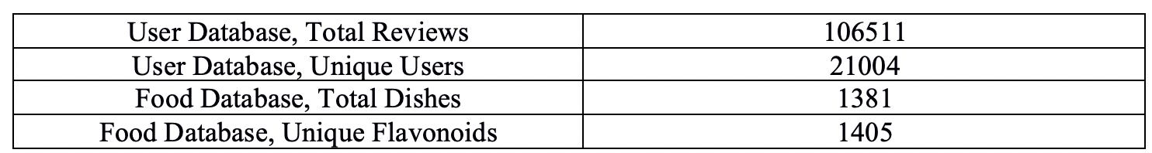
Data Collection
The table below gives the summary of our data that we have collected.

Slide 14
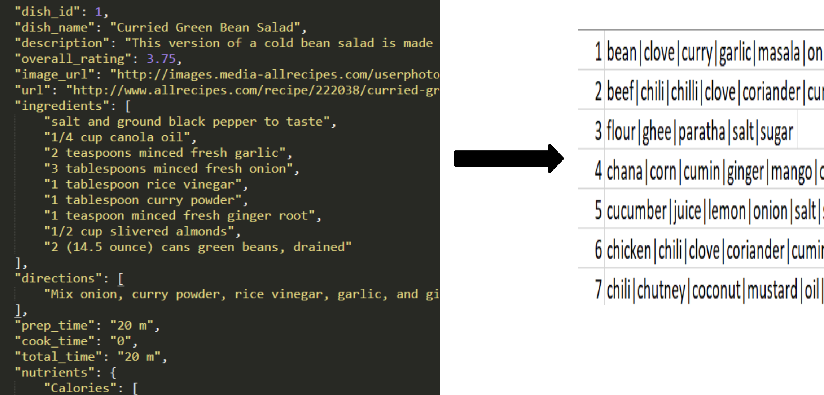
Data Pre-Processing
Extracting Ingredients
The raw food data that was collected by scraping Yummly, was stored in json format , later based on pattern matching ,ingredients were extracted.
The figure shows how the data is pre-processed only the ingredient are extracted as a results we ended up with around 100 unique ingredients that is distributed among 1381 dishes.

Slide 15
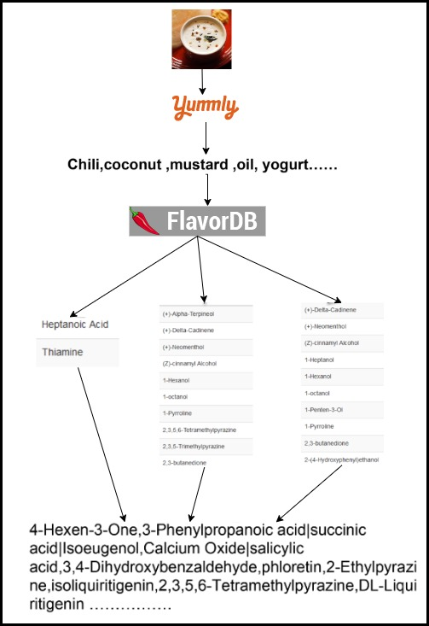
Data Pre-Processing
Extracting Flavonoids
Since we are using flavonoid molecules in our recommendation system. We have used the FlavorDB to get the flavonoids associated with each unique ingredients.

Slide 16
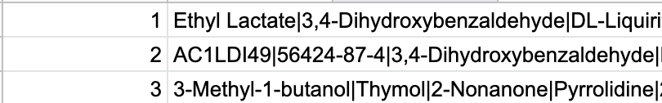
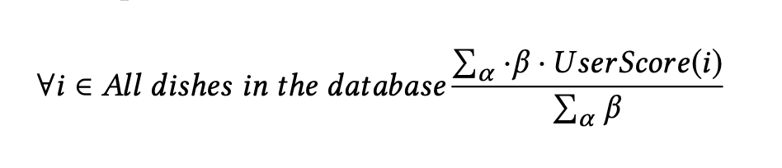
Recommendation System
Content Based Recommendation System.
Implemented a Content Based Filtering algorithm that takes the content or properties of an item into consideration. Items are described with a set of descriptor terms or tags [ingredients , Flavonoids] which forms the basis for item-based comparison.
We have implemented two variations of the same model in-order to compare the results, one model uses the food ingredients directly along with flavour scores and the other model uses the chemical compound [Flavonoids] present in ingredients of the food item.
Tf-Idf technique is used to generate features vector for each food item.
For a given user, the below equation is used to calculate the preference score for an unrated dish j, using the scores for all dishes i that the user has rated, by calculating the similarity between dish i and j, and weighing the cosine similarity with the dish score j.
α ∈ dishes rated by the user and β to be CosineSimilarity(i,j). Then the user preference score will be:

Slide 17
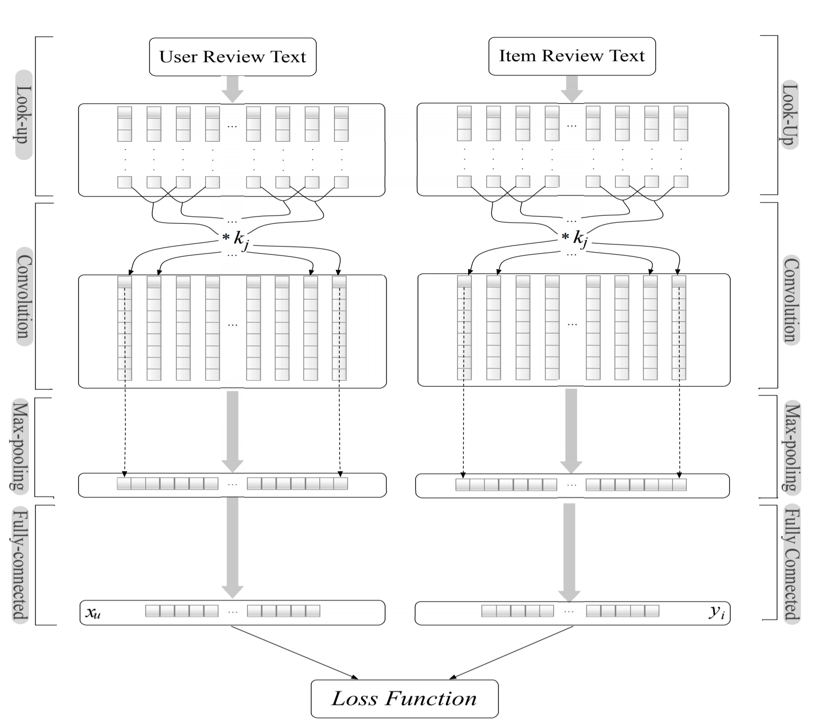
Recommendation System
Deep Cooperative Neural Network [DeepCoNN]
One of the major drawbacks of the Collaborative filtering as also discussed in the above sections is that they model users and items just based on the scores provided by the user and ignores the most vital part that is the review given by the users. The same problem is faced by the content based filtering technique as it only captures the rating and item description , it fails to model the user and item description as a whole.
This basic problem is what the DeepCoNN is trying to solve.
The DeepCoNN is a Neural Network that tries to model users and items in a jointly manner thereby making use of the review text to predict item ratings.
The DeepCoNN also tries to solve the most common problem that is encountered in the recommendation system that is the cold start problem and the sparsity problem.
Thus the DeepCoNN has proved to solve the above stated problems and also proven to elevate the performance of the recommendation system.

Slide 18
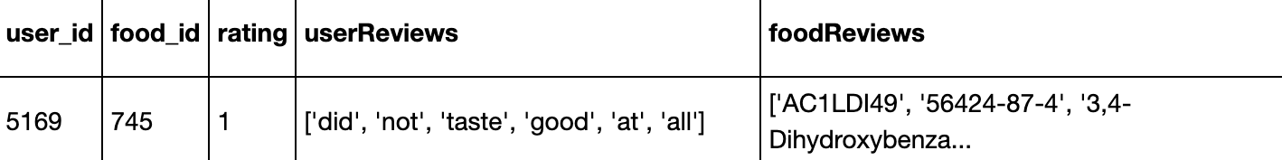
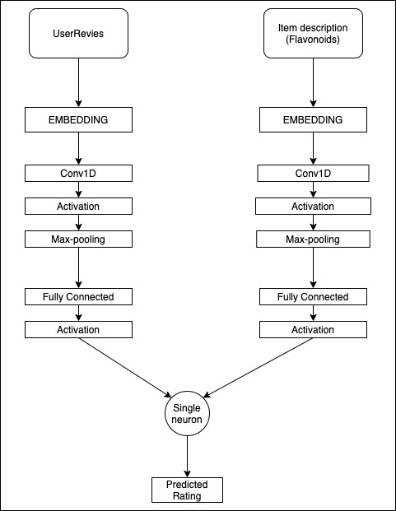

Slide 19
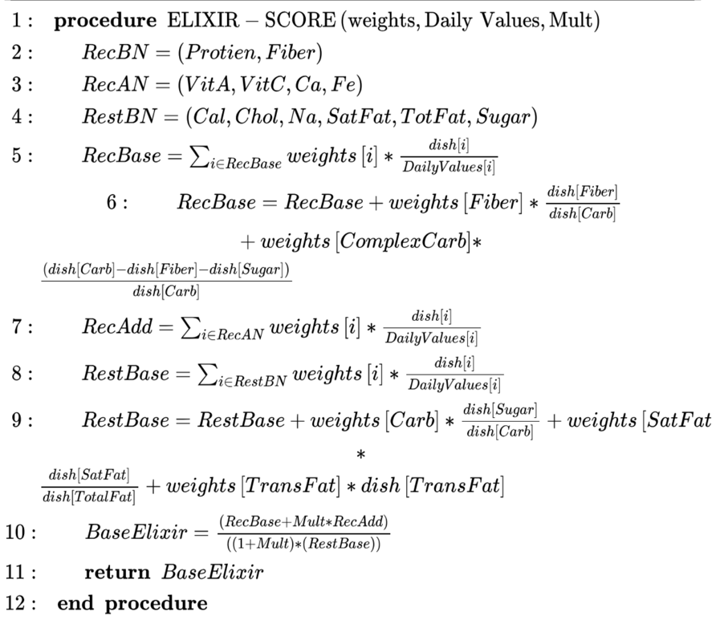
Recommendation System
Environment and Life Integrated eXpert Individualized Recommendation [ ELIXIR ]
ELIXIR is an algorithm that aims at incorporating expert knowledge while making any recommendation.
The algorithm has proven to successfully segregate healthy dishes from unhealthy dishes.
Once the allowed weights per nutrient is calculated specific to the user then that information is used to calculate health score.
The health scores calculated will act like a second pass filter that is once the recommendation system recommends dishes that is in preference to the user flavonoid choices , the recommended dishes might lack health factors associated to it , since we are aiming at recommending not only food that the users prefers mostly but also healthy food. This is where the ELIXIR comes into the picture, where it will take in the users bio information and assign a health score to each recommended dishes. Thus it is then upto the user to choose which dish would they prefer.

Slide 20
Results
Content Based Recommendation System
In order to test the model the dataset was split (75-25) into training and testing data. Two variants of the model was trained ,former being a baseline model which only had the ingredients and the flavour score as features and the latter having the flavonoids data. Mean Square Error metric was used as an error measure.
The baseline model gave an MSE of 1.04 and the model that used Flavonoids gave an MSE of 0.45 , which is significantly lower than the baseline. Thus this proves that incorporating micro level details of a dish such as flavonoid molecules will enhance the performance of the model
Method | MSE
TF-IDF with flavours and Ingredients | 1.04
TF-IDF with Flavonoids | 0.45

Slide 21
DeepCoNN
The DeepCoNN model was trained with different configuration and the summary of the result is shown below table. It can be seen that even with DeepCoNN network the model performs well. But the. Drawback of this system is that it needs reviews whenever it is making any recommendation thus this becomes a bottleneck in the model
Model Configuration | MSE
1 convolutional layer with Max Pooling | 0.49
1 convolutional layer with Average Pooling | 0.9059
2 convolutional layers with Max Pooling | 1.2861
2 convolutional layers with Average Pooling | 1.4721

Slide 22
Working Example
In-order to demonstrate how the system takes the flavonoid preference into consideration we have taken a user with the conditions specified ahead, the figure lists the dishes that is already rated by the user. Once this information was fed into our model, the fig below to the right shows the list of recommended dishes , analysis could be made that the user prefers dessert dishes and the model succeeds in recommending dessert food. Along with the predicted rating the model also calculates health score using the ELIXIR algorithm associated with each recommended dish which is calculated based on the attributes of the user in this case height=162cm, weight=130lb, age=30 ,gender=male , condition=normal ,steps taken=5000, floors covered=20,bmi ratio=1.2

Slide 23
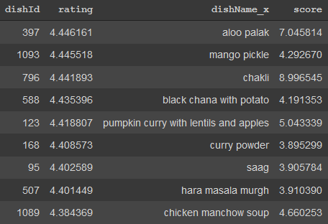
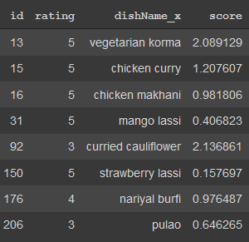
Users ‘ history
Recommended Dishes

Slide 24
Why Your Solution is Better?
User’s prefers to eat healthy food by sacrificing the pleasures of taste, and this is what most of the recommendation systems that is being used in food related sites have incorporated.
We have proposed a mechanism where we have implemented a recommendation system which incorporates flavonoid(chemical compounds) present in the food as features thereby not only recommending healthy food but also taking into consideration the taste preference of the user.

Slide 25
Technologies / Methodologies
Hardware Requirements
As the project requires text processing and we are dealing with reviews and also trying to train a deep learning based model we require moderate computational powers, a minimum of 4 GB ram and a GPU would be preferable.
Software Requirements
Python 3.0 or greater,
Windows or linux operating system
Jupyter notebook
Google Colab
Python packages like numpy,pandas,nltk,mechanize,beautifulsoup,sklearn
Frameworks like Keras,Tensorflow

Slide 26
Further Enhancements
In this project we have used TF-IDF as embedding for both the text and the flavonoid list for the DeepCoNN model. There’s no common embedding that encodes both text and chemical compounds. So in the future if there exists some embedding that is generic in nature then it might be substituted for the TF-IDF which might further enhance the performance of the system
In the content based filtering algorithm, in order to extract similar dishes it uses cosine similarity as a metric, since we are using TF-IDF inorder to vectorize the flavonoids, most of the contents in the matrix are empty thus resulting in a huge sparse matrix. If in the future there exists embedding for just chemical compounds then it might be substituted for TF-IDF , if chemical embedding is used then similar flavonoids might be present in the same vector space and in nearby vicinity thereby using the cosine metric in this case makes a much better sense and also the results might improve.

Slide 27
Thank You

