Slide 1
Link prediction in Bipartite graph
SK SAQLAIN MUSTAQ
-01FB16ECS388
SUMAIR AHMED SHARIFF
-01FB16ECS399
HARSHVARDHAN SUROLIA
-01FB16ECS408

Slide 2
PROJECT TOPIC
There’s huge amount of work done on link prediction on graphs that contains nodes of one type only such as social network graphs , but few work has been done on link prediction in bipartite graphs
We tried to modify algorithms that are used for link prediction in social graph so that they can be applied on bipartite graphs.
We created a bipartite graph from the latest Yelp challenge dataset by taking users and business that they reviewed respectively

Slide 3
WHAT IS UNIQUE ABOUT THIS PROJECT
We used supervised random walk algorithm[2] that was being used in normal link prediction in social graphs and applied the same to a bipartite graph that would predict which next business will a customer review.

Slide 4
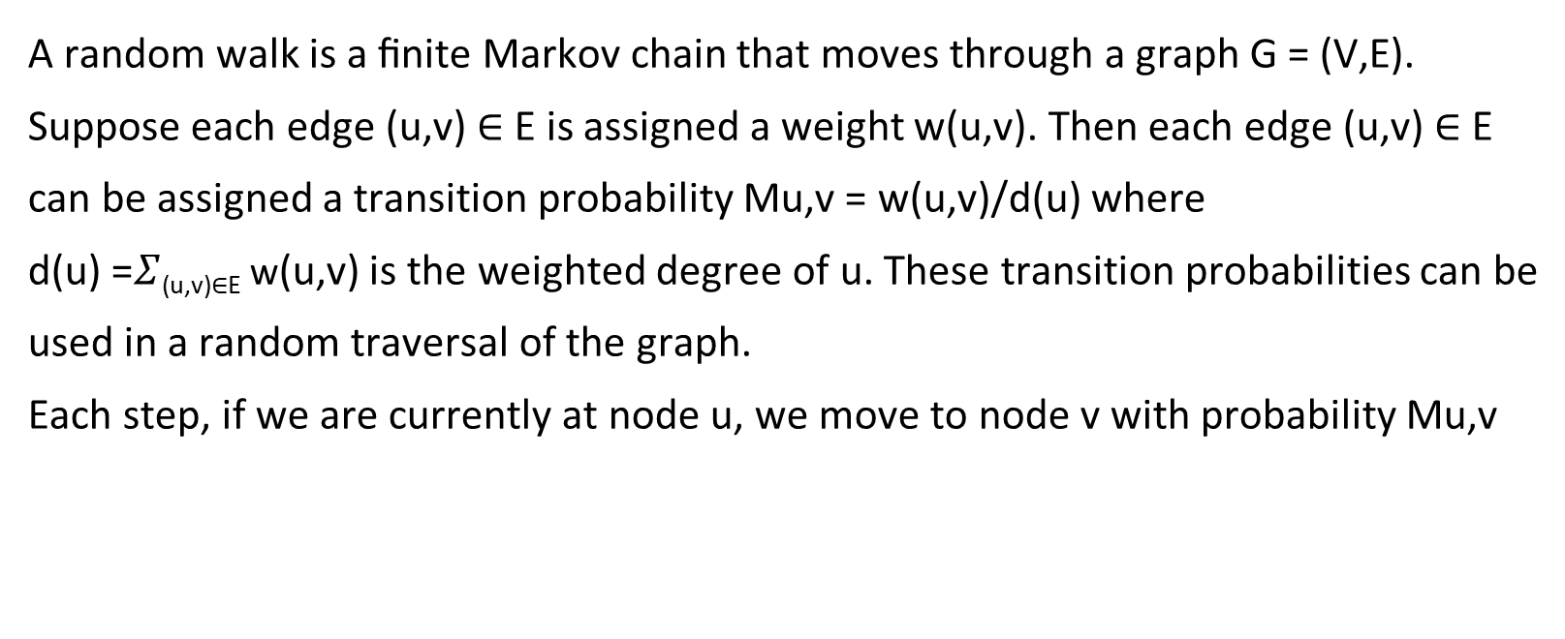
Random Walk[1]
A random walk is a ﬁnite Markov chain that moves through a graph G = (V,E).
Suppose each edge (u,v) ∈ E is assigned a weight w(u,v). Then each edge (u,v) ∈ E
can be assigned a transition probability Mu,v = w(u,v)/d(u) where
d(u) =$Σ$_{(u,v)∈E} w(u,v) is the weighted degree of u. These transition probabilities can be
used in a random traversal of the graph.
Each step, if we are currently at node u, we move to node v with probability Mu,v

Slide 5
Supervised random walk [2]
Supervised random walks is a technique that makes predictions using personalized random walks over the network with weighted edge
Instead of initializing weights from a specific distribution(heuristic),the edge weights are learned in a supervised way. Edge weights are assigned as a function f of the attributes of the edge and the involved nodes. Ideally, the parameters of this function would be set so the nodes that will link up to a node v in the future are given a higher score by the random walk than nodes that won’t.

Slide 6
Supervised random walk [2]
Considering a single node in the directed graph G(V,E), a node s and a set of candidates to which s could create an edge. We label nodes to which s creates edges in the future as destination nodes D = {d1,...,dk}, while we call other nodes to which s does not create edges no-link nodes L = {l1,...,ln}. We label candidate nodes with a set C = {ci} = D ∪ L. We think of nodes in D as positive and nodes in L as negative training examples.
Each node and each edge is G is further described with a set of features.
For edge (u,v) in G we compute the strength a_{uv} = f_{w}(ψ_{uv}). Function f_{w} parameterized by w takes the edge feature vector ψ_{uv} as input and computes the corresponding edge strength a_{uv} that models the random walk transition probability. It is exactly the function f_{w}(ψ) that we learn in the training phase of the algorithm.

Slide 7
Supervised random walk [2]
The optimization problem.
The training data contains information that source node s will create edges to nodes d ∈ D and not to nodes l ∈ L. So, we aim to set the parameters w of function f_{w}(ψ_{uv}) so that it will assign edge weights a_{uv} in such a way that the random walk will be more likely to visit nodes in D than L, i.e., p_{l} < p_{d},
for each d ∈ D and l ∈ L.
Thus the optimization problem is to find the optimal set of parameters w for the function f_{w}(ψ_{uv}) such that the page rank scores of nodes in D will be greater than the scores of nodes in L.

Slide 8
Supervised random walk [2]
The edge features that were taken into consideration were
The age of the edge , when it was created [2]
Sentiment of the rating whether it was positive or negative (positive if rating is greater than 3 other wise negative sentiment) [2]
The rating itself
A constant feature [2]

Slide 9
Evaluation [2]
Link prediction is a binary classification task .
To evaluate this the network was divided into two snapshots at time t and a later t’ and attempted to predict which pairs of nodes in the earlier snapshots will have an edge between them in the later snapshots
For example, we created a training set using earlier times t_{train} as January and t’_{test} as July , because the was users review business might evolve over time
Only users who were active for last six months were taken into consideration.

Slide 10
Algorithm
Overview:-
The random walk assigns each node u a probability , nodes are ordered by probability and top ranked nodes are then predicted as destinations of future links
preprocessing the data (train-test split)
Build bipartite graph
Train the model.
Test the mode.
Evaluate the model.

Slide 11
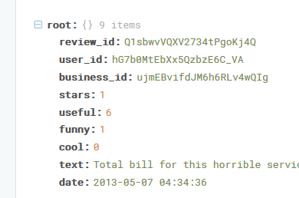
DATASET
The algorithm is made to run over Yelp Challenge Dataset. Which consists of information such as business , reviews and users
The dataset was used to construct a bipartite graph where one side of the network represents users and the other side represents business, edges are connected between users and business if the user has reviewed that business respectively.
The dataset contains around 6M reviews and 192K businesses.

Slide 12
Results

Slide 13
QUANTITY OF WORK – THE MAIN CODE MODULES ( WHAT THEY DO)
Serial no | Code module description | Status (% complete) | What it does ?
1. | Numpy |  | Data cleaning
2. | Pandas |  | Data manipulation
3. | Seaborn |  | Plotting of graphs
4. | Matplotlib |  | Basic graph
5. | XGBoost |  | Applies gradient boosting
6. | Scikit-learn |  | Logistic regression and finding precision score, confusion matrix

Slide 14
OUR TOP THREE LEARNING IN THIS PROJECT
Serial No | Top Learning in this project
1 | Learnt to apply sna algorithms on huge data
2 | Learnt how to use Random Walk Algorithm for link prediction
3 | Learnt to apply ML concepts to Link prediction problems.

Slide 15
TOP CHALLENGES UNRESOLVED SO FAR
Only considering the top scored edges for the connection is not suitable in real-environment as each user might connect to multiple users at the same time, thus the connection threshold might be one deciding factor.
Each user might connect to only few other business thus making use of a ML algorithm for link prediction will result in lots of false positive results as the dataset has lots of no-link data then link-data.
We used Wilcoxon-Mann-Whitney [2] loss function which is too slow to converge.

Slide 16
REFERENCES
Random walk https://en.wikipedia.org/wiki/Random_walk
Backstrom, Lars, and Jure Leskovec. "Supervised random walks: predicting and recommending links in social networks." In Proceedings of the fourth ACM international conference on Web search and data mining, pp. 635-644. ACM, 2011. https://arxiv.org/pdf/1011.4071.pdf
Benchettara, Nesserine, Rushed Kanawati, and Celine Rouveirol. "Supervised machine learning applied to link prediction in bipartite social networks." In 2010 International Conference on Advances in Social Networks Analysis and Mining, pp. 326-330. IEEE, 2010.
https://github.com/Pepton21/supervised-random-walks-with-restarts

