Slide 1
Yes Bank Datathon
Team Details: Code2Create (BITS Pilani, Pilani Campus)
By Indraneel Ghosh and Siddhant Kundu

Slide 2
Data Cleaning and Normalization

Slide 3
Data Cleaning and Normalization
We dropped all data entries having null values so that they would not interfere with the heat map generation process.
To further clean up the dataset, we chose to convert all string entries to UPPERCASE.

Slide 4
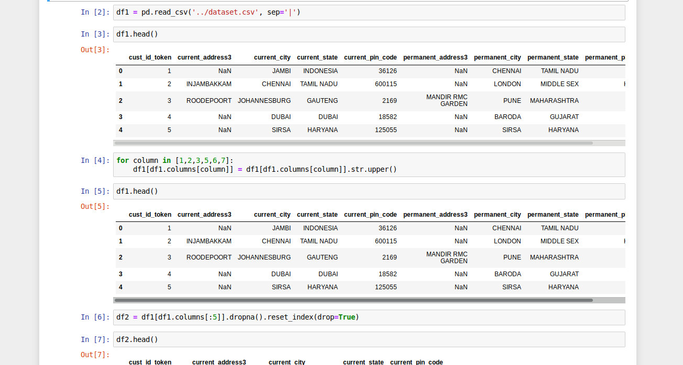

Slide 5
Algorithm and Implementation Details
Notes:
Time: 10-20 Seconds

Slide 6
Modelling Constraints
Due to monetary constraints we tested on a smaller segment of the provided dataset to obtain our results. The results obtained have been attached.

Slide 7
Algorithms and Techniques Used
Exploratory Data Analysis to study the dataset.
Google Maps API for generating Maps along with open source Library GMaps.
Google Maps Geocoding API(For getting the latitude and longitude), Google Maps Javascript API(For Generating Heatmap on the World Map)

Slide 8
Implementation Details
Granularity: Grouping done on the basis of Area, Streets and Major Cities.(Using Relational Algebra implementations available in Pandas)
The code can be generalized further if there is a lack of monetary constraints to take input from users with this type of information classification.
Due to monetary constraints, the we randomly selected 50 samples(Using random sampling techniques available in Pandas) from each classification to plot the heat map.(Higher the number of data points, the better the heat map becomes)
To check for resolution of the heat map, we used areas with different population densities.
Implementations added for permanent and current addresses(As provided by the database)

Slide 9
APIs Used
Google Maps Geocoding API(For getting the latitude and longitude)
Google Maps Javascript API(For Generating Heatmap on the World Map)

Slide 10
Libraries and External Requirements
Numpy
Pandas
Matplotlib
Seaborn
Gmaps
Json
Requests
googlemaps

Slide 11
Heat Map Results

Slide 12
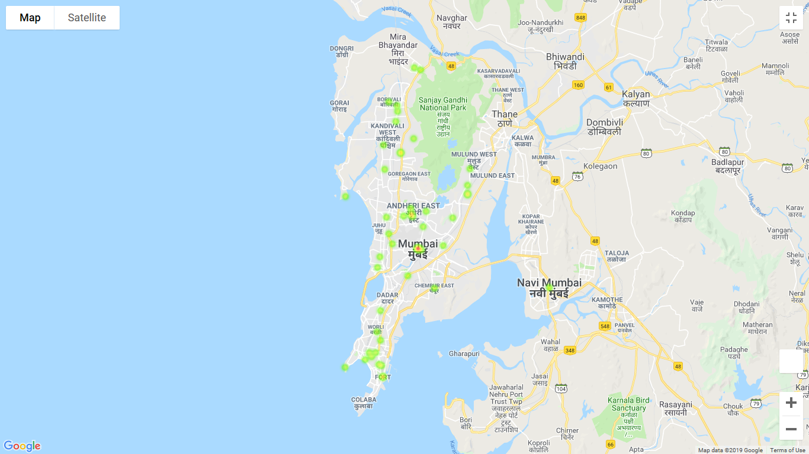
Current city - Mumbai

Slide 13
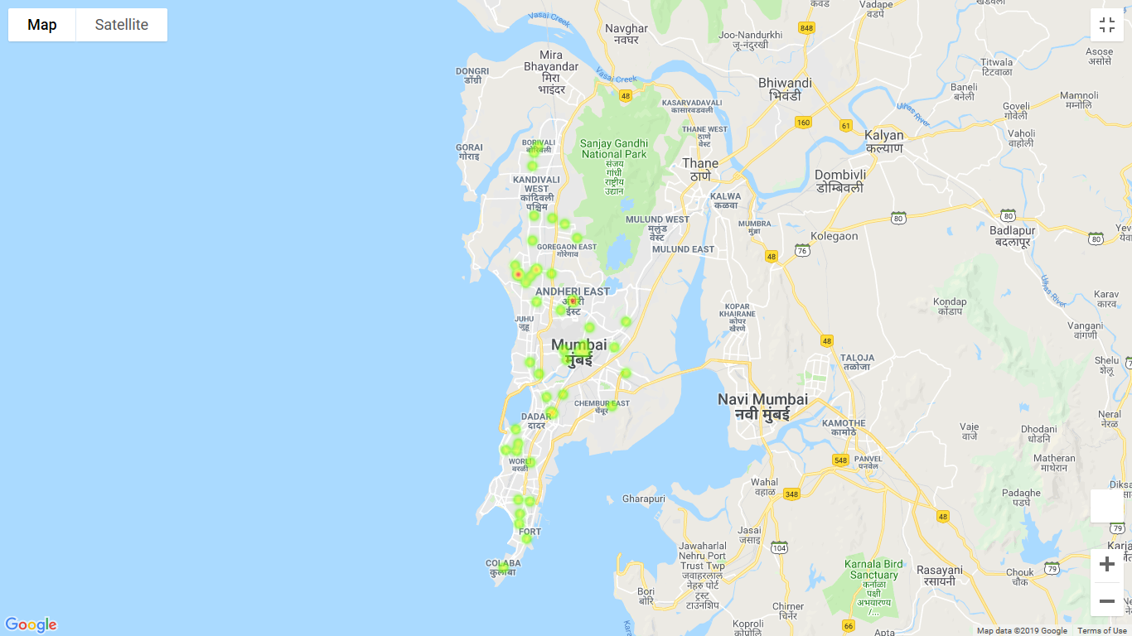
Permanent city - Mumbai

Slide 14
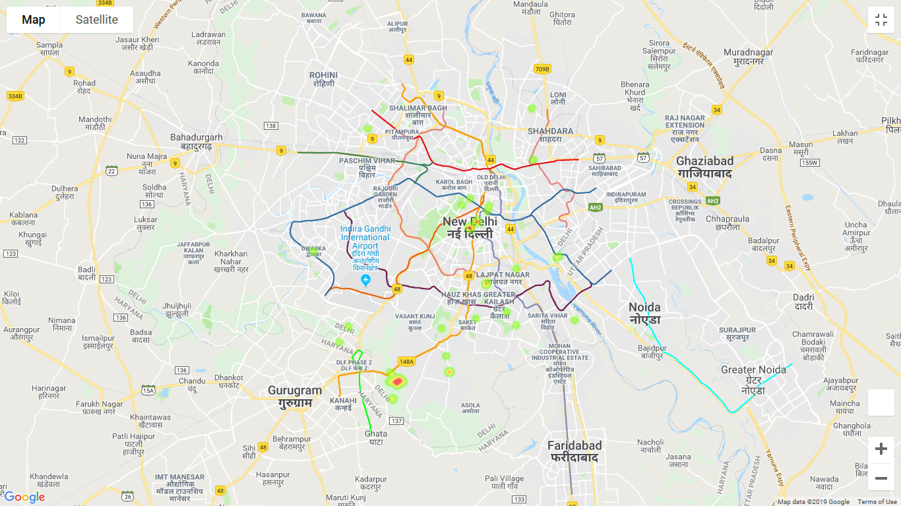
Current pin code - 110047

Slide 15
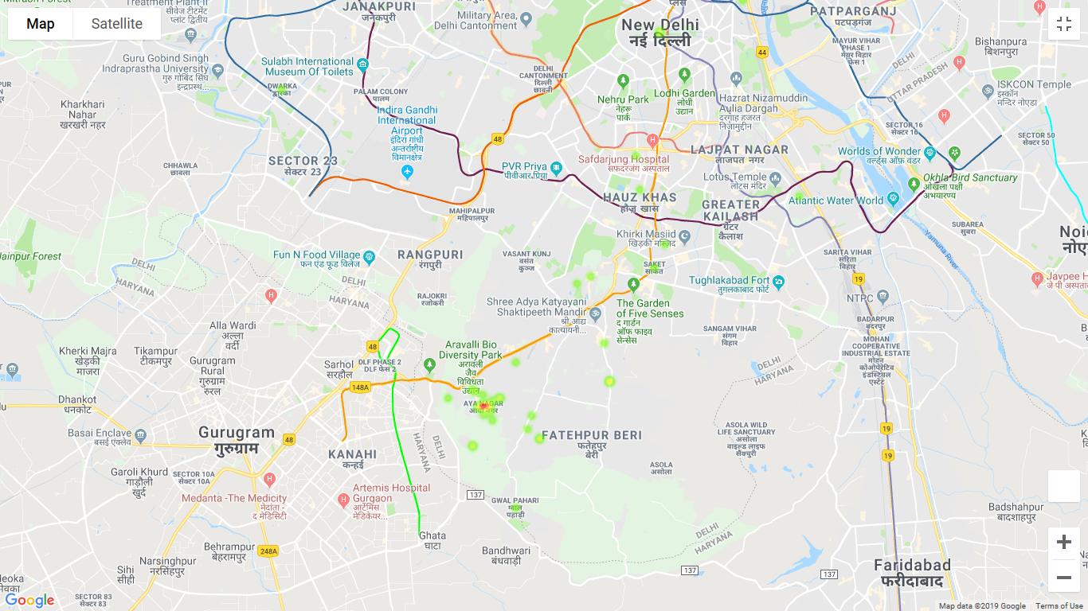
Permanent pin code - 110047

Slide 16
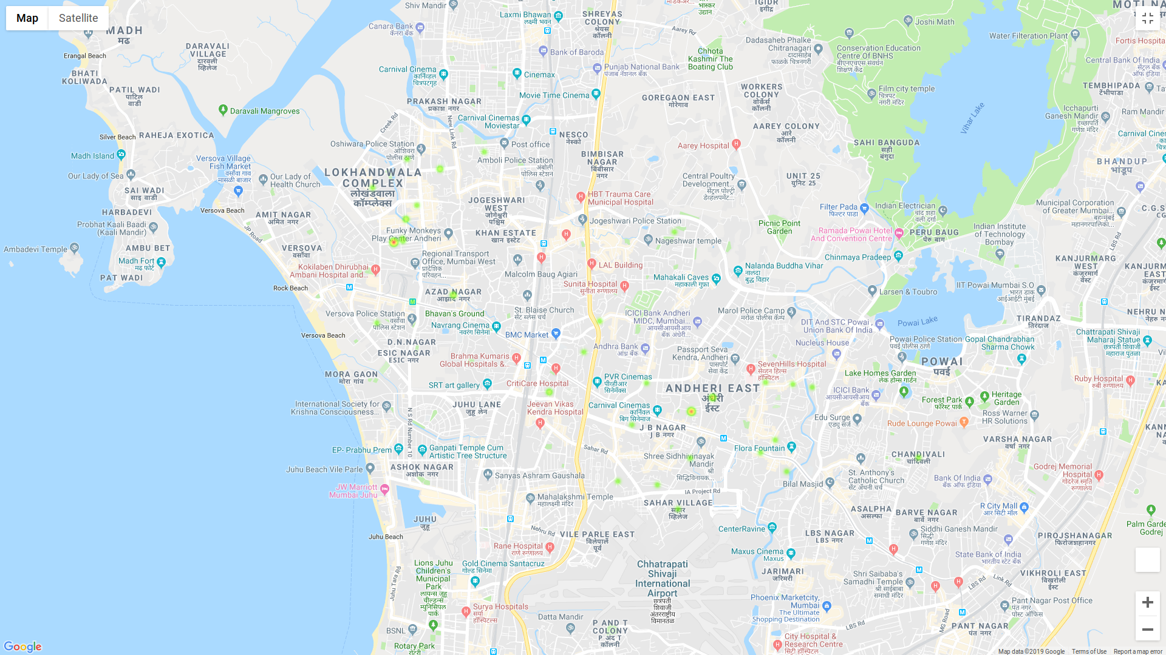
Current street - ANDHERI

Slide 17
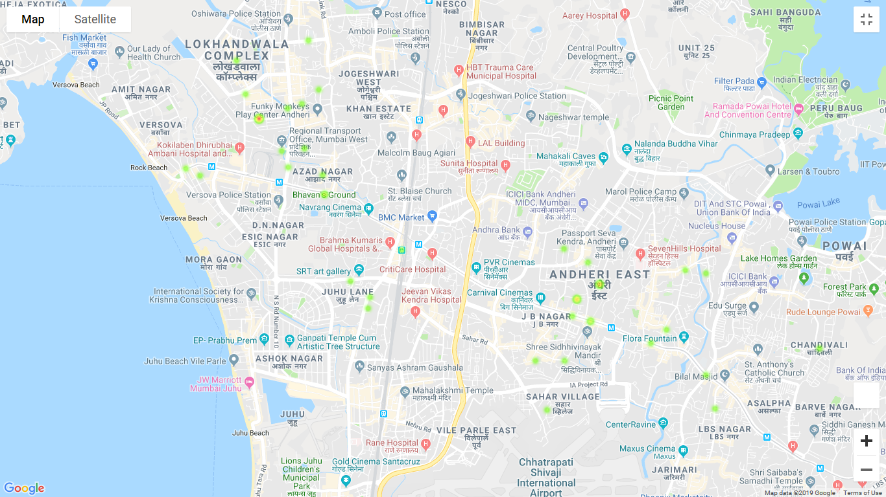
Permanent street - ANDHERI

Slide 18

Code Base

Slide 19
Repository Link
https://github.com/ighosh98/datathon
(Note: For security reasons the tester would have to generate their own independent API Key)

Slide 20
Thank You

