Slide 1

24 Marzo 2022
CANCRO GASTRICO AVANZATO (AGC):
La stadiazione

Slide 2
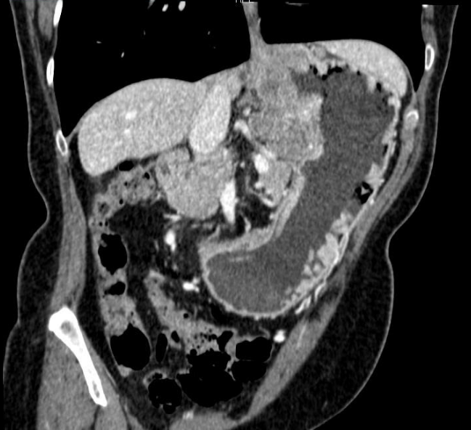
Imaging Radiologico: il ruolo nell’AGC
TC: metodica predominante
Staging (torace e addome)
Re-staging in seguito a trattamento
Follow-up
RM: ruolo marginale
Imaging ristretto alla cavità addominale
Conferma linfonodi metastatici, dubbie metastasi epatiche
PET: metodica limitata (N, M)
Imaging poco accurato per GC poco avidi di FDG
Scarsa sensibilità nel riconoscimento di linfonodi perigastrici
Ricerca linfonodi metastici e metastasi a distanza sconosciute

Slide 3
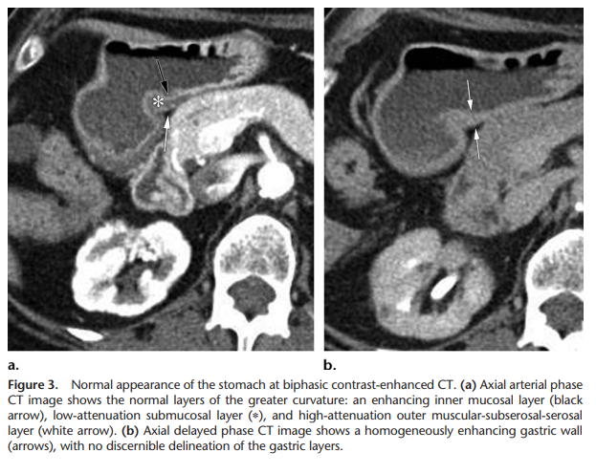
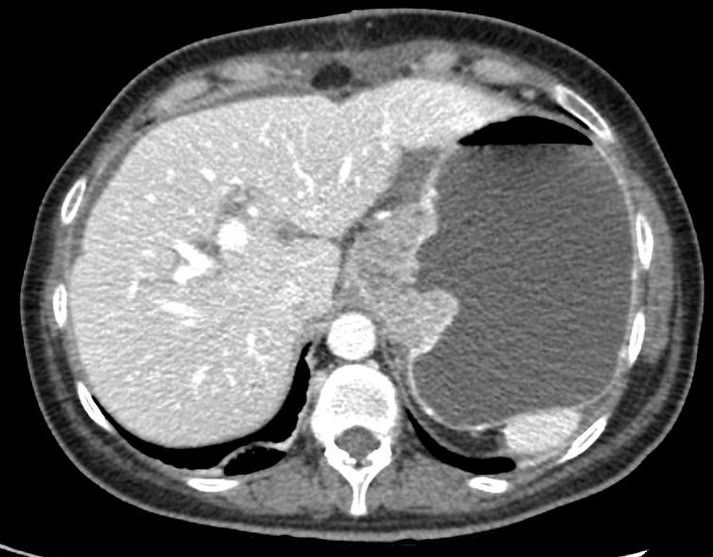
Il protocollo TC
Necessaria adeguata distensione gastrica:
500-1000 mL di acqua o contrasto per OS con granuli effervescenti
Eventuali agenti ipotonici (Buscopan/glucagone)
Protocolli post iniezione del mdc
Fase arteriosa tardiva (40s) AS: migliore rappresentazione strati parietali gastrici, valutazione fegato
Fase portale (70s) TOR-AC: studio parenchimale
(Fase tardiva (180s) AC) : studio dell’addome e pelvi, carcinosi peritoneale
-Ligaments and Lymphatic Pathways in Gastric Adenocarcinoma, 2019 Radiographics, Jennifer J. Young at al

Slide 4
Management del paziente con AGC: l’importanza della stadiazione
T2 N0
Intervento chirurgico
N +
NAChT + Intervento chirurgico
AGC
resecabile
T3
T4a
T4b
disseminazione peritoneale
no
si
Conversion therapy+ PIPAC+Surgery/HIPEC
Importanza ≥T3 N+/- o N+!
Up-front surgery vs possibile NAChT + surgery

Slide 5
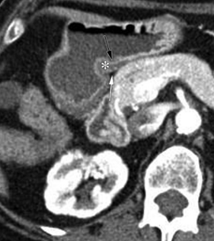
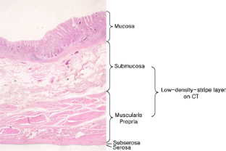
T - Staging
T3
T4
T2
T1a
T1b
Fase arteriosa parenchimale: miglior stratificazione parietale gastrica
-Kim, J. et al. Diagnostic performance of 64-section CT using CT gastrography in preoperative T staging of gastric cancer according to 7th edition of AJCC cancer staging manual. Eur Radiol 22, 654–662 (2012). -Images courtesy of prof.Mazzei, University of Siena, Department of Radiology

Slide 6
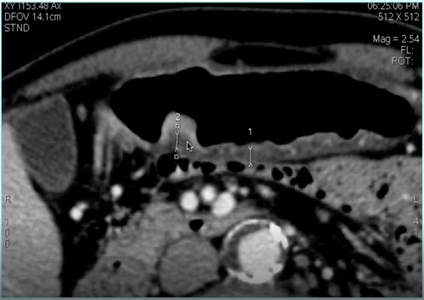
T - Staging
T3
T4
T2
T1a
T1b
T1a: Enhancement e/o ispessimento del solo strato mucosale interno
-Kim, J. et al. Diagnostic performance of 64-section CT using CT gastrography in preoperative T staging of gastric cancer according to 7th edition of AJCC cancer staging manual. Eur Radiol 22, 654–662 (2012). -Images courtesy of prof.Mazzei, University of Siena, Department of Radiology

Slide 7
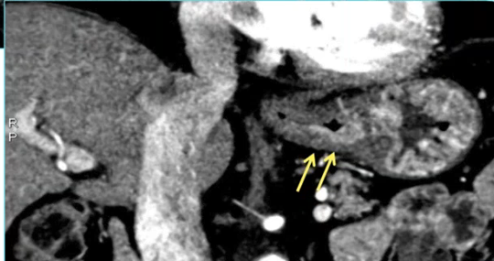
T - Staging
T3
T4
T2
T1a
T1b
T1b: Infiltrazione <= 50% dello strato ipodenso
-Kim, J. et al. Diagnostic performance of 64-section CT using CT gastrography in preoperative T staging of gastric cancer according to 7th edition of AJCC cancer staging manual. Eur Radiol 22, 654–662 (2012). -Images courtesy of prof.Mazzei, University of Siena, Department of Radiology

Slide 8
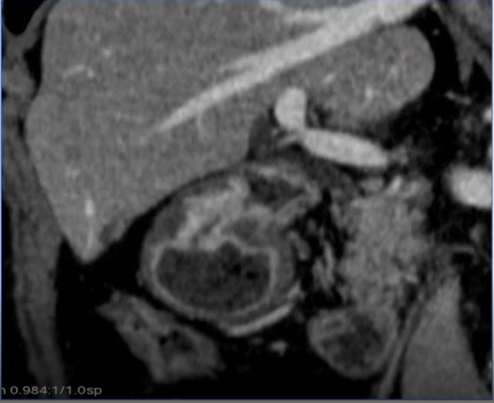
T - Staging
T3
T4
T2
T1a
T1b
T2: Infiltrazione => 50% dello strato ipodenso, senza coinvolgimento del margine esterno
-Kim, J. et al. Diagnostic performance of 64-section CT using CT gastrography in preoperative T staging of gastric cancer according to 7th edition of AJCC cancer staging manual. Eur Radiol 22, 654–662 (2012). -Images courtesy of prof.Mazzei, University of Siena, Department of Radiology

Slide 9
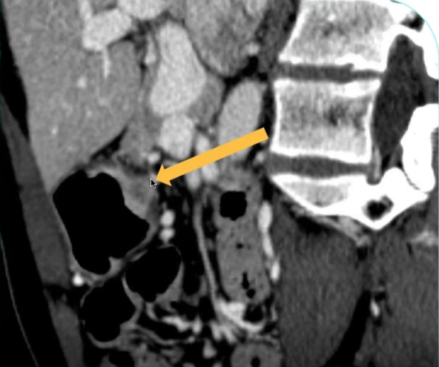
T - Staging
T3
T4
T2
T1a
T1b
T3: coinvolgimento di tutto lo strato parietale ipodenso fino al margine esterno, minima irregolarità dei profili e fat stranding
-Kim, J. et al. Diagnostic performance of 64-section CT using CT gastrography in preoperative T staging of gastric cancer according to 7th edition of AJCC cancer staging manual. Eur Radiol 22, 654–662 (2012). -Images courtesy of prof.Mazzei, University of Siena, Department of Radiology

Slide 10
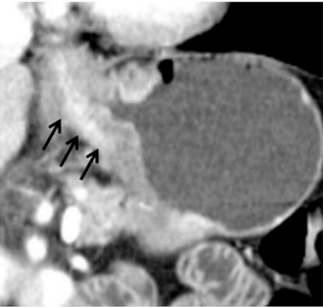
T - Staging
T3
T4
T2
T1a
T1b
T4a: margine dello strato esterno irregolare o nodulare e/o banda di infiltrazione adiposa perigastrica
-Kim, J. et al. Diagnostic performance of 64-section CT using CT gastrography in preoperative T staging of gastric cancer according to 7th edition of AJCC cancer staging manual. Eur Radiol 22, 654–662 (2012). -Images courtesy of prof.Mazzei, University of Siena, Department of Radiology

Slide 11
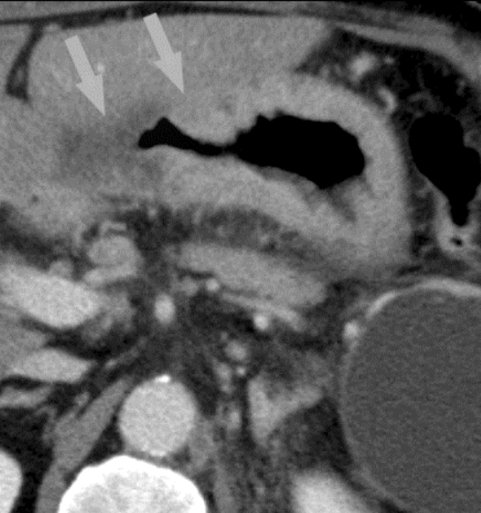
T - Staging
T3
T4
T2
T1a
T1b
T4b: obliterazione del piano adiposo tra neoplasia e organi adiacenti o diretta invasione
-Kim, J. et al. Diagnostic performance of 64-section CT using CT gastrography in preoperative T staging of gastric cancer according to 7th edition of AJCC cancer staging manual. Eur Radiol 22, 654–662 (2012). -Images courtesy of prof.Mazzei, University of Siena, Department of Radiology

Slide 12
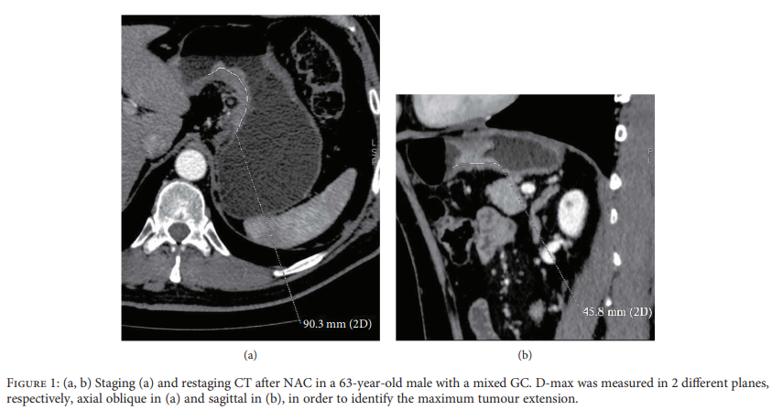
Diametro massimo tumorale (D-max)
Misura di estensione massima tumorale, correlazione misure radiologiche vs istologiche
Correlazione con parametro T (profondità di infiltrazione di parete)
Utile nella valutazione di risposta al trattamento (correlazione riduzione D-max con TRG – Becker)
Gastric Cancer Maximum Tumour Diameter (D-Max) Reduction Rate at CT Examination as a Radiological Index for Predicting Histopathological Regression after Neoadjuvant Treatment: A Multicentre GIRCG Study

Slide 13
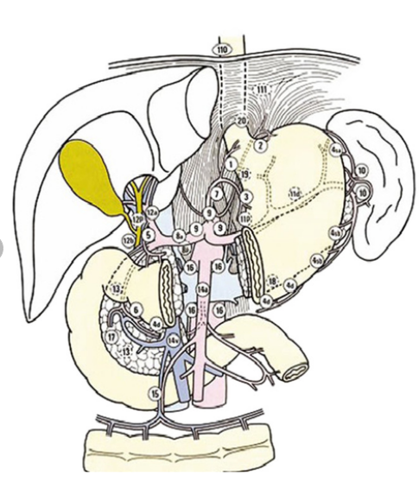
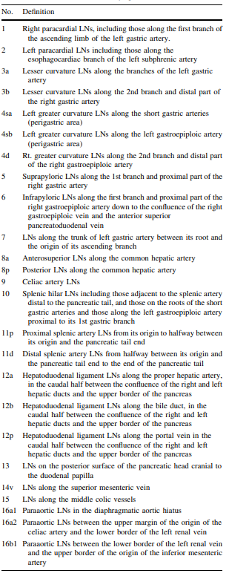
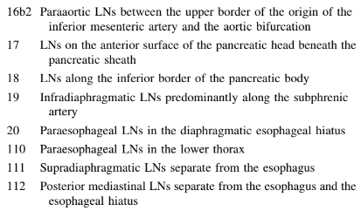

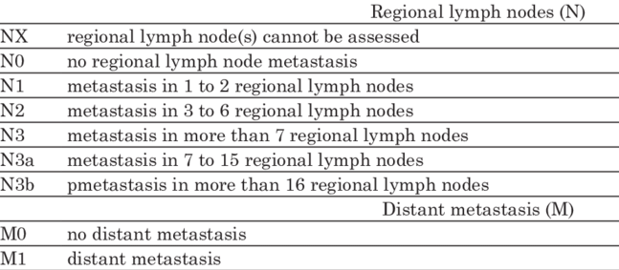
N - Staging
Linfonodi extra-regionali (M)
Linfonodi regionali (N)
Japanese Gastric Cancer Association. Japanese classification of gastric carcinoma: 3rd English edition. Gastric Cancer

Slide 14
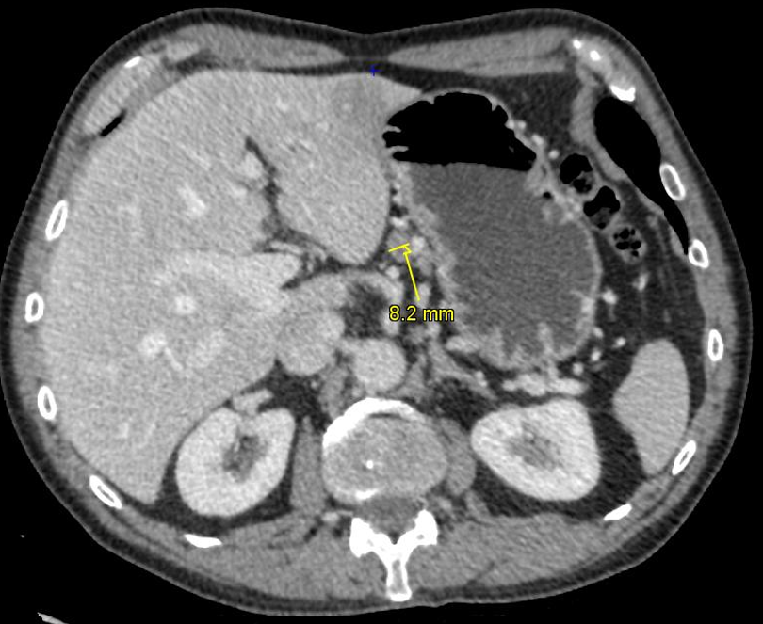
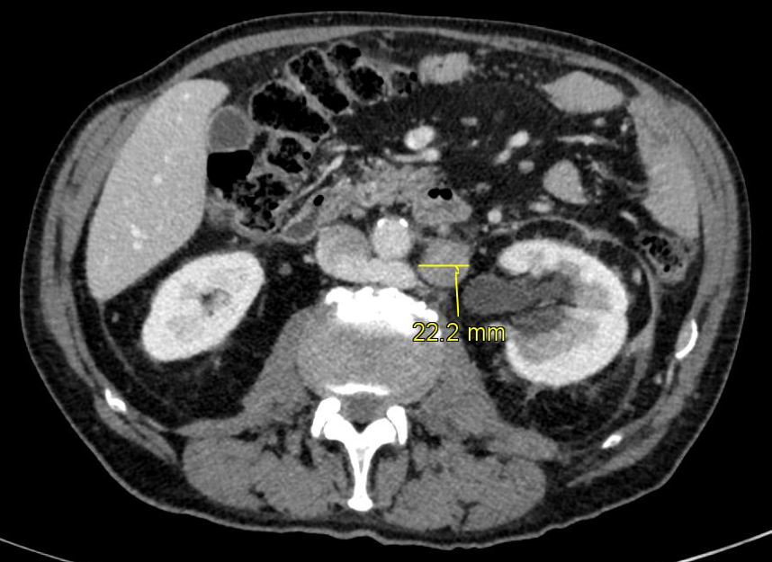
Approccio alla valutazione N+
Fenomeni micrometastatici: classici cut - off inadeguati!
Dimensione del linfonodo patologico correla con la sede: (double dimensional cut-off)
St. 3
Sede | Diametro max asse corto
Perigastrici (lvl 1) st <7 | ≥ 5 mm
Distanti (lvl 2 e paraaortici) | ≥ 8 mm
Altre caratteristiche: forma, necrosi, enhancement, clusterizzazione
St. 16b1
- The Italian Research Group for Gastric Cancer (GIRCG) guidelines for gastric cancer staging and treatment: 2015. De Manzoni et al -Marrelli, D., Mazzei, M.A., Pedrazzani, C. et al. High Accuracy of Multislices Computed Tomography (MSCT) for Para-Aortic Lymph Node Metastases from Gastric Cancer: A Prospective Single-Center Study.

Slide 15
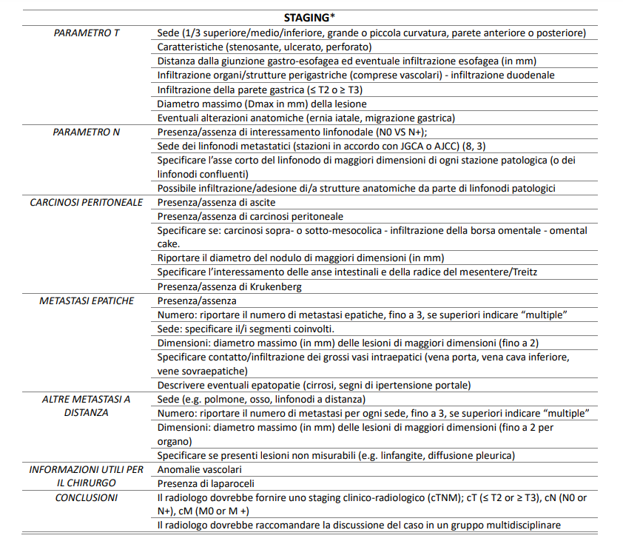
Ruolo del radiologo: cosa comunicare (STAGING)
-Structured and shared CT radiological report of gastric cancer: a consensus proposal by the Italian Research Group for Gastric Cancer (GIRCG) and the Italian Society of Medical and Interventional Radiology (SIRM) – EUR Radiol

Slide 16
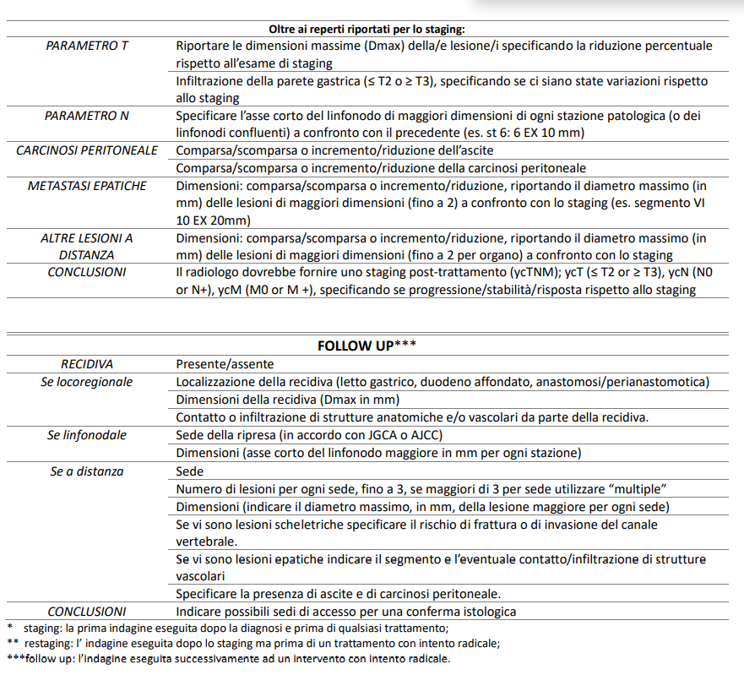
Ruolo del radiologo: cosa comunicare (RESTAGING-FU)
RESTAGING**
-Structured and shared CT radiological report of gastric cancer: a consensus proposal by the Italian Research Group for Gastric Cancer (GIRCG) and the Italian Society of Medical and Interventional Radiology (SIRM) – EUR Radiol

Slide 17
GRAZIE PER L’ATTENZIONE!

