Slide 1

My health for Me
Lily, Krupa, Rahil, Swetha, Barbara

Slide 2
VitalaMe – My health for ME
Company Ethos
Take ownership of your health again
Reformulate the way you think about healthy living
Incentives healthy behavior changes

Slide 3

The current stigmas around smoking
The now

Slide 4
Building an app with optimism in mind
Market research
Market research
Do you like the idea of a physical depiction of your health based on your data?
Current smoking cessation apps only give general feedback, I want to know my personal risk Anonymous, South Kensington
I know the risks of smoking and want to stop but I don’t want to be covered with negativity, I need some optimism Anonymous, South Kensington
If there was a visual way to see my risks or how much I spend, maybe I would think twice Anonymous, South Kensington

Slide 5
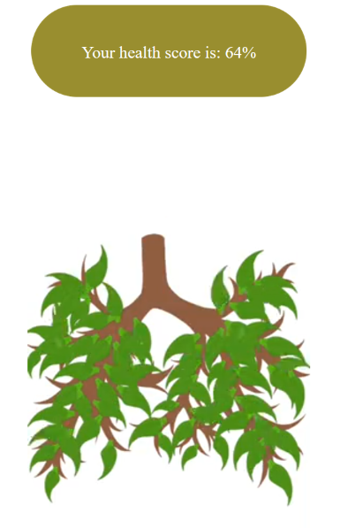
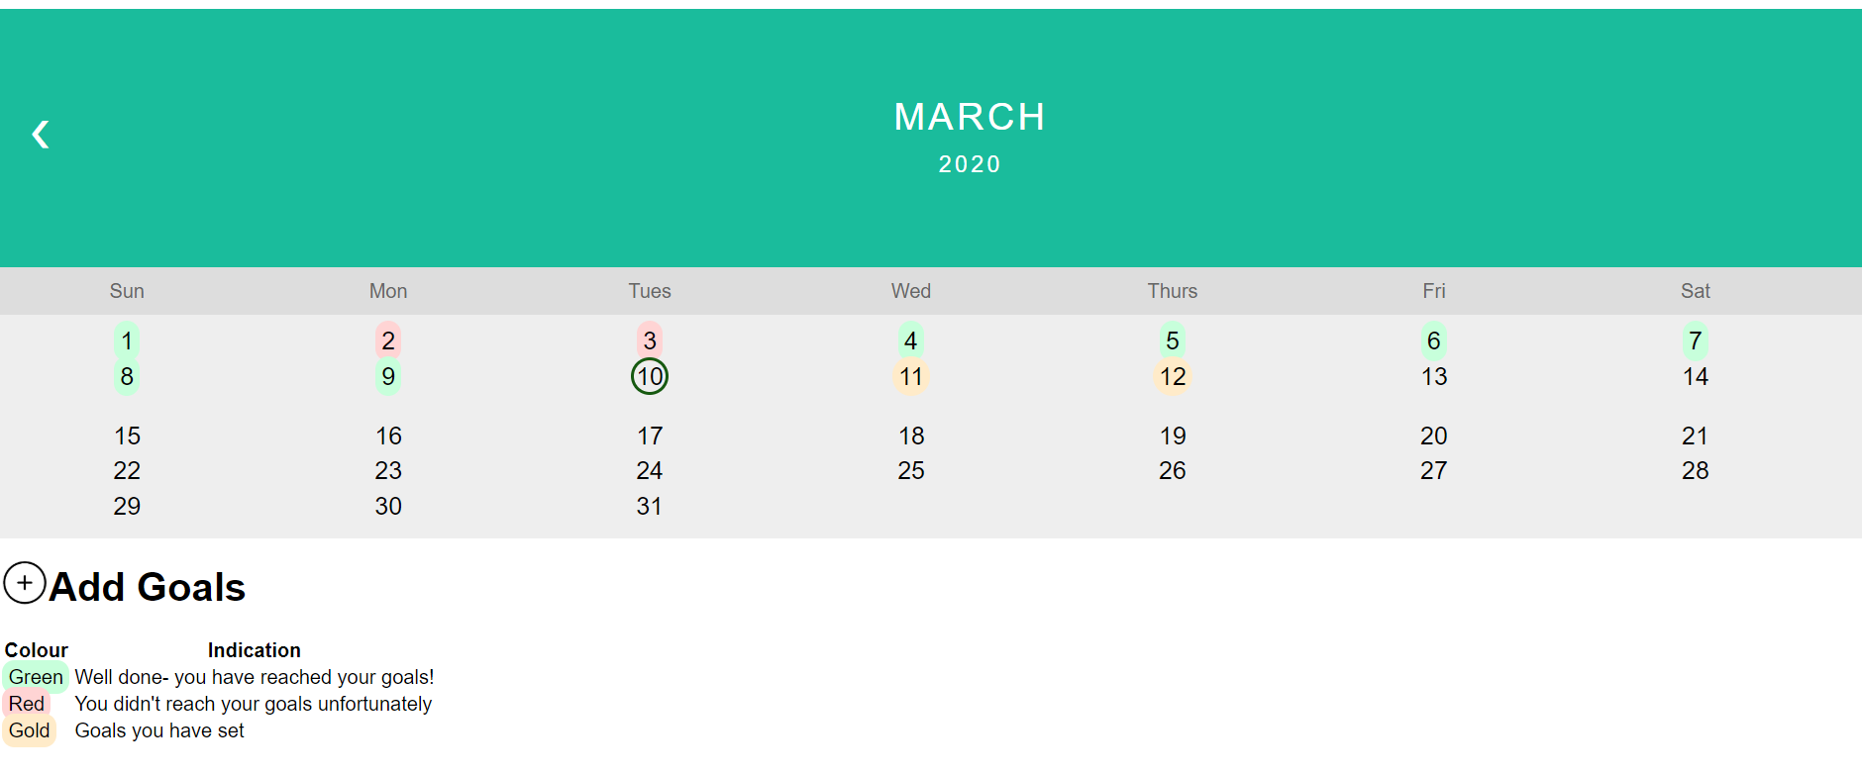
Special features of VitalaMe
The calendar feature allows users to set their goals and track their performance.
On the Personal Profile Page, the tree animation allows a visual depiction of the users’ health as well as their health score.

Slide 6

Our Future Plans
In future, we hope to extend this website to track and bring awareness other risk factors, to improve people’s health.

