Slide 1
Deep Reinforcement Learning Project
Thomas Fishwick
210020607
GitHub Link: https://github.com/SL477/DRL-coursework

Slide 2
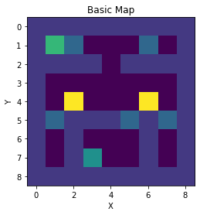
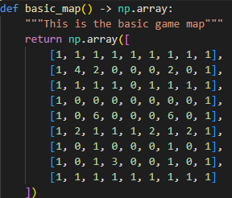
Basic - Define an environment and the problem to be solved
Here we are trying to solve an environment, which is a fairly simple maze defined in a NumPy array
We have our two reward points, which need to be claimed in order by the agent
We also have our two yellow traps
Our agent starts at a random free location in the map
Notes:
The primary goal is the reactor control panel in the bottom middle. The secondary goal is the escape route top left. The purple walls are impassable and the doors (blue) are purely decorative. Our agent teleports into a random free location on the map.
Our environment is a Numpy array in the basic map function in the map module
For the random start it takes the list of potential states, then runs a while loop until it randomly chooses one which has a value of 0 indicating free space. We could have made this more efficient by filtering down to the free locations first

Slide 3
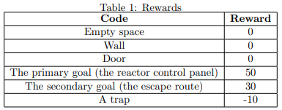

Basic – Define a state transition function and the reward function
Every position on the map is a potential state and action. We flattened the map array, then using key of the cells we determined which ones were passable from one cell to another. So that each state could have up to four different actions.
The reward function used the same mapping, but filling in the rewards that each action would give
Notes:
Our trap will also take off 10 points of health each time our agent hits it. Once it gets to less than or equal to 0 the episode ends. Same if the agent collects the escape route.
Our Q matrix is first made, as it is just an empty array. The R matrix loops through the array of states working out their X and Y values, then checking the cells around it to work out whether there is a legal action to move there and what the reward would be (if it was a legal action).
The reward dictionary is then used to determine legal moves for the agent.

Slide 4
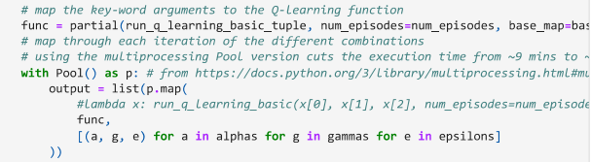
Basic - Set up the Q-learning parameters (gamma, alpha) and policy
We setup our Q-learning algorithm as a function and then grid-searched through it in parallel using Python’s multi-processing library in order to get the best parameters in a reasonable amount of time
Alpha (learning rate): 1
Gamma (discount for future rewards): 0.8
Epsilon (chance of exploiting over exploring): 0.9
Number of episodes (not grid searched for): 1000
Notes:
Because running each set of values sequentially would take a very long time we used Python’s multi-processing in order to take advantage of the other processor cores.
We had to make sure that the different CPUs used different random seeds for working out whether to explore or exploit, otherwise they returned identical values (we should have done the same thing for the random start as well).

Slide 5
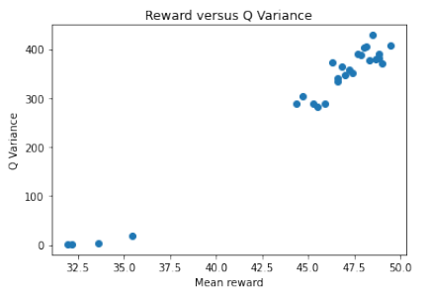
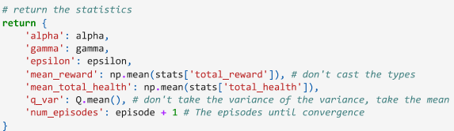
Basic – Run the Q-learning algorithm and represent its performance
We used our grid-search from earlier, feeding in the same values repeatedly so that we could collect various statistics easily
We set our Q-Learning algorithm to collect the mean health of the agent, the mean reward, the Q matrix variance and the number of episodes
Using the dataframe of these we built various graphs to show its performance
Notes:
As there was a lot of variability in the scores from any individual runs due to differences in the starting position, we took advantage of our grid searching algorithm in order to process many runs at once. This gave us 27 runs worth of data for our model.
As you can see as the Q variance got higher the average rewards got higher.

Slide 6
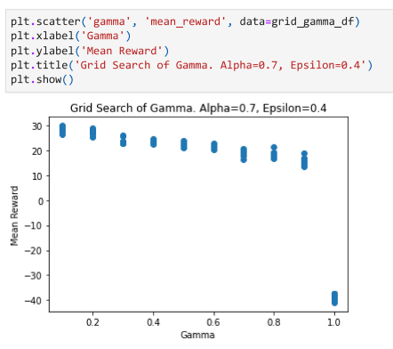
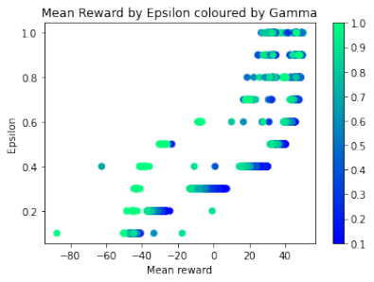
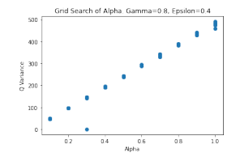
Basic – Repeat the experiment with different parameter values, and policies
From our earlier grid searches, we looked for other interesting parameters and also looked at holding the Gamma stationary while changing the Alpha parameter (and vice versa). As we already had all of the code from earlier to collect the statistics we plugged the data into various graphs:
Notes:
We saved our dataframes to CSV files so that the code wouldn’t need to be rerun to generate the graphs again

Slide 7
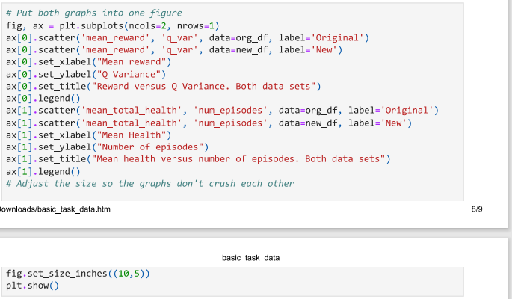
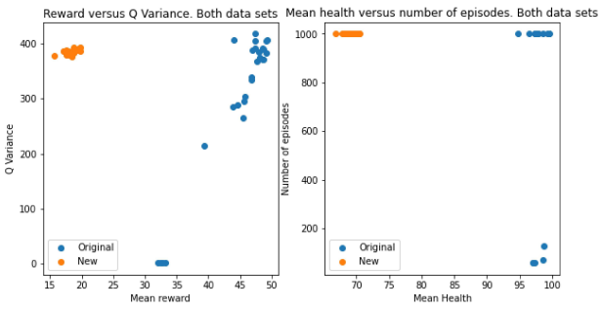
Basic – Analyse the results quantitatively and qualitatively
From our grid search code we could repeatedly run the Q-algorithm to gather data on its performance
Notes:
From the reward data and health we could roughly work out what the algorithm had done. Unfortunately we never collected video data of what the basic algorithm was doing

Slide 8
Advanced-Implement DQN with two improvements, Double Q
We used a more advanced version of our basic map as our environment
Using RLLib we grid searched to get the best hyper-parameters
We setup our neural network based upon this
Our replay memory was based on the one from PyTorch which uses a dequeue
So that we did not repeat code (too much) in the optimise model function we had an if statement to check if we were running in Double Q mode. If we were we predicted the column from the main DQN model and then got the target from the target network for that column. Otherwise we just got the biggest column from the target network. Then we compared the Q values and expected Q together
Notes:
Our advanced map was much larger, featured something akin to ray-tracing for vision, with doors blocking sight. Moving enemies, and a compass to point to the objective
dequeue - like a list but once it hits capacity the first item is dropped to let the next one in
Our main challenge here was working out a way to easily flip between DQN and Double DQN, but it helped that the beginning and end of the algorithm was very similar

Slide 9
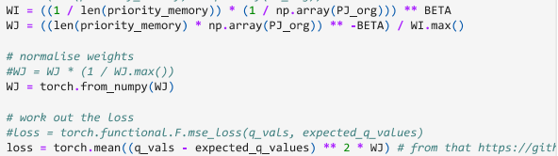
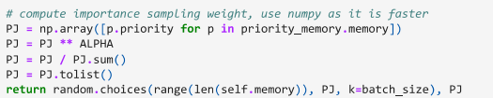
Advanced-Implement DQN with two improvements, Prioritised Replay
The prioritised replay memory inherited from the replay memory class. Adding the sample function to work out the priority of the memory sample and returning that and the weights
The optimise model function then had an extra section added to it (it was a new function with old one copied to it) which used the equations from the prioritised replay paper to create a weighted RMSE for the loss
The new weights were then written back to the prioritised memory
Notes:
We could then run Prioritised Replay with the Double Q as well
Our main challenge here was in being able to write back the new weights of the memories’ priorities and in creating a loss function which took into account the weights. Fortunately we were able to use PyTorch’s mean function and used it to generate the weighted RMSE as the loss.

Slide 10
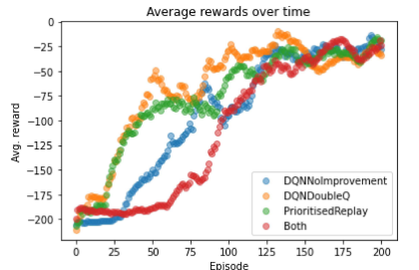
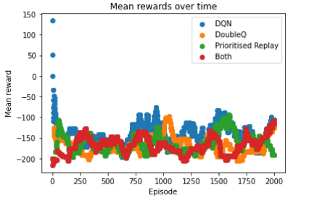
Advanced – Analyse the results quantitively and qualitatively
We loaded our state dictionary into our neural network class and then used it to predict the next action. Every time it did this we saved the output array from the agent’s point of view to a list. We then ran through this list converting them to pictures and saved each picture into a video file so that we could watch exactly what our agent had done.
RLLib
Ours
Notes:
None of our algorithms did particularly well here.
We had also run an earlier version of our environment (the main change were the reward amounts) through RLLib’s version of the algorithms, so that we were able to see how it had done. With either improvement improving on the base DQN, but not both.

Slide 11
Advanced – Apply RL algorithm of your choice (from RLLib) to one of the Atari Learning Environment
Here we chose the Space Invaders environment and the Evolutionary strategies algorithm
We used our video capture code to capture each frame of the environment into a video
We then used Ray tune to tune our environment (Docker aborted this at around the 30 hours mark). We had some difficulty in setting Ray to use our 6 core CPU, as it wanted something much bigger
Notes:
After having some issues in getting the environment working, we were able to start training. With Evolutionary Strategies taking a very long time per epoch

Slide 12
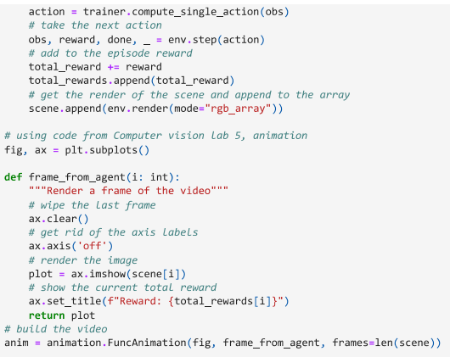
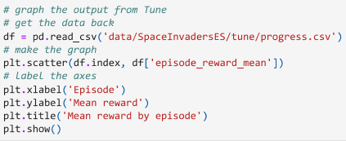
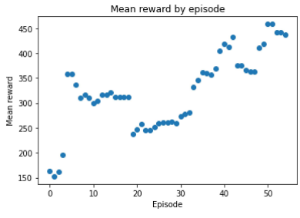
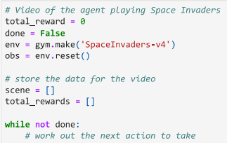
Advanced-Atari analyse the results quantitively and qualitatively
From the CSV file which Ray Tune generated we generated a graph of the mean rewards over time
We used similar code from the DQN section to capture each frame of what the agent was doing into a video
Notes:
Since I did this coursework I implemented a much cleaner and more efficient video capture function which directly saves to MP4 as it goes along (Computer Vision coursework) rather than saving the Numpy arrays to a list and indexing into them, which is rather inefficient and causes your computer to die for bigger videos

Slide 13
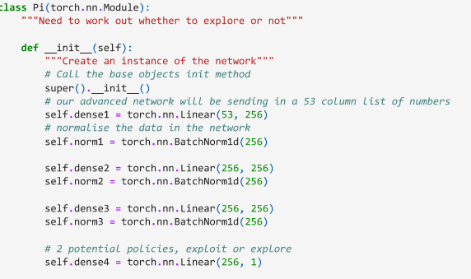
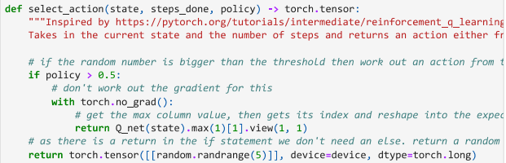
Soft-Actor Critic
Here we have our DQN and Replay Memory classes from earlier. But add another Neural Network Pi, to run a regression on the probability of whether or not to explore/exploit (our policy) (we exploit if it outputs >0.5, otherwise we explore)
Notes:
Once we had our models from DQN setup, it was relatively straightforward to setup another model to regress whether to explore or exploit

Slide 14
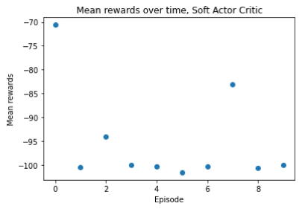
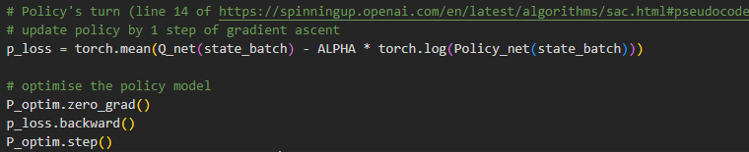
Soft-Actor Critic
We fill up our memory at each episode using our Neural Networks to select actions
We take our sample from the memories
Compute the target Q values, sorting out which ones have no next state, adding rewards and multiplying by Gamma. Optimising the Q Network (this part is similar to DQN)
Then we get the loss for the Pi network & optimise
Then repeat until the networks converge
Notes:
We fill up our memory at each episode using our Neural Networks to select actions – something that was probably a good idea to do for the DQN models
We ran out of time here so only ran the model through ten rounds of training. Our environment was roughly the one the DQN network used, but with the rewards from the Basic Task

