Slide 1
SEP 788/789 – Deep Learning and Neural Networks Fake News Detection
Group16: Ruiqiao Wang
Zhuangyuan Shen
Siqi Zhao

Slide 2
Agenda
Problem Statement
Project Challenge
Development Framework
Proposed Approach
Result
Difficulties and Solutions
Group Reflection and Improvement

Slide 3
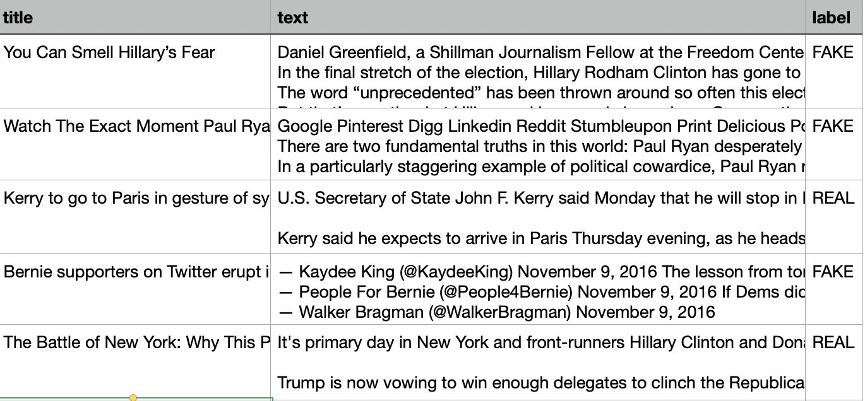
Problem Statement
Using AI to predict the likelihood of REAL news
NLP text binary classification problem
Dataset: 6336 pieces of news belonging to one of the two classes- REAL or FAKE

Slide 4
Project Challenge
Huge dimension of the input features - Curse of dimensionality
Small amount of data – Only 6336 pieces of data points

Slide 5
Development Framework
NLTK
Scikit-learn
TensorFlow, Keras
gensim
Other Scientific Computing Library – NumPy, Matplotlib…

Slide 6
Proposed Approach
Outline
Data Analysis
Preprocessing of dataset
Machine Learning Model
Deep Learning Model
Metrics
Notes:
Let’s move on the next part Proposed Approach
Our approach of this project can be consisted of these parts,
Data Analysis
Preprocessing of dataset
Machine Learning Model
Deep Learning Model
Metrics

Slide 7
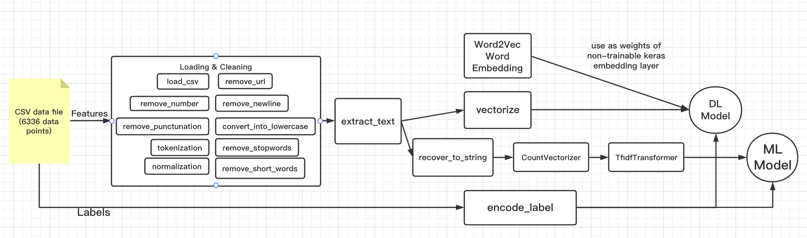
Proposed Approach Outline
Notes:
First, let’s take a look at the overall project outline, our project follows the structure shown in this figure, Each rectangle is implemented by using python functions. The circle is the model we trained. Next, we will introduce each part separately in detail.

Slide 8
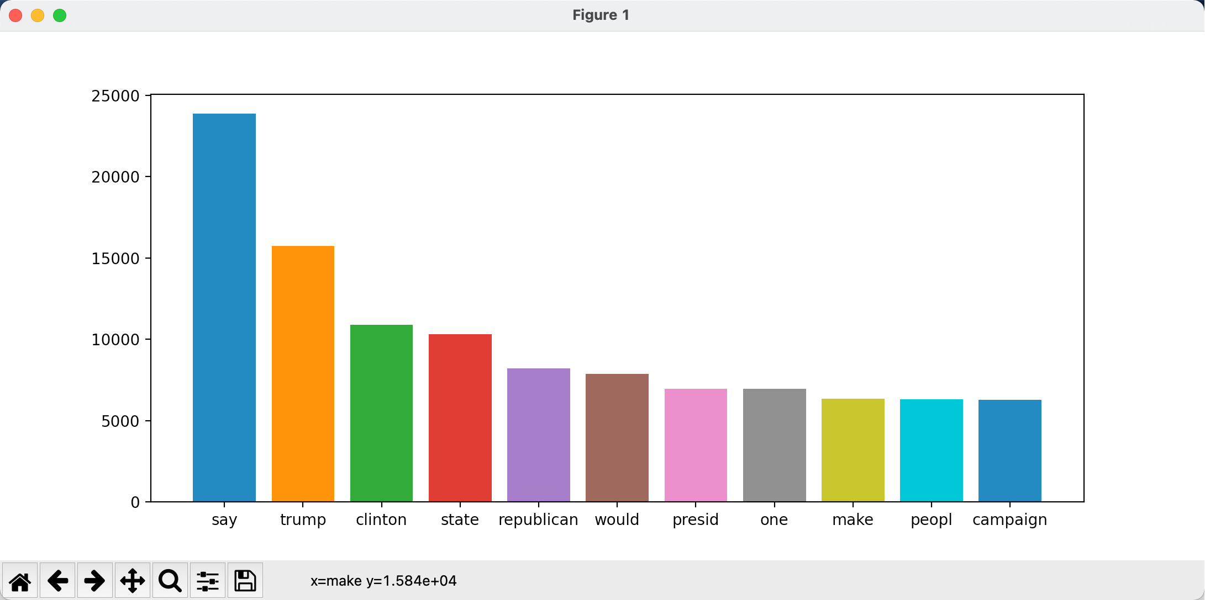
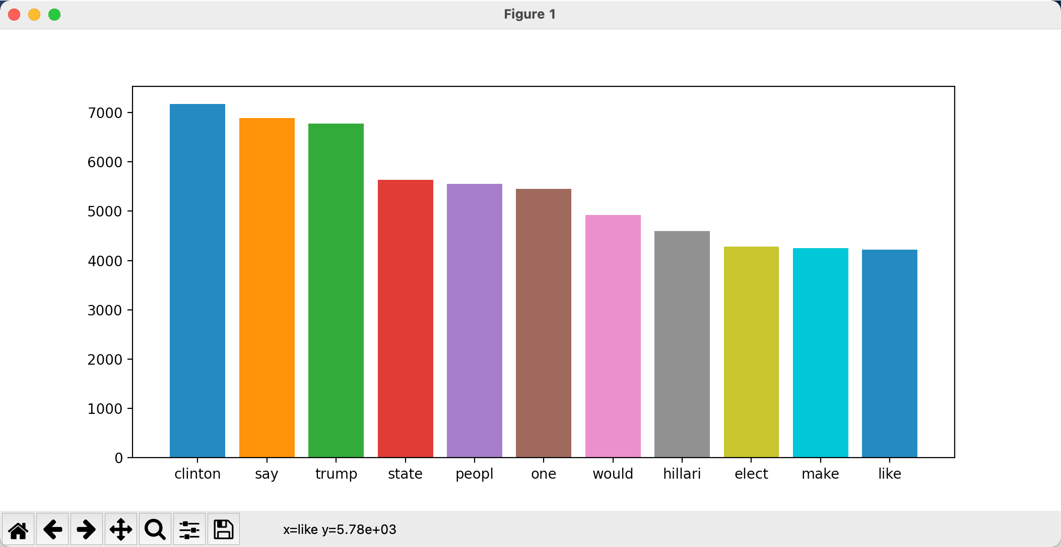
Data Analysis
Fig1. Word frequency distribution histogram for REAL news
Dataset Visualization
Fig2. Word frequency distribution histogram for FAKE news
Notes:
The first part, Data Analysis, We statistic the top ten most frequent words in real news and fake news. And plot these two diagrams. To facilitate the understanding of the dataset.

Slide 9
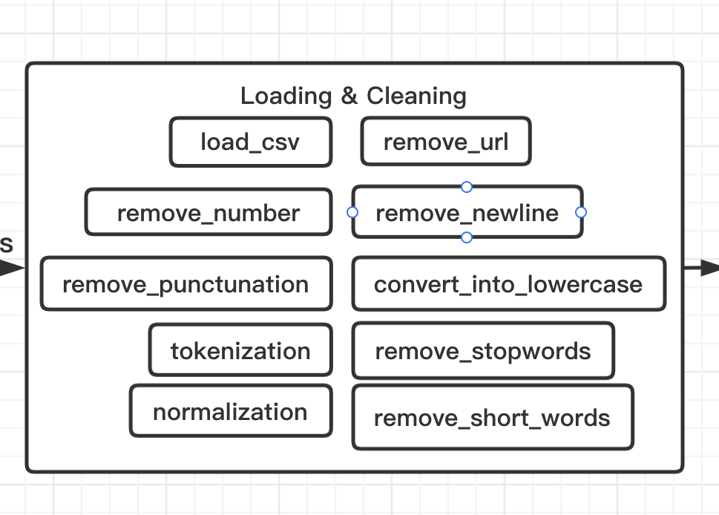
Preprocessing of dataset
We used regular expressions, and the NLTK language processing library to clean the data
We can add or ignore some of these methods according to the different needs of the training model stage
Notes:
Next is Preprocessing of dataset, fist during loading data, we delete the blank news or missing new, then remove url, because it is useless to analysis language. And also remove the number, blank line, and punctuations. In order to remove the stop words and normalize the text, we convert all text into lowercase and made them into every little words, that is tokenization. Finally we remove the short words which only contain one or two letters, such as a, b, or some useless words.

Slide 10
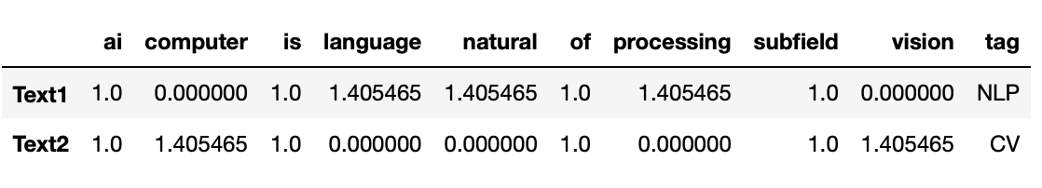
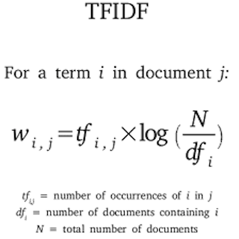
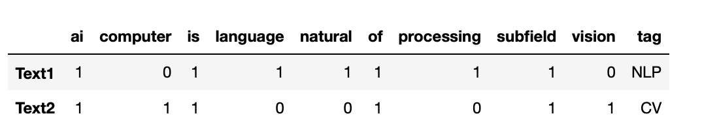
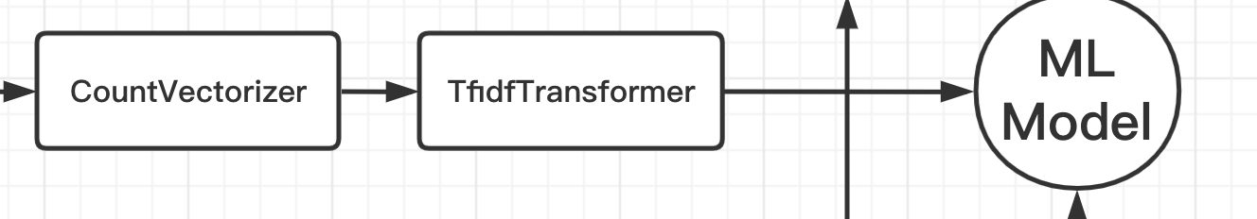
Machine Learning Model
Text1 = “Natural Language Processing is a subfield of AI”
Text2 = “Computer Vision is a subfield of AI”
Build Scikit-learn Pipeline
CountVectorizer()
TfidfTransformer()
Training model:
Naive Bayes
K-Nearest Neighbours
Support Vector Machines
Logistic Regression
Decision Tree
Notes:
And then it is ML part, Ruiqiao will help to explain this part.

Slide 11
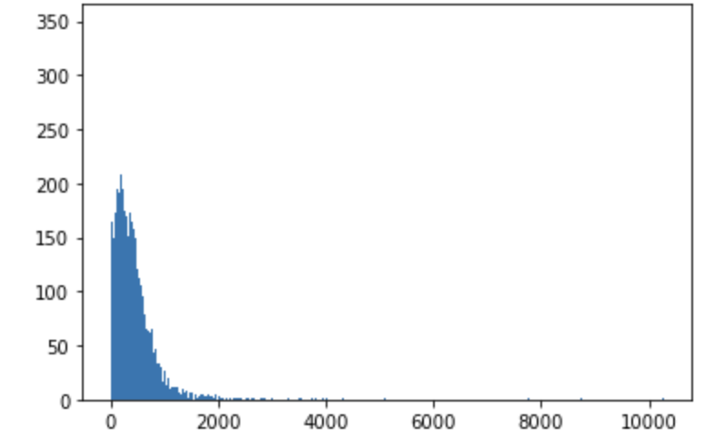
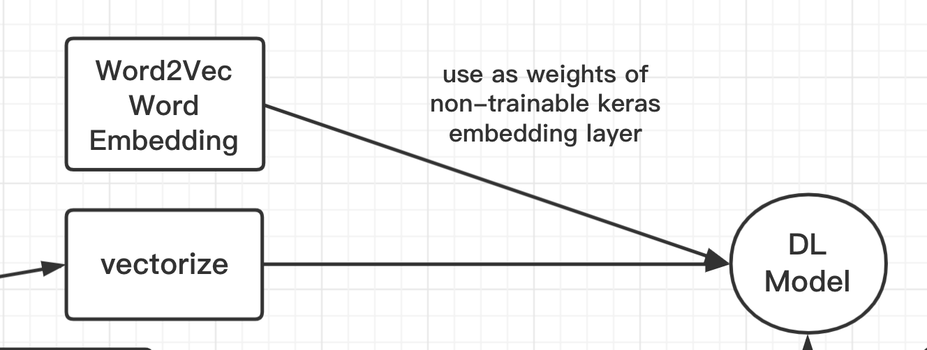
Deep Learning Model
Implement by Keras
Using keras’ built-in Tokenizer to vectorize the text
Padding the text
Word embedding: Word2Vec implement by Word2Vec model of genism
Getting embedding vectors from word2vec and using its as weights of non-trainable keras
embedding layer
Early Stop to prevent over fitting
Training model:
MLP
CNN
LSTM
Notes:
For Deep learning part, first we use Keras to implement it.
Using keras’ built-in Tokenizer to use Unique Numbers to Vectorize – represent each word by its index in the words dictionary.
And then we padding the text, make the length of each news the same, if the length is too long, remove the extra part, if the length is not long enough, use 0 to fill in. By exploration, we plot this diagram. This diagram shows the length of the text after data cleaning. We found that most of the text is below 1000, so we choose 1000 for text padding to ensure that the data contains most of the information at the same time saving training time.
Also we performed word embedding by using Gensim Word2Vec model
And we used Early Stop to prevent over fitting
Finally we trained three dl model: MLP CNN LSTM

Slide 12
Metrics
Precision
Recall
F1-Sorce
Accuracy
Confusion matrix
Notes:
Evaluation Method, we used precision, recall, F1-sorce, Accuracy and confusion matrix.

Slide 13
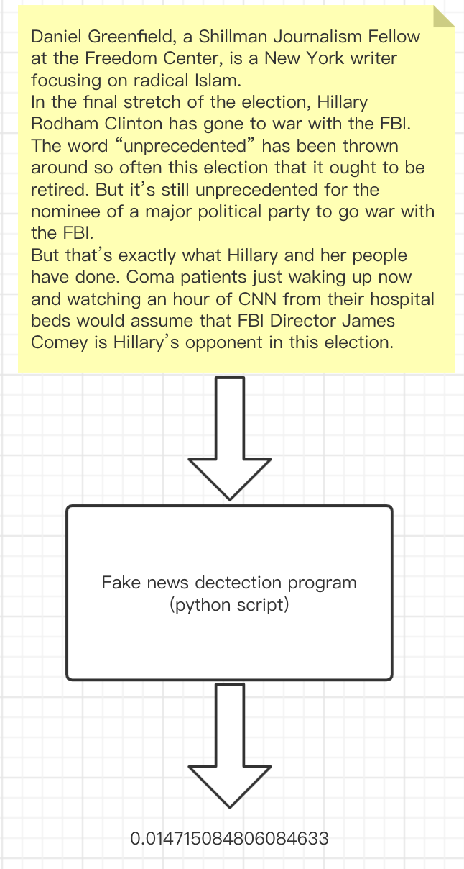
Result
Model | Accuracy
Naive Bayes | 0.8333333333333334
K-Nearest Neighbours | 0.8698412698412699
Support Vector Machines | 0.9333333333333333
Logistic Regression | 0.9317460317460318
Decision Tree | 0.8047619047619048
MLP | 0.9009523582458496
CNN | 0.8876190185546875
LSTM | 0.9141269612312317
Notes:
Let’s move on to the next part, result and demo.
Through experiments, we got this table. It contains various models and the accuracy rates obtained by these models. Finally, we save the model and write a program (that is a python script) to predict true and false news. The input is a piece of news, and the output is the likelihood of this news is REAL

Slide 14
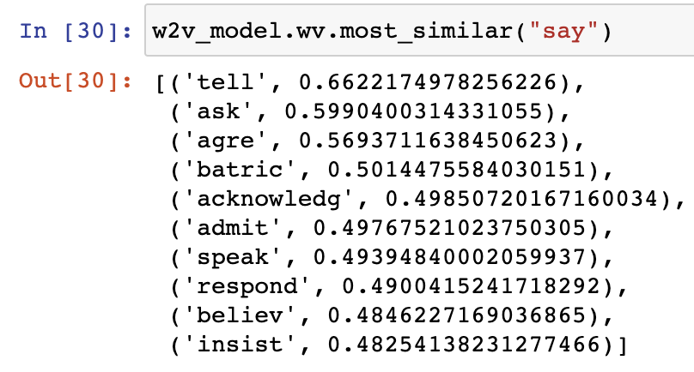
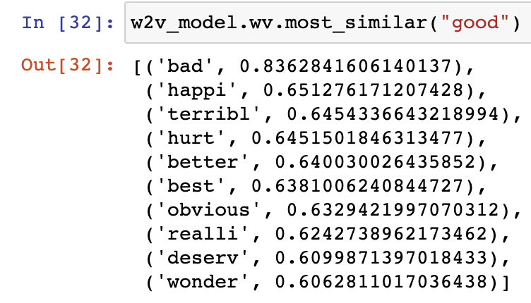
Difficulties and Solutions
Huge dimension of the input features, lead to overfitting
- Word2Vec word embedding, Keras Embedding layer
- Scikit-learn CountVectorizer() & TfidfTransformer()
- capture the similarities between two words
Lack of data
- Cross-Validation
Notes:
As mentioned in the pervious challenge section, the input features have huge dimensionality, at the begining of the project. we didn't do the unsurprivised word embedding. The validation accurcy of each model are only round 70%. But the training accarvcy is already near 100%. Becase we not perfermor word embedding and can not capture the similarities between two words. after we use word2vec, we create the word vector for every words and we can find the similar word. For example, in these experiment screenshot, we can see.......

Slide 15
Group Reflection
Improvement or Future Work
NLP Data Augmentation
- Increase the amount of training data and improve the generalization ability of the model
- Add noise data to improve the robustness of the model
Try more modern model: Transformer/Google Bert
- Solve the lack of data problem
Practice and made us more familiar with development using machine learning or deep learning frameworks
Practice the NLP problem, improve experience
Notes:
Because we still have a week to improve out project , we decided to enhance our project by these factors: 1. NLP Data Augmentation related paper about Data Augmentation

Slide 16
Thank you for watching
Group16: Ruiqiao Wang
Zhuangyuan Shen
Siqi Zhao

