Slide 1
Hands On Java 11 OCP Certification Prep
Jeanne Boyarsky, Scott Selikoff
& Ken Fogel
Wednesday, September 18, 2019
Oracle Code One (HOL18122)

Slide 2
URLs
https://speakerdeck.com/boyarsky
https://github.com/boyarsky/2019-oraclecodeone-cert-hol

Slide 3



About Us
Java Developer
CodeRanch Mod
Java Champion
Java Developer
CodeRanch Mod
Software Consultant
Teacher
DawsCon Organizer
Java Champion

Slide 4
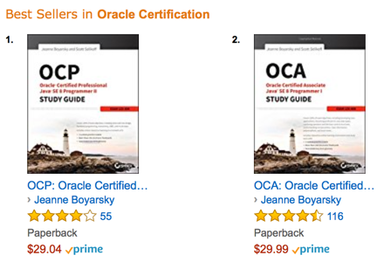
Jeanne & Scott’s Java 8 Cert Books

Slide 5
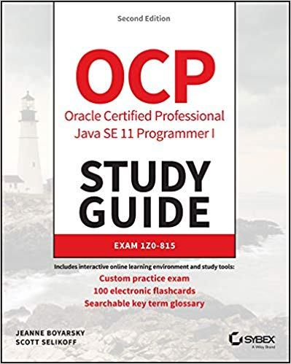
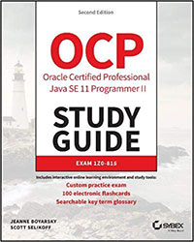
Pre-order Java 11 Cert Books
Book I (Exam 1Z0-815) available in November

Slide 6
Disclaimers
A bit of the material is from our books.
Some of the material in this presentation may appear in our upcoming certification books.

Slide 7
Agenda
I. Certification Overview
II. Modules
III. Lab #1
IV. Small features
V. Var/Stream Changes
VI. Lab #2
...then Off to CloudFest @ Chase Center!

Slide 8
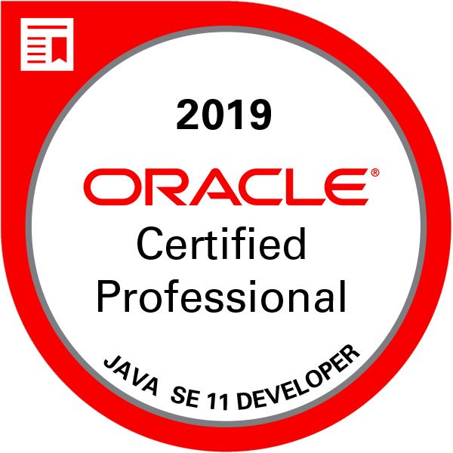
I. Certification Overview
What is the OCP Java SE 11 Developer Certification?

Slide 9
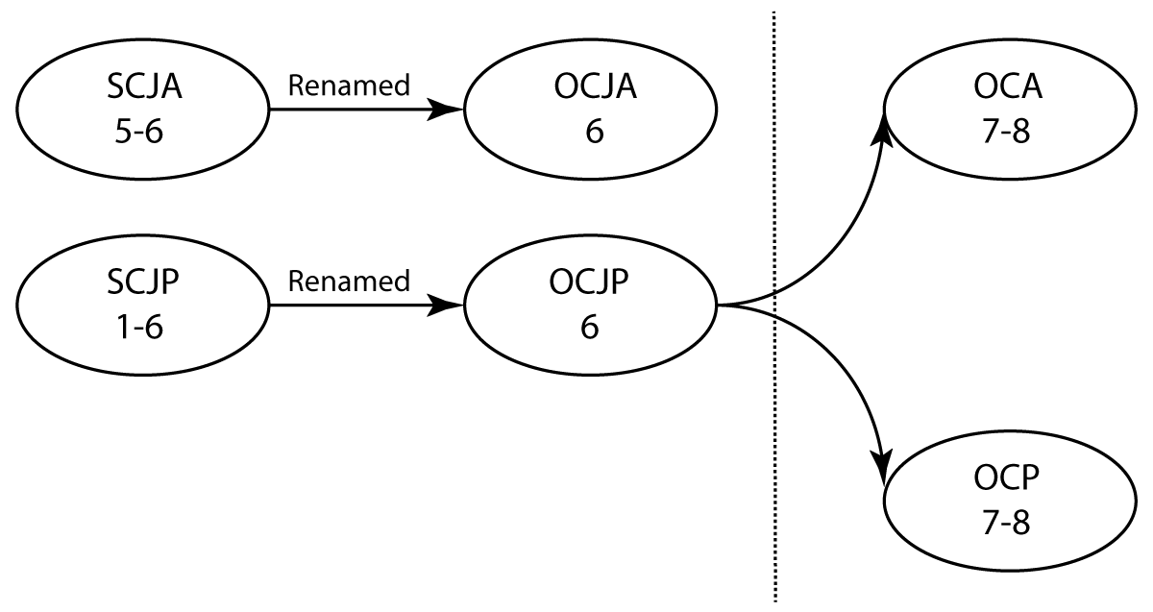
Previous Certification History
+ upgrade

Slide 10
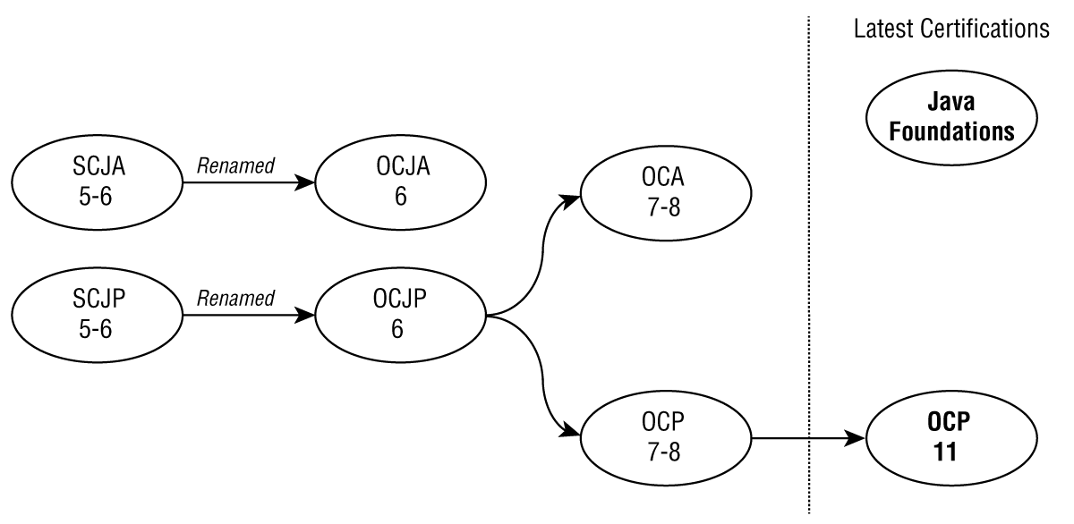
New Certification Path

Slide 11
Java 11 Path
Yes, 2 OCP level exams
1Z0-815
(OCP part 1)
1Z0-816
(OCP part 2)
+
No cert granted for completing 1Z0-815
OCP Part 1 (1Z0-815) similar to OCA 8 (1Z0-808) exam, but much harder!
OCP: Java SE 11 Developer

Slide 12
If you have an older cert
If already passed | Need to take
OCP 6, 7, 8 | 1Z0-817 (upgrade exam)
OCA 6, 7, 8 | 1Z0-816 (part 2)
OCJP/SCJP 1.5 or earlier | 1Z0-815 (part 1) + 1Z0-816 (part 2)

Slide 13
II. Modules

Slide 14
JDK has been modularized
JDK
java.base
automatically available
java.base
java.logging
java.sql
+ many more

Slide 15
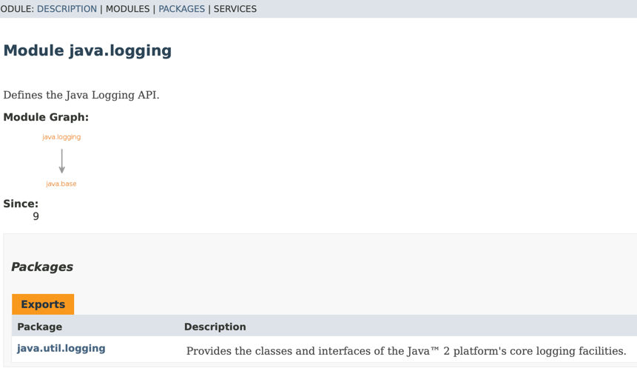
Module graph
https://docs.oracle.com/en/java/javase/11/docs/api/java.logging/module-summary.html

Slide 16
Simple module
src
package1
MyClass1.class
package2
MyClass2.class
module-info.class
Requirements
module-info file
One or more packages

Slide 17
module-info.java
module moduleName {
requires otherModuleName;
exports packageName;
}

Slide 18
Module file “commands”
requires – dependencies
requires transitive – grant to caller
exports – share package
exports to – share package with specific module
opens – for reflection
provides/uses – for services

Slide 19
Module implications
Can have “private” package
No circular dependencies

Slide 20
Question 1
Given a module, which command allows other modules to access a package it defines?
exports
opens
reflects
requires
None of the above
Notes:
A

Slide 21
Question 2
How many modules are available by default?
0
1
2
3
4
Notes:
B

Slide 22
Question 3
Which module command allows reflection?
exports
opens
reflects
requires
None of the above
Notes:
B

Slide 23
Question 4
Which are true of the module-info?
It must have a public modifier
It cannot have a public modifier
It is required to be in a module
It appears at the root of the module
E. Its name is moduleInfo.java
Notes:
B,C,D

Slide 24
III. Lab #1
Required Software for Today
Java 11
Editor or IDE of your choice
Note: we don’t recommend using an IDE to study for the cert, but we only have two hours

Slide 25
Labs
We will sprinkle in some concepts from earlier versions of Java into the labs. (ex: reading from a file).
If you are not familiar with these, it is fine to Google or ask us for help.
Sample solutions are in the github repo.

Slide 26


III. Lab #1
https://github.com/boyarsky/2019-oraclecodeone-cert-hol
Notes:
Image from https://www.maxpixel.net/Clipart-Boy-Science-Cartoon-Lab-Experiments-Vitro-2841726 and https://www.publicdomainpictures.net/en/view-image.php?image=238196&picture=woman-drinking-coffee

Slide 27
IV. Small Features
Underscore (_)
private interface methods
effectively final in
try-with-resources

Slide 28
Underscores
Single _ no longer a valid identifier
Double underscore valid
$, numbers, and letters valid
Why? Positioning for future

Slide 29
Private methods
private and private static methods allowed in interfaces
Why? Can be used by static and default methods to reduce code duplication
Can’t be used outside of interface declaration

Slide 30
6 Types Allowed in Interfaces
Type | Scope/Modifiers
Constants | public static final
Abstract Methods | public abstract
Default Methods (8) | public default
Instance Methods (9) | private
Public Static Methods (8) | public static
Private Static Methods (9) | private static

Slide 31
Effectively Final Definition
Added in Java 8
If typed final before param/local variable and it would still compile
Can be used in lambda expressions

Slide 32
Which are effectively final?
int numChairs = 4;
int numLegs = numChairs * 4;
numChairs++;
System.out.println(numChairs);
UnaryOperator<Integer> rc1 = r -> r * numChairs;
UnaryOperator<Integer> rc2 = r -> r * numLegs;

Slide 33
Try-with-Resources - Before
Resource must be declared with try-with-resources
Path path = Paths.get("file");
try(BufferedReader reader =
Files.newBufferedReader(path)){
// read file
}

Slide 34
Try-with-Resources - After
Effectively final resources can be declared before try-with-resources
Path path = Paths.get("file");
BufferedReader r = Files.newBufferedReader(path);
try(r) {
// read file
}

Slide 35
What’s wrong here?
Connection con =
DriverManager.getConnection(url);
PreparedStatement ps =
con.prepareStatement(sql);
ps.setInt(1, id);
ResultSet rs = ps.executeQuery();
try (con; ps; rs) {
while (rs.next()) {
// process result set
} }
Resource leak!
Notes:
http://openjdk.java.net/jeps/225

Slide 36
Question 1
Which of the following compile?
String _a = null;
String _1 = null;
String $ = null;
String _ = null;
String __ = 1;
Notes:
A,B,C

Slide 37
Question 2
Which can fill in the blank?
interface TheInterface {
____ int method() { return 1; } }
public
protected
no modifier
private
None of the above
Notes:
D

Slide 38
Question 3
Which can fill in the blank?
interface TheInterface {
____ static void method() {} }
public
protected
no modifier
private
None of the above
Notes:
A,C,D

Slide 39
Question 4
How many identifiers could have independently been changed to _ in Java 9?
0
1-2
3-4
public interface Planet {
int COUNT = 1;
void add(int num);
private static int getCount() { return COUNT; }
}
5 or more
None – code does not compile
Notes:
D

Slide 40
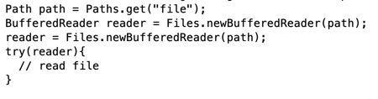
Question 5
Which is true at the end of the code block?
Reader is closed
Reader remains open
None; the code does not compile
Notes:
C

Slide 41
V. Var/Stream Changes
Var (local variable
type inference)
Streams

Slide 42
String name = "SF";
var name = "Jeanne";
List list = List.of(1, 2, 3);
var list = List.of(1, 2, 3);
Syntactical sugar/less boilerplate
Not immutable (no val)

Slide 43
List<WebElement> headers = thead.findElements(By.tagName("th"));
VolunteerDashboardRow headerRow = new VolunteerDashboardRow(headers);
vs
var headers = thead.findElements(By.tagName("th"));
var headerRow = new VolunteerDashboardRow(headers);
Notes:
Point out scanability

Slide 44
var csvPath = createAndGetFile(CSV_DATA);
try (var csvWriter =
Files.newBufferedWriter(csvPath);
var csvPrinter = new
CSVPrinter(csvWriter,
CSVFormat.DEFAULT)); {
}

Slide 45
Map<Integer, String> productMap1
= new HashMap<Integer, String>();
Map<Integer, String> productMap2
= new HashMap<>();
var productMap3
= new HashMap<Integer, String>();
Notes:
Not always less typing

Slide 46
Where can we use?
var name = "SF";
var other = name + 2;
var list = List.of(1, 2, 3);
for (var num : list) {}
(@NotNull var map, var list) -> true;

Slide 47
All or nothing
Good
(var map, var list) -> true
No good
(var map, list) -> true
(var map, List list) -> true
Notes:
Useful for annotation

Slide 48
Where can’t we use?
class Inner { var bad = "abc"; }
var noGood;
noGood = 4;
Also instance variables, etc

Slide 49
Does this work?
var var = "var";

Slide 50
Pros | Cons
Less typing | Loss of information
Less redundancy | Variable names matter more
Can scan variable names | Be careful!
http://openjdk.java.net/projects/amber/LVTIstyle.html

Slide 51
Strings
"abc\n123"
.lines()
.count();
"abc".chars()
.count();

Slide 52
Streams - ofNullable
Optional.ofNullable() existed since Java 8
stream = dubiousObj == null
? Stream.empty()
: Stream.of(dubiousObj);
stream = Stream.ofNullable(dubiousObj);

Slide 53
Streams - iterate
Stream.iterate(10, i-> i-1)
.limit(10)
.forEach(System.out::println);
Stream.iterate(10, i-> i>0, i-> i-1)
.forEach(System.out::println);

Slide 54
Streams - takeWhile
Stream.iterate(1, i-> i< 10, i-> i + 1)
.takeWhile(i -> i < 5)
.forEach(System.out::println);
Assumes ordered stream. Takes all elements until one doesn’t match. Prints the numbers 1-4

Slide 55
Streams - takeWhile
How to print all Fibonacci #s less than 30?
Stream.iterate(
new SimpleEntry<Integer, Integer>(1,1),
e -> new SimpleEntry<Integer,Integer>(
e.getValue(), e.getKey()+e.getValue()))
.map(Entry::getValue)
.takeWhile(n -> n < 30)
.forEach(System.out::println);

Slide 56
Streams - dropWhile
Stream.iterate(1, i-> i< 10, i-> i + 1)
.dropWhile(i -> i < 5)
.forEach(System.out::println);
Assumes ordered stream. Takes all elements until one doesn’t match. Prints the numbers 5-9

Slide 57
Streams - dropWhile
Stream.iterate(new SimpleEntry<Integer, Integer>(1,1),
e -> new SimpleEntry<Integer, Integer>(
e.getValue(), e.getKey()+e.getValue()))
.map(Entry::getValue)
.dropWhile(n -> n < 30)
.forEach(System.out::println);
Note: This doesn’t work. takeWhile and dropWhile aren’t always opposites.
Notes:
Drops prefix and then goes on infinitely

Slide 58
Question 1
What is the output?
var a = 1; var b = a;
int c = b; System.out.println(c);
a does not compile
b does not compile
c does not compile
1
None of the above
Notes:
D

Slide 59
Question 2
What is the output?
var a = 1; var b = a;
String c = b; System.out.println(c);
a does not compile
b does not compile
c does not compile
1
None of the above
Notes:
C

Slide 60
Question 3
Which variable declarations compile?
var a = null; var b = 1;
var c; var var = 3;
a
b
c
var
Notes:
B and D

Slide 61
Question 4
Which allow using var?
Inner class instance variables
Lambda variables
Static variables
Try-with-resources
Notes:
B, D

Slide 62
Question 5
What does the following output?
long count = Stream
.iterate(1; i-> i< 10; i-> i+2).count();
System.out.println(count);
0
5
10
The code does not compile
None of the above
Notes:
D (semi-colons not commas)

Slide 63
Question 6
What does the following output?
Stream.iterate(1, i-> i< 10, i-> i++)
.takeWhile(i -> i < 5)
.forEach(System.out::println);
The numbers 1-4
The numbers 5-9
An infinite stream
The code does not compile
None of the above
Notes:
C (i++ doesn’t update anything)

Slide 64
Question 7
What does the following output?
long count = Stream
.iterate(1, i-> i< 10, i-> i+2).count();
System.out.println(count);
0
5
10
The code does not compile
None of the above
Notes:
B

Slide 65
Question 8
What does the following output?
Stream.iterate(1, i-> i< 10, i-> ++i)
.dropWhile(i -> i < 5)
.forEach(System.out::println);
The numbers 1-4
The numbers 5-9
An infinite stream
The code does not compile
None of the above
Notes:
B

Slide 66
Question 9
What does the following output?
long count = Stream.of(null).count();
System.out.println(count);
0
1
null
The code does not compile
None of the above
Notes:
E

Slide 67
VI. Lab #2
(when done have a beer at CloudFest)
Notes:
Image from https://www.maxpixel.net/Clipart-Boy-Science-Cartoon-Lab-Experiments-Vitro-2841726 and https://www.publicdomainpictures.net/en/view-image.php?image=238196&picture=woman-drinking-coffee

