Slide 1

C++ Workshop
Swinburne Linux Hardware and Code Club (SLHCC)
Presented by Dylan Armstrong | President

Slide 2

Discord Link – Are you on it?

Slide 3
Agenda
Basics of C++ (A Primer)
Object-Oriented Programming in C++
Array Wrapper
Memory Management in C++
Data Structures
Iterator
Stack
Tree
Template Metaprogramming
Cubed Exponent Meta-function

Slide 4
Basics of C++ (A Primer)

Slide 5
Language History
Developed by Bjarne Stroustrup at Bell Labs in 1983.
Originally called “C with Classes”.
The latest standard is C++20, with C++23 in preview.

Slide 6
Fundamentals
C++ is a statically-typed language that is mixed paradigm (generic, object-oriented, procedural, etc.)
Designed to have portability (like C)
All lines end with a semicolon (even class definitions – unlike C#!)

Slide 7

Basic Types and Strings in C++
int, char, bool, float, void are some basic types in C++
size_t, is a unsigned integer e.g. $x$ $∈${ 0 $≤x ≤$ $∞$}
Strings exist in C++ under the <string> header and can be used within the standard library - std::string
C like strings are character arrays, C++ adds strings through the standard library.

Slide 8
Standard Library and I/O
Contains all the standard features of the C++ programming language.
Uses std as the scope identifier.
I/O (input and output) comes from the <iostream> header e.g. cout (for console output) and cin (for console input)
NOTE: In C++23 (currently in preview), a new <print> header will be introduced allowing for std::print and std::println

Slide 9
Pre-Processor Directives
A pre-processor directive is a pre-processor instruction to load libraries, etc.
#include is a pre-processor directive to include a library e.g. #include <iostream>
Other pre-processor directives include #define

Slide 10
Constants in C++
const – runtime constant (executed at runtime)
constexpr – compile time constant (executed at compile time)

Slide 11
Auto
Auto is for complex-types that may be hard for the compiler to determine; hence the programmer may need to guide the compiler.
Auto in most cases should not be used.

Slide 12
Pointers and References (Brief Introduction)
Pointers point to another address location in memory. (We will touch on pointers more later) They use the ad-hoc (*) operator after the type name or before the variable name.
References can be used in different ways in C++ e.g.
L-Value References (reference to an L-Value – useful for preventing unnecessary copies of objects passed as function arguments int&)
R-Value References (reference to an R-Value int&&)
References (gets the address of a variable in memory e.g. &x)

Slide 13
Lambda Expressions
Callable unit of code within another function
Primarily uses auto
Contains capture list, arguments, return type (optional), etc.

Slide 14
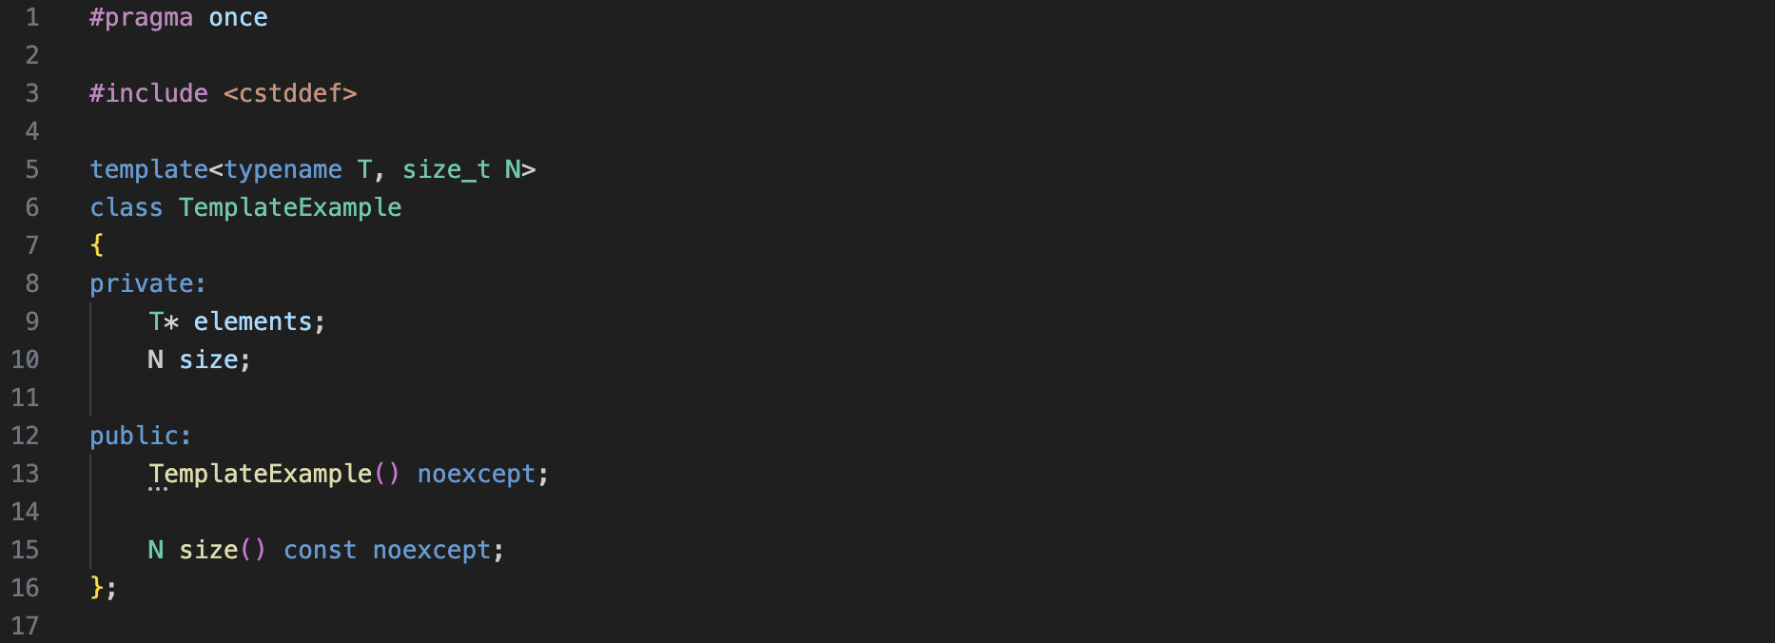
Templates
Allow for generic abstractions in C++
Type-agnostic data types
Templates work for variables, functions, classes and type aliases in C++.

Slide 15
Initializing a Template with argument list
When instantiating a template use a template argument list.
As per previous slide: TemplateExample<int, 50> or TemplateExample<size_t, 3> are valid.

Slide 16
Type Aliases
using is preferred to typedef in C++.
Allows for types to be referred to by other names.

Slide 17
Type Casting
In most cases, static_cast<T> will work.
Other type casts exist in C++ but are not really required for this workshop.

Slide 18
Noexcept
When a functions must not throw an exception, mark it noexcept.
Don’t use this everywhere though. Only use it when the function can safely not throw an exception.

Slide 19
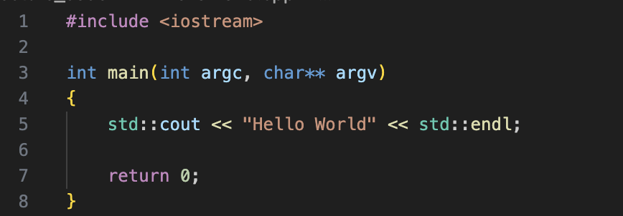
Hello World Program in C++

Slide 20
OOP in C++

Slide 21
Classes
Classes are the basis for object-oriented programming.
They define what member variables and member functions an object has.
#pragma once is a guard against repeat inclusion.
Const – on the right-hand side of the function means that the method must not change this object.
private, protected and public are the 3 C++ access modifiers.
Constructors can be overloaded in C++.
Operators can also be overloaded.
Class specifications should be in header files (.h/.hpp)
Class implementations should be in compilation files (.cpp)
The exception to this is for template classes!

Slide 22
Workshop 1
Let’s create an Array Wrapper class in C++
Should have:
Two member variables:
A pointer of type int (the array contents)
The size of the array
Three member functions:
A constructor – to initialize member variables
An overloaded index operator
A size method – getter to return the size of the array

Slide 23
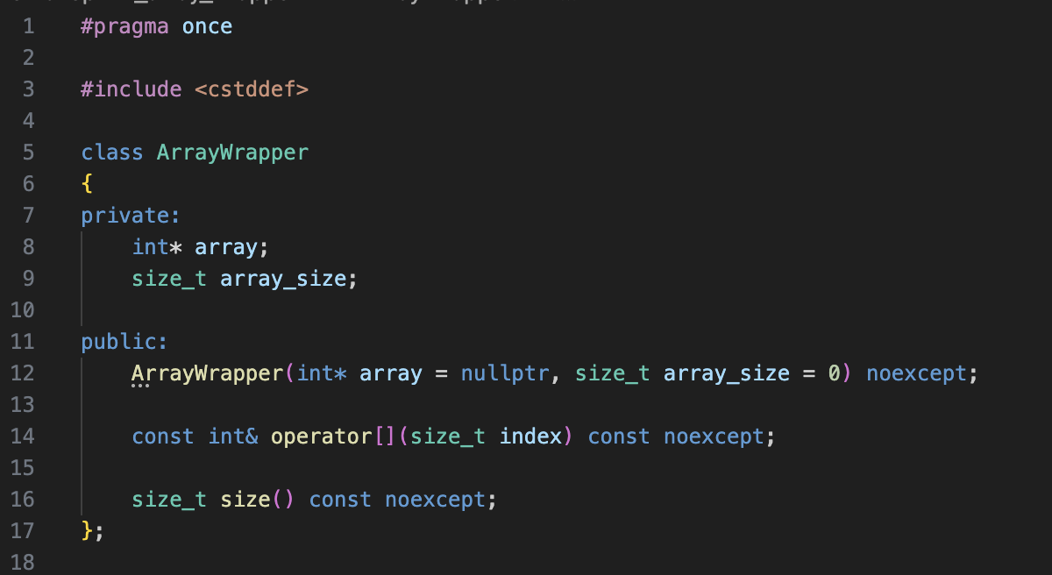
Specification – ArrayWrapper.h
Guard against repeat inclusion
Note the semicolon!

Slide 24
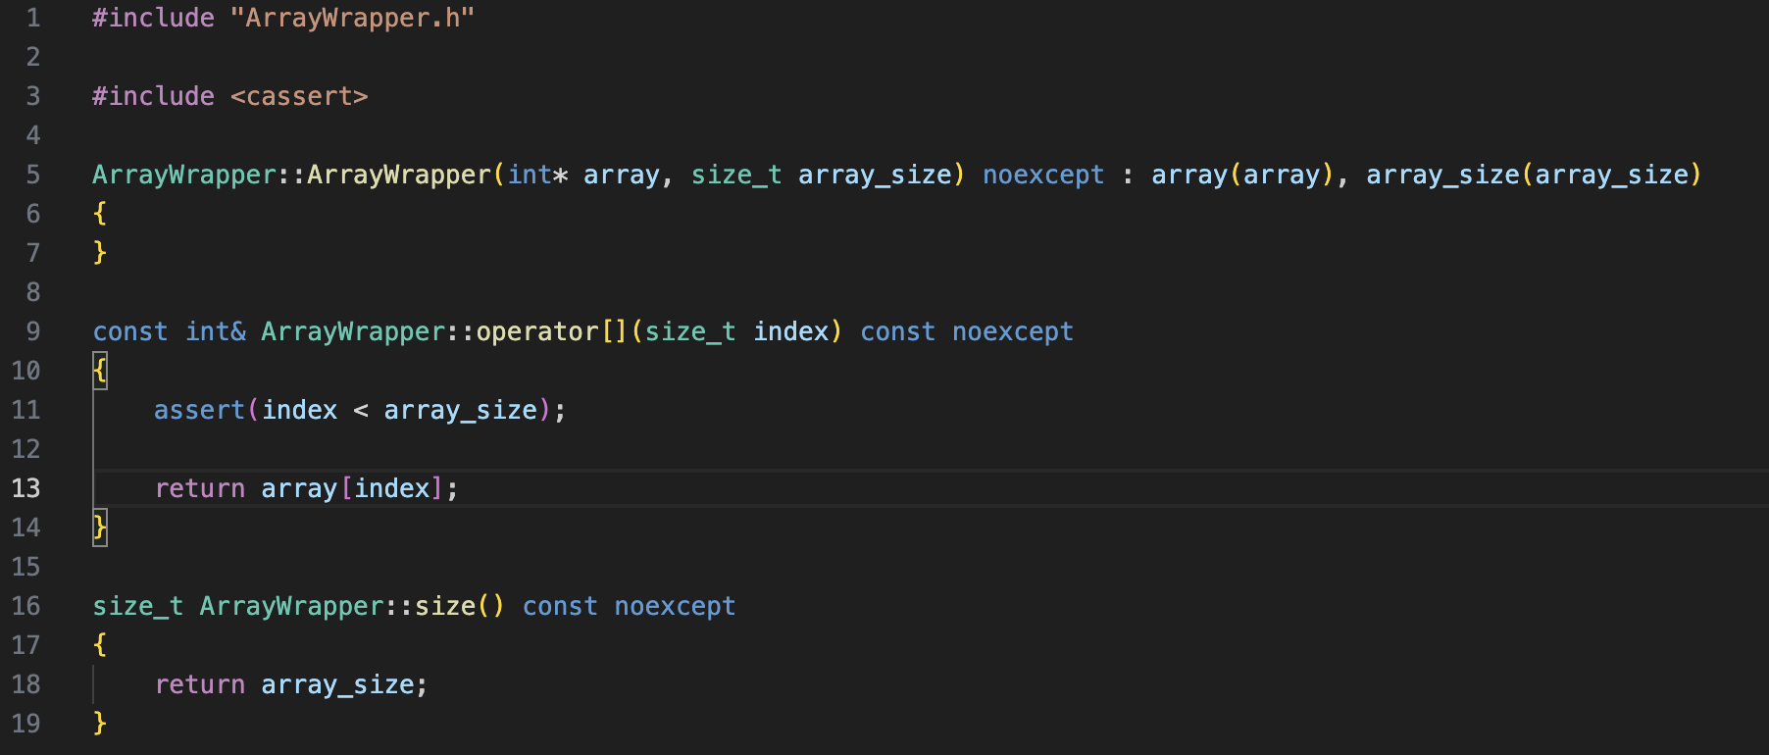
Implementation – ArrayWrapper.cpp

Slide 25
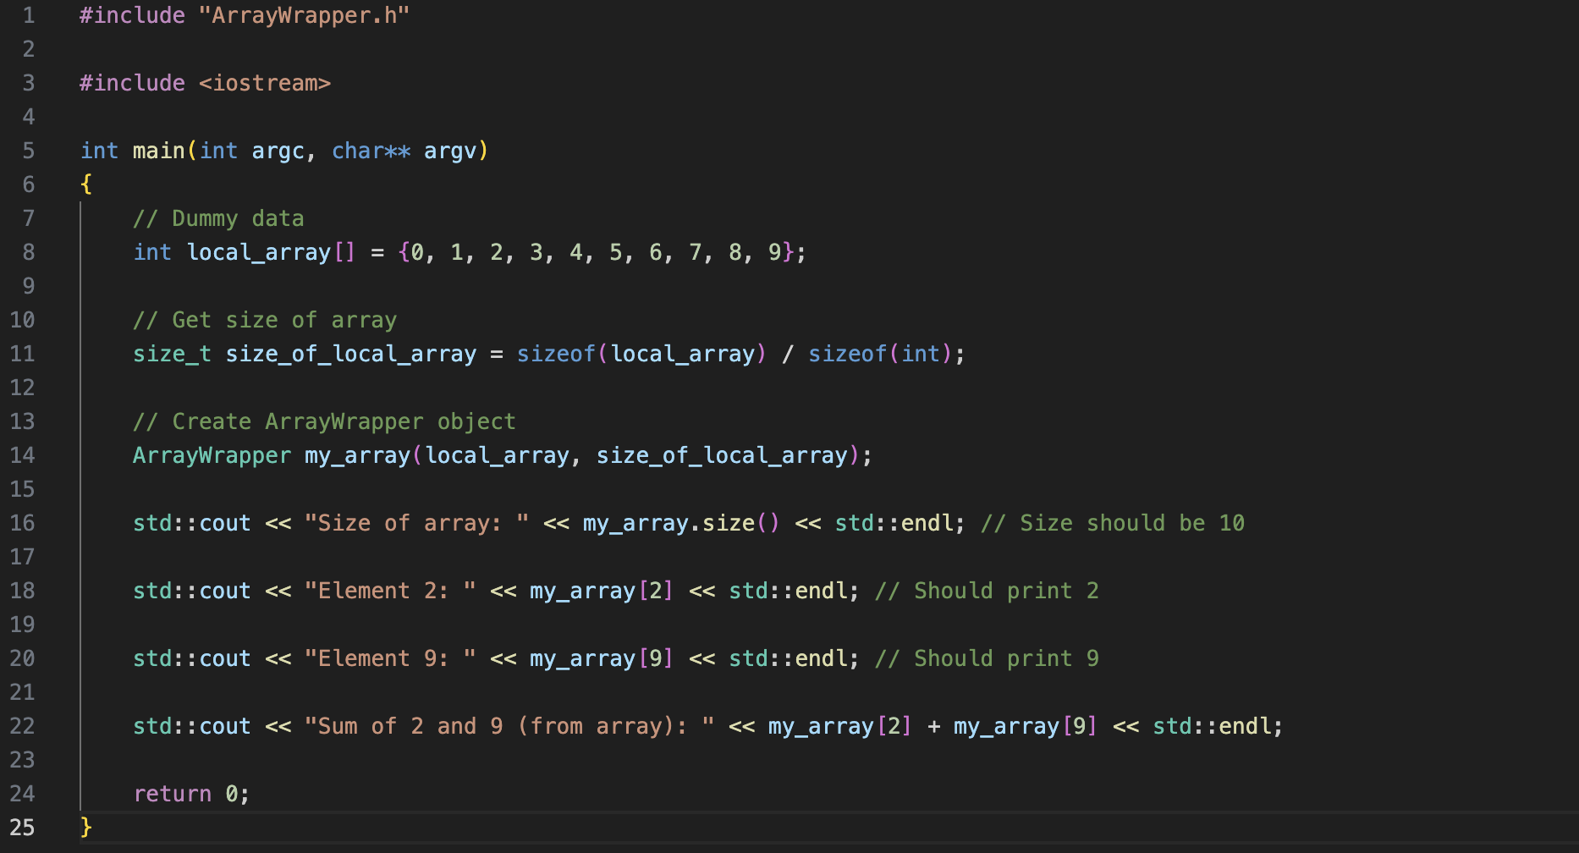
Running – Main.cpp

Slide 26
Memory Management

Slide 27
(Raw) Pointers
A raw pointer points to another location in memory. This memory can be newly allocated heap memory by using new.
C++ does not automatically free raw pointers! The programmer must free the memory by using delete or delete[]. If you fail to do this, you will create memory leaks.
Only use heap memory in certain cases, as it is computationally expensive e.g.
Where the size of an object is not known at runtime – use Heap Memory
Where the size is known – use Stack Memory
NOTE: If an object needs to free memory when going out of scope the destructor can be used with a ~ in front. E.g. ~ArrayWrapper()

Slide 28
References
L-Value references
Reference bound to an l-value – prevent uncessary copies when passed to functions.
R-Value references
Reference bound to an r-value - useful for move semantics.

Slide 29
Copy and Move Semantics
Allow objects to be copied safely
Copy constructor
Copy assignment
Allow objects to moved safely
Move constructor
Move assignment
The other 2 canonical methods are the default constructor and destructor.

Slide 30
Smart Pointers (std::unique_ptr)
Unique pointers have ownership over another single object.
Use std::make_unique instead of new when allocating memory
Smart pointers will free themselves when going out of scope.
Access smart pointers from the <memory> header

Slide 31
Smart Pointers (std::shared_ptr)
Allows for shared ownership over multiple objects
Participates in reference counting
Use std::make_shared

Slide 32
Smart Pointers (std::weak_ptr)
Holds a non-owning or “weak” reference to a std::shared_ptr
Can be used like a shared_ptr by calling the weak_ptr’s lock() method.

Slide 33
Data Structures

Slide 34
Iterator
Traverses through a collection
Useful for traverses through custom data types

Slide 35
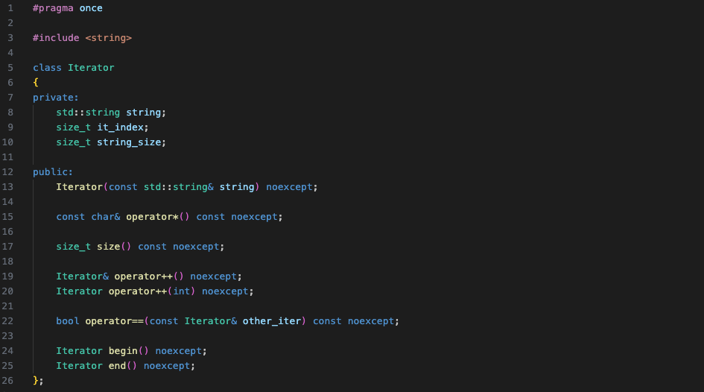
Workshop 2 – Iterator (Specification – Iterator.h)

Slide 36
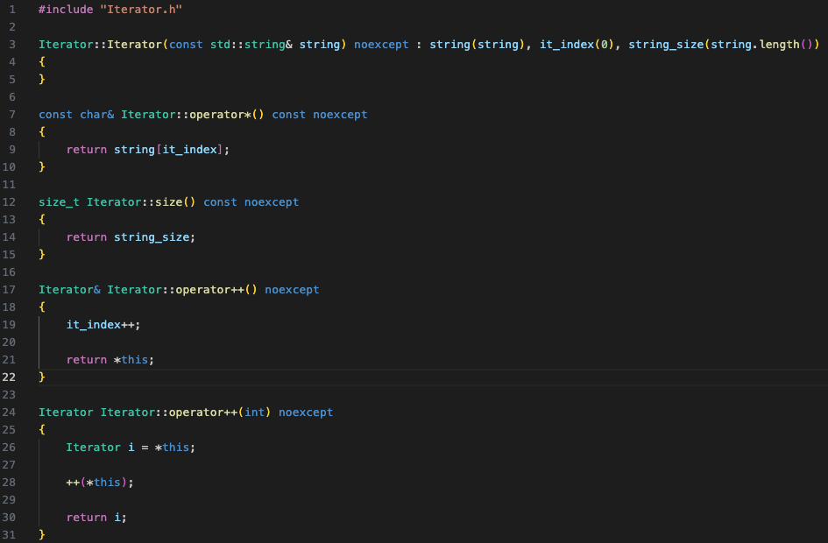
Implementation – Iterator.cpp

Slide 37
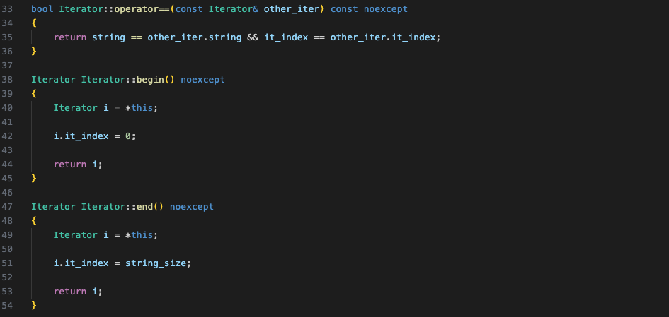
Implementation (cont.)

Slide 38
Stack
Linear data structure
Elements are placed on the top
Elements are popped from the top

Slide 39
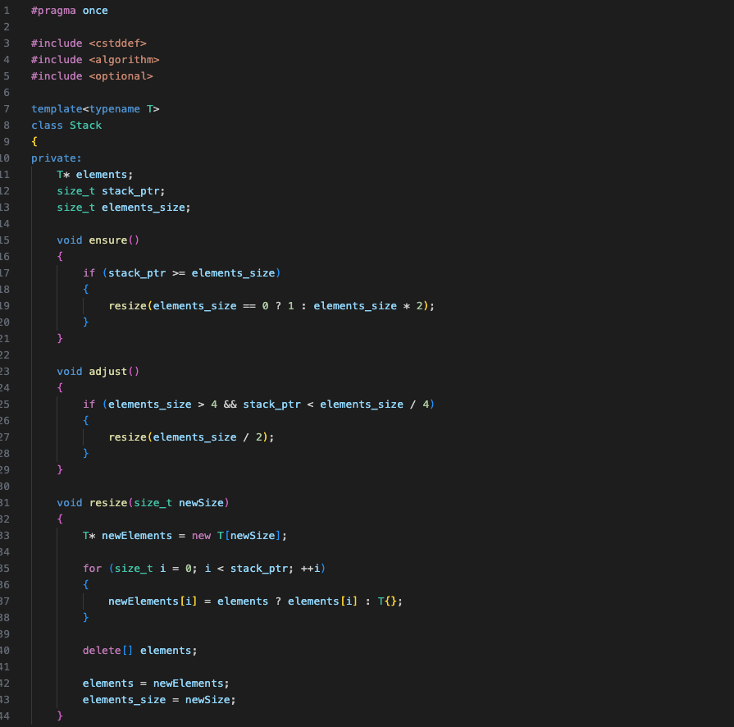
Workshop 3 – Stack (Stack.h)

Slide 40
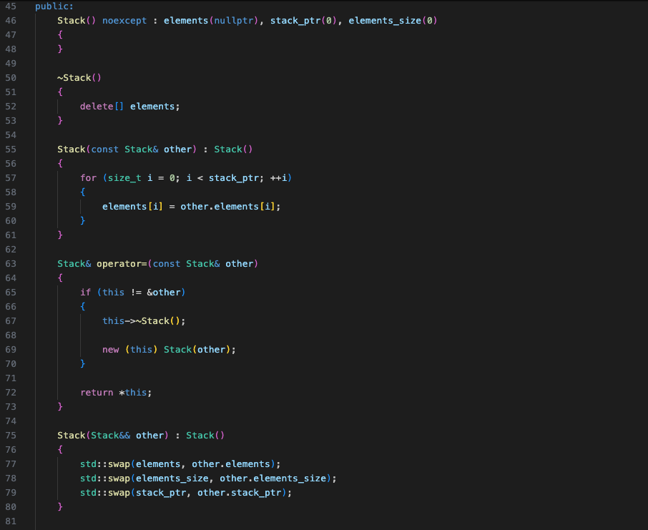
Stack.h (cont.)

Slide 41
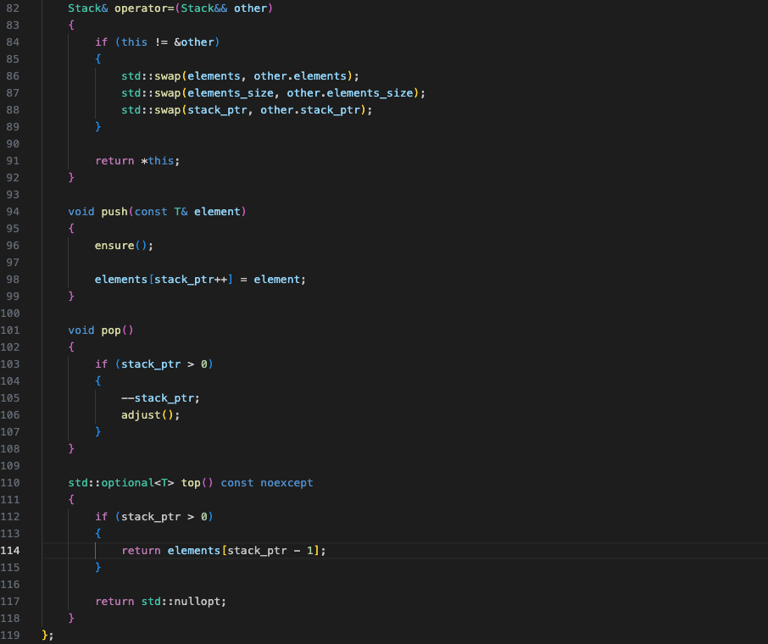
Stack.h (cont.)

Slide 42
Tree
Tree is a tree (finite set) of nodes
Different types of trees exist
2-Ary (Binary Tree): For two child nodes of each node
N-Ary Tree: Same as a 2-Ary but with 3, 4, 5… N number of child nodes for each node

Slide 43
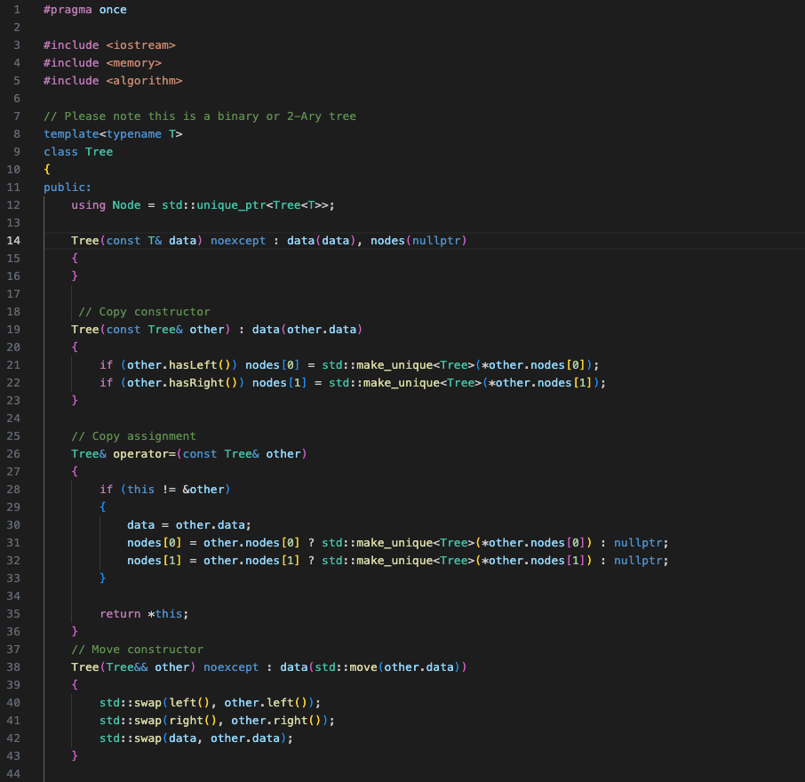
Workshop 4 - Tree

Slide 44
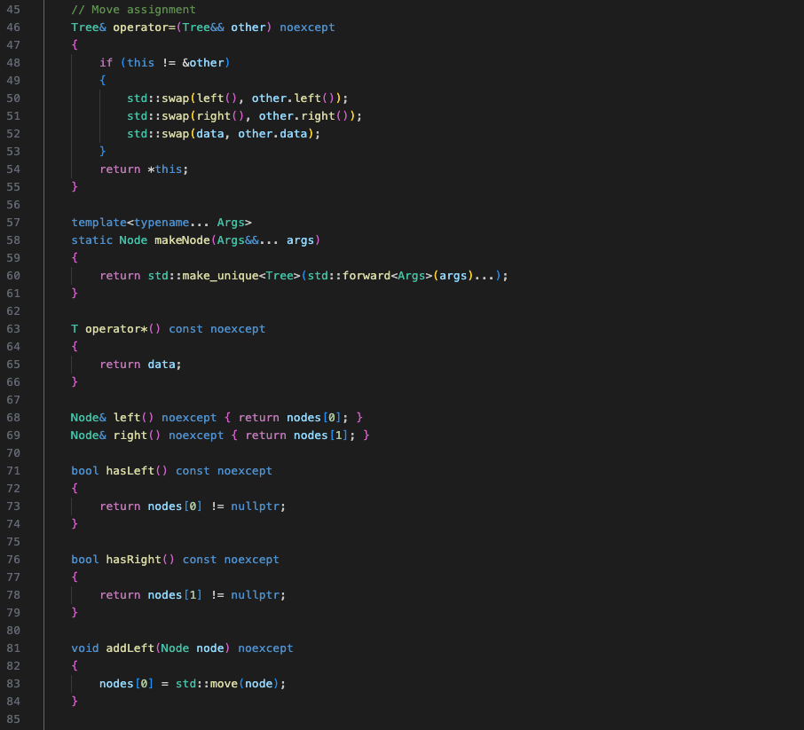
Tree (cont.)

Slide 45
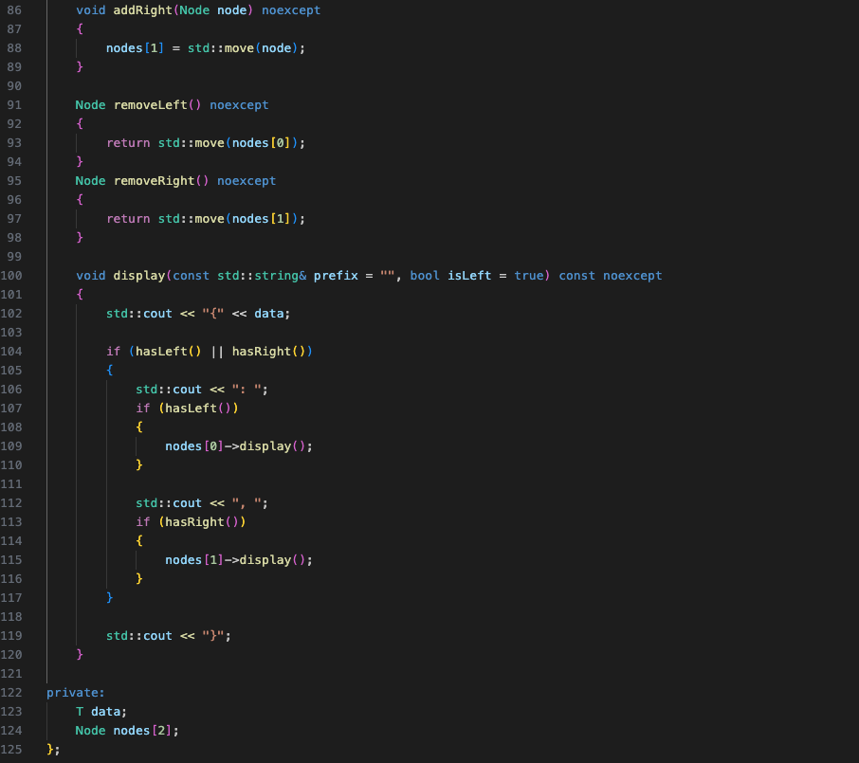
Tree (cont.)

Slide 46
Template Metaprogramming (Brief Intro)

Slide 47
Template type deduction
C++ compiler sometimes deduces the type of a template argument list
std::vector<int> for example, can be written as std::vector

Slide 48
Variadic Templates
Contain a parameter pack, multiple template arguments packed together.
template<typename… Args>

Slide 49
Why Template Metaprogramming?
Allows things to be evaluated at compile time. Faster.

Slide 50
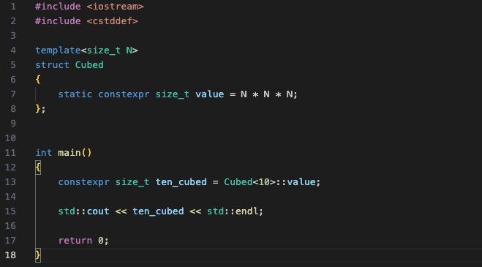
Workshop 5 – Cubed Exponent Metafunction

Slide 51
Template Metaprogramming – Final Note
It can get rather complex, for the sake of this tutorial I have kept it as basic as possible.

Slide 52
Further Resources
Other important data structures
Queue
Dequeue
Linked List (Singly and Doubly)
This talk is amazing for explaining template metaprogramming (by Walter E Brown – 2014 at cppcon) – it goes into lots more depth:
Part 1: https://www.youtube.com/watch?v=Am2is2QCvxY
Part 2: https://www.youtube.com/watch?v=a0FliKwcwXE

Slide 53
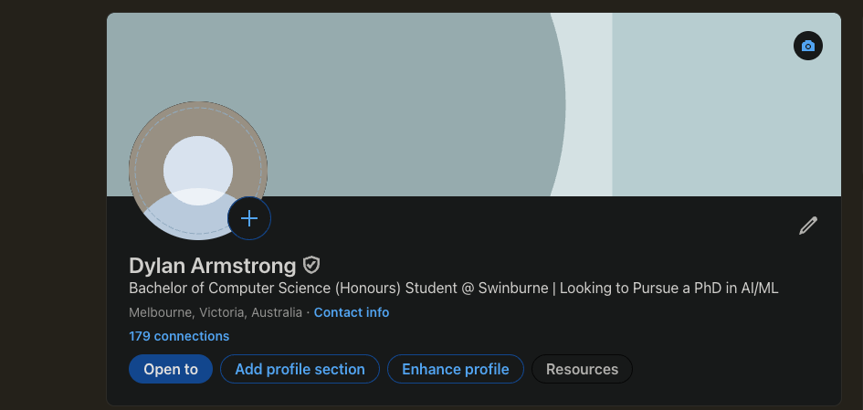
Finishing Up
Slides will be made available (will be posted in SLHCC Discord Server via GitHub repo).
All workshop code will be available free, forever on GitHub (same with lecture example code snippets)
Feel free to contact me regarding the workshop after it:
Email: 105040962@student.swin.edu.au or swinburnelhcc@gmail.com
Linkedin:

Slide 54
Finishing Up
On Behalf of the Swinburne Linux Hardware and Code Club (SLHCC) committee
Dylan Armstrong | President
Timothy Rabbitt | Vice President
Danielle Birkett | Secretary
Oscar Thomas | Treasurer
We wish you the best of luck for your studies, and hope that this workshop was valuable and that you learnt something!
Questions?

Slide 55
FIN

