Slide 1
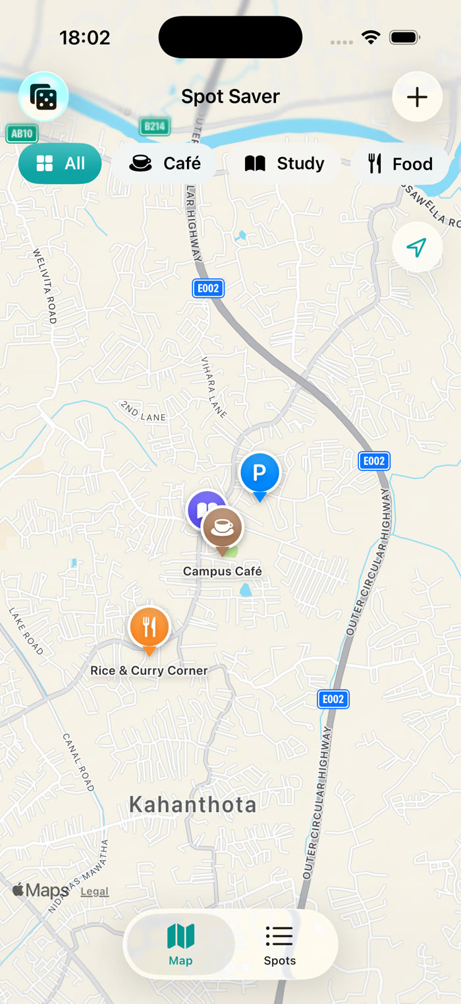
Spot Saver
A personal map of the places you love – cafés, study spots, food and parking.
Asan M A M · IT22253262 · SE4041 Assignment 02 Part A

Slide 2
Good places get forgotten
1
2
3
Map apps
Notes apps
Photos
Show every business, not the places you rated, and hold no personal notes.
Keep the text but not the location, so getting back needs another app.
Have a location but no rating, category or comment.
For students, people new to a city and commuters: save a place in seconds, find it again, get directions.

Slide 3
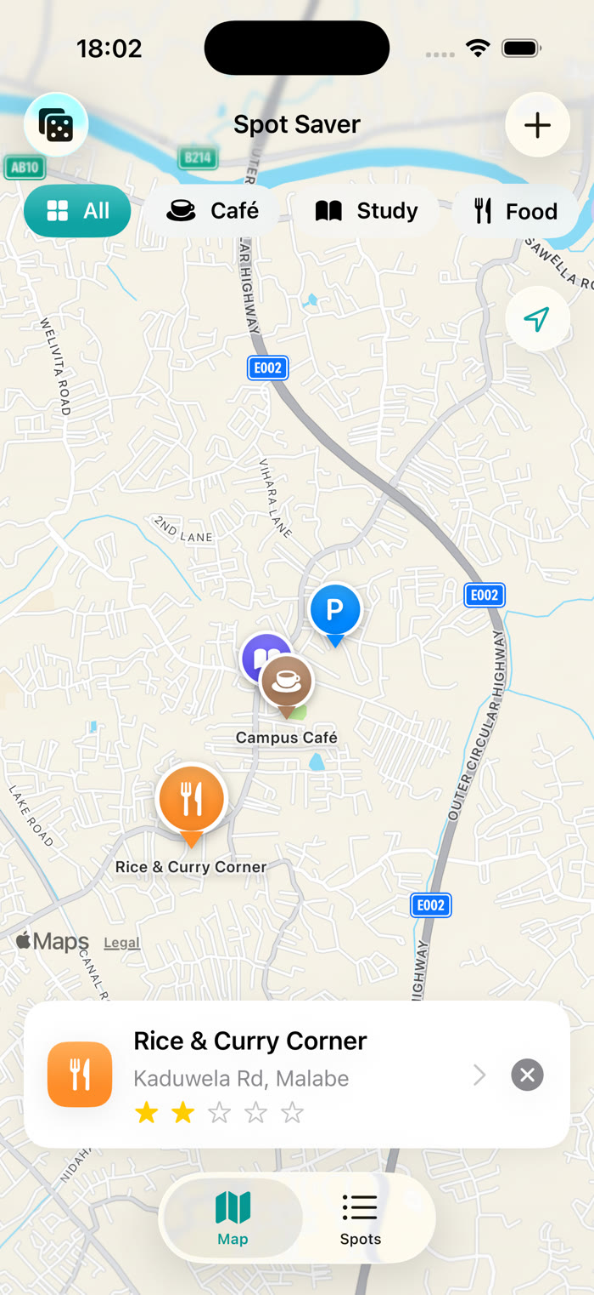
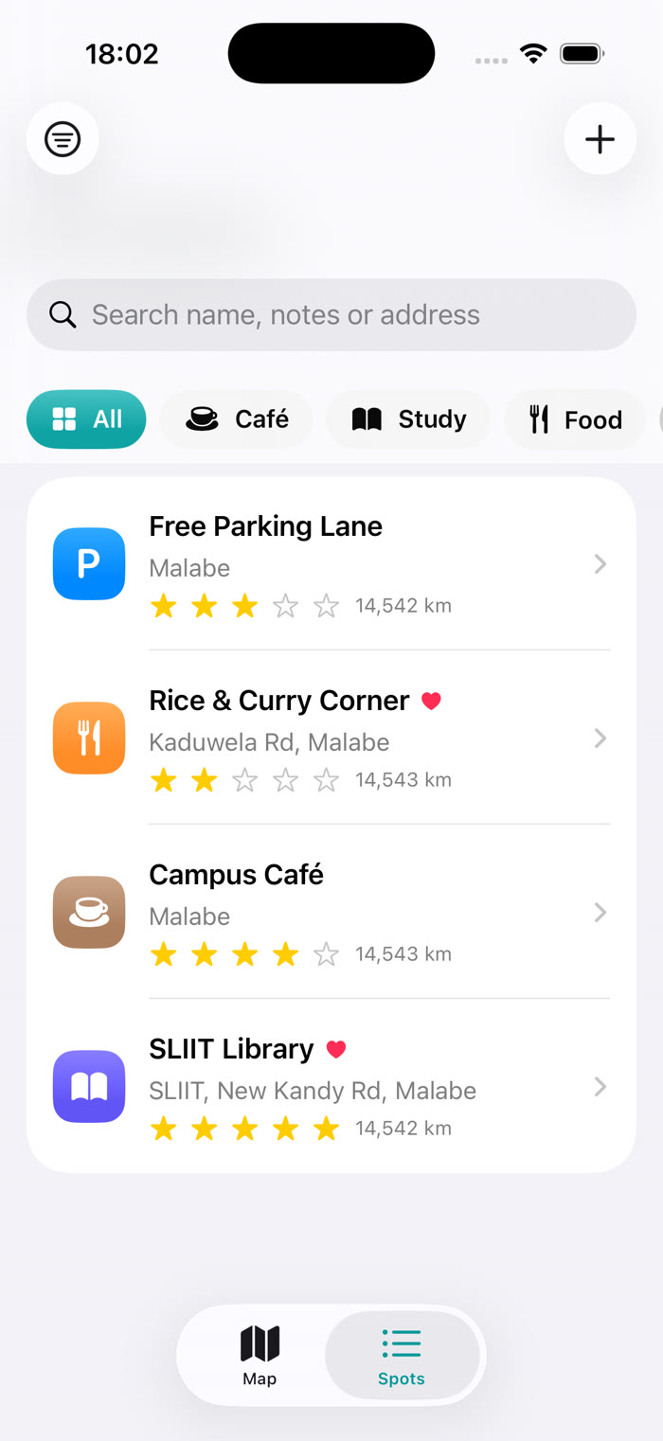
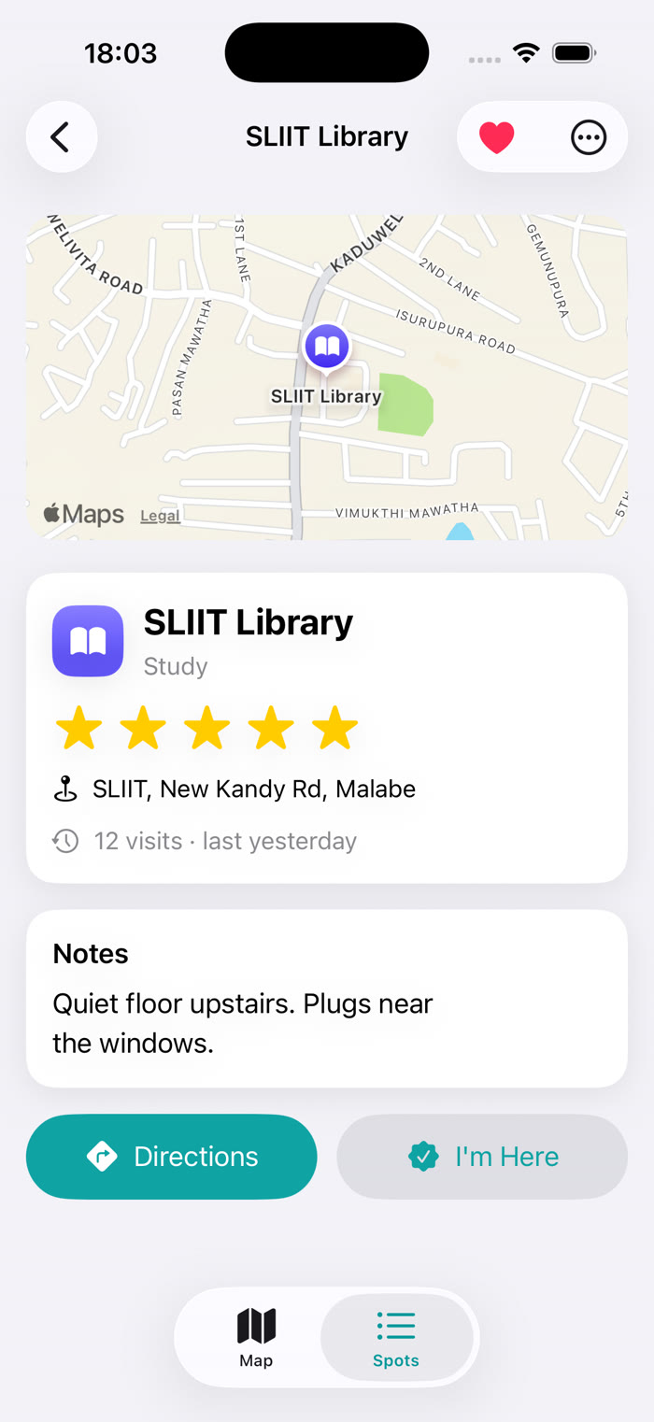
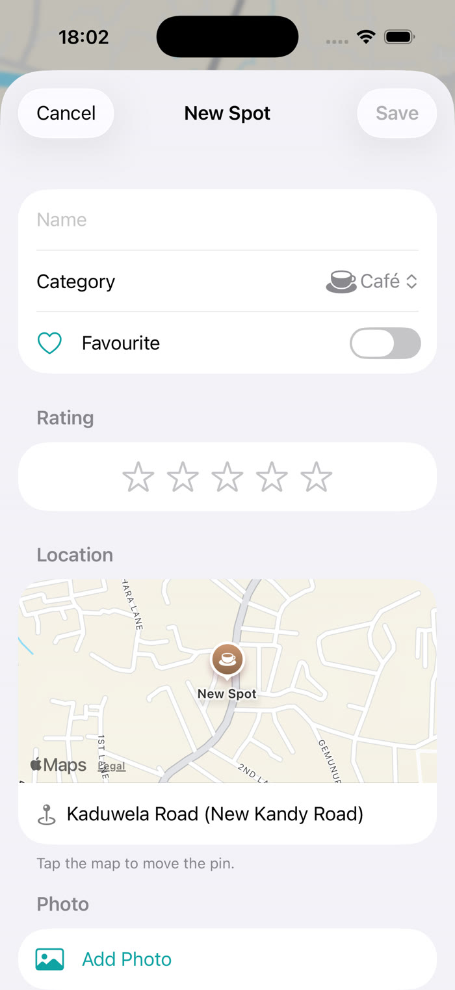
Save, find and return
Map
Long-press to save; tap a pin
Spots
Search, filter, sort, swipe
Details
Directions and visit history
Editor
Address fills in automatically

Slide 4
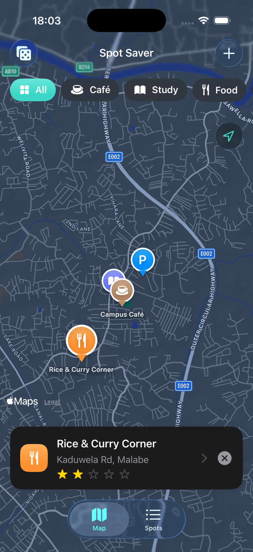
MapKit at the centre of the app
MapKit for SwiftUI: custom animated pins, long-press to drop a spot
Reverse geocoding fills the address (MKReverseGeocodingRequest)
Directions through Apple Maps in one tap
CoreLocation live updates power "Nearest" sorting
SwiftData stores spots on the device; photos in external storage
Surprise Me flies the camera to a spot you haven't visited in 2+ weeks

Slide 5
Built to a professional standard
14
4
Dark Mode and Dynamic Type
VoiceOver labels; adjustable star rating
iPad sidebar and landscape layouts
Photos downscaled to save memory
unit tests
UI tests
5
3
custom components
layers: views, logic, services

Slide 6
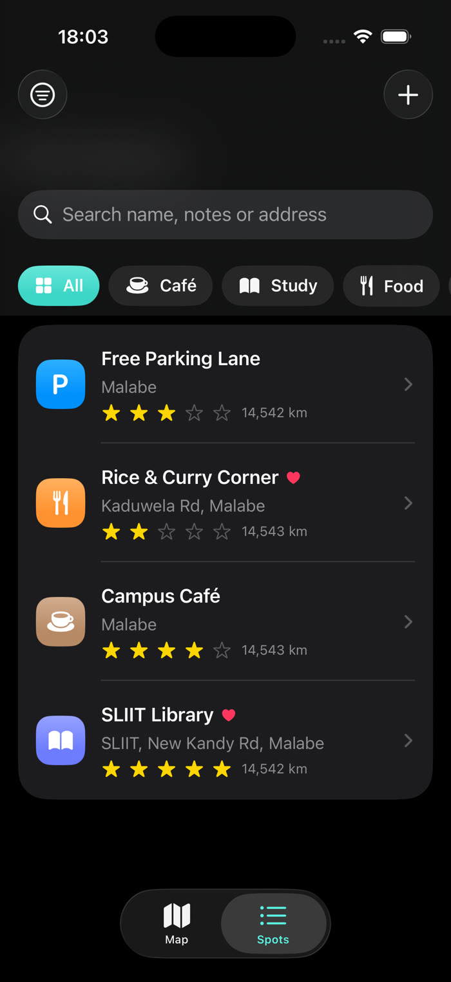
Live demo
Next: iCloud sync, sharing spots with friends and a home-screen widget.
Thank you – questions welcome.
Asan M A M · IT22253262

