Slide 1
Coding for Life Sciences
Python
Alex Payne

Slide 2
What is Python?
Programming language
Free and open source
Monty Python’s Flying Circus
Works on Windows, Mac and Linux computers

Slide 3
Why use Python?
Easy to learn
Emphasises readability
General data types

Slide 4
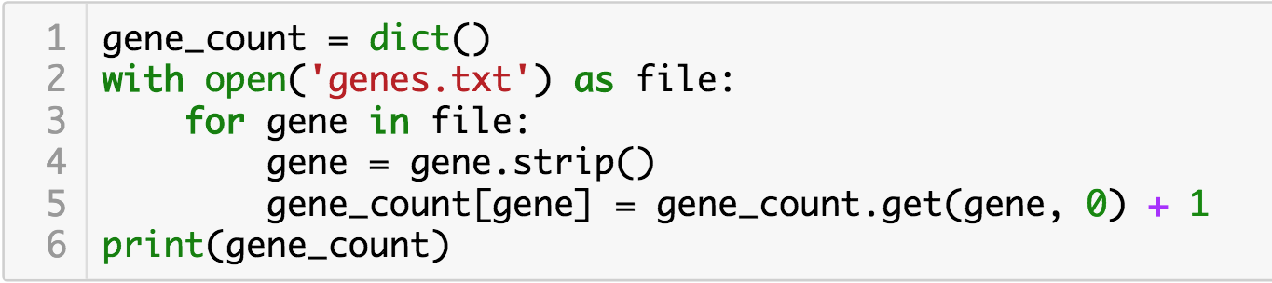
Why use Python?
Automation
Counting occurence of a word in a file
Renaming lots of files
Cropping all the images in a folder

Slide 5

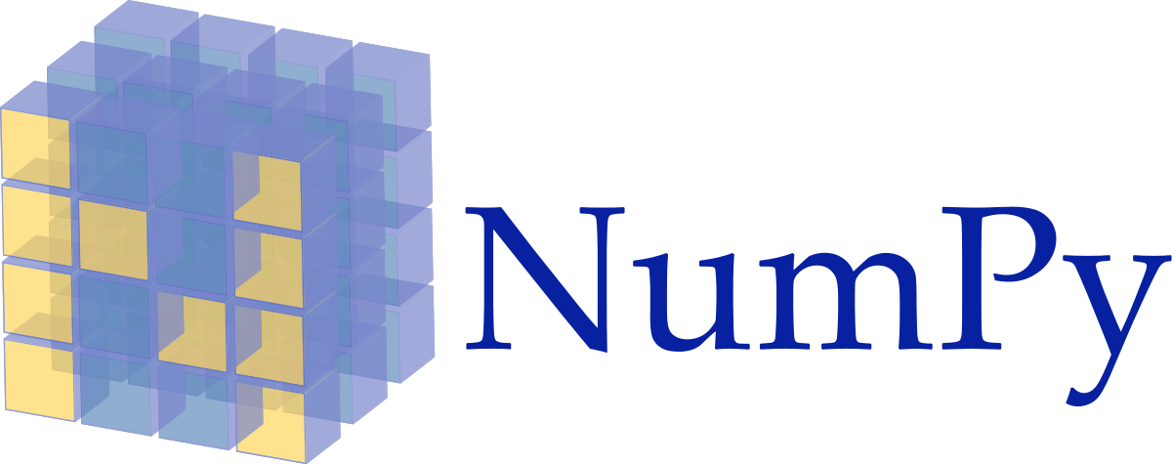
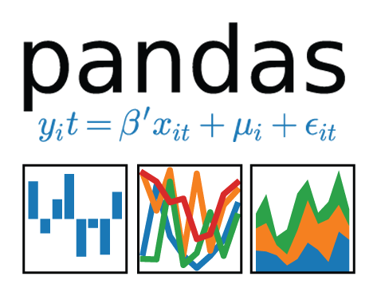

Why use Python?
Reproducibility
Jupyter
NumPy
Pandas
SciPy

Slide 6
Where to find out more?
Python tutorial: https://docs.python.org/3/tutorial
Anaconda: https://www.anaconda.com
Code Review: https://codereview.stackexchange.com
MIT OpenCourseWare: https://goo.gl/idWacG

