Slide 2
Dilution Curve
Validation
Test Kit

Slide 3
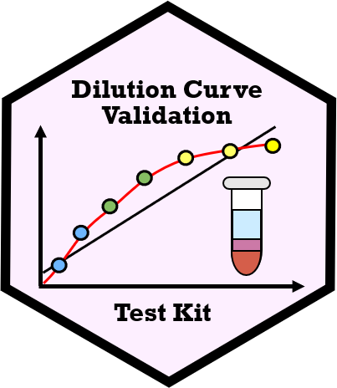

Slide 4
Input Data
Calculation
Dilution Curve Plotting
Interactive
Static
Dilution Annotation
Sample Name | Dilution Annotation
Dilution Table
Sample Name | Dilution Annotation | Transition Name | Signal
Dilution Summary Table |  | plotly Figures
Transition Name | Dilution Statistics Summary | Interactive Figures
Trellis Visualisation
Cognostics Id | Cognostics Table | Panel
Transition Name | Dilution Statistics Summary | Figures
create_dilution_table
add_plotly_panel
convert_to_cog
Transition Signal Data
Sample Name | Transition 1 | Transition 2
 | Signal
summarise_dilution_table
Dilution Summary Table
Transition Name | Dilution Statistics Summary
Dilution Summary Table |  | ggplot Figures
Transition Name | Dilution Statistics Summary | Static Figures
evaluate_linearity
add_ggplot_panel
Transition Name | Classification Results | Dilution Statistics Summary
write_summary_excel
view_ggplot_pdf
view_trellis_html
Report Results
Excel File
PDF File
HTML Folder

Slide 5
Input Data
Calculation
Dilution Curve Plotting
Interactive
Static
Dilution Annotation
Sample Name | Dilution Annotation
Dilution Table
Sample Name | Dilution Annotation | Transition Name | Signal
Dilution Summary Table |  | plotly Figures
Transition Name | Dilution Statistics Summary | Interactive Figures
Trellis Visualisation
Cognostics Id | Cognostics Table | Panel
Transition Name | Dilution Statistics Summary | Figures
create_dilution_table
add_plotly_panel
convert_to_cog
Transition Signal Data
Sample Name | Transition 1 | Transition 2
 | Signal
summarise_dilution_table
Dilution Summary Table
Transition Name | Dilution Statistics Summary
Dilution Summary Table |  | ggplot Figures
Transition Name | Dilution Statistics Summary | Static Figures
evaluate_linearity
add_ggplot_panel
Transition Name | Classification Results | Dilution Statistics Summary
write_summary_excel
view_ggplot_pdf
view_trellis_html
Report Results
Excel File
PDF File
HTML Folder

