Slide 2
Dilution Curve
Validation
Test Kit

Slide 3


Slide 4



lancer
https://www.1001freedownloads.com/free-clipart/black-knight
https://creazilla.com/nodes/7765632-mountain-range-clip-art-clipart?tag_id=1967

Slide 5


Slide 6
Input Data
Calculation
Dilution Annotation
Sample Name | Dilution Annotation
Dilution Table
Sample Name | Dilution Annotation | Transition Name | Signal
create_dilution_table
Transition Signal Data
Sample Name | Transition 1 | Transition 2
 | Signal
summarise_dilution_table
Dilution Summary Table
Transition Name | Dilution Annotation | Dilution Statistics Summary
evaluate_linearity
Transition Name | Dilution Annotation | Dilution Statistics Summary
 |  | Grouping Results | Statistics Summary
write_summary_excel
Dilution Curve Plotting
Static
Interactive
Report Results
Excel File
Dilution Summary Table |  |  | ggplot Figures
Transition Name | Dilution Annotation | Dilution Statistics Summary | Static Figures
add_ggplot_panel
view_ggplot_pdf
PDF File
convert_to_cog
HTML Folder
Dilution Summary Table |  |  | plotly Figures
Transition Name | Dilution Annotation | Dilution Statistics Summary | Interactive Figures
Trellis Visualisation
Cognostics Id |  | Cognostics Table | Panel
Transition Name | Dilution Annotation | Dilution Statistics Summary | Figures
add_plotly_panel
convert_to_cog
view_trellis_html

Slide 7
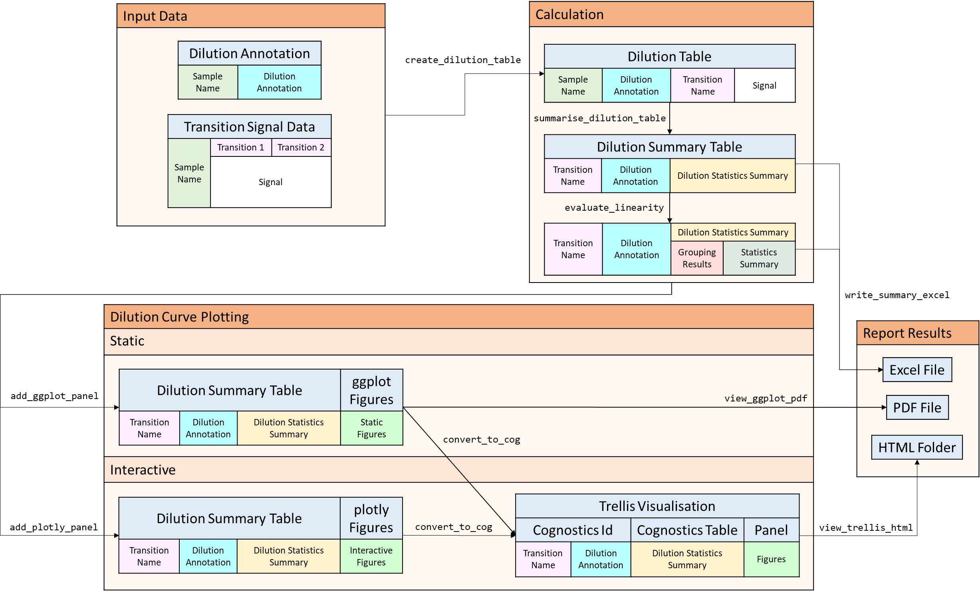

Slide 8
Input Data
Calculation
Curve Batch Annotation
Sample Name | Curve Batch Annotation
Curve Table
Sample Name | Curve Batch Annotation | Curve Name | Signal
create_curve_table
Curve Signal Data
Sample Name | Curve 1 | Curve 2
 | Signal
summarise_curve_table
Curve Summary Table
Curve Name | Curve Batch Annotation | Curve Statistics Summary
evaluate_linearity
Curve Name | Curve Batch Annotation | Curve Statistics Summary
 |  | Grouping Results | Statistics Summary
write_summary_excel
Curve Plotting
Static
Interactive
Report Results
Excel File
Curve Summary Table |  |  | ggplot Figures
Curve Name | Curve Batch Annotation | Curve Statistics Summary | Static Figures
add_ggplot_panel
view_ggplot_pdf
PDF File
convert_to_cog
HTML Folder
Curve Summary Table |  |  | plotly Figures
Curve Name | Curve Batch Annotation | Curve Statistics Summary | Interactive Figures
Trellis Visualisation
Cognostics Id |  | Cognostics Table | Panel
Curve Name | Curve Batch Annotation | Curve Statistics Summary | Figures
add_plotly_panel
convert_to_cog
view_trellis_html

Slide 9
