Slide 1

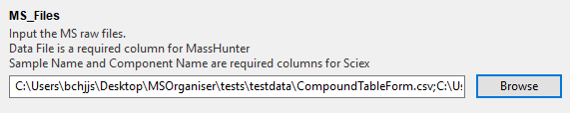
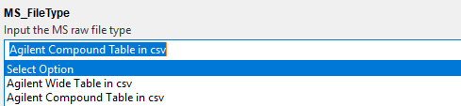
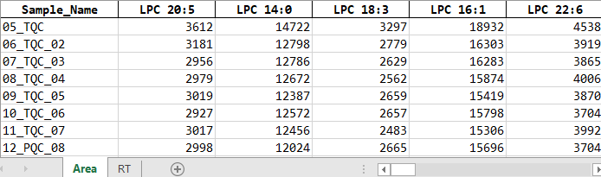
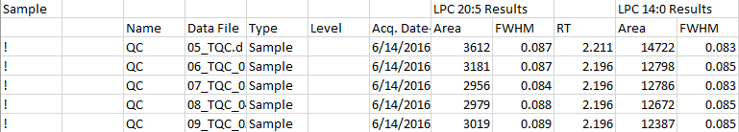

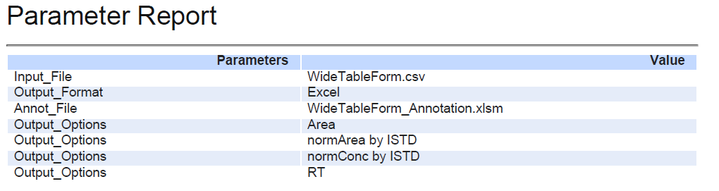
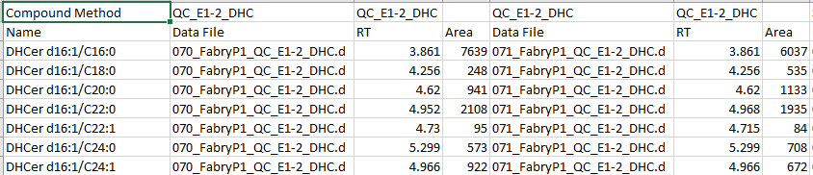
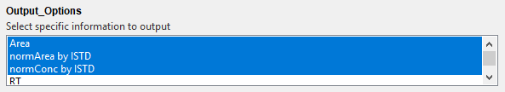
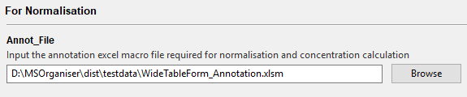
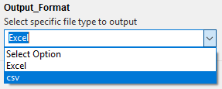
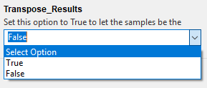
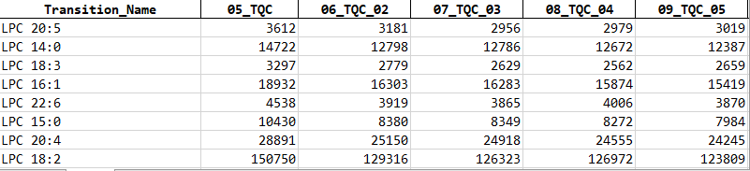
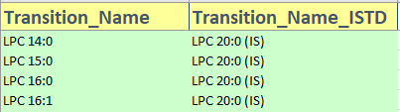
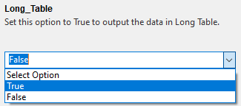
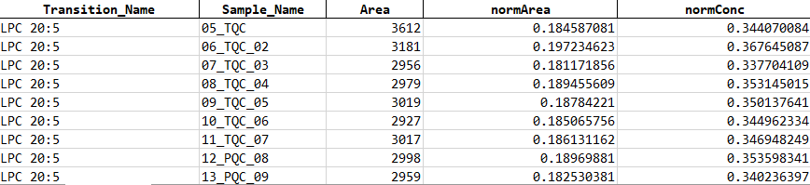
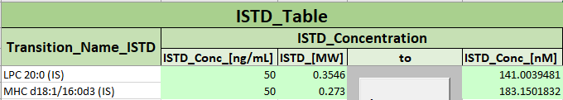
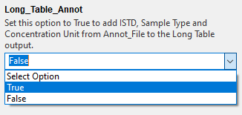
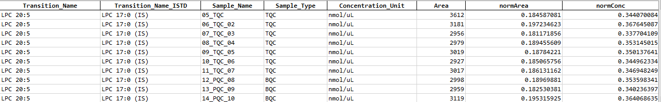
MSOrganiser Summary
Input MRM data
Organise MRM data to tidy form
Table of valid MRM data formats
Load MRM Files and specify MS_FileType and
Output Directory
3. Click start to organise data
MRM transition names data form | Compulsory column names | Restricted column names
Agilent’s WideTable form | Data File (from Sample) | Quantitation Message (from Sample) Columns from Qualifier Methods ISTD Compound Methods ISTD Compound Results
Agilent’s CompoundTable form | Name (from Compound Method) Data File (from Sample) | Quantitation Message (from Sample) Columns from Qualifier Methods Qualifier Results ISTD Compound Methods ISTD Compound Results
By default, organised data will be output into an Excel file in wide table form
Example
A report pdf file will also be provided to record the parameters used
2. Choose Output options
Input Annotation File
Additional Features
When doing normalisation and concentration calculation, MS Template Creator Excel file must be provided
Different output format for the organised data.
Set Transpose_Results to True to let the sample name be the columns instead of the transition names.
Refer to the summary sheet or user manual to see how it is used.
Options to output results in a Long Table are available
Transition Name Annotation
ISTD Annotation
Sample Annotation
Updated: 2021-05

Slide 2
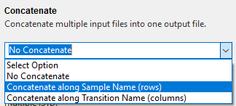


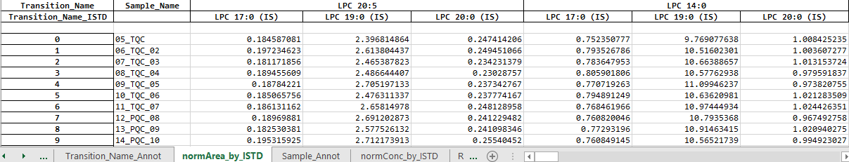
MSOrganiser Summary
Additional Features
Select the following concatenation options to combine multiple input files to one result file.
If there is a need to calculate the normalised area and concentration, set Allow_Multiple_ISTD to True
Updated: 2021-05

Slide 3
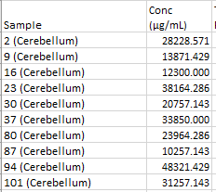
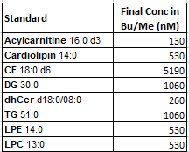
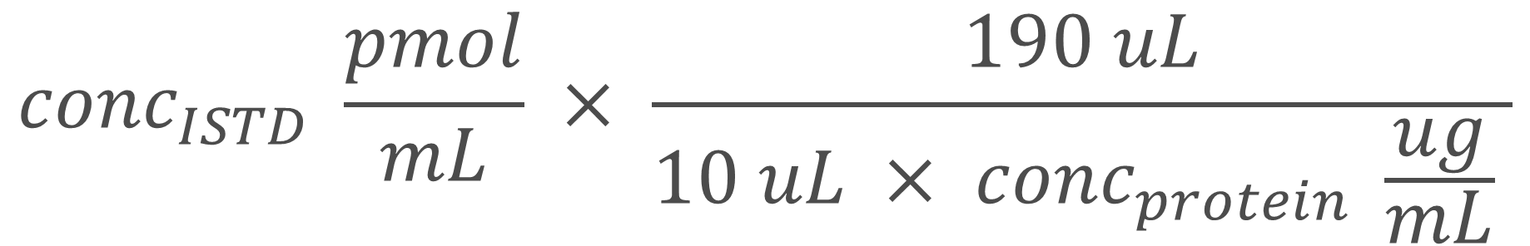
Protein concentration calculation
BuMe with ISTD volume
$${conc}_{ISTD} \frac{pmol}{mL} × \frac{190 uL}{10 uL × {conc}_{protein} \frac{ug}{mL} }$$
Protein homogenate volume

Slide 4
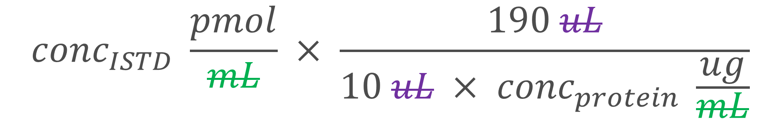

Protein concentration calculation
$${conc}_{ISTD} \frac{pmol}{mL} × \frac{190 uL}{10 uL × {conc}_{protein} \frac{ug}{mL} }$$
$${conc}_{ISTD} \frac{pmol}{mL} × \frac{190 uL}{10 uL × {conc}_{protein} \frac{ug}{mL}}$$

Slide 5
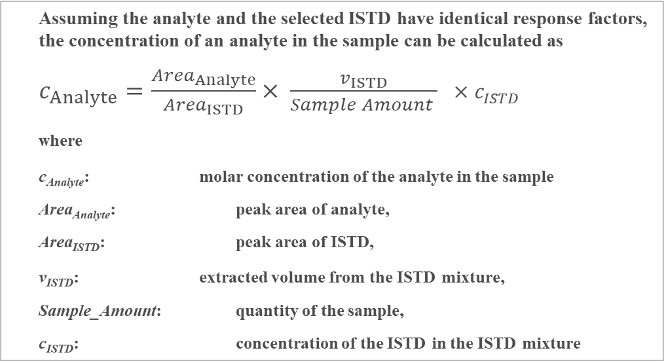
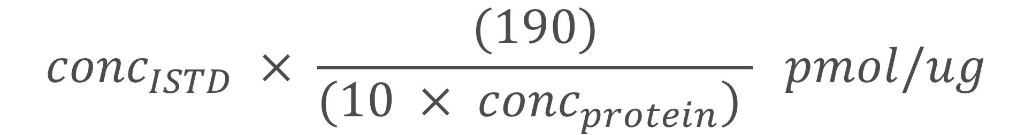
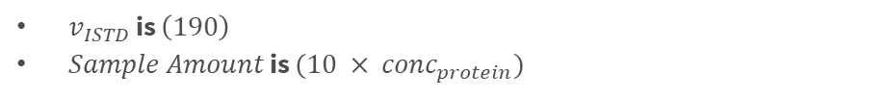
Protein concentration calculation
$${conc}_{ISTD} × \frac{(190)}{(10 × {conc}_{protein}) } pmol/ug$$
Assuming the analyte and the selected ISTD have identical response factors, the concentration of an analyte in the sample can be calculated as
$c_{Analyte}=\frac{{Area}_{Analyte}}{{Area}_{ISTD}}× \frac{v_{ISTD}}{Sample Amount } ×c_{ISTD}$
where
c_{Analyte}: molar concentration of the analyte in the sample
Area_{Analyte}: peak area of analyte,
Area_{ISTD}: peak area of ISTD,
v_{ISTD}: extracted volume from the ISTD mixture,
Sample_Amount: quantity of the sample,
c_{ISTD}: concentration of the ISTD in the ISTD mixture
$v_{ISTD}$ is $\left(190\right)$
$Sample Amount$ is $(10 × {conc}_{protein})$

Slide 6
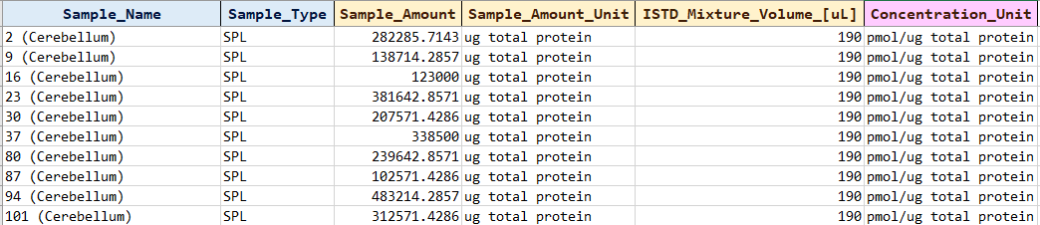

To put in MS Template Creator
Protein concentration calculation
$Sample Amount$ is $(10 × {conc}_{protein})$
$v_{ISTD}$ is $\left(190\right)$

Slide 7

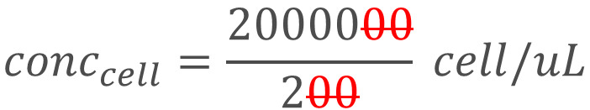
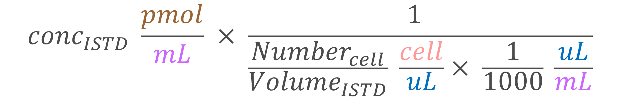
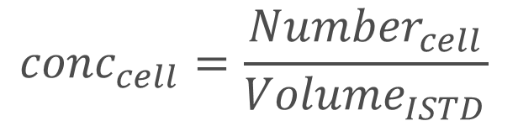
Cell number concentration calculation
$${Volume}_{ISTD}= 200 uL$$
$${Number}_{cell}= 2000000 cell$$
$${conc}_{cell}=\frac{{Number}_{cell}}{{Volume}_{ISTD}}$$
$${conc}_{ISTD}=\{some_value\} pmol/mL$$
$${conc}_{cell}=\frac{2000000}{200} cell/uL$$
$${conc}_{cell}=10000 cell/uL$$
$${conc}_{cell}=10 cell/mL$$
$Convert to concentration in\left(\frac{pmol}{cell}\right) :$
$${conc}_{ISTD} \frac{pmol}{mL} × \frac{1 }{\frac{{Number}_{cell}}{{Volume}_{ISTD}} \frac{cell}{uL}× \frac{1}{1000} \frac{uL}{mL}}$$

Slide 8

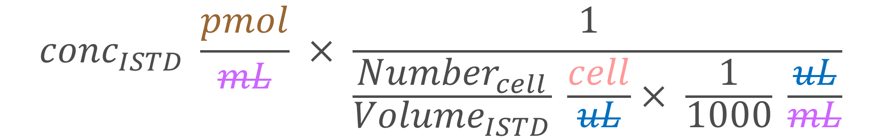



Cell number concentration calculation
$${conc}_{ISTD} \frac{pmol}{mL} × \frac{1 }{\frac{{Number}_{cell}}{{Volume}_{ISTD}} \frac{cell}{uL}× \frac{1}{1000} \frac{uL}{mL}}$$
$${conc}_{ISTD} pmol× \frac{{Volume}_{ISTD}}{\frac{{Number}_{cell}}{1000}cell}$$
$$=$$
$${conc}_{ISTD} × \frac{{Volume}_{ISTD}}{\frac{{Number}_{cell}}{1000}} \frac{pmol}{cell}$$
$$=$$

Slide 9


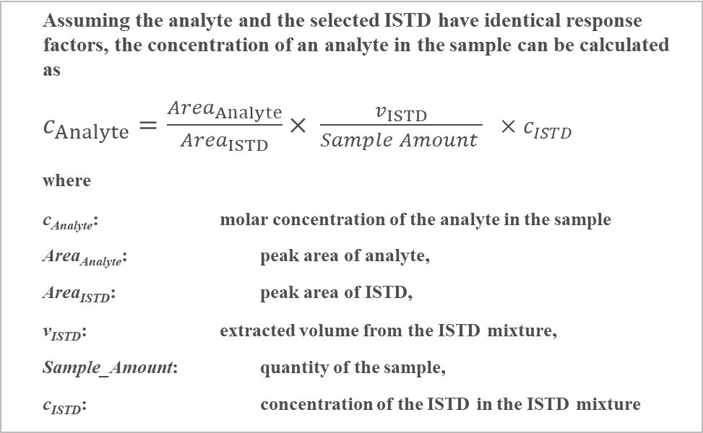
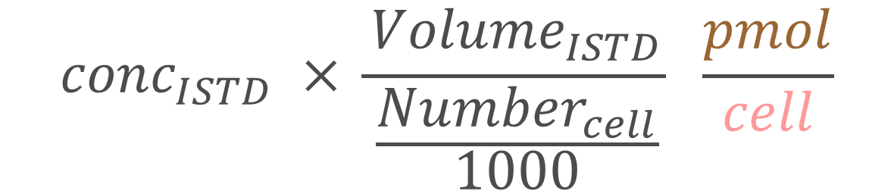
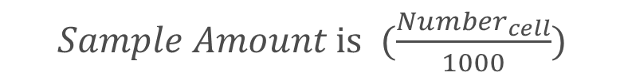
Cell number concentration calculation
Assuming the analyte and the selected ISTD have identical response factors, the concentration of an analyte in the sample can be calculated as
$c_{Analyte}=\frac{{Area}_{Analyte}}{{Area}_{ISTD}}× \frac{v_{ISTD}}{Sample Amount } ×c_{ISTD}$
where
c_{Analyte}: molar concentration of the analyte in the sample
Area_{Analyte}: peak area of analyte,
Area_{ISTD}: peak area of ISTD,
v_{ISTD}: extracted volume from the ISTD mixture,
Sample_Amount: quantity of the sample,
c_{ISTD}: concentration of the ISTD in the ISTD mixture
$${conc}_{ISTD} × \frac{{Volume}_{ISTD}}{\frac{{Number}_{cell}}{1000}} \frac{pmol}{cell}$$
$c_{ISTD}$ is ${conc}_{ISTD} \frac{pmol}{mL}$
To put in MS Template Creator
$Sample Amount$ is $(\frac{{Number}_{cell}}{1000})$
$v_{ISTD}$ is $\left({Volume}_{ISTD}\right)$
cell number
(free text)

