Slide 1

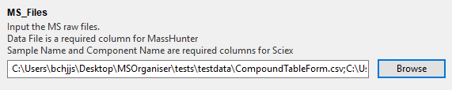
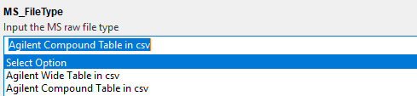
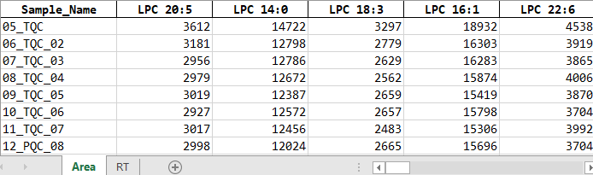
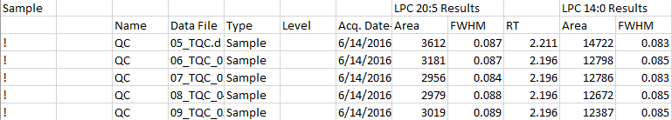

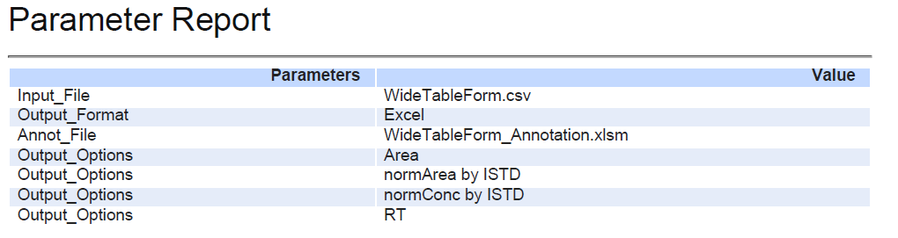
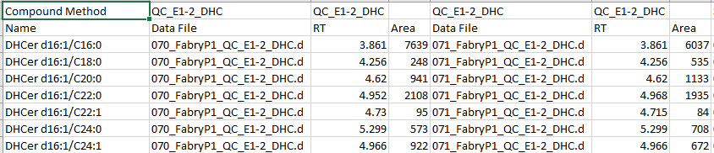
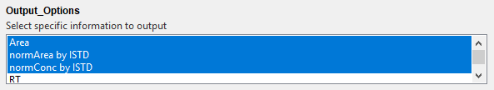
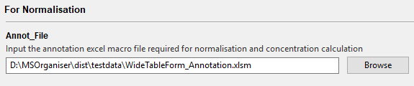
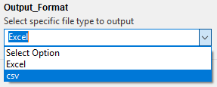
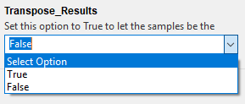
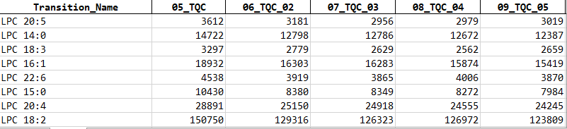
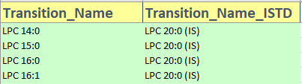
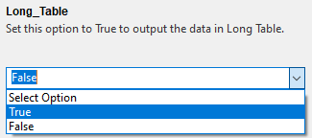
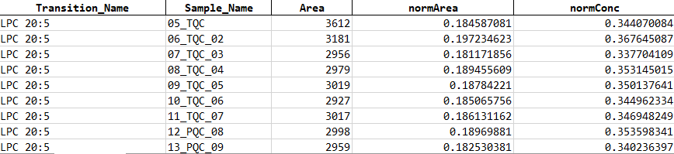
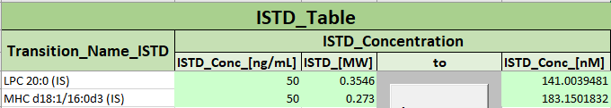
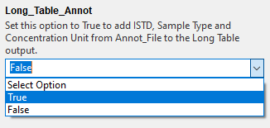
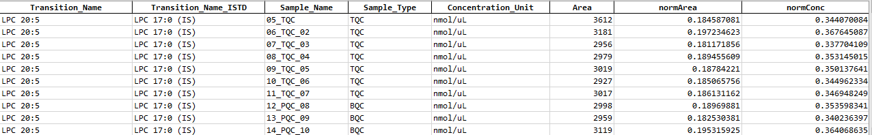
MSOrganiser Summary
Input MRM data
Organise MRM data to tidy form
Table of valid MRM data formats
Load MRM Files and specify MS_FileType and
Output Directory
3. Click start to organise data
MRM transition names data form | Compulsory column names | Restricted column names
Agilent’s WideTable form | Data File (from Sample) | Quantitation Message (from Sample) Columns from Qualifier Methods ISTD Compound Methods ISTD Compound Results
Agilent’s CompoundTable form | Name (from Compound Method) Data File (from Sample) | Quantitation Message (from Sample) Columns from Qualifier Methods Qualifier Results ISTD Compound Methods ISTD Compound Results
By default, organised data will be output into an Excel file in wide table form
Example
A report pdf file will also be provided to record the parameters used
2. Choose Output options
Input Annotation File
Additional Features
When doing normalisation and concentration calculation, MS Template Creator Excel file must be provided
Different output format for the organised data.
Set Transpose_Results to True to let the sample name be the columns instead of the transition names.
Refer to the summary sheet or user manual to see how it is used.
Options to output results in a Long Table are available
Transition Name Annotation
ISTD Annotation
Sample Annotation
Updated: 2021-05

Slide 2
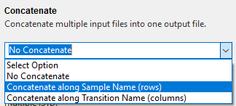


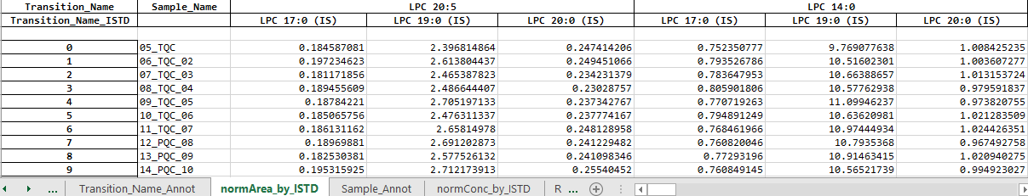
MSOrganiser Summary
Additional Features
Select the following concatenation options to combine multiple input files to one result file.
If there is a need to calculate the normalised area and concentration, set Set Allow_Multiple_ISTD to True
Updated: 2021-05

